Slide 1
COMPETENCY 1 TRADE AND TRAINING
REALITIES OF THE TRADE

Slide 2
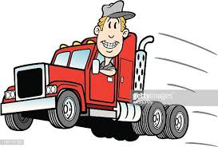
Rules of the class
Educational planning
(Enter the dates in the notebook).

Slide 3
PROFESSIONAL REQUIREMENTS
REQUIRED QUALITIES
Autonomy
Good worker
good physical condition
Good organizational skills
Organized and structured
Patient, calm and courteous
Good sense of direction
Resistance to stress or pressure

Slide 4


Tasks and working conditions
Ensure truck is in good condition ( Circle Check)
Understand and respect the regulations ( Law 430)
Establish itineraries (routes) based on clients and appointments
Observe and respect road signs
Manage traffic, detours, unexpected delays and weather
Be prepared to work long hours
Manage the pressure of the dispatcher and customers
Be away from your family for long periods of time
And more

Slide 5


There is no better job...if you do it right.
TRUCK DRIVING...JOB STRESSFUL?
NO SIR!! I’M 36 YEARS OLD AND I FEEL GREAT!

Slide 6
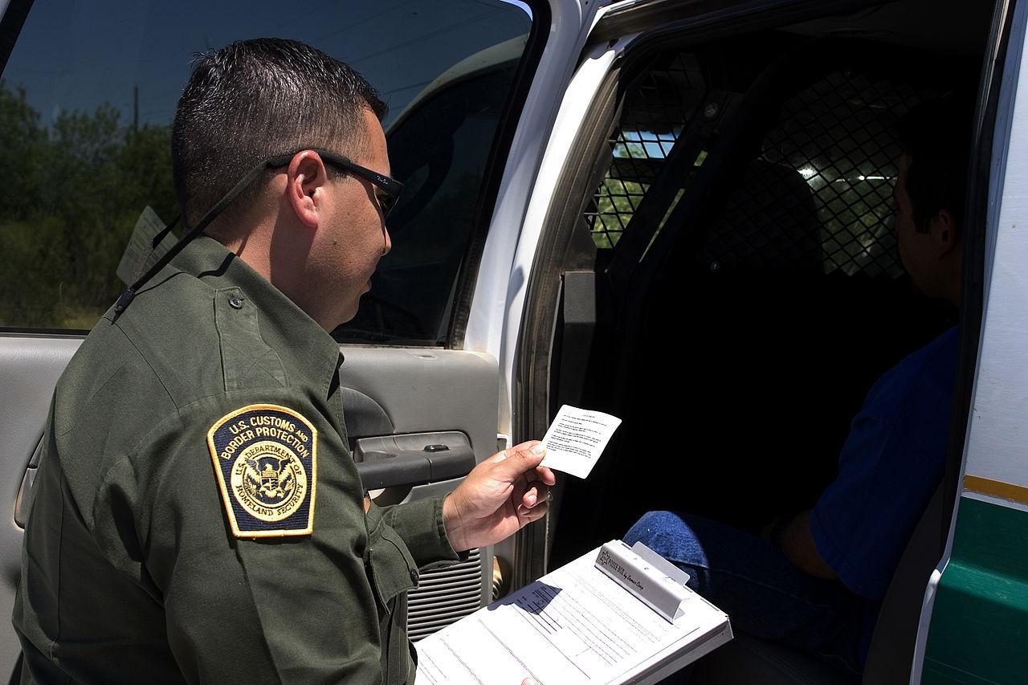

TASKS AND WORKING CONDITIONS ( CONT’D)
The driver must ensure that all documents are submitted to the employer related to pick-ups, deliveries and custom clearances of each load.
Be familiar with American regulations (if necessary).
And of course, basic tasks like driving, coupling,
uncoupling, loading, unloading,etc.
You will need to be available to work on irregular
schedules like weekends, civil holidays, night shift, etc.

Slide 7


ATTENTION !
C.F.T.R teaches you skills, but the industry
hires attitudes.
Never forget that you are representing your employer.
Your attitude on the road or at the customers
warehouse says a lot about your professional
Transportation is based on customer service.

Slide 8


Health and safety risks
Excessive speed and dangerous driving
Improper working methods
Lack of alertness
Inadequate vehicle maintenance
Lack of training and unconventional schedules. long hours, nights
Distraction (text, tablet, map, tec.)
Weather conditions
Heavy traffic
The employer and the worker must comply with the legal obligations of the CNESST.

Slide 9
RIGHTS AND RESPONSABILITIES
Every employment comes with its own responsibilities. Respecting these are essential in order to guarantee good working conditions, safety, productivity and professionalism for all those involved.
A heavy vehicle driver should make sure to keep a good driving record.
To inspect your equipment and to keep it in order.
To comply with all regulations and to be up to date.
To be aware of restrictions (load, size, routes, etc.)
To properly fill out documents (quantities, signature or other).
To secure merchandise properly and securely.
Respect deadlines.

