Slide 1
COMPETENCY 1
DESCRIPTION OF THE 10 COMPETENCIES FOUND IN THE
VOCATIONAL TRAINING PROGRAM

Slide 2
COMPETENCY 1
Trade and Training
( 15 HEURES)
BECOME FAMILIAR WITH THE NATURE OF THE TRADE
UNDERSTANDING THE TRAINING PROCESS
CONFIRM YOUR
CAREER CHOICE
BEGIN YOUR INTEGRATION INTO THE LEARNING ENVIRONMENT

Slide 3
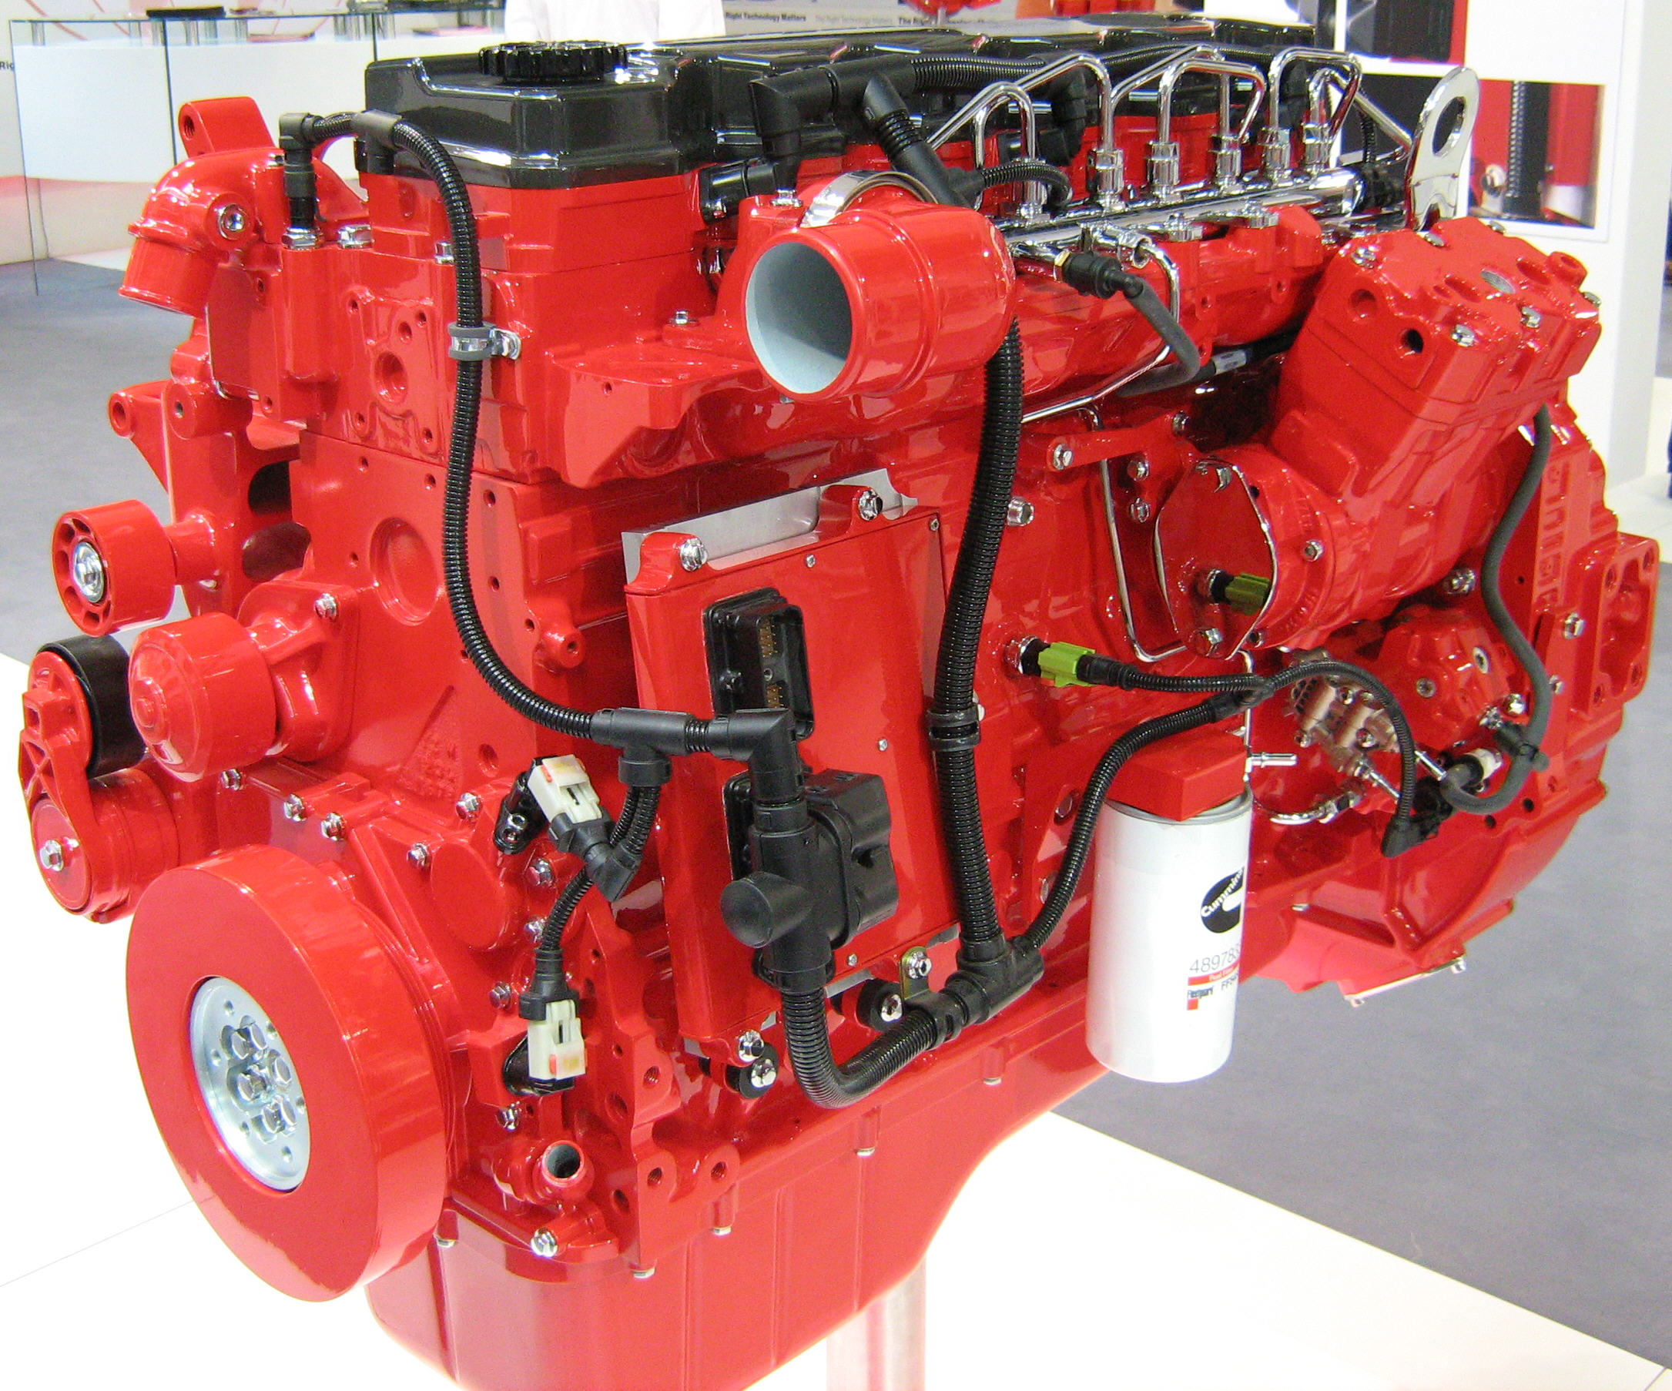
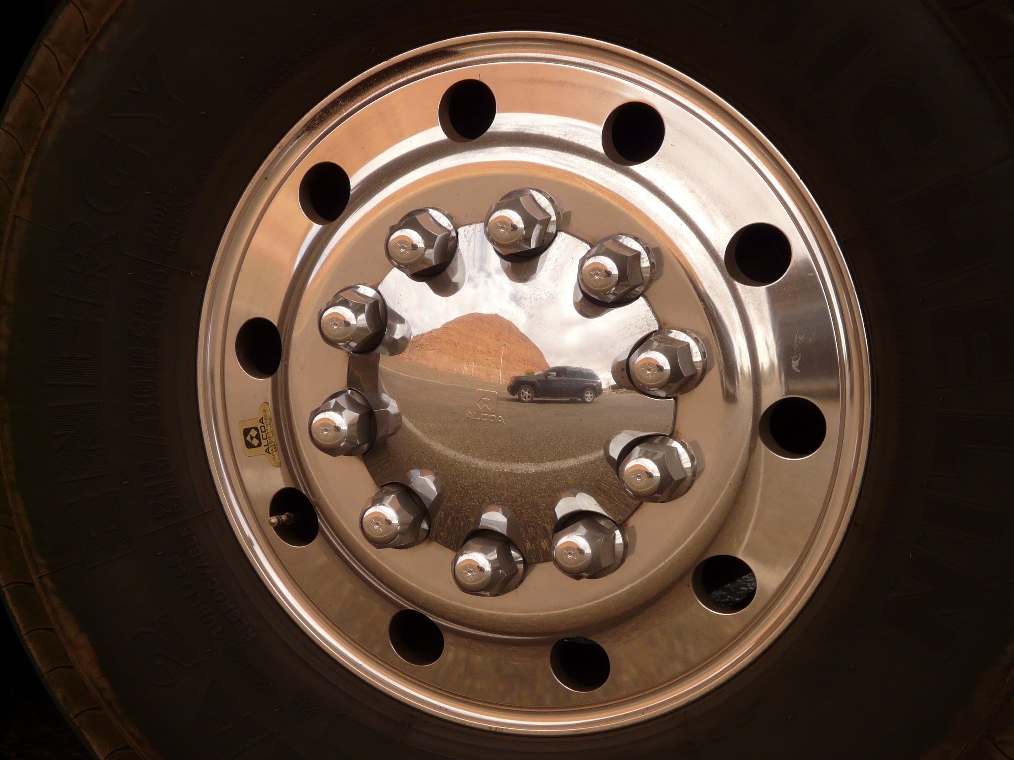
COMPETENCY 2 : TRUCK SYSTEMS (TO IDENTIFY THE POSSIBLE SYSTEMS THAT CHARACTERIZE SEMI TRAILERS) 45 HOURS
ENGINES
TRANSMISSIONS
DIFFERENTIALS
BRAKES
WHEELS AND TIRES
ETC.

Slide 4



COMPETENCY 3 : REGULATIONS (TO RESOLVE PROBLEMS STEMMING FROM THE APPLICATION OF REGULATIONS) 45 heures
LAW 430
HOURS OF SERVICE
LOAD AND SIZE LIMITS
CIRCLE CHECK
DANGEROUS GOODS
LOAD SECURING
ETC.

Slide 5
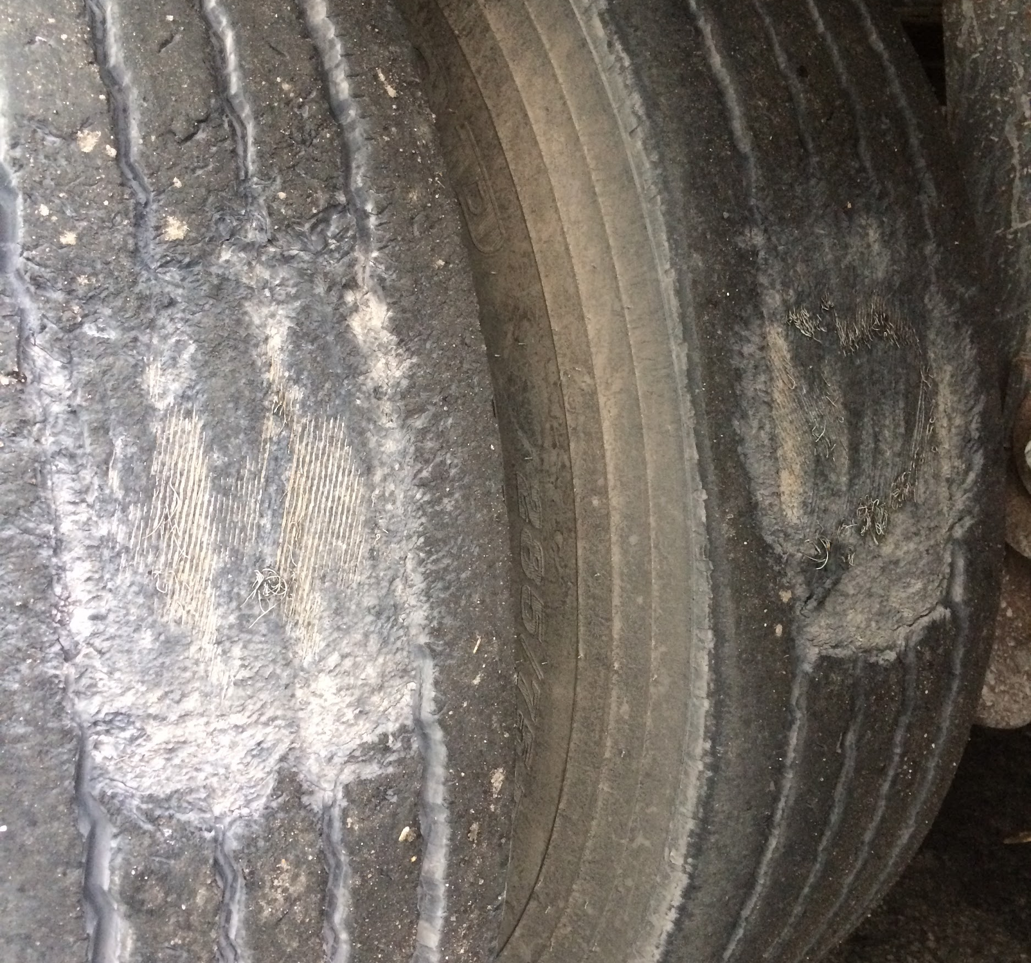

COMPETENCY 4: CONDITION OF TRUCK
45 HOURS
TO ENSURE THAT THE TRUCK IS IN GOOD CONDITION
CIRCLE CHECK
PERFORM A VEHICLE INSPECTION
FIND POSSIBLE DEFECTS
SHOW CONCERN FOR PREVENTION
KNOWING MAJORS AND MINORS

Slide 6
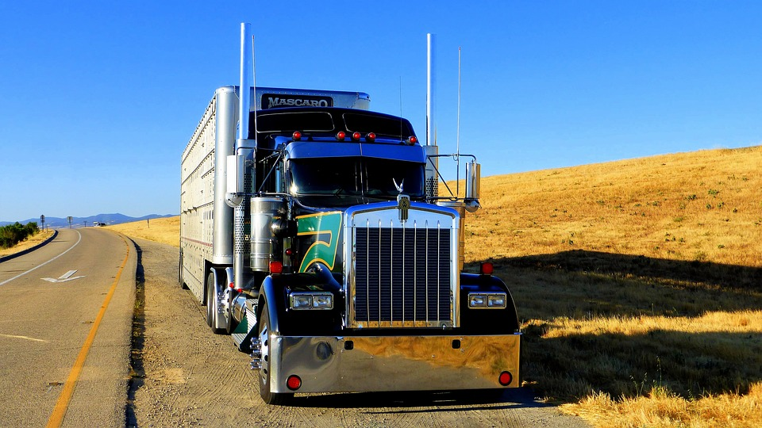
COMPETENCY 5: BASIC DRIVING TECHNIQUES 90 HEURES
TO PERFORM BASIC DRIVING TECHNIQUES
CHANGING GEARS...DOUBLE CLUTCH
AUTOMATIC TRANSMISSION
COUPLING AND UNCOUPLING
BACK UP (STRAIGHT LINE)
TURNS
PROPER USAGE OF MIRRORS
ETC.

Slide 7
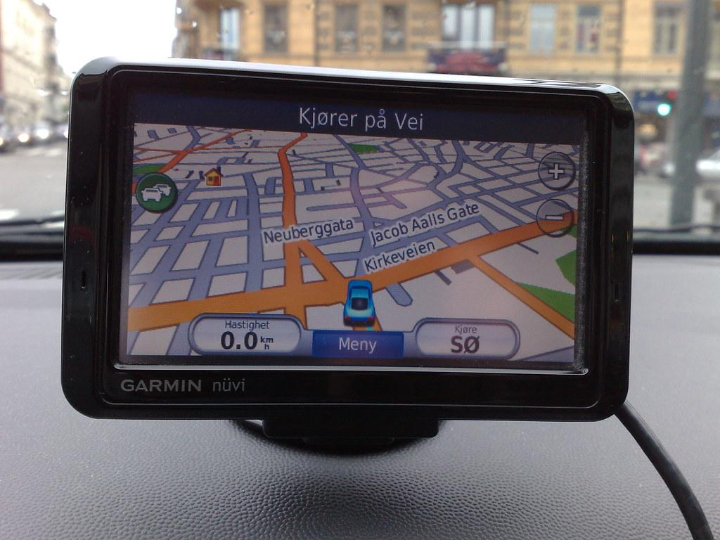


COMPENTENCY 6: PLANNING A TRIP 45 HOURS
TO PLAN A TRIP
PROVINCIAL, MUNICIPAL AND INTERNATIONAL MAPS
PLANNING AN ITINERARY
CALCULATIONS USED FOR PLANNING A TRIP
ELECTRONIC DEVICES (GPS)

Slide 8

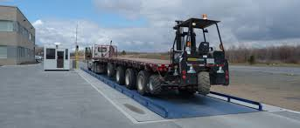
COMPETENCY 7: LOADING AND UNLOADING 45 HOURS
TO HANDLE THE LOADING AND UNLOADING OF A TRUCK
SECURING THE LOAD
MOVING THE AXLES AND FIFTH WHEEL
LOAD DISTRIBUTION
ETC.

Slide 9

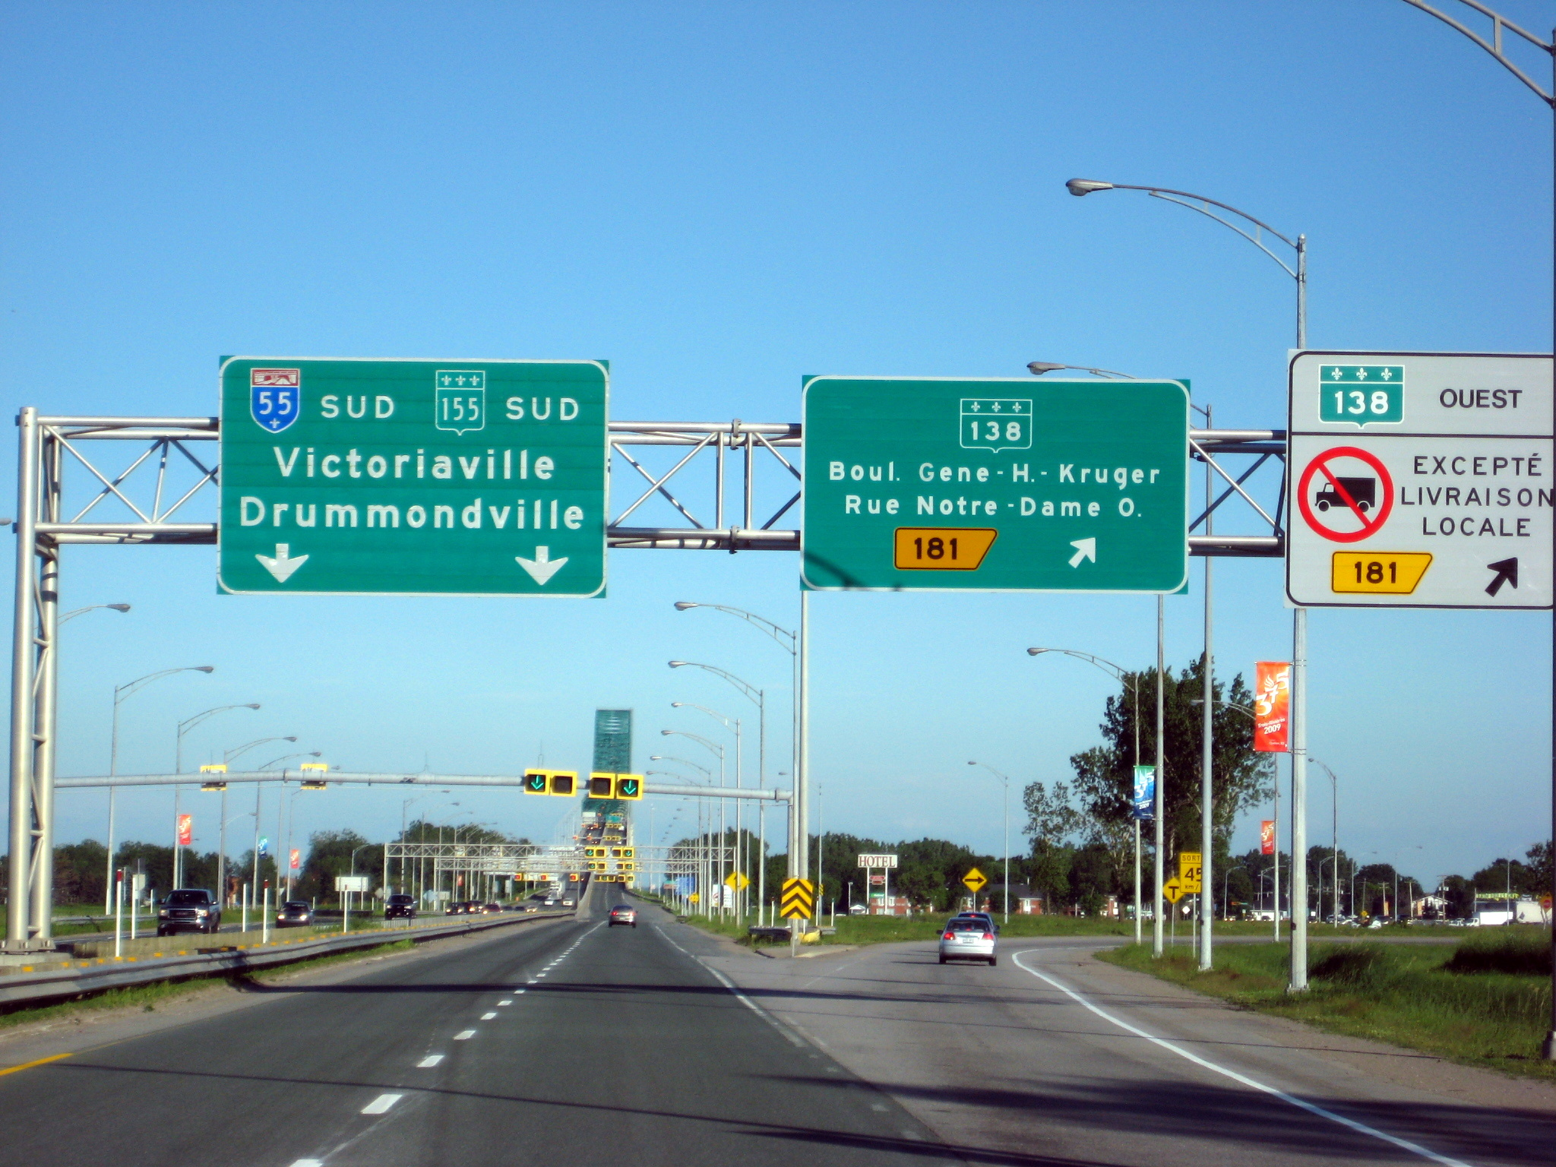
COMPETENCY 8: RURAL AND HIGHWAY DRIVING
(TO DRIVE A TRUCK ON RURAL AND HIGHWAYS) 60 heures
Following signs-turns in motion-on ramps and off ramps-etc.
Anticipation- good road handling- left hand backup

Slide 10

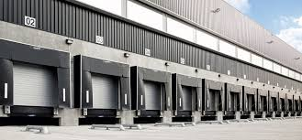
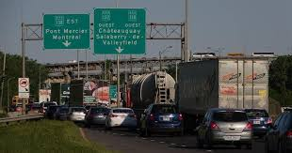
COMPETENCY 9: DELIVERY TRIPS 135 HEURES
TO MAKE A TRIP WITH A DELIVERY
MAKING MULTIPLE DELIVERIES WHILE USING AN ITINERARY
CROSSING TOWNS AND MANEUVERING HILLS
BACK UPS IN THE INDUSTRY (DOCKS AT COMPANIES)
ECONOMICAL DRIVING
PROBLEM SOLVING

Slide 11


COMPETENCY 10: INTERNSHIP 90 HOURS
INTEGRATION INTO THE WORKPLACE
78 HOURS OF INTERNSHIP WITH A COMPANY
9 HOURS THEORY (INTERNSHIP PREPARATION)
3 HOURS (RETURN OF INTERNSHIP)

