Slide 1

Synthesis
C-2: Possibilities of truck systems
Notes:
Fait par Charles Morier et révisé par André Lamothe

Slide 2
Identify the possibilities of a tractor-trailer systems.
1. Distinguish the particularities of a truck.
2. Become acquainted with the capabilities of the power unit.
3. Choose the modes of use of the motion transmission system.
4. Choose ways to optimize braking system performance.
5. Know the capabilities and limitations of suspension systems and steering, as well as wheels.

Slide 3

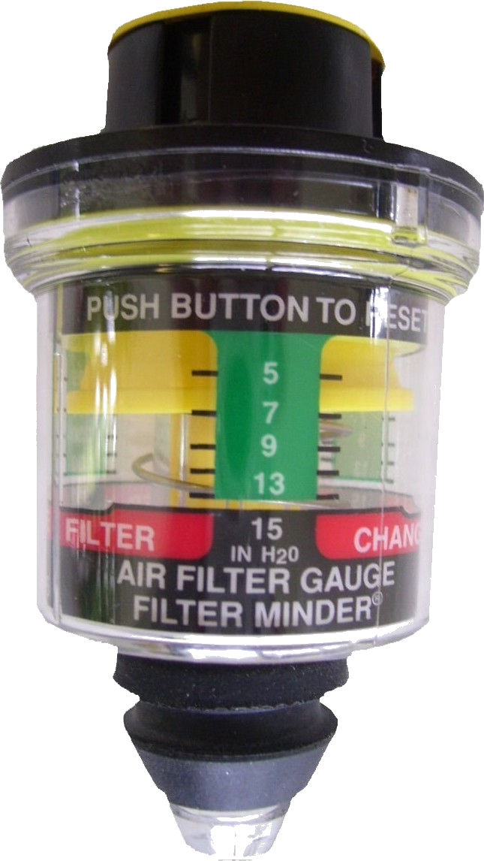






Exhaust filter pictogram "DPF"
Air filter restriction gauge
Air filter
pictogram
Warning
Transmission
Temperature
Coolant
2
Température
Pressure lb/po “PSI”
Exhaust
Air tank #1
Brake application

Slide 4
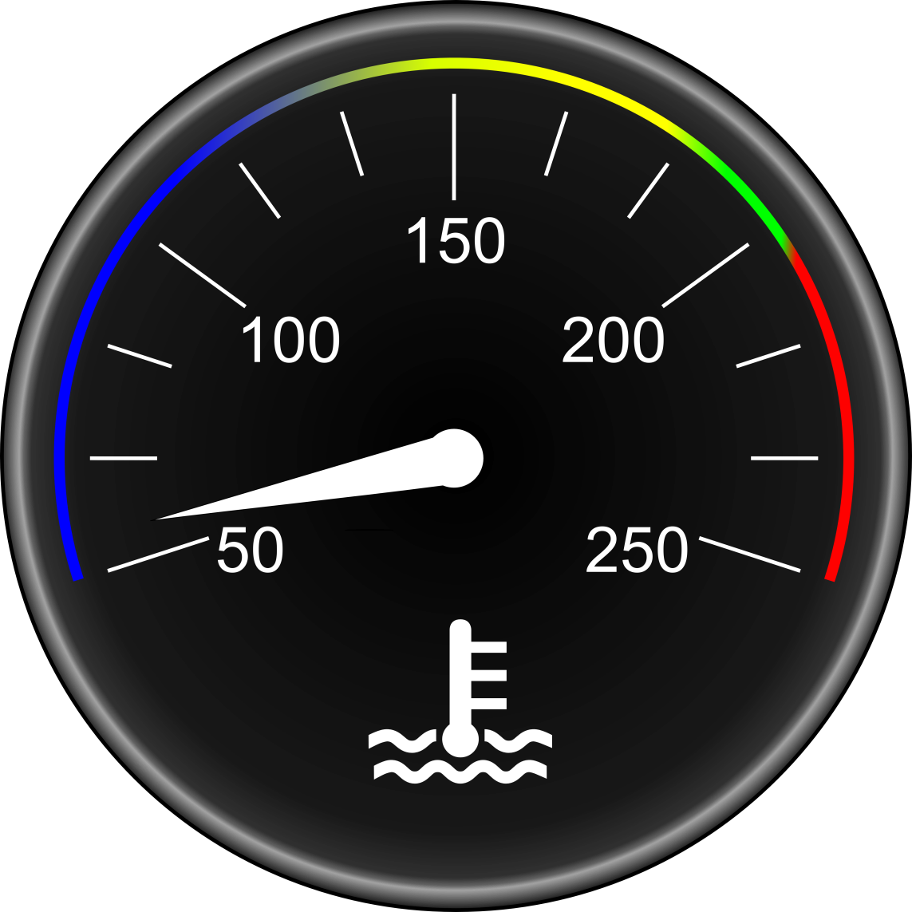
Associated gauge
Engine temperature (coolant)
Associated pictogram
180°F and 205°F +/- 10
ref:(2.2.2)
Notes:
Expliquez les températures moyennes de fonctionnement selon les fabricants dans une généralité.
Pour informations plus précises se référer au guide du fabricant du moteur.
Comment traiter l’opération du moteur selon sa température.

Slide 5

Associated pictogram
INDICATOR LIGHTS
Low level indicator
Associated with a lack of coolant.
ref:(2.2.2)
Notes:
UN TROP BAS NIVEAU PEUT ÊTRE ASSOCIÉ À DES CODES OU À DES ANOMALIES MOTEUR. Les décisions à prendre. Faire l'appoint à froid. Fuites visibles? Faire un rapport. Le système de refroidissement contient environ 45 litres de liquide de refroidissement.

Slide 6
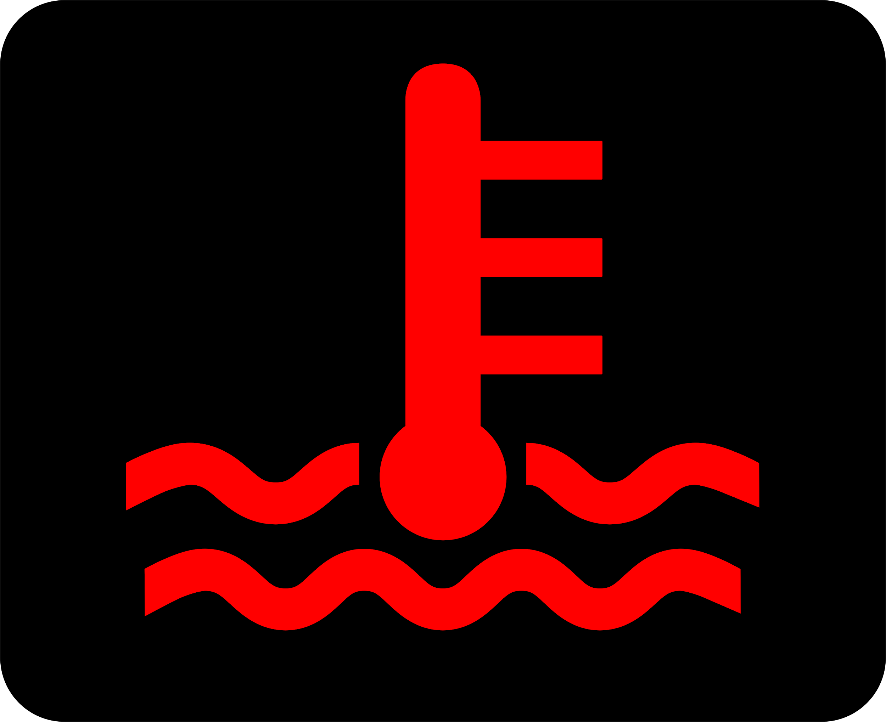
Associated pictogram
INDICATOR LIGHTS
High temperature indicator
Associated with engine overheating, it can be lit alone or accompanied by another indicator.
+ 205°F
ref:(2.2.2)
Notes:
Donnez des moyens à prendre en cas de surchauffe; Immobilisation; point mort; ventilateur manuel si possible; RPM 1100 env. 2 à 3 minutes. Vérifier la pression d’huile, etc.

Slide 7

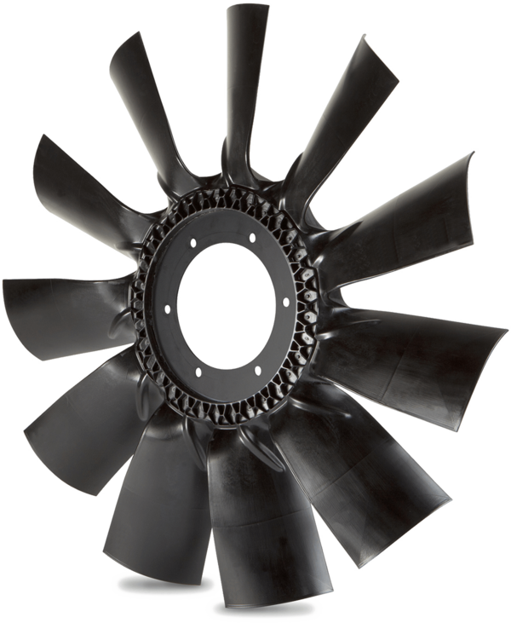
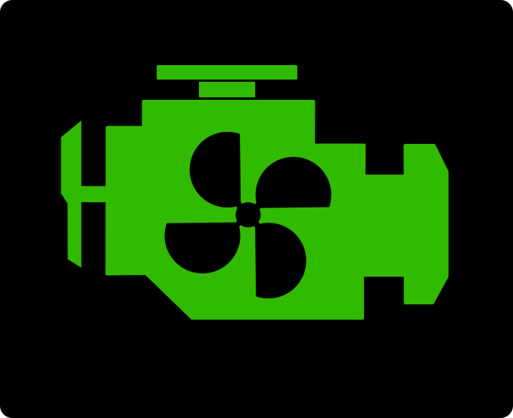
Fan operating indicator
Switch for manual fan activation
ref:(2.2.2)

Slide 8
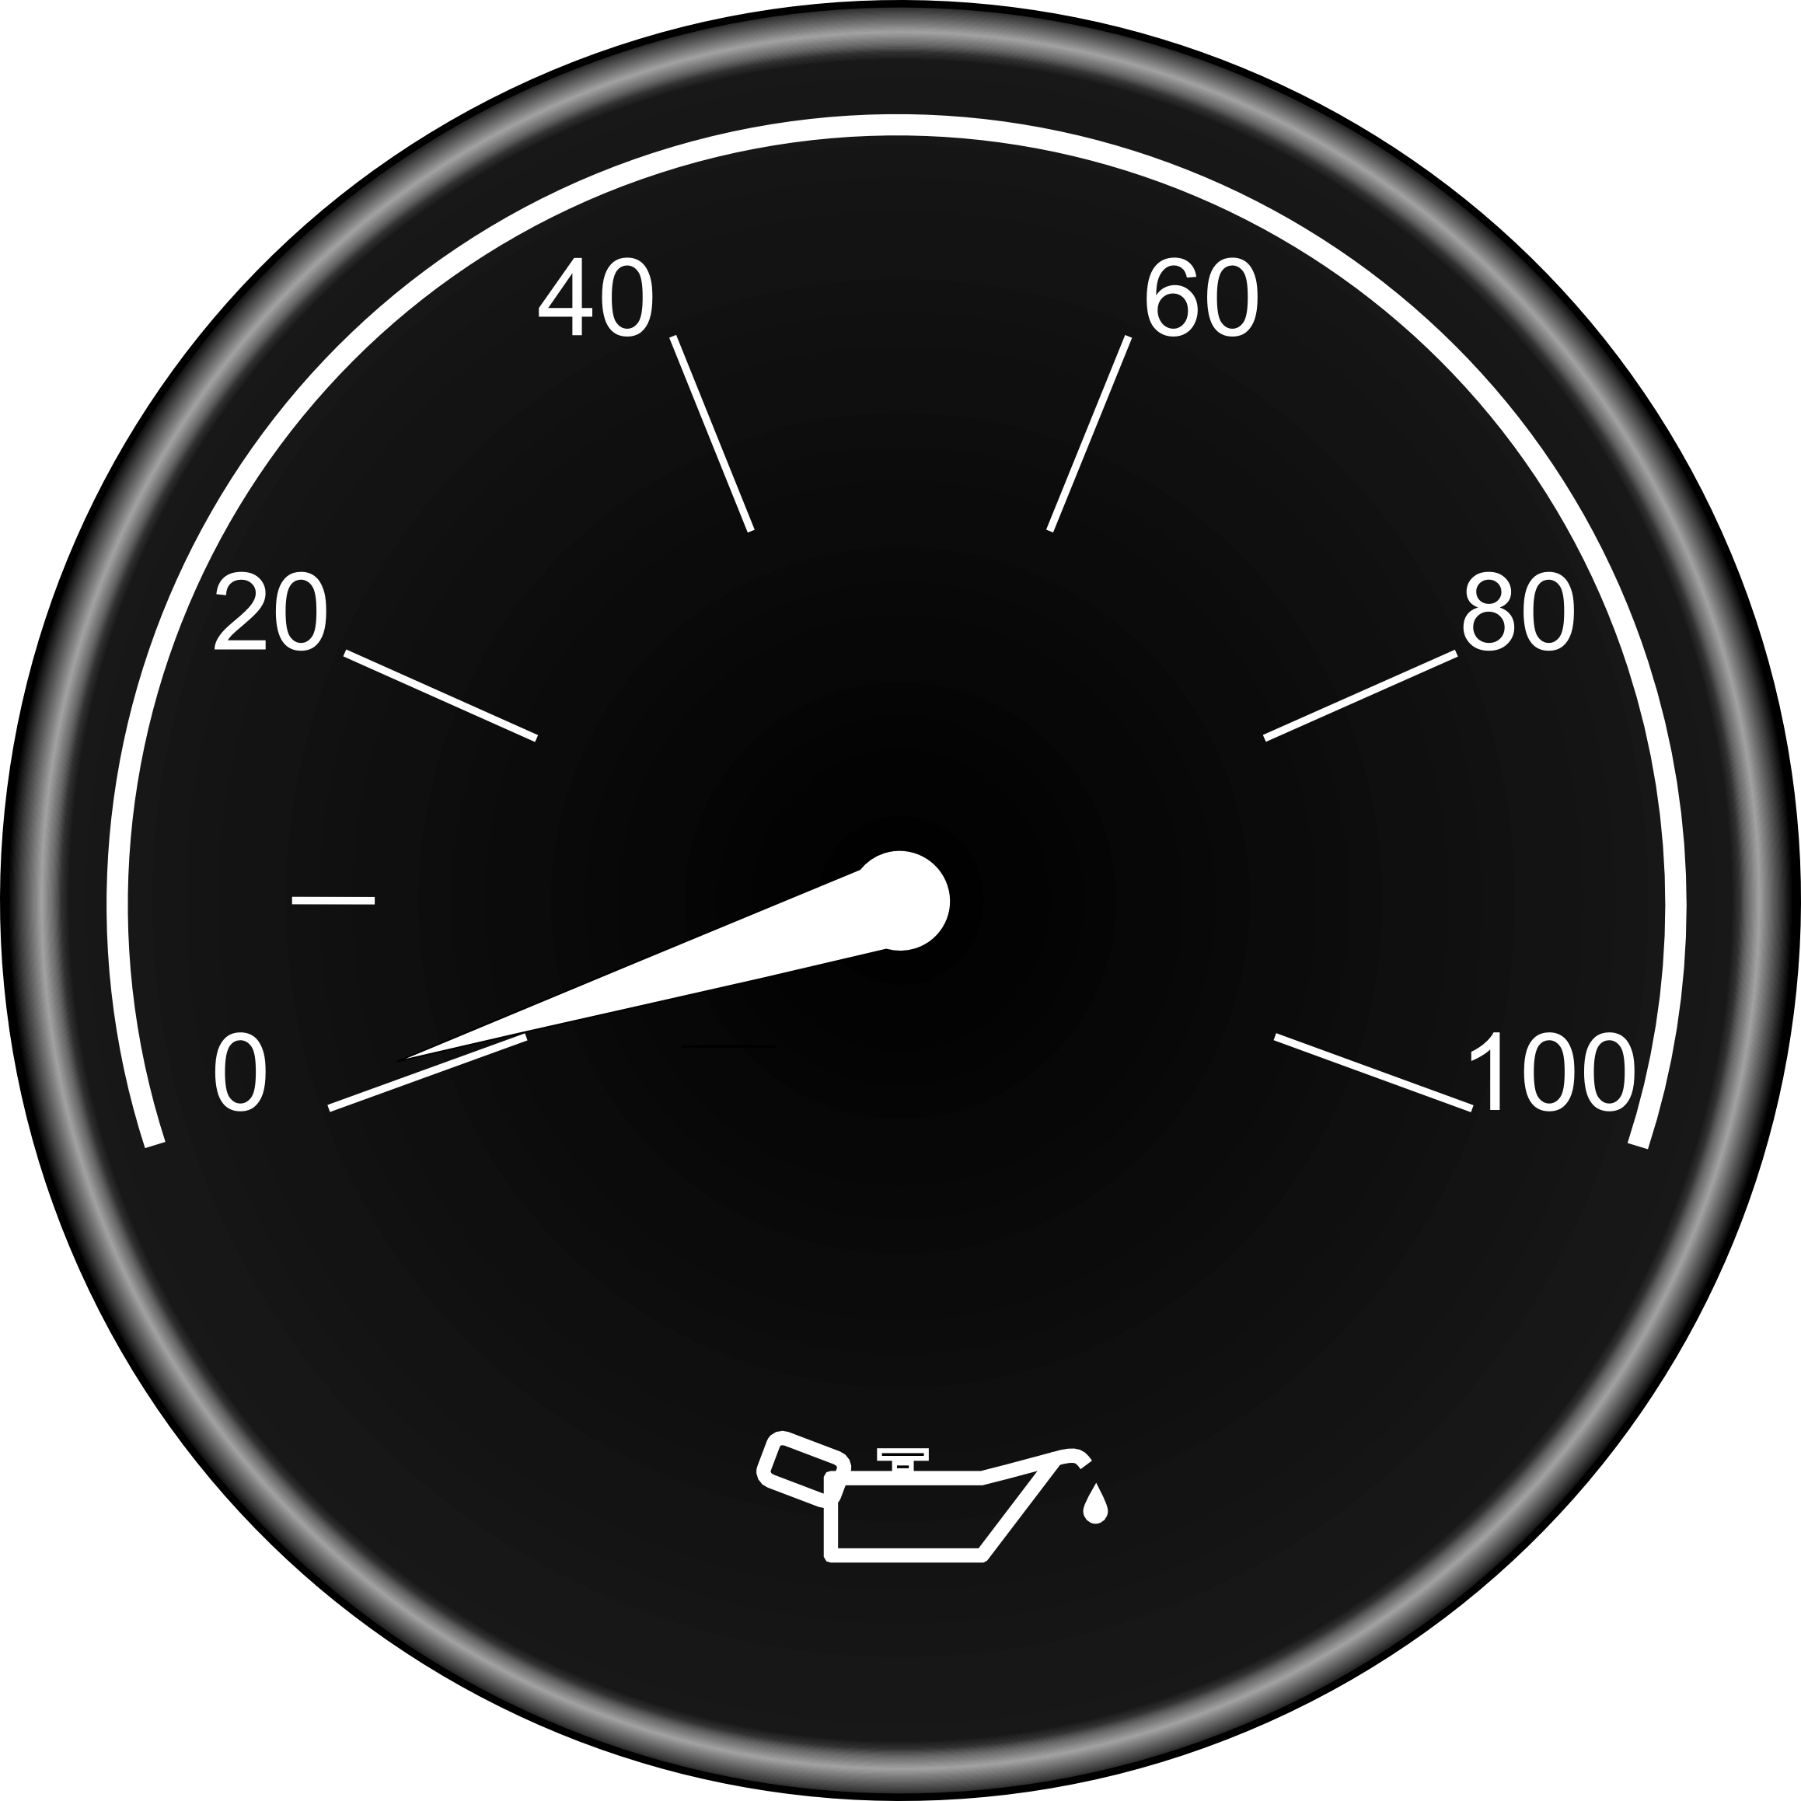

Minimum and maximum engine oil pressures range vary from one manufacturer to the other. Refer to the Owner's Manual forgauge reading accuracy. At normal operating temperatures, idle pressure should be a minimum of 15lb/po.
At cruising speed, about 1300 rpm, it should be between
40 lb/po et 60 lb/po.
Engine Oil Pressure
2
N.B. When starting in cold weather, the oil pressure can momentarily increase significantly or have a delay of 10 seconds before any reading shows on the gauge.
ref:(2.2.3)
Notes:
Pressions normales moyennes
Vérifier la pression au démarrage

Slide 9
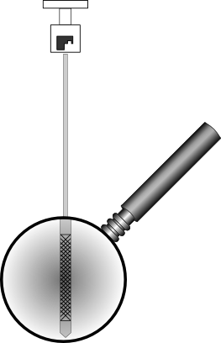
When should the engine oil level be checked?
When should engine oil be added?
Approximately how many litres of oil separate the minimum and maximum level on an engine oil dipstick?
At least once a day and ideally when the engine is cold, before moving it.
When the level is close to the minimum.
About 4 liters
ref:(2.2.3)
Notes:
Comment et quand prendre la lecture du niveau d’huile. Quantité d’huile représenté sur la jauge.
Capacité d’environ 40 litres

Slide 10
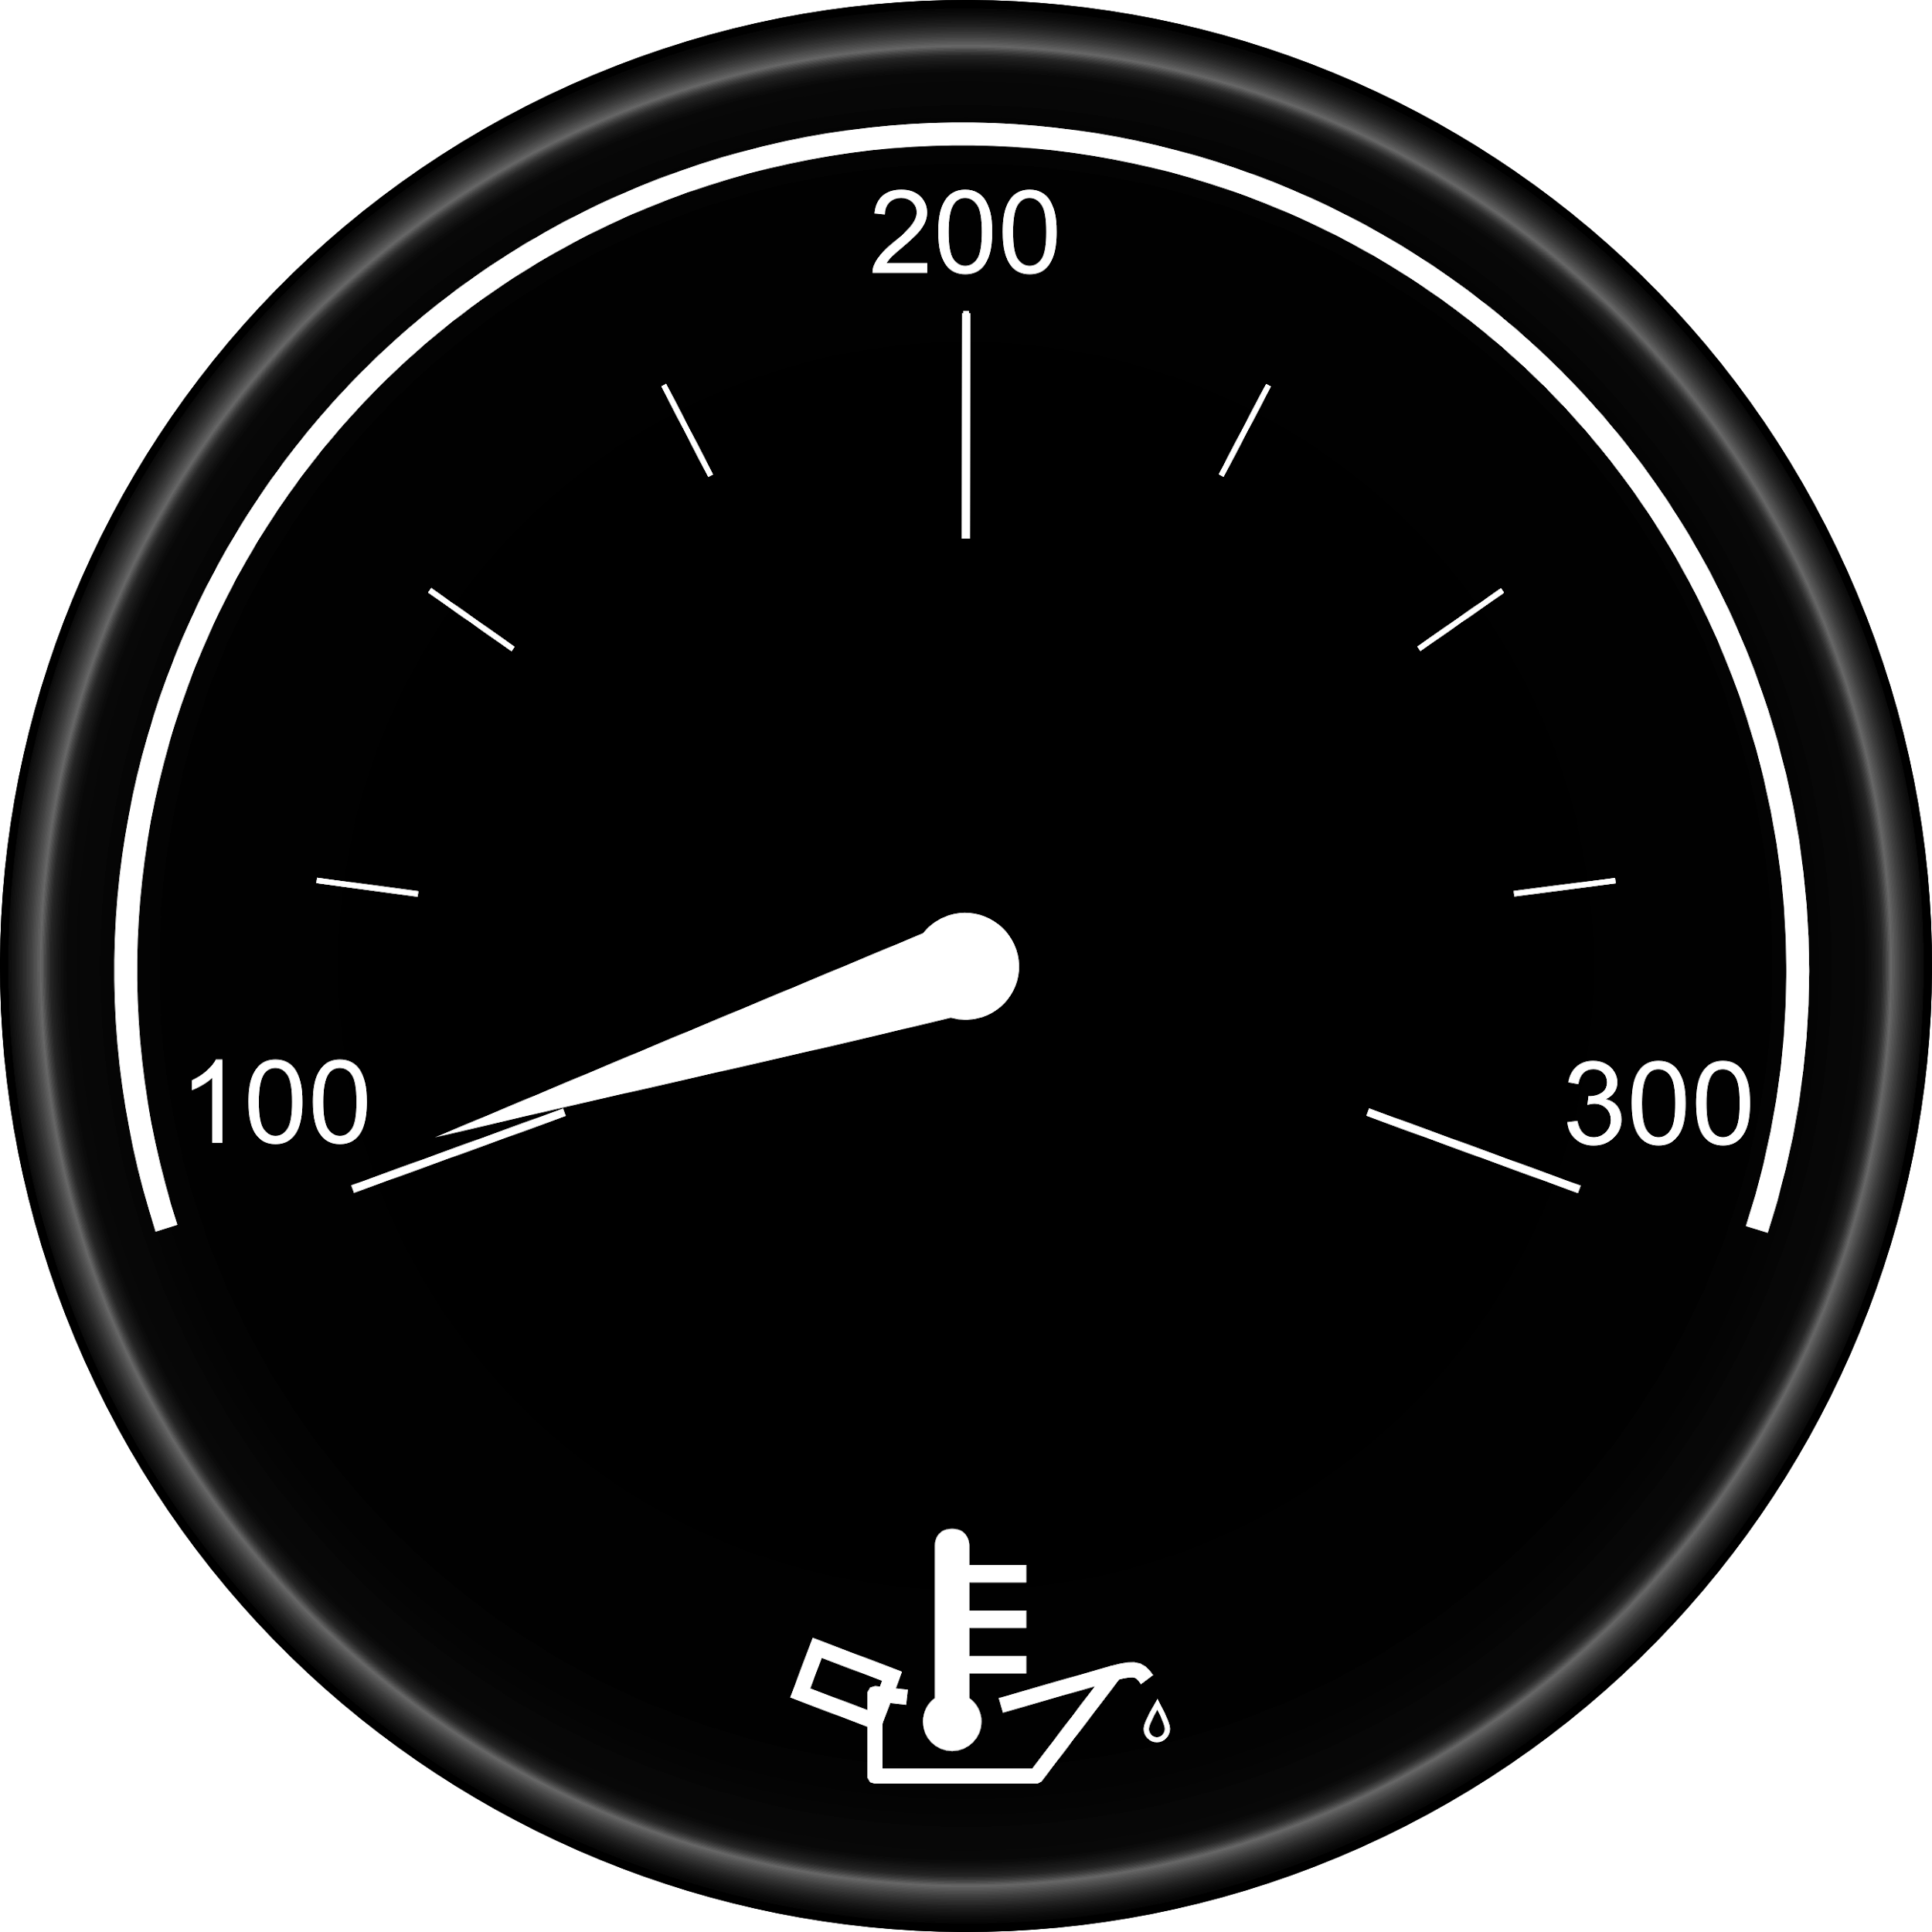

Oil temperature should remain between 200°F and 250°F
ref:(2.2.3)
Notes:
Températures normales
Expliquer ce qui apporte des variations de températures
Température maximale

Slide 11
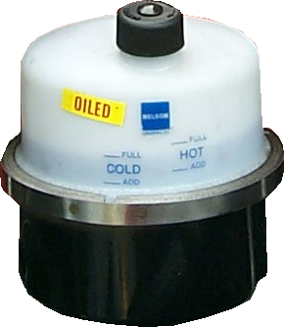
Power Steering
Oil level must be respected
COLD AND HOT
ref:(2.5.1)

Slide 12

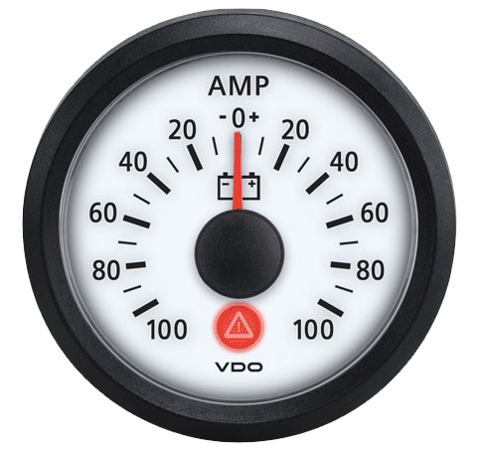
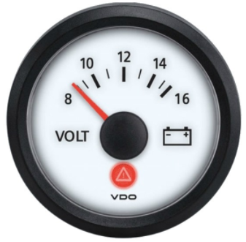

An ammeter (optional dial) is used to measure the intensity of an electric current. Its normal reading is slightly above zero. If there is a high demand for current, the reading will increase on the positive side. On the other hand, if the alternator is no longer working, the reading will go on the negative side.
The alternator supplies the current into the charging system. The voltage on the voltmeter should be between 12 and 14 volts. 12 being the minimum in cold, and 14 the maximum in operation.
Pictogram associated with the charging system
Warning light indicating an anomaly at the charging system
ref:(2.2.4)

Slide 13
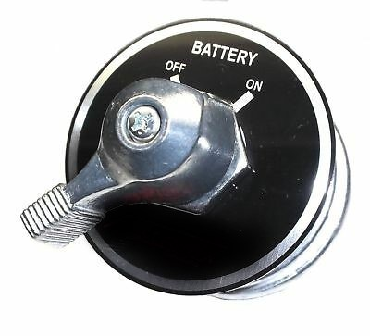
Battery protection switch“Kill switch”:
This switch isolates the batteries from any drainage source when the vehicle is not in use. Installed as an option on some trucks, it must therefore be set to "ON" in order to make it possible to operate it.
ref:(2.2.4)

Slide 14
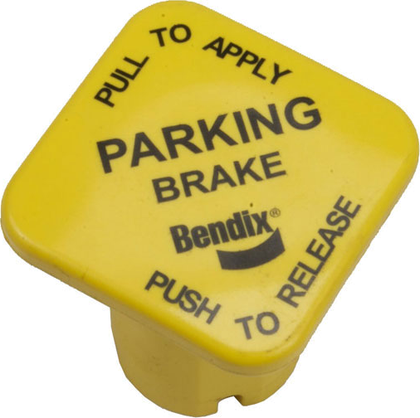
DPF Regeneration
Three types of regeneration:
Passive (in motion): Initiated by the computer. Without driver intervention
The high temperature of the exhaust makes it possible to transform all the soot into ash autonomously.
Active (in motion): Initiated by the computer. Without driver intervention
Requires diesel to be added to the exhaust to raise the internal temperature.
Stationary: Initiated by the driver using the switch
ref:(2.2.5)
Notes:
Passive: La température élevée de l’échappement permet de transformer toute la suie en cendre de façon autonome, tandis que la “Regen” Active requiert un ajout de diesel dans l’échappement afin d’élever la température interne.

Slide 15
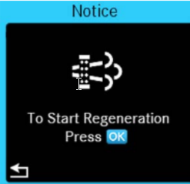




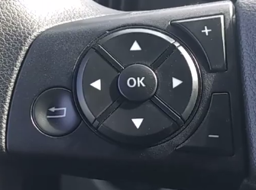
Stationary driver-induced regeneration
Associated pictograms
Power switches and buttons
ref:(2.2.5)

Slide 16
The 5 prerequisites:
1- Park the vehicle in a safe place.
2- Transmission must be neutral.
3- Engine temperature should be around 170 degrees F
4- Parking brakes must be applied
5- Hold the regeneration switch for about 5 seconds or until
the engine revolution increases.
ref:(2.2.5)

Slide 17

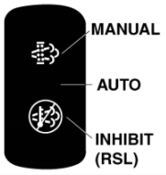
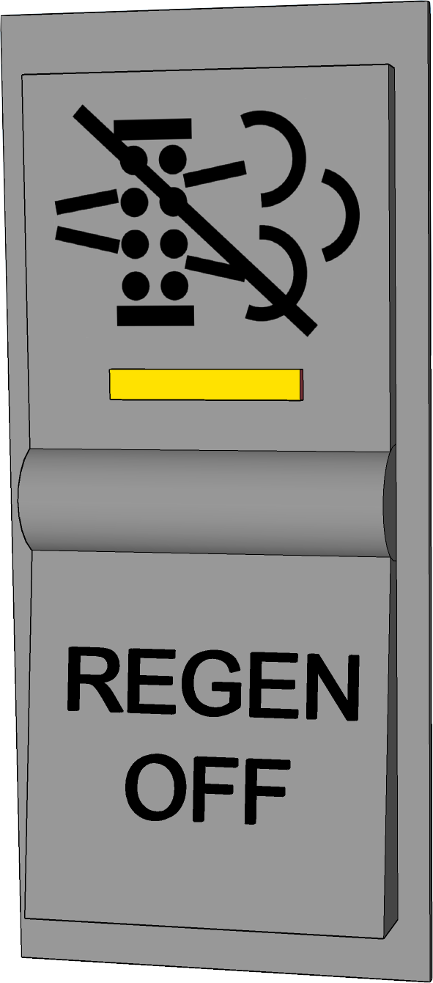

Optional two-way switches to stop regeneration when needed.
NB: This option must be used strictly for security reasons. Examples: Parking (engine running) in a garage or near flammable products.
Function: Allows the driver or mechanic to avoid or stop all forms of regeneration.
Three-way switch that combines power on as well as inhibition of regeneration. Normal position: "MEDIAN" or "AUTO"

Slide 18





Particulate filter pictograms (8) and meaning
Pictograms | Levels | Signification | Actions to be taken
Level 1
(light on)
Exhaust filter regeneration recommended.
By driving on the highway at the permitted speeds
or start the regeneration process when parked.
Level 2
(light on and flashing)
Exhaust filter regeneration required.
Driving on the highway at the permitted speeds or begin the regeneration process while parked.
Level 3
(indicator light on and flashes in addition the "engine warning" light is on)
The filter has reached its maximum capacity. Exhaust filter regeneration required.
The engine power will be decreased.
The vehicle must be parked and begin the regeneration process.
Level 4
(Indicator light on and flashes in addition the "engine warning" and "engine danger" lights are on)
The filter has exceeded its maximum capacity. Exhaust filter regeneration required.
The vehicle must be parked and begin the regeneration process.
The engine may stop and troubleshooting may be required.
The exhaust can reach a very high temperature.
Depending on the exhaust gas outlet, pay attention to where to park the vehicle before undertaking parked regeneration.
ref:(2.2.5)

Slide 19
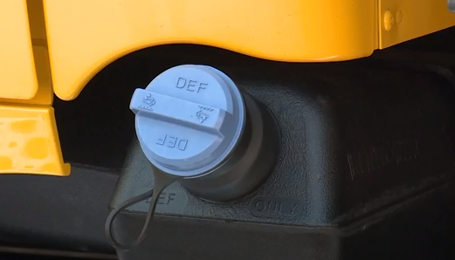
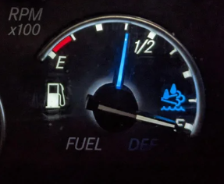
DIESEL EXHAUST FLUID "DEF"
Blue cap
ref:(2.2.5)

Slide 20
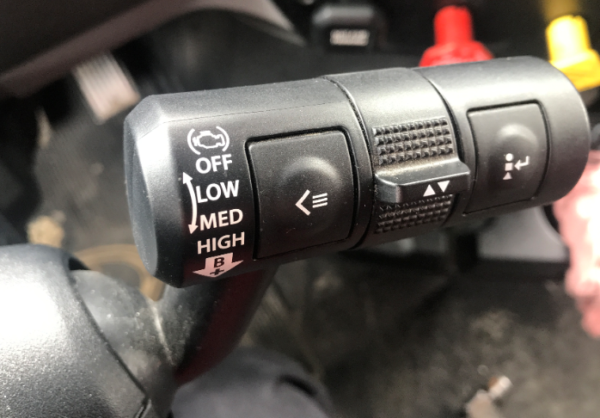
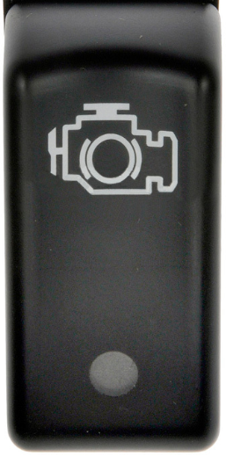

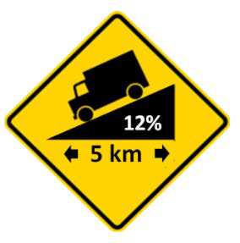
AUXILIARY BRAKES (Engine Brake or Retarder)
A valuable tool.
They reduce service brake application and provide additional braking capability.
For example, the majority of well-anticipated highway exits could be negotiated without using the service brake. Similarly, the use of auxiliary brakes is part of the procedures to secure downhill operation .
ref:(2.2.6)
Notes:
Réf: CVL p.154
La portion de “Les freins complémentaires” est pertinente.
La portion “ Ralentir dans une côte en utilisant la transmission et la compression du moteur” est nettement exagérée, il serait approprié de mentionner aux élèves que le premier rapport n’est pas utile.

Slide 21
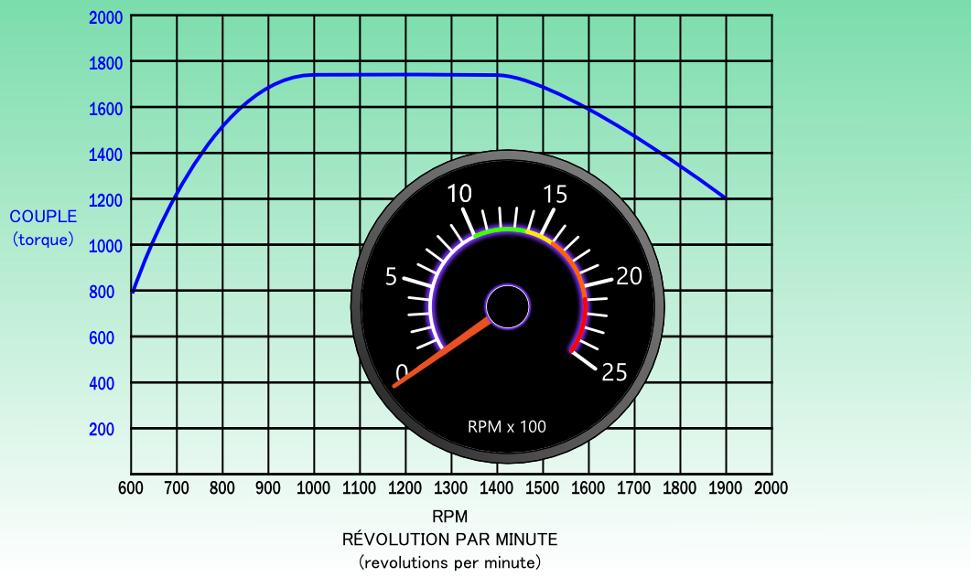
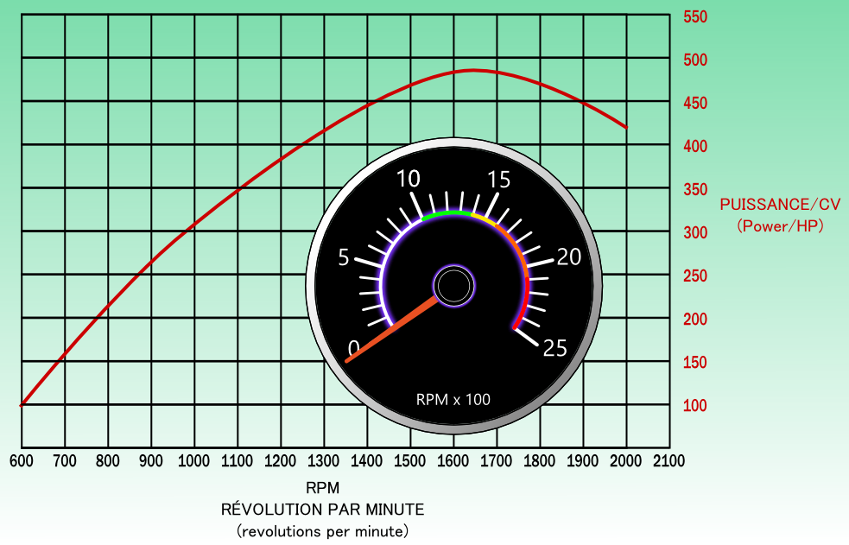
RPM: Torque and HP/Power
ref:(2.2.7)
Notes:
Notez que le couple est dans une plage d’opération de plusieurs RPM.
Le HP est plus souvent avec une pointe “peak”, donc il augmente graduellement et abaisse graduellement.
Les couleurs contenues dans la tachymètre reflète l’efficacité des tours/minute.

Slide 22
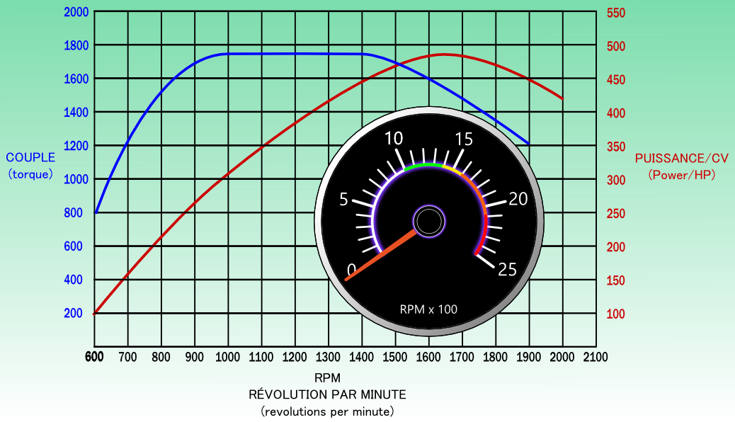
Terminology
Peak Tork start range
Progressive (economical) changes in gear ratios:
Low range: the recovery can be below the maximum torque, at less than 1000 RPM.
High range: the recovery must be at the beginning of the maximum torque, at 1000 RPM (With a difference of 400 RPM, it would be necessary to change the ratio to 1400 RPM for the recovery to be at 1000 RPM)
Peak Tork:
Useful when upgrading in high range.
Ideal range:
The peak tork range is between 1000 et 1425 rpm according to this graph.
Peak Tork end range
ref:(2.2.7)
Notes:
Due à l’augmentation importante du couple par la transmission en bas palier, il n’est pas nécessaire d’avoir une reprise au couple maximum. Une reprise à 800 RPM pourrait donc être acceptable en situation normale de conduite.

Slide 23
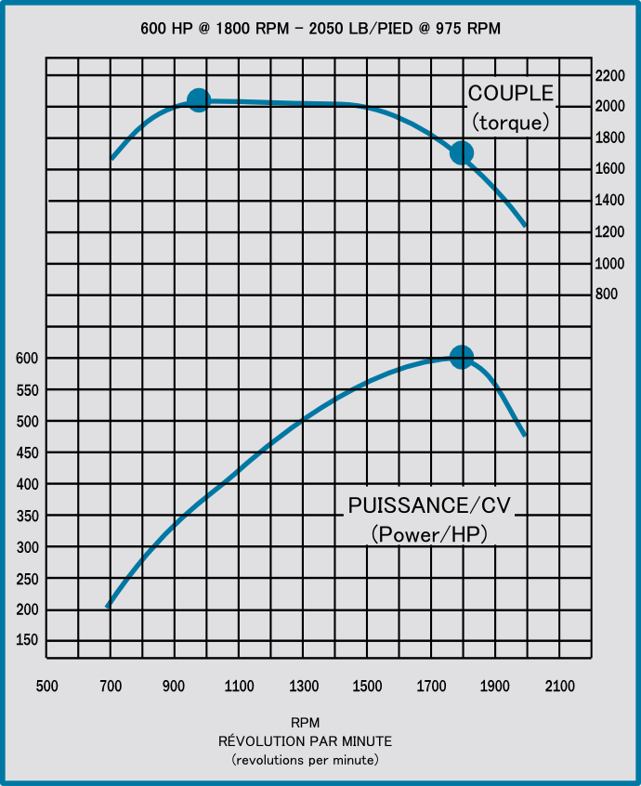
In this second example, the 16L engine develops
2050 lb/ft of torque @ 975 rpm.
Over this torque range, which extends over about 400 rpm, the figure 975 therefore represents the minimum speed to be respected under load..
In addition, this engine develops
600 HP @ 1800 rpm (best engine RPM when using the engine brake)
The number 1800 therefore represents the maximum speed to be achieved to obtain the maximum power of this engine.
ref:(2.2.7)

Slide 24
The engine plate gives you relevant information for the engine operation.
HP Power
Maximum RPM
Maximum torque
ETC.

Slide 25
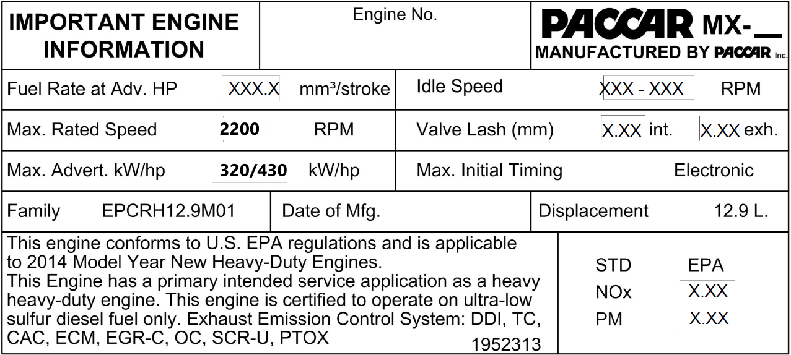
(MAX Rated Speed)
Max HP 430 HP

Slide 26



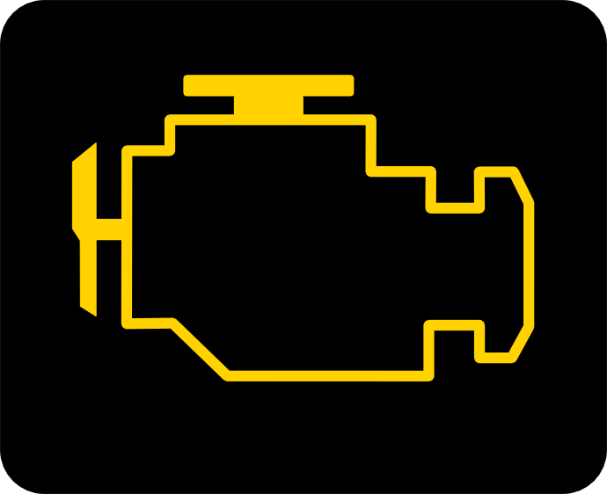
Warning lights
Engine anomaly. You need to check your gauges. The vehicle may be driven. Notify the mechanic.
This indicator is linked with an audible signal. This indicates a Severe engine failure.
You must stop safely andTurn off the engine.
Cold start assist system. Wait for it to turn off before starting the engine.
The illuminated indicator indicates that the thermostatic fan is on.
Anomaly related to the emission control system. The vehicle may be driven. Notify the mechanic.
ref:(2.2.7)
Notes:
Il faut se rappeler de toujours vérifier le FED durant la RDS.
Témoin jaune jaune allumé simplement faire un rapport mécanique, le plus tôt possible.
Suite à une défaillance grave du moteur, le conducteur peut utiliser l’override afin de se libérer de la voie, il aurait avantage à l’utiliser avant que le camion s’immobilise complètement.

Slide 27
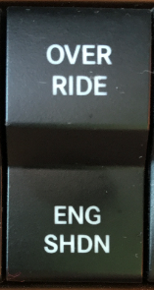
“engine override” switch
When the engine shutdown light is illuminated, it may be necessary to use the Override Switch to move the vehicle or restart it. If there is no switch, stop the engine with the key and restart.
This switch is usually associated with the Detroit Diesel engine (Ex:DD13). It would be in the driver's best interest to use it before the truck comes to a complete stop.
Notes:
Plus d’un “override” peut est possible en cas de besoin. Le ECM enregistre toutes les séquences...

Slide 29
DRIVING HABITS TO ADOPT
Avoid unnecessary idling: An idling engine consumes about 4 liters/hour. One hour of idling for an engine is equivalent to two hours of wear at cruising speed.
POSSIBLE SOLUTIONS;
Warm up the engine by moving slowly and gradually until the operating temperature of the engine is reached
Turn off the engine during basic maneuvers. (RDS, hitch, uncoupling, storage...)
Turn off the engine during waiting periods; customers, customs, full of fuel...
Travel the last minutes of a trip without putting the engine under load, to allow it to cool down. Thus, it will be possible to turn off the engine as soon as the parking brake is applied.
ref:(2.2.8)

Slide 30
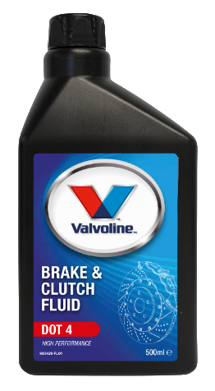
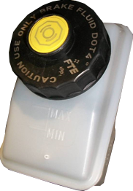
Hydraulic clutch fluid
MIN
ref:(2.3.1)

Slide 31
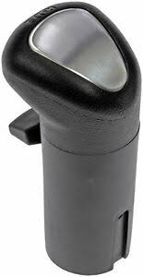
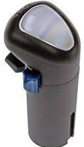
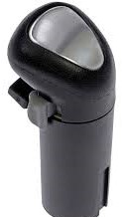
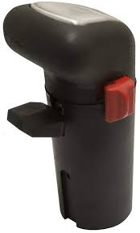
Manual transmission knobs
The range selectors
ref:(2.3.2)
Notes:
Les boutons noir sont les sélecteurs de paliers (Range) dans l’auxiliaire de la transmission.
Les boutons rouge et gris sont des sélecteurs de vitesses hautes (HIGH) et basses (LO) aussi dans l’auxiliaire de la transmission.
Le bouton bleu est un sélecteur de très basse vitesse (DEEP) toujours dans l’auxiliaire de la transmission.

Slide 32
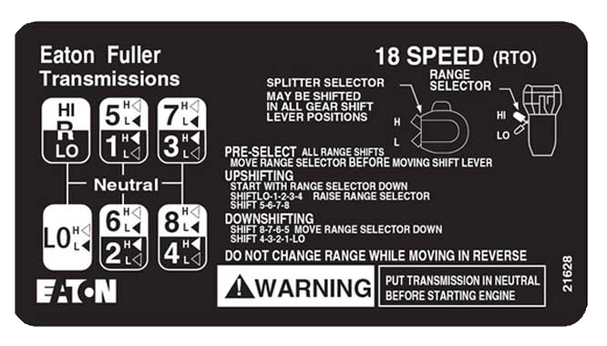
Manual transmission knobs
With a bearing selector and a gray button, it's an 18-speed with half-gears on both HI and LO range.
ref:(2.3.2)
Notes:
Les boutons noir sont les sélecteurs de paliers (Range) dans l’auxiliaire de la transmission.
Les boutons rouge et gris sont des sélecteurs de vitesses hautes (HIGH) et basses (LO) aussi dans l’auxiliaire de la transmission.
Le bouton bleu est un sélecteur de très basse vitesse (DEEP) toujours dans l’auxiliaire de la transmission.

Slide 33
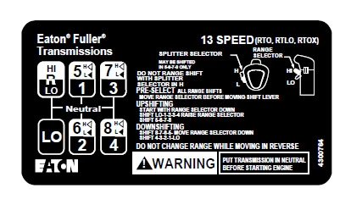
Manual transmission knobs
With a bearing selector and a red button, it's a 13-speed with half-gears on the high range only
ref:(2.3.2)
Notes:
Les boutons noir sont les sélecteurs de paliers (Range) dans l’auxiliaire de la transmission.
Les boutons rouge et gris sont des sélecteurs de vitesses hautes (HIGH) et basses (LO) aussi dans l’auxiliaire de la transmission.
Le bouton bleu est un sélecteur de très basse vitesse (DEEP) toujours dans l’auxiliaire de la transmission.

Slide 34
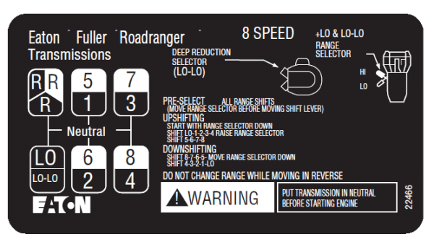
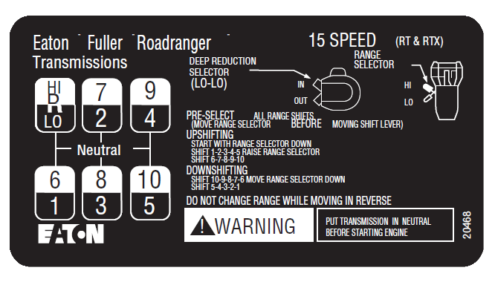
Manual transmission knobs
With a range selecto and a blue button, there are several possibilities but no half speed. It is a deep reduction selector.
(A 4-hole diagram if it is an 8LL) (A 5-hole diagram if it is a 15)
ref:(2.3.2)
Notes:
Les boutons noir sont les sélecteurs de paliers (Range) dans l’auxiliaire de la transmission.
Les boutons rouge et gris sont des sélecteurs de vitesses hautes (HIGH) et basses (LO) aussi dans l’auxiliaire de la transmission.
Le bouton bleu est un sélecteur de très basse vitesse (DEEP) toujours dans l’auxiliaire de la transmission.

Slide 35
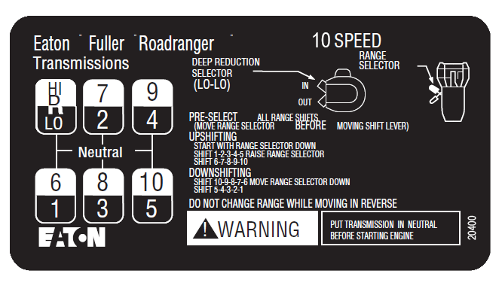
Manual transmission knobs
With a single range selector, it's a 10-speed transmission.
(5-hole diagram)
ref:(2.3.2)
Notes:
Les boutons noir sont les sélecteurs de paliers (Range) dans l’auxiliaire de la transmission.
Les boutons rouge et gris sont des sélecteurs de vitesses hautes (HIGH) et basses (LO) aussi dans l’auxiliaire de la transmission.
Le bouton bleu est un sélecteur de très basse vitesse (DEEP) toujours dans l’auxiliaire de la transmission.

Slide 36
Automated transmission
This type of transmission combines a manual gearbox with a shift actuator and a traditional computer-controlled clutch. It is
Widely used in the field of transport.
ref:(2.3.3)
Notes:
Voir vidéo pour plus d’explications.
https://www.youtube.com/watch?v=bJ1i5Bvujbg&list=PL_t8JD78rP4HItbWn8Rft2IFGLLkAbQTp&t=19s&index=5

Slide 37
Automated transmission
In addition, it modify the driving of the heavy vehicle. Indeed, since driving is similar to that of an automobile, the notion of anticipating maneuvers can be quickly forgotten.
For example, since the driver does not have to do any downshift, this can result in turns maneuvers too fast.
ref:(2.3.3)
Notes:
Voir vidéo pour plus d’explications.
https://www.youtube.com/watch?v=bJ1i5Bvujbg&list=PL_t8JD78rP4HItbWn8Rft2IFGLLkAbQTp&t=19s&index=5

Slide 38
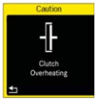
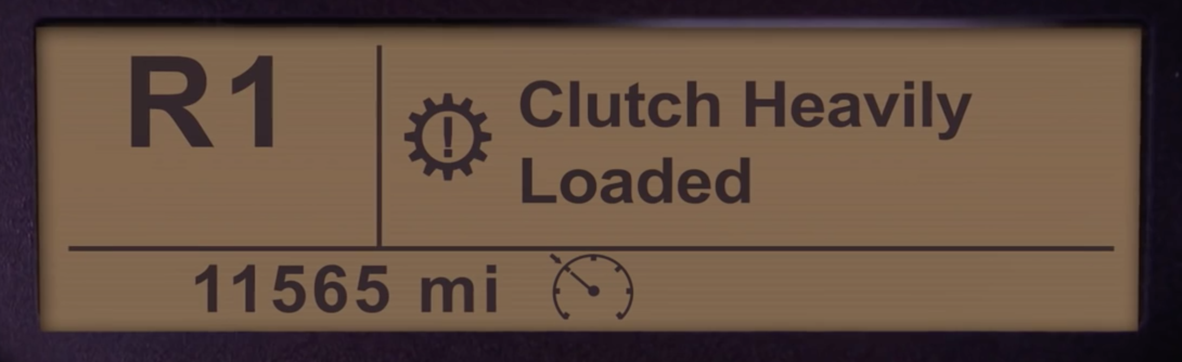
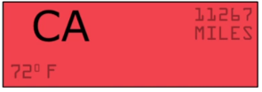
Automated transmission
Be aware of the clutch abuse warnings.
“clutch abuse”; “clutch overheating”. Often caused by prolonged maneuvers at very low speeds.
ref:(2.3.3)
Notes:
Voir vidéo pour plus d’explications.
https://www.youtube.com/watch?v=bJ1i5Bvujbg&list=PL_t8JD78rP4HItbWn8Rft2IFGLLkAbQTp&t=19s&index=5

Slide 39
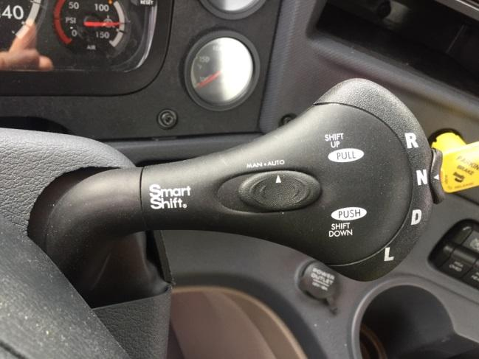
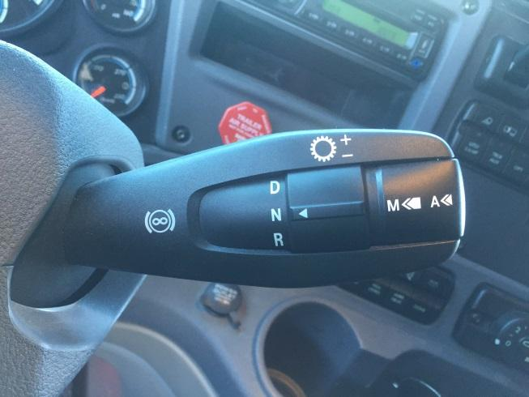
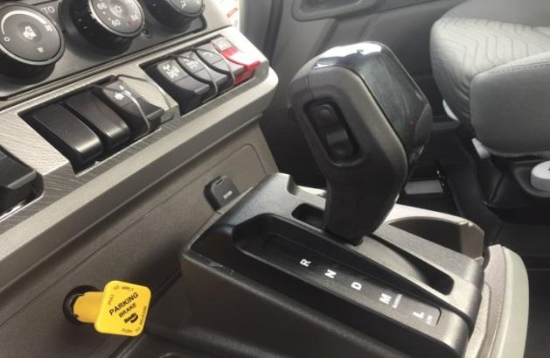
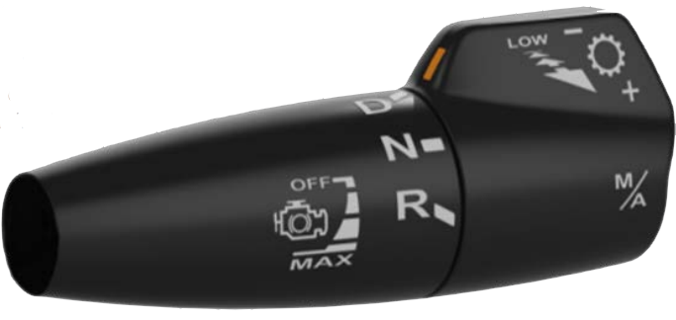
Some automated transmission clutch controls

Slide 40
The Differential Inter-axle (Power Divider)“PDL”
The "Inter-axle" inter-axle differential is equipped with a non-optional locking system that ensures (if activated) the distribution of engine power equally to the front and rear axles of the vehicle, regardless of the state of adhesion of the road. An indicator light and/or audible indicates the current system is being used. There is no speed limit for his engagement. However, it must be deactivated when not required.
Dangers:
Do not engage the inter-axle differential if the wheels slip, this can cause a mechanical breakdown.
If you use this system for a long time when the road is dry, it can result in a locking mechanism breakdown.
ref:(2.3.4)

Slide 41
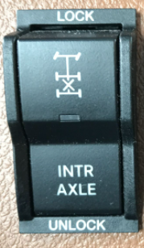
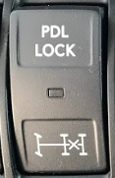
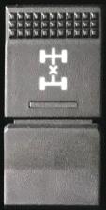

The Differential Inter-axle (Power Divider) “PDL” :
There is no speed limit for his engagement. However, it must be deactivated when not required.
Dangers:
Do not engage the inter-axle differential if the wheels slip, this can cause a mechanical breakdown.
If you use this system for a long time on a dry road, it can result in a locking mechanism breakdown.
Switches
Lights
ref:(2.3.4)

Slide 42





Differential / inter-wheel wheel lock“ Axle lock or Diff Lock’’:
The inter-wheel is an integrated differential locking system. It is optional when purchasing the vehicle. On a tandem trucks, the inner-axle option can be found on a single axle or on both axle.
When equipped, the driver has the option of engaging the inter-wheel differential(s) to increase traction in particular situations.
ref:(2.3.4)
Notes:
C’est le conducteur qui active la commande de blocage à l’aide des interrupteurs du tableau de bord.
Indicateurs du tableau de bord lorsque le blocage est activé.
Exemples de situations:
À l’approche d’une pente ascendante enneigée, glacée;
Lors de l’attelage ou du dételage d’une semi-remorque;
Terrain, chaussée accidentés.

Slide 43


The dangers:
Do not exceed 40 km/h with the inter-wheels engaged, it could result in mechanical breakdowns.
In a turn, when the differentials are locked, the vehicle may tend to understeer and go straight;
High possibility of skidding if all tires slip;
Do not use on dry pavement, mechanical breakdown could result;
Do not use on downhills.
ref:(2.3.4)

Slide 44
Procedure for engaging the inter-axle lock while in motion:
Make sure the wheels don't slip and you are driving straight;
Turn the switch to“ lock ” position;
Release the accelerator (optional to press the clutch pedal) and resume driving;
When the system is engaged, a pictogram and/or a sound will warn the driver.
Procedure for disengaging the system while in motion:
Make sure the wheels don't slip and you are driving straight;
Turn the switch to “unlock” position;
Release the accelerator (optional to press the clutch pedal) and resume driving;
When the system is disengaged, the pictogram and/or the sound will go off .
Note that some truck brands incorporate speed limits for engagement and/or automatic release of these systems.
ref:(2.3.4)

Slide 45
Procedure for engaging the inter-wheel while in motion:
Can be engaged at low speed
Make sure the wheel don't slip and you are not in a turn;
Turn the switch to“ lock ” position;
Release the accelerator (optional to press the clutch pedal) and resume driving;
When the system is engaged, a pictogram and/or a sound will warn the driver.
Do not exceed 40km\h when engaged;
Procedure for disengaging the system while in motion:
Make sure the wheel don't slip and you are not in a turn;
Turn the switch to “unlock” position;
Release the accelerator (optional to press the clutch pedal) and resume driving;
When the system is disengaged, the pictogram and/or the sound will go off.
Note that some truck brands incorporate speed limits for engagement and/or automatic release of these systems..
ref:(2.3.4)

Slide 46
Procédure pour engager les blocages interponts et\ou interroues, avant de mettre le véhicule en mouvement.
La transmission au neutre ou engagée avec la pédale d’embrayage enfoncée.
Engagez l’interrupteur ou les interrupteurs à “ lock ”
Mettre le camion en mouvement
Lorsque le système est engagé, un témoin lumineux et/ou sonore avertit le conducteur.
Procédure pour désengager le ou les systèmes lorsque le véhicule est à l'arrêt.
La transmission au neutre ou avoir la pédale d’embrayage enfoncée;
Désengagez l’interrupteur à “unlock”;
Mettre le camion en mouvement;
Lorsque le système est désengagé, le témoin lumineux et/ou sonore s'éteint.
À noter que certaines marques de camion intègrent des limitations de vitesse d’engagement et/ou de dégagement automatique de ces systèmes.
ref:(2.3.4)

Slide 47


TRACTION CONTROL SYSTEM
The traction control system controls wheel slip during acceleration to improve traction. It intervenes automatically by applying the brakes to the wheel that slips. This intervention forces the transfer of power from the engine to other wheels that have better traction. This can be useful to limit the risk of getting stuck.
INDICATOR LIGHTS:
Turns on and off when starting the engine;
It will flash quickly to signal that the system is activated.
If it remains lit, it indicate that the system is out of service.
On the dashboard, you can find different names of this system, for example:
TC, TCS, ATC, ASR, TRAC CTRL.
ref:(2.3.4)
Notes:
Si toutes les roues veulent patiner, le système réduit la puissance du moteur et limite le régime du moteur pour améliorer la traction. Cette action peut se faire à n’importe quelle vitesse.
ASR : de l'allemand « Antriebsschlupfregelung », signifiant « Contrôle de traction » ;
TCS : de l'anglais « Traction Control System » signifiant « Système de contrôle de la traction » ;
ATC: automatic traction control
ASC et ASC+T : terminologie BMW, de l'anglais « Automatic Stability Control [+ Traction] », signifiant « Contrôle automatique de stabilité [et de traction] »
Notez que le fonctionnement reste le même pour chacun des systèmes.

Slide 48


SYSTEM DEACTIVATION
When stuck in deep snow, melted snow or mud, the switch can be used to partially disable the traction control function. This will result in an increase power at the wheel and a limitation of braking action at the wheel. Therefore, getting unstuck will be easier. Some manufacturers use the name mud/snow or off road.
When traction control is disabled, an indicator light flashes in the dashboard.

Slide 49
Despite all these systems, your vehicle may remain stuck. At this point, other means will have to be taken to increase friction under the vehicle's tires.
● Select a higher gear. By choosing a higher gear , the torque force imposed on the wheels is reduced. In this way, the risk of slipping is reduced.
● Put traction aids under tires or any other material that can increase tire grip (sand, abrasive, chains, etc.).
ref:(2.3.4)
Notes:
Si toutes les roues veulent patiner, le système réduit la puissance du moteur et limite le régime du moteur pour améliorer la traction. Cette action peut se faire à n’importe quelle vitesse.
Au poste de conduite, vous pouvez retrouver différentes appellations de ce système, par exemple : TC, TCS, ATC, ASR, TRAC CTRL.
Notez que le fonctionnement reste le même pour chacun des systèmes.

Slide 50

The braking system
Safety valve
Air dryer
Air compressor
Supply tank
Air pressure regulator
ref:(2.4.1)

Slide 51

Kinetic energy
When the weight of the vehicle is doubled, the braking distance is also doubled. (X2)
When the vehicle speed is doubled, the braking distance is four times longer. (X4)
When weight and speed are doubled, the braking distance is eight times longer. (X8)
Braking start
Braking distance
ref:(2.4.1)
Notes:
50 km/hr avec 15 tonnes est la distance de freinage repère de 27 m réf:p107 et 108 du CVL
50 km/hr avec 30 tonnes est la distance de freinage de 54 m...X2
100 km/hr avec 15 tonnes est la distance de freinage de 108 m...X4
100 km/hr avec 30 tonnes est la distance de freinage de 216 m et il n’y a pas de dessin...X8

Slide 52

The air compressor
Its role:
Supply compressed air to the supply tank
In a pneumatic braking system, part of the power required for braking comes from compressed air. The air compressor pumps pressurized air into tanks.
ref:(2.4.1)
Notes:
Le compresseur est entraîné par la rotation du moteur,il est alimenté en air par le filtre à air du moteur et il est lubrifié par l’huile moteur.

Slide 53


Air dryer
The air dryer installed between the compressor and the supply tank and removes moisture from the compressed air
ref:(2.4.1)
Notes:
Un élément chauffant est installé sous l’assécheur d’air afin d’empêcher l’humidité de geler.

Slide 54

The supply tank
The supply tank store compressed air that comes from the compressor.
ref:(2.4.1)
Notes:
Il alimente le circuit primaire et secondaire.

Slide 55

The air pressure regulator
Its role: Starting the compressor at a minimum of 80 psi "start of the pumping cycle" and stopping it between 117 and 137 psi "end of the pumping cycle"
The air pressure regulator controls the minimum and maximum air pressures of the pneumatic system and controlling the purge of the air dryer (desiccator).
ref:(2.4.1)
Notes:
Le régulateur de pression est habituellement préréglé entre 105 à 125 psi pour le démarrage et 20 psi de plus pour l’arrêt. réf:p 97 et 98 du CVL pour le circuit

Slide 56

The primary (1) and secondary (2) air tanks
The primary and secondary tank stores compressed air that comes from the supply tank.
ref:(2.4.1)
Notes:
L’avertisseur de basse pression est relié à un témoin lumineux et sonore, il doit s’activer à un minimum de 55psi.

Slide 57

The simple brake receiver (actuator,booster)
The brake receiver acts with the help of compressed air as a force multiplier that will put pressure on the adjustable lever.
ref:(2.4.1)

Slide 58


The dual brake receiver (actuator,booster)
The dual brake receiver, in addition to performing the same action as the single brake receiver, it also apply the parking brake.
ref:(2.4.1)

Slide 59

The slack adjuster
The slack adjuster also acts as a force multiplier through its leverage
ref:(2.4.1)
Notes:
Il en existe plusieurs marques et modèles.

Slide 60






Pictograms and gauges associated with braking systems
Primary system
Secondary system
Application pressure gauge
ref:(2.4.2)

Slide 61





Brake system warning lights
Low air pressure indicators lights
Parking brake application indicator lights
ref:(2.4.2)

Slide 62
THE ANTI-LOCK BRAKING SYSTEM
ABS
The Anti-lock Braking System (ABS) is a driver assistance system, designed so that the driver can maintain control of his vehicle and prevent it from skidding during braking. When there is a loss of grip, the ABS computer uses wheel speed sensors to determine if one or more wheels are about to lock during braking. Before a lock occurs on a wheel, the modulator valve releases the brake pressure on the wheel several times per second. The constant rotation of the wheels prevents skidding and maintains steering control.
ref:(2.4.3)
Notes:
Commutateur ABS hors route (option)
Votre véhicule est peut-être équipé d'un commutateur destiné spécifiquement à la fonction hors route ABS. Cette fonction ne doit PAS être utilisée pour la conduite sur route pavée; elle est destinée à améliorer le freinage en dehors des routes pavées (par exemple sur le gravier et dans la boue). La fonction ABS hors route permet la formation d’une légère accumulation de matière devant une roue momentanément bloquée.
Caractéristiques et avantages
• Modifie le seuil d’entrée en fonction du système ABS pour optimiser ce dispositif en usage hors route.
• Améliore la maîtrise du véhicule et aide à raccourcir les distances de freinage hors route ou sur les surfaces à mauvaise adhérence, par exemple sur le gravier, le sable et la terre.
• Permet aux ralentisseurs de fonctionner indépendamment de la fonction ABS.
• Si votre véhicule n'est pas équipé d'un ralentisseur, le commutateur ABS hors route fonctionnera de la même façon.

Slide 63




ABS Operating Indicator light
The usually yellow ABS light illuminates in the dashboard for a few seconds when starting the engine and then turns off. Two ABS indicator light may be present: one for the truck and one for the trailer. If the dashboard or trailer light remains constantly illuminated, it informs the operator that the ABS computer has detected a fault in its components and that the system is unserviceable. However, conventional brakes operate normally. It will then be essential to adapt the driving of this vehicle accordingly. In addition, since ABS is mandatory on all heavy vehicles, it will need to be repaired as soon as possible.
ref:(2.4.3)
Notes:
Commutateur ABS hors route (option)
Votre véhicule est peut-être équipé d'un commutateur destiné spécifiquement à la fonction hors route ABS. Cette fonction ne doit PAS être utilisée pour la conduite sur route pavée; elle est destinée à améliorer le freinage en dehors des routes pavées (par exemple sur le gravier et dans la boue). La fonction ABS hors route permet la formation d’une légère accumulation de matière devant une roue momentanément bloquée.
Caractéristiques et avantages
• Modifie le seuil d’entrée en fonction du système ABS pour optimiser ce dispositif en usage hors route.
• Améliore la maîtrise du véhicule et aide à raccourcir les distances de freinage hors route ou sur les surfaces à mauvaise adhérence, par exemple sur le gravier, le sable et la terre.
• Permet aux ralentisseurs de fonctionner indépendamment de la fonction ABS.
• Si votre véhicule n'est pas équipé d'un ralentisseur, le commutateur ABS hors route fonctionnera de la même façon.

Slide 64



Driver assistance system
Some vehicles are equipped with driver assistance systems. These systems allow, for example, lane keeping, hazard detection in front of the vehicle, assisted braking (adaptive cruise control) or the issuance of safety warnings; sound and/or vibration. Their goal is to avoid situations that can lead to an accident.
They use, among other things, the vehicle's braking system to improve the control of all equipment. A pictogram in the dashboard testifies to their presence. It turns on for a few seconds when igniting, then turns off. The indicator flashes at each manoeuvre that requires its intervention. If it remains constantly on, the system is idle and needs to be repaired as quickly as possible..
ESP (Electronic stability program)
Electronic stability system
The system may include anti-roll and anti-skid
These systems can reduce engine torque, engine braking and strategically apply service brakes in an attempt to avoid the worst..
ref:(2.4.3)

Slide 65



Tires
ref:(2.5.2)

Slide 66


Dimensions
Radial "carcasses”
Trade width in inches
Wheel diameter in inches
ref:(2.5.2)

Slide 67

Tires pressures and capacities
The maximum pressure is indicated on the sidewall of the tire by the tire manufacturer. This indication can also be found in the door frame of the truck. This pressure must be respected if the maximum loads allowed by law are to be achieved.
The carrier may, in consultation with the tire representative, determine a lower pressure that reflects the value of the loads being carried. This will optimize tire performance.
The CFTR therefore uses a pressure of 105 lb/in. for the steered axle and 80 lb/inch for the drive and trailer axles.
2
2
ref:(2.5.2)
Notes:
Ces pressions sont adéquates dûe au fait que nous ne sommes pas chargé à pleine capacité.
La pression en double est diminuée afin de compenser les irrégularités de la route, les bosses, les trous, les trottoirs etc.

Slide 68
Tire inflation
It is normal for a tire to have a slight drop in air pressure. A reinflation is then recommended. However, certain precautions will need to be taken. First, the adjustment must always be done cold. Never adjust the pressure of a hot tire, because of the high risk of explosion (flash sidewall breakage). If the tire has a pressure drop of more than 20%, it should be disassembled and inspected before reinflation.
Next, it is recommended to use a jaw inflation chuck and a hose extension with a control valve and pressure gauge. The extension therefore makes it possible to stand at least one meter from the sole, and not facing the sidewall of the tire.
ref:(2.5.2)

Slide 69



Appropriate liquid to add in wheel hubs lubricated with oil
ref:(2.5.3)

Slide 70


Re-torque label(sticker)
ref:(2.5.3)

Slide 71



Switches
Some switches use a similar pictogram that illustrates the vertical movements of the rear of the truck when the deflation or inflation of the suspension is controlled by the operator. The abbreviation HGT "height" relates to the height of the rear of the truck. The abbreviations "LOWER OR DUMP" represent the action of lowering ↓ the suspension of the tractor.
Suspension
ref:(2.5.4)

Slide 72



Indicator lights
Some reminder lights are integrated into the switch, while others will be visible on the dashboard or directly in the multifunction display. These remind us that the suspension is lowered. Some manufacturers included a warning buzzer when the suspension is lowered.
ref:(2.5.4)

Slide 73



When uncoupling the semi-trailer, the operator will use the switch to lower the tractor's suspension before moving forward to the half-wheel point. The purpose of the maneuver is to reduce the pressure inside the air bags to avoid excessive stretching of the suspension’s air bags. Thus, the shock absorbers, the air bags and leveling valve will not suffer any damages.

Slide 74
Leveling valve
All axles or groups of axles fitted with air suspension have at least one leveling valve. The valve keeps the vehicle constantly at the same level. Thus, the air pressure in the air bags increases as the load gets heavier on the vehicle.
ref:(2.5.4)

Slide 75

Trailer suspension dump valve
The control of the semi-trailer allows, just like the switch on a truck, the activation of the air suspension. Both the inflation and deflation can be operated manually or automatically.
ref:(2.5.4)

Slide 76
Good luck!

