Slide 1

Competency 2 Lesson 2.5.4
Suspension Systems

Slide 2
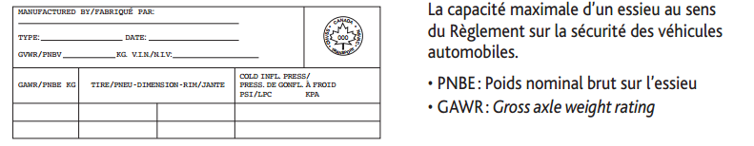
The suspension:
The suspension of a truck is used to absorb imperfections found on roads. It also helps ensure better road handling regardless of the load. However, it has its limits given the significant physical forces associated with driving a heavy vehicle. In addition to offering comfort to the driver, it must in certain cases protect the cargo, such as the transport of furniture, electronic devices or any other goods that are fragile. But, more importantly, the modern truck’s suspension is designed so that each wheel carries the same amount of support as possible, and therefore has the same traction and braking force. In the case of a set of axles, the suspension system must be designed to equalize, to the nearest 1000 kg, the mass that can be measured under its wheels at all times.
G.A.W.R.
Reference; Page 3 Load and Size Limits

Slide 3
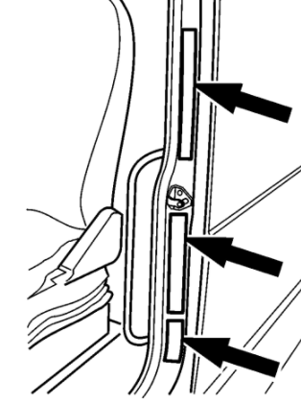
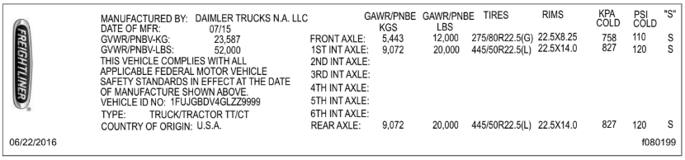
The maximum capacity of the front axle is listed on a sticker usually affixed to the driver’s door frame. It also contains the maximum weights allowed by the manufacturer of all its axles in pounds (lbs) and kilograms.(kgs)

Slide 4
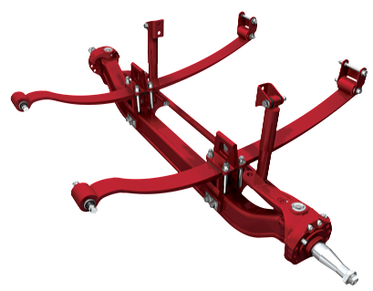
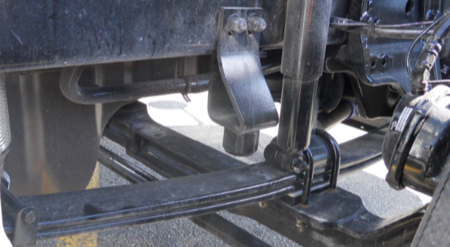
Types of Suspensions:
Leaf Spring Suspension
Steering Axle
Parts to check:
U-Bolts
Leaf Springs...

Slide 5
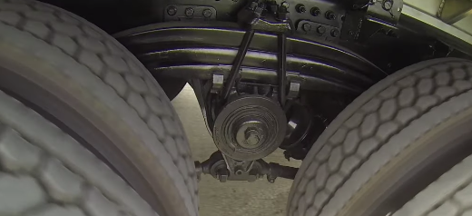
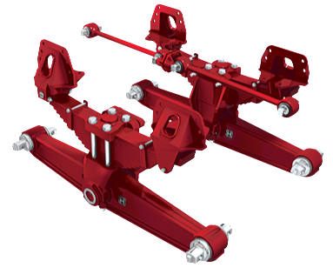
Leaf Spring Suspension
Drive Axle
Parts to check:
Reaction Rods...

Slide 6
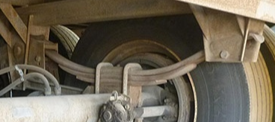
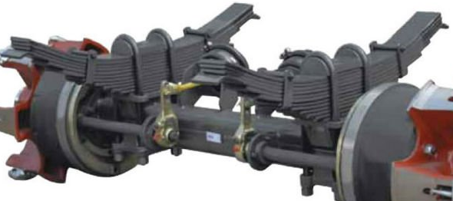
Leaf Spring Suspension
Semi-trailer Axle
Parts to check:
Suspension Supports...

Slide 7
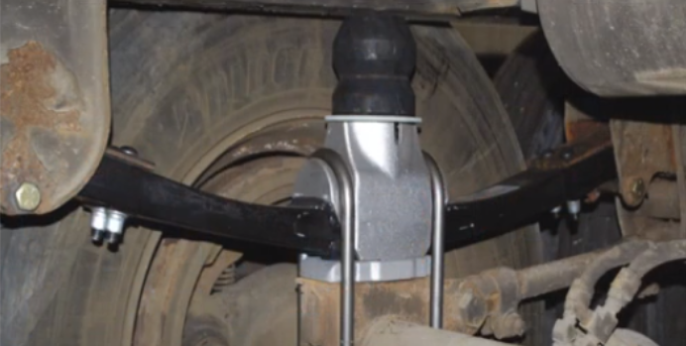
Leaf Spring Suspension (Composite)
Semi-trailer Suspension

Slide 8
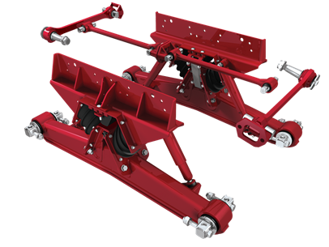
Rubber Coil Spring Suspension
Drive Axle
Parts to check:
Rubber cushions...

Slide 9
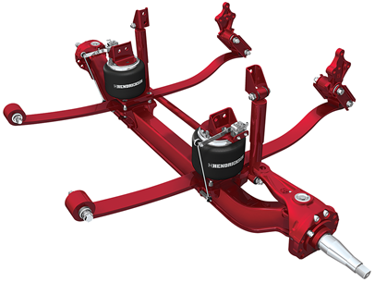
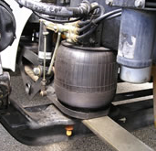
Air Springs
Steering Axle
Parts to check:
Airbags
Spring Shackles...

Slide 10
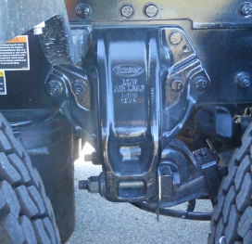
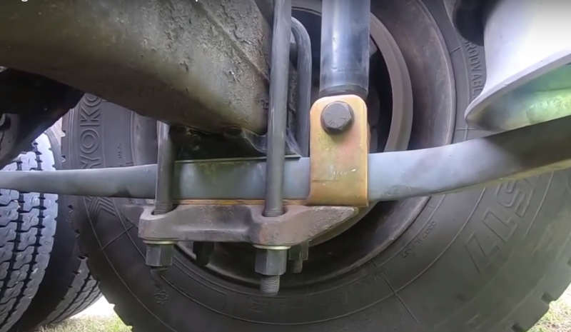
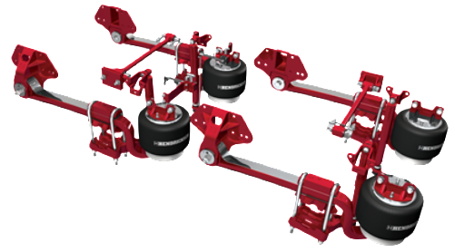
Air Springs
Drive Axle
What parts should we check?
Notes:
PIÈCES À VÉRIFIER SELON LA SAAQ

Slide 11
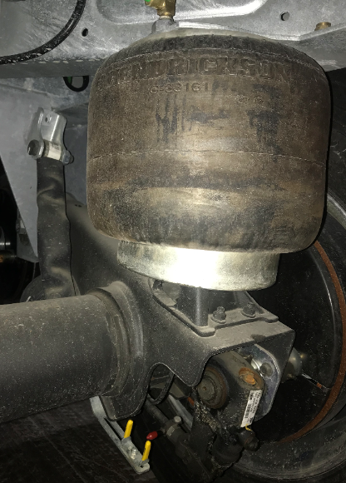
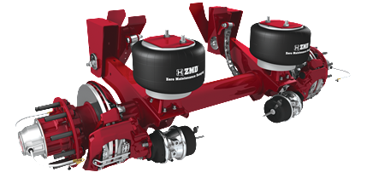
Air Springs
Semi-trailer Axle
What parts should we check?

Slide 12
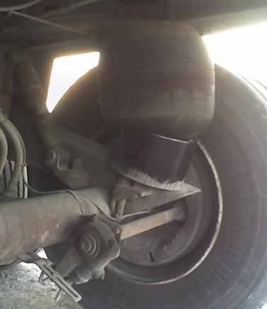
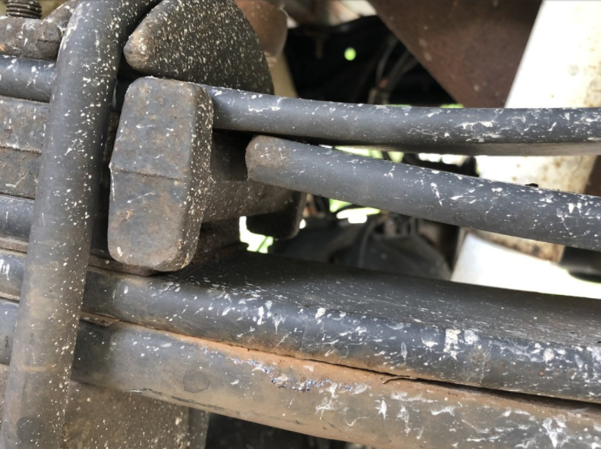
ANOMALIES (defects)
Defective Leveling Valve
Broken Leaf Spring

Slide 13
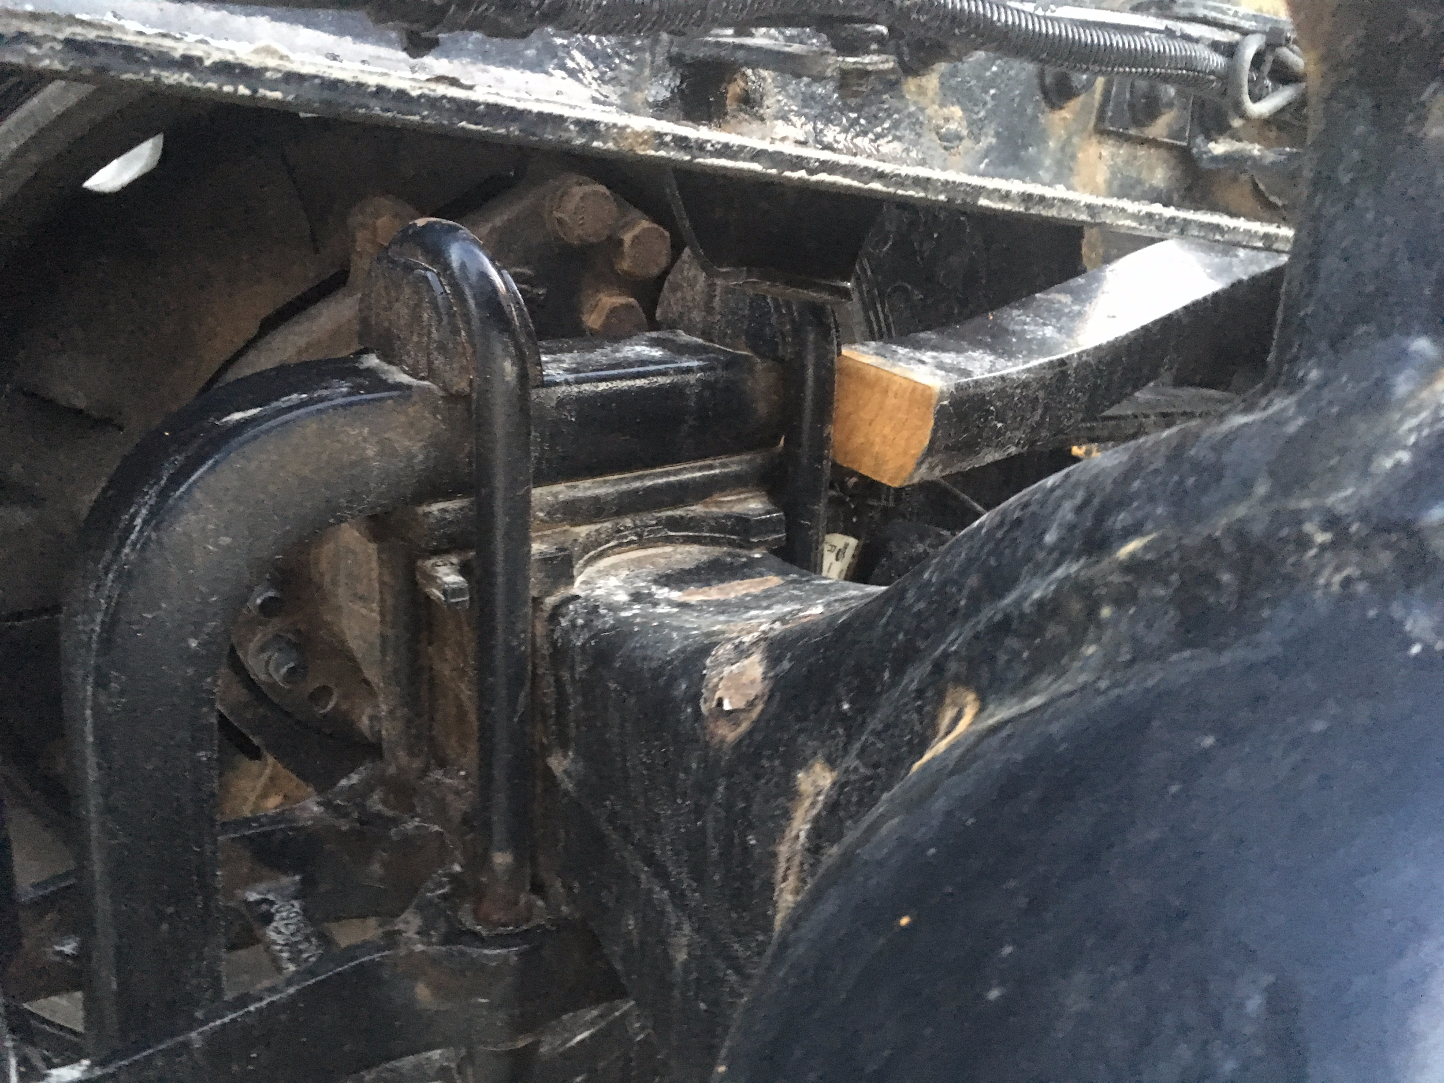
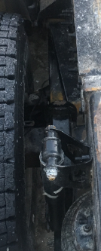
ANOMALIES
(defects)

Slide 14
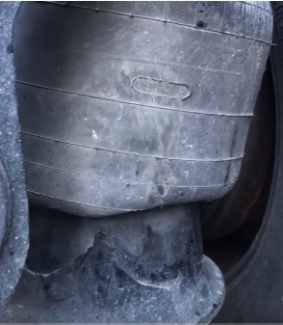
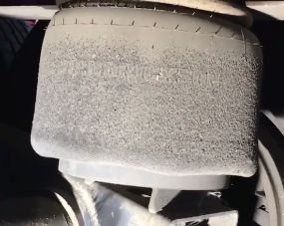
ANOMALIES
(defects)
Damaged Airbag or
Presence of an Air Leak

Slide 15
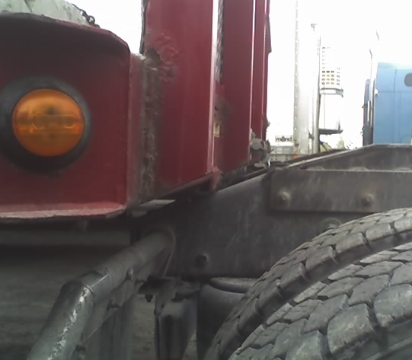

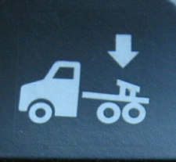
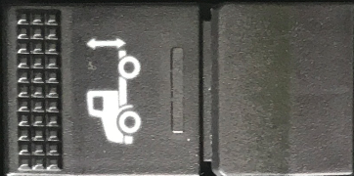
Switches:
Some switches use a similar pictogram which illustrates the vertical movement of the rear of the truck. Deflation or inflation of the suspension is controlled by the driver. The abbreviation HGT stands for the Height of the rear of the truck. The symbol ↓ or word DUMP represents lowering the suspension.
Coupling Approach
Use:
The driver will use this switch prior to uncoupling the semi-trailer. The purpose of this maneuver is to reduce the pressure inside the airbags to prevent excessive stretching of the entire suspension. The pressure of the airbags and deflation time is proportional to the weight that is in the trailer. This switch can also be used EXCEPTIONALLY when the semi-trailer is to low to hitch (coupling). Use Caution!

Slide 16

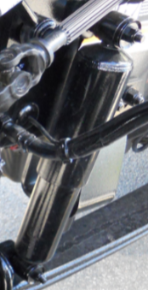
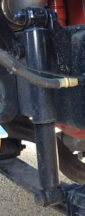
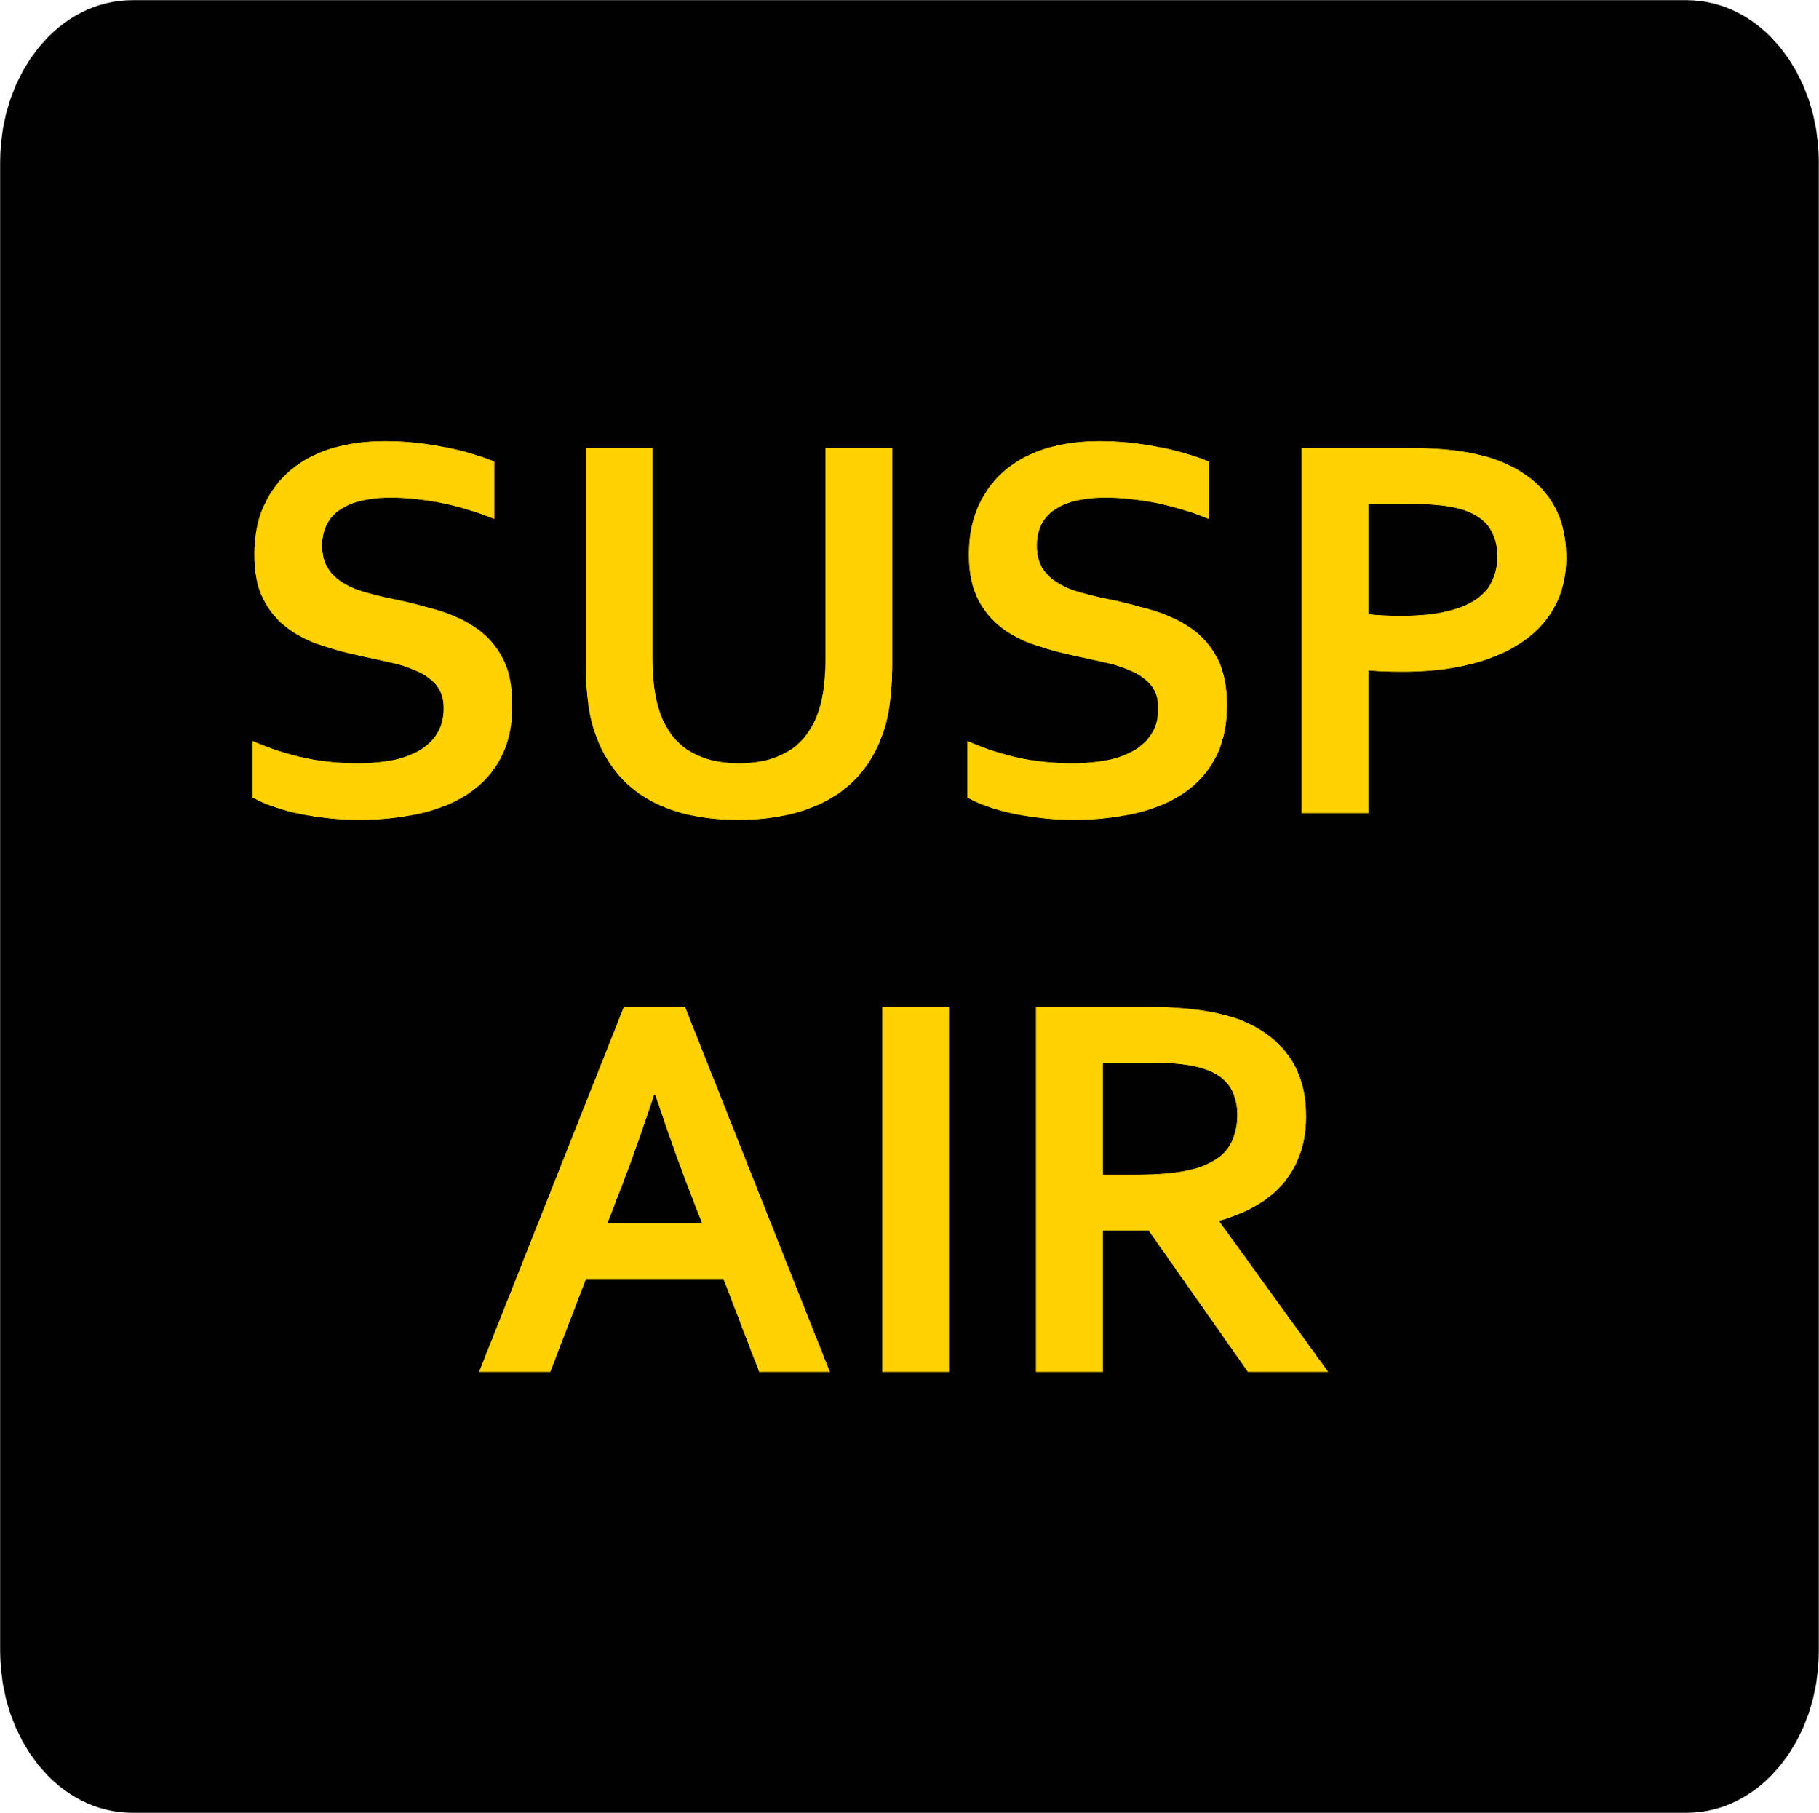
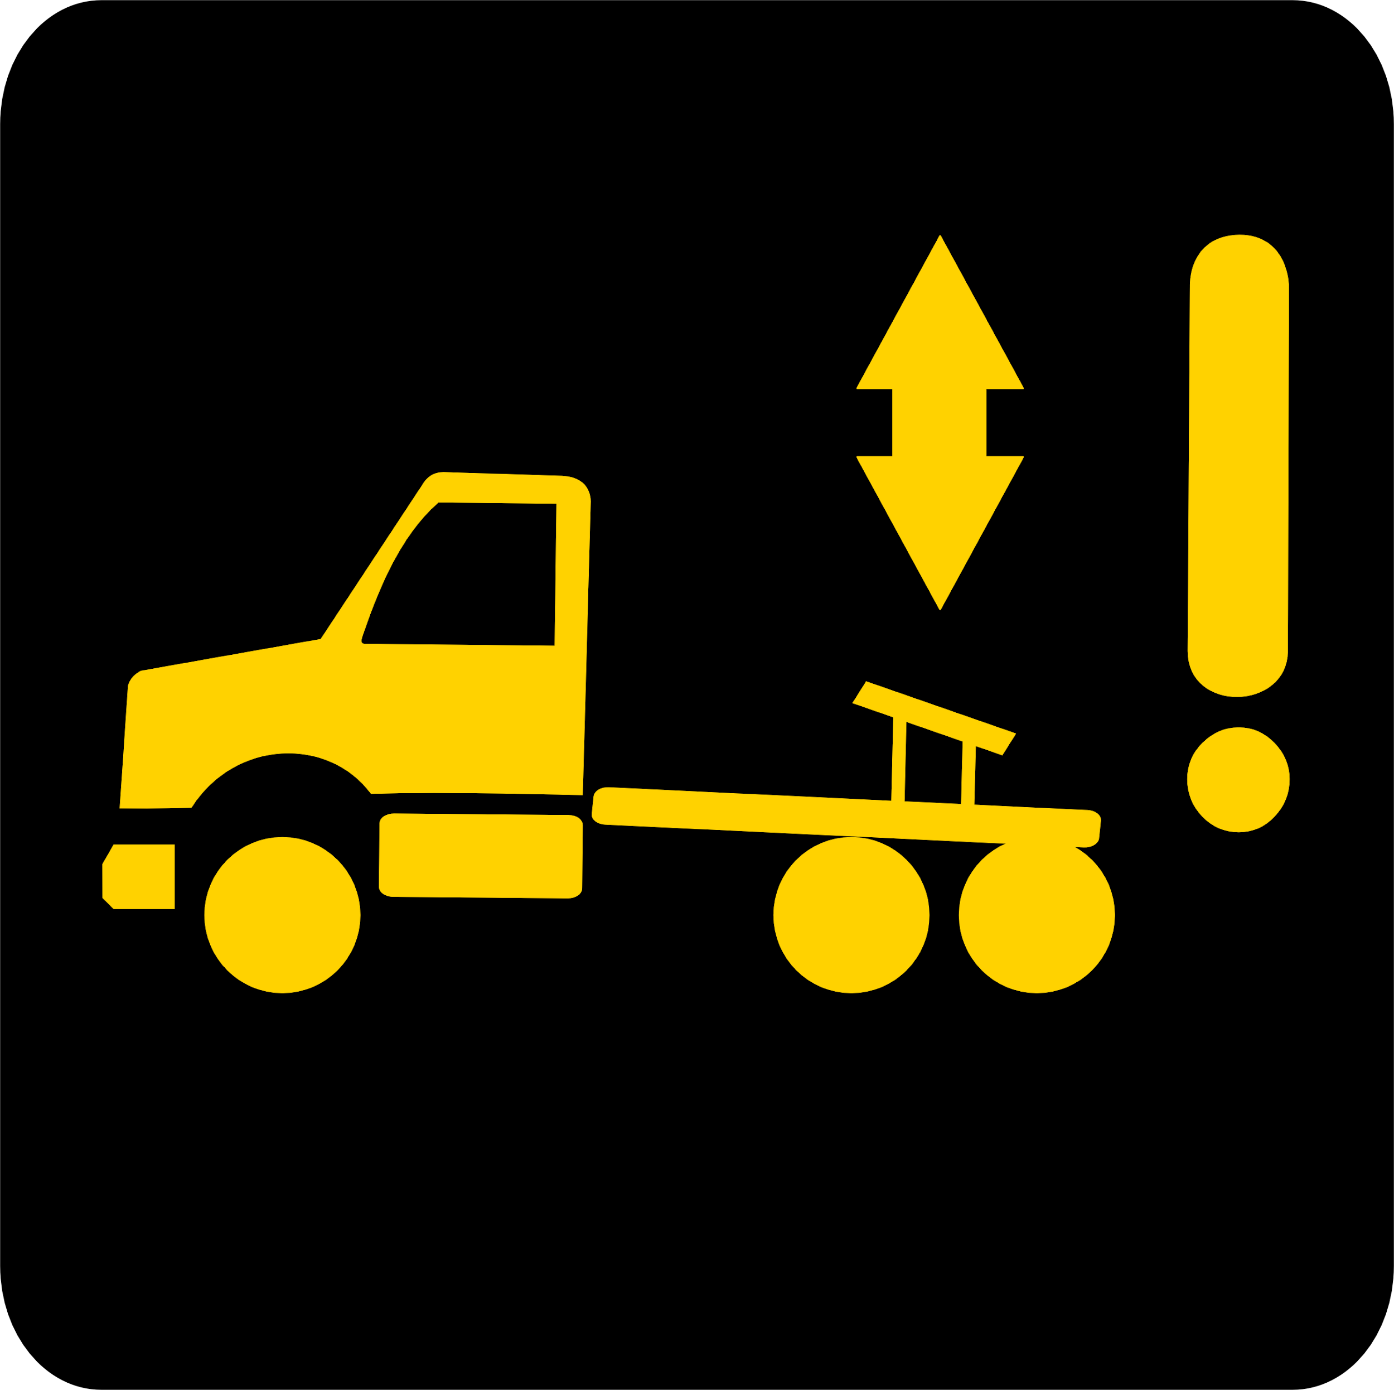
Shocks
Role:
Absorbs the oscillatory (repetitive motion) movements of the suspension springs and thus improves the stability and handling of the vehicle.
Warning Lights
Some warning lights are integrated into the switch itself, while others will be visible in the dashboard or directly in the multifunctional display These remind us that the suspension is lowered.
Verification: Leaks and fixations

Slide 17
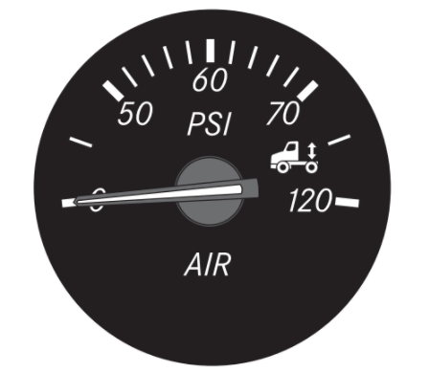
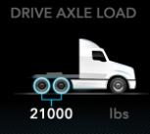

Warning Lights
The first type, in the form of a pressure gauge, shows the air pressure in PSI present in the (deflated) airbags of the truck. The second indicator shows, like a scale, the approximate weight in KG under the rear wheels. So here it shows 3 700 kg for a tractor bobtail. The equivalent pressure in PSI is usually 10. Finally, the last gauge , multi-functional display, simulates a mass of 21000 lbs (loaded truck) on the drive axle.

Slide 18
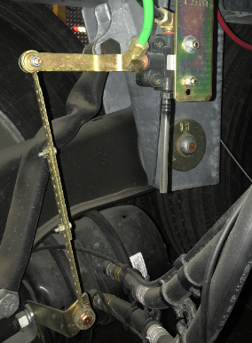
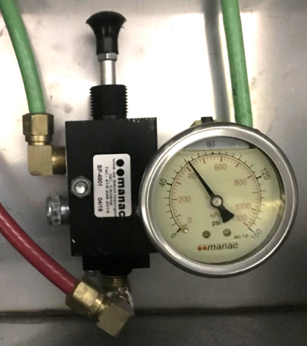
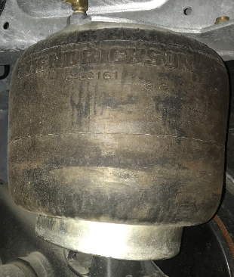
Control Valve
All axles or groups of axles with an air suspension have a least one control valve. The latter keeps the vehicle constantly at the same level. Thus, the more the load is increased on the vehicle, the more the air pressure will increase in the airbags.
Semi-trailer control valve
The semi-trailer control valve allows, just like the switch on the instrument panel, the activation of the air suspension. Both the inflation and deflation can be operated manually or automatically.

Slide 19
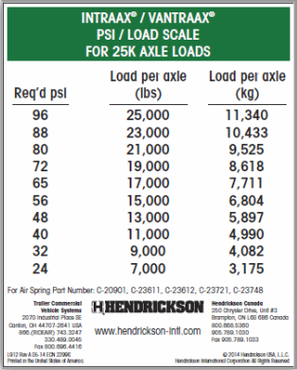
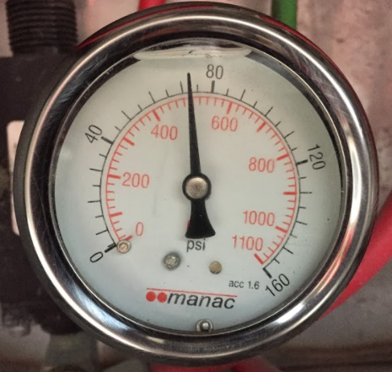
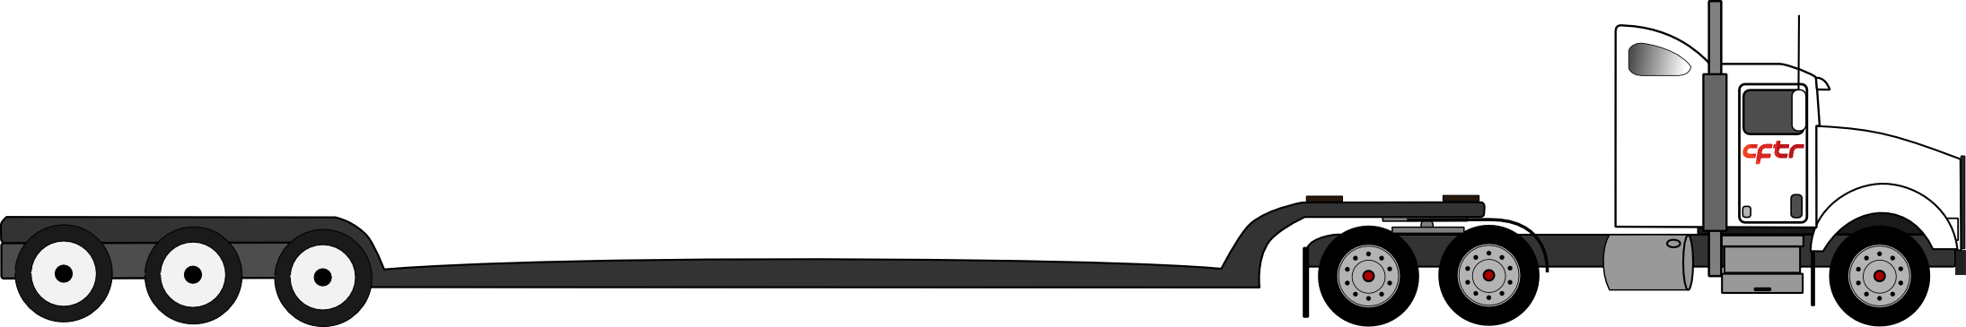
Use
In addition to the pressure gauge, the semi-trailer control valve box, generally provides an equivalence chart. This allows the approximate determination of the mass under the wheels of the semi-trailer..
For example: When a pressure gauge indicates a pressure of 72 PSI, this equals a mass of 8 618 kg/axle or ( multiply by 3 axles) a combined weight of 25 854 kg
(3 axles)

Slide 20
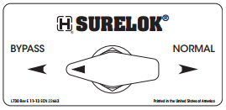

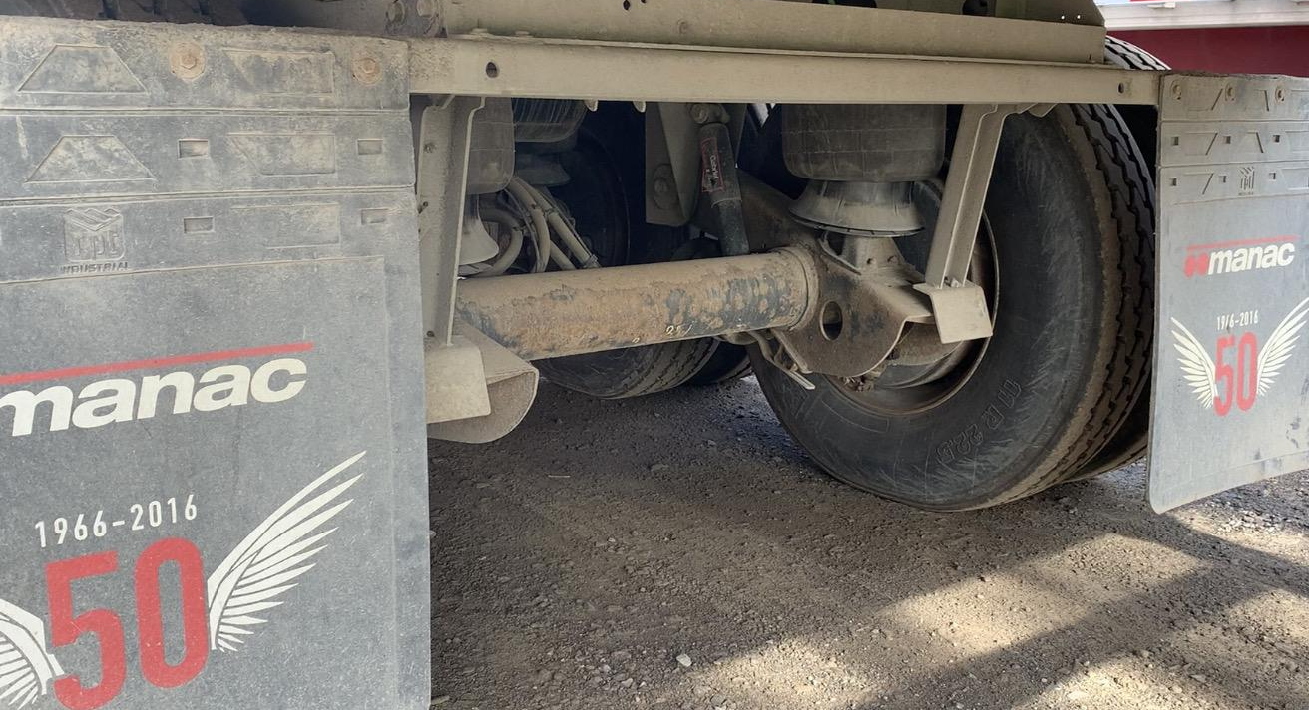
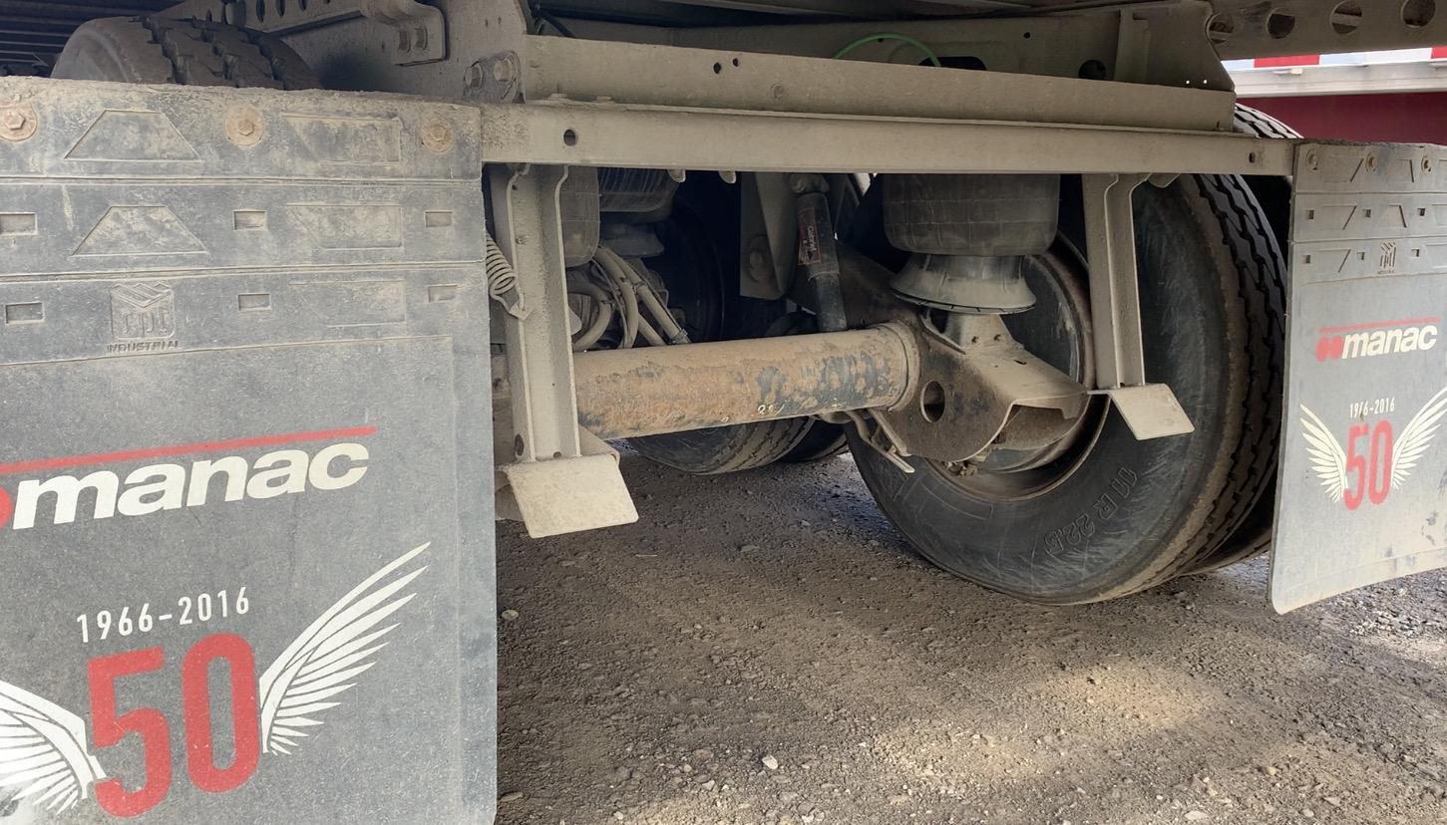
Optional Equipment
Some semi-trailer suspensions are equipped with an anti-deflation mechanism called SURELOK. This mechanism helps prevent the suspension of a stationary semi-trailer from sagging and moving unexpectedly forward “Dock walk”. Thus, as its name suggests, it will benefit from a higher loading threshold when the configuration of the dock requires it. In addition, it increases the life of the landing gear (stationary loaded trailer) and bumper stops. It seems that most transport carrier rarely equip their trailers with BYPASS valve.
Surelok Demo
Parking Brake Applied
Parking Brake Released “bypass”
Notes:
Cliquez sur le pictogramme vidéo pour voir le fonctionnement avec une vidéo.

Slide 21
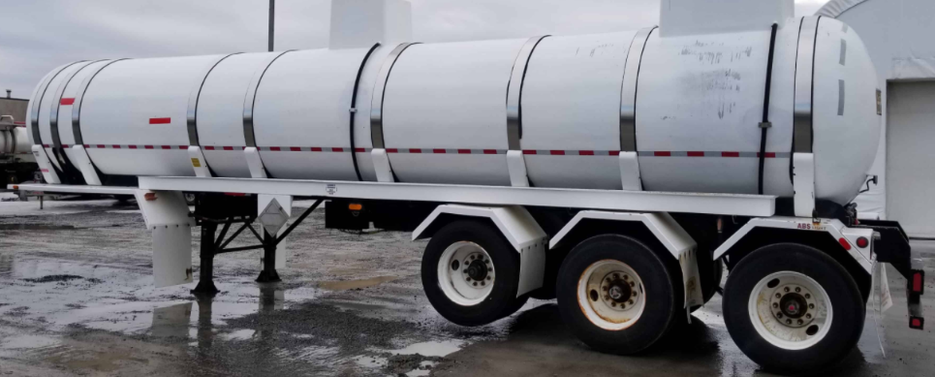

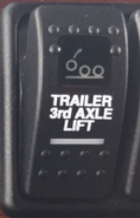
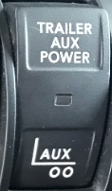
Lift Axle
The lift axle of a semi-trailer is an optional configuration available on certain semi-trailers. The primary function of this is to support more load on the equipment versus a tandem axle. When installed on the front axle of a tri-axle trailer, the driver has the option to use the switch “Trailer Auxiliary” to reduce the pressure in the airbags of that axle (lift axle) during a tight turn. This will prevent damage to your lift axle. In addition, it can be kept in the upright position when the transported load requires fewer axles on the ground (less weight in trailer).
Switches

Slide 22
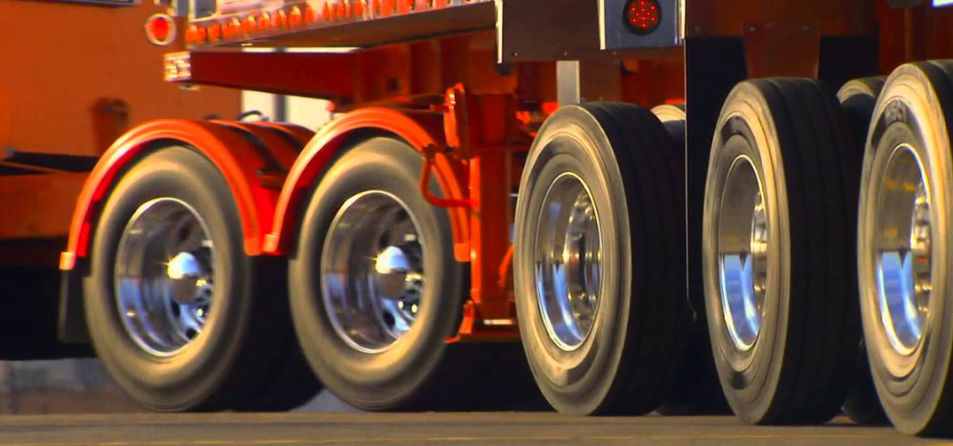
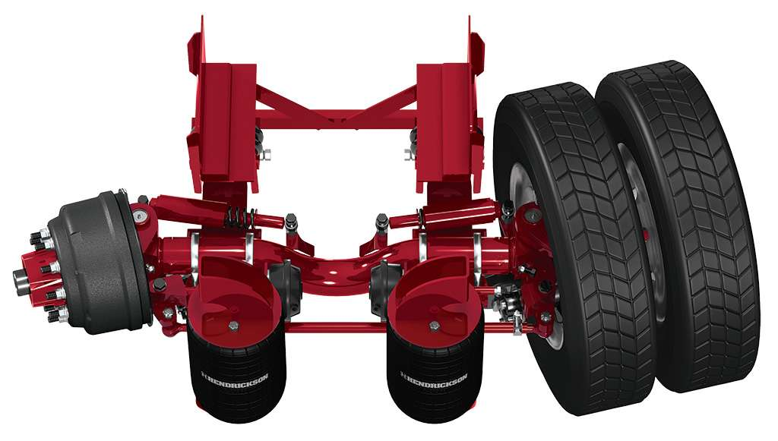
Self-Steering Axle
The self-steering axle, as its name suggests, turns automatically following the movement of the equipment. On a semi-trailer, it is installed at the front of a tri-axle group (in Quebec) and can be fitted as a single or twin assembly. It is constantly on the ground during turns, of course, when the load being carried requires its presence. However, it must be raised when backing up, not to damage its internal parts. It can be raised either automatically by a mechanism or by the intervention of the driver (switch on dashboard).

Slide 23
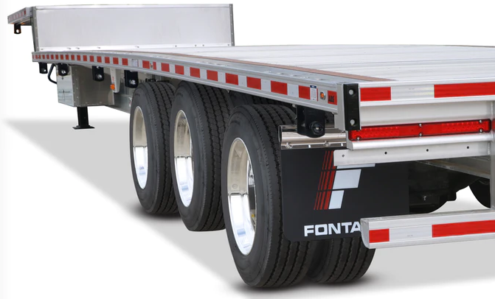
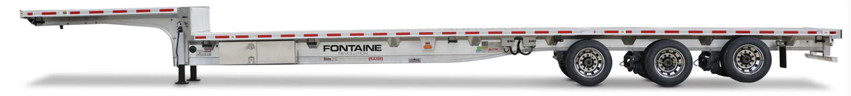

Load-bearing Axle
This is an axle installed on a semi-trailer fitted with an automated “SMART LIFT AXLE” control device, which raises the axle when the load exerted on it is insufficient. Thus, the system operates completely automatically without any intervention from the driver. This system therefore makes it possible to reduce operating costs related to the suspension, tires and even fuel consumption. Currently in Quebec, it requires a special permit to circulate on public roads.

Slide 24
Index:
Suspension: Set of vehicle components which provide the flexible connection between the chassis frame and the axles.
Air Spring: Rubber device, with variable flexibility that replaces leaf springs in an air suspension. Common term: Airbag suspension.
Pneumatic suspension: Suspension with air springs (airbags). Common term: Air suspension
Load-bearing axle: Set of wheels arranged symmetrically on the same axle beam, intended to support part of the load.
Steering axle: It is a shaft to which the wheels of a vehicle are mounted. This bushing or bearing allows the wheels to rotate without the axle itself.
Single axle: Comprising of 1 sole set of wheels.
Tandem axle: Comprising of 2 sets of wheels. (Must balance at 1000 kg or less).
Tri-axle: Comprising of 3 sets of wheels equally spaced and attached to the same suspension. (Must balance at 1000 kg or less).
Self-turning axle: Auxiliary axle with a fixed central beam of which is fitted with a spring device allowing them to adapt to the trajectory of the vehicule.
Center lift axle: An axle that can be lowered to increase the weight capacity or to distribute the weight of cargo over more wheels.Common term: Airlift axle

Slide 25
THANK YOU
FOR YOUR
PARTICIPATION

