Slide 1
Competency 2 Lesson 2.5.3
Wheels

Slide 2
Wheels
Objectives of the lesson:
Recognize the different types of wheels and their condition.
Recognize the different types of hubs and their condition.

Slide 3
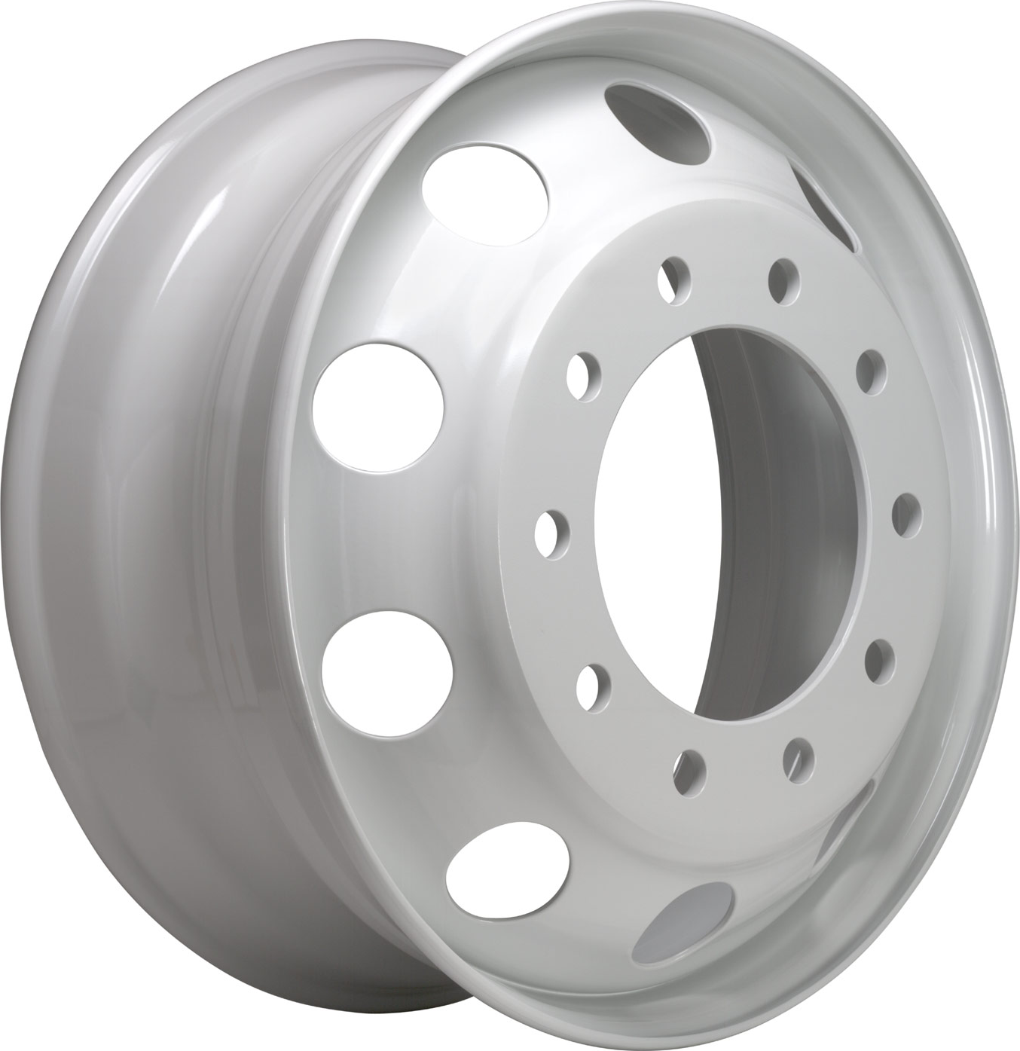
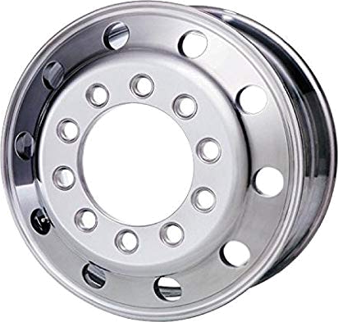
Rims
Definitions:
Duel Wheels: Wheels mounted in pairs on either side of a rear axle of some heavy vehicles.
Drive Axle Wheels: Wheels mounted on a drive axle.
Steering Axle Wheels: Wheels mounted on a steering axle.
Disc Wheels (common name: Budd Wheel)
Rim: Circular part of the wheel where the tire sits.
Steel Wheel
Aluminium Wheel

Slide 4
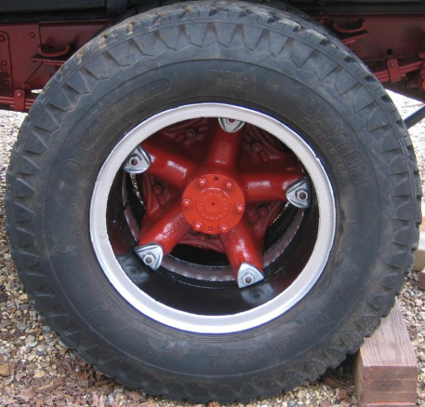
Spoke Wheel
Spoke
Lug Nut
Stud
Rim
Notes:
Type of wheel... very limited use for several years. (Optional)

Slide 5
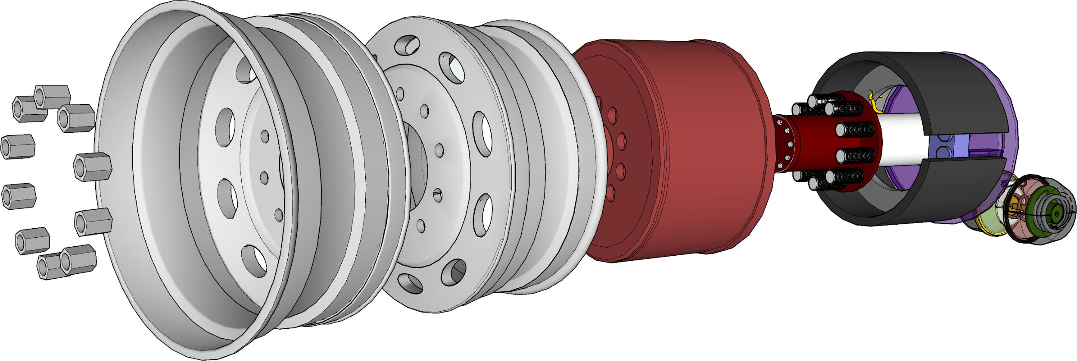
Duel Wheel Assembly
Pieces to identify: Lug nuts, rims, brake drum, hub, brake shoes, etc.

Slide 6
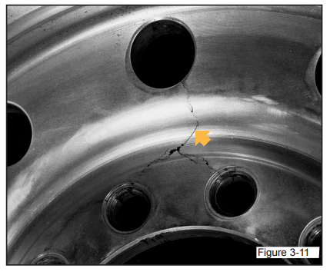
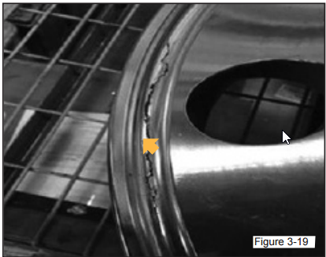
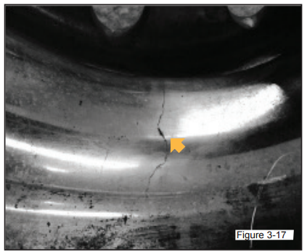
Disc wheels Inspection
Check for CRACKS.

Slide 7
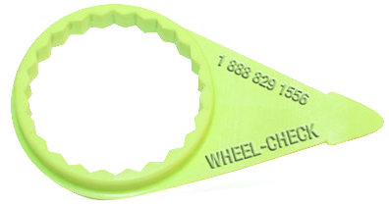
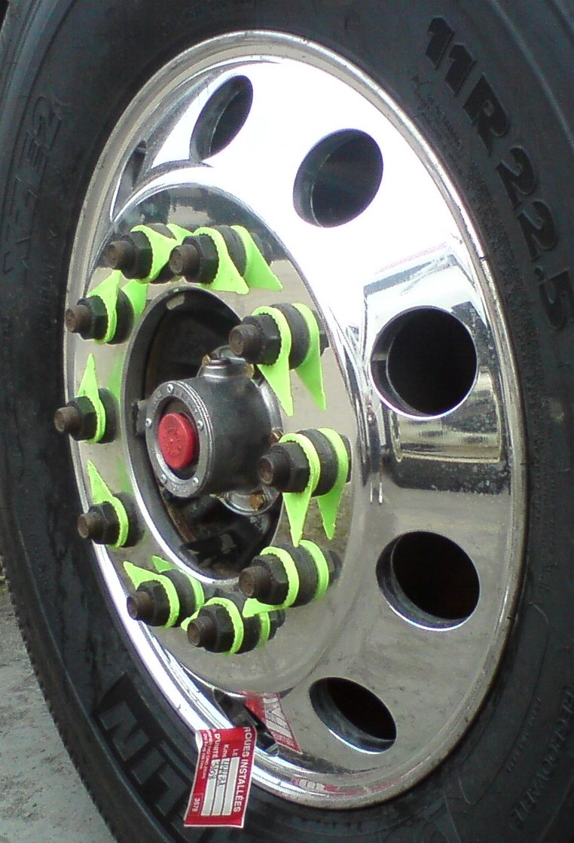
Loose or missing lug nuts
A heavy vehicle with loose or missing lug nuts cannot be driven until the repair is made. Tightness indicators, such as those shown in the following illustration, are very useful to the driver, while performing his Circle Check.
If one of them is no longer aligned, it is easy to recognize the defect. Rust marks around the bolts on a steel wheel are also a good indication that a lug nut is loose.

Slide 8
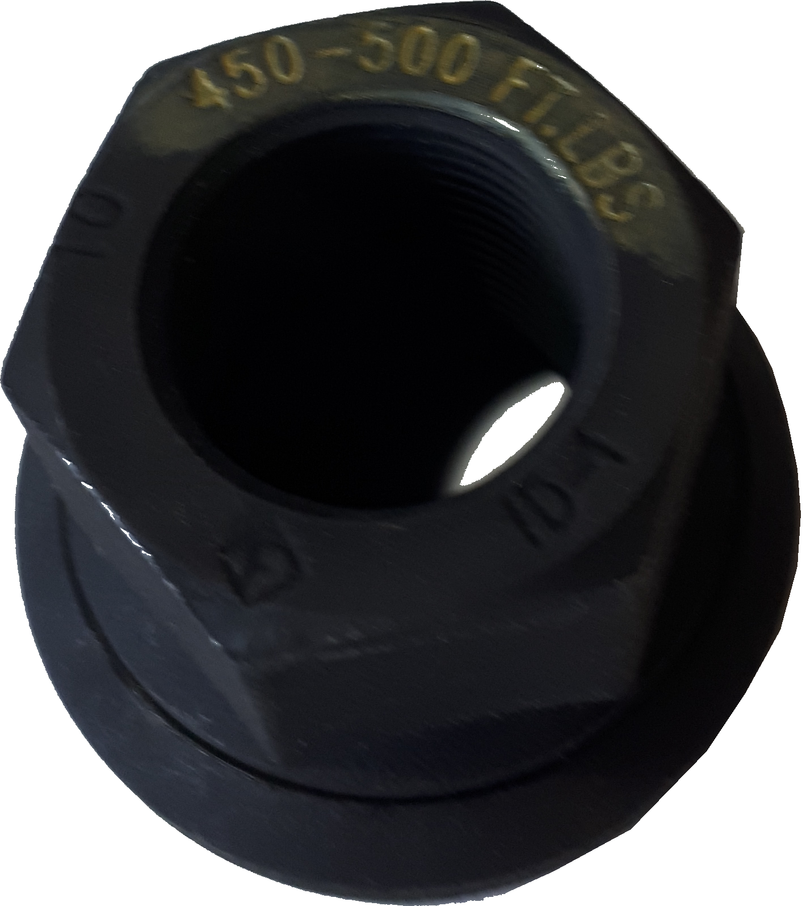
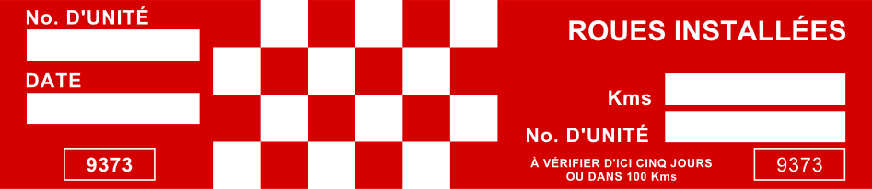
Retorque Labels
When this label is affixed to the valve at CFTR, it indicates that this wheel has been recently installed. For safety reasons and/or to comply with the law and regulation of the province, all newly installed wheels must be re-tightened (retorqued) to the torque set by the manufacturer. In the following example, you have the obligation as a driver, to have the wheels retorqued (re-tightened) within 5 days or 100 km whichever one comes first. Using a torque wrench, set the wrench between 450-500 lbs, according to the specifications from the manufacturer and tighten each lug nut individually.
Obviously, policies and procedures differ from company to company. It is the owner’s responsibility to ensure its application.

Slide 9
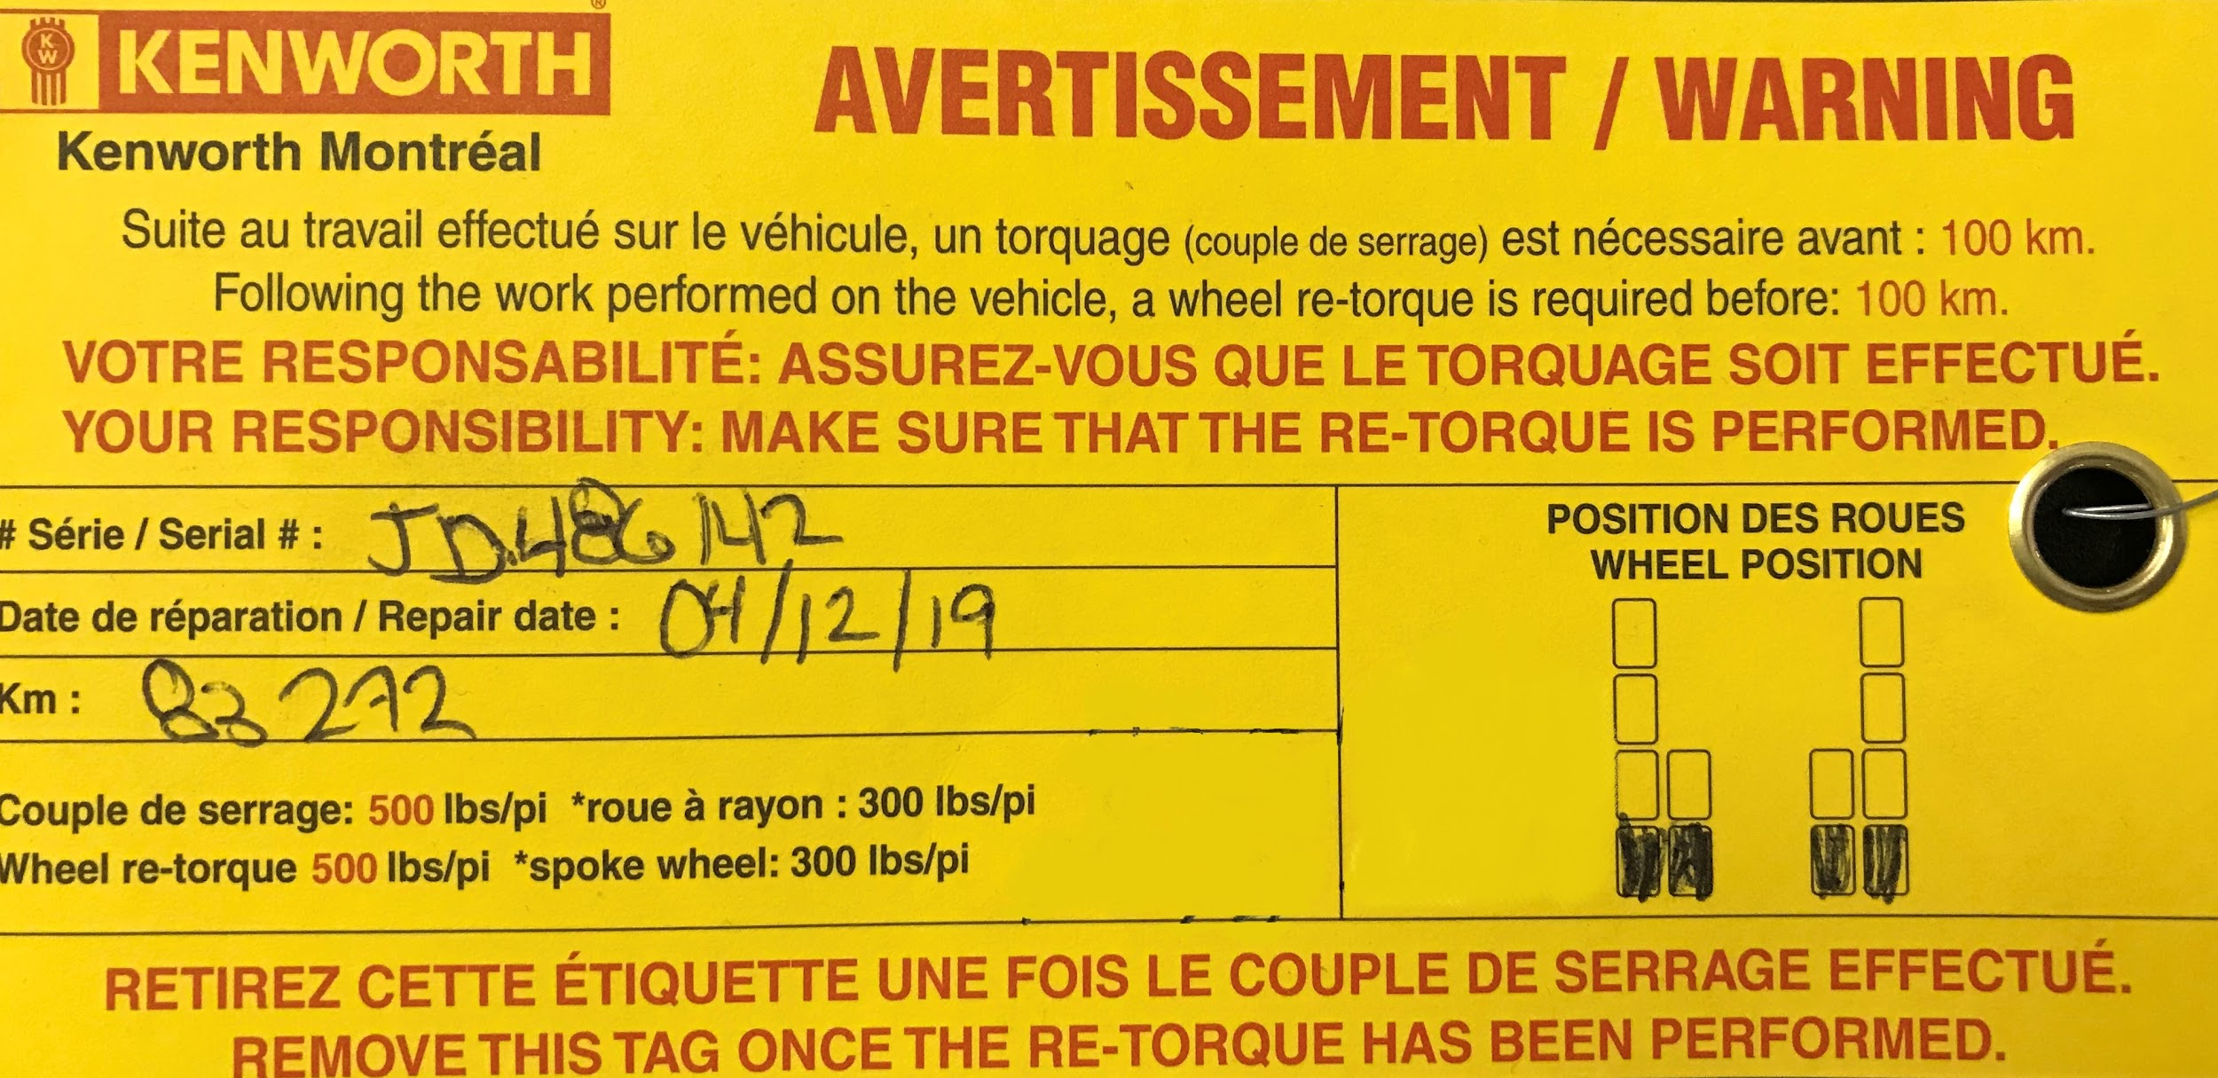

Slide 10
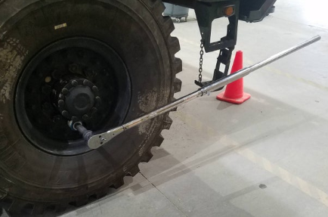
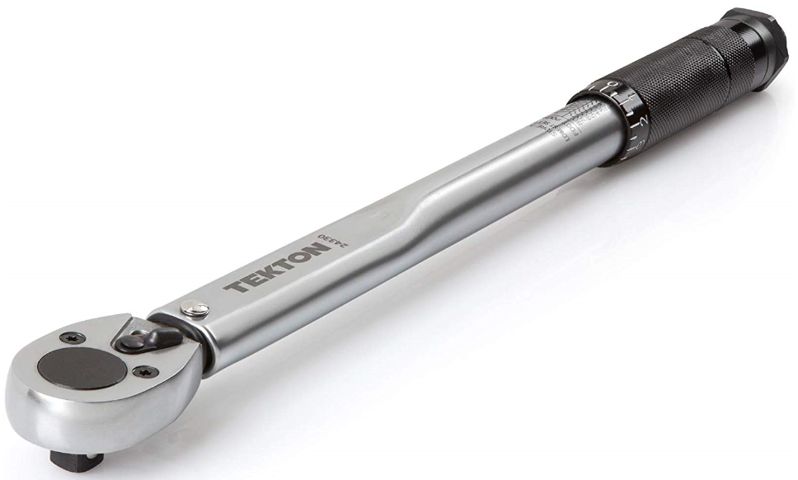
Torque Wrench

Slide 11
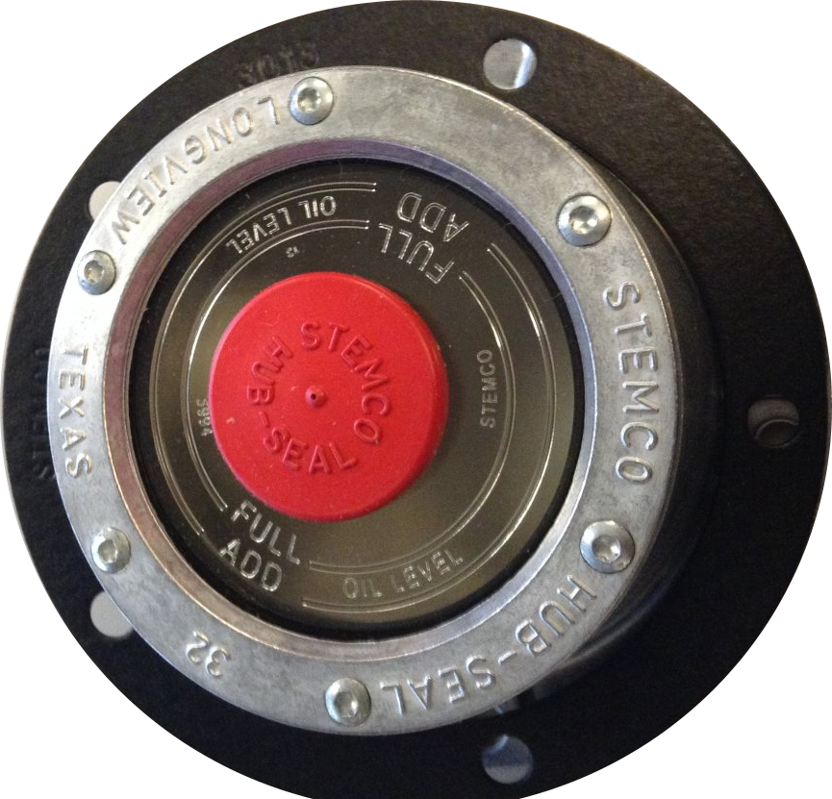
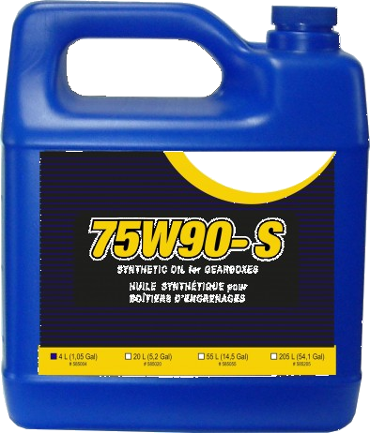
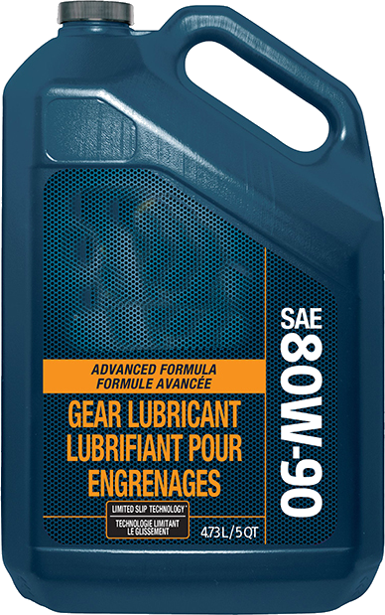
Suitable fluid to add to oil lubricated wheel hubs.
Two types that are used:
Synthetic gear oil with a viscosity of 75W90.
80w90 grade mineral oil can also be used.
Follow the manufacturer’s recommendations or consult the mechanic.
These oils have a peculiar smell which makes it easier to detect leaks during the Circle Check. Leaks can occur on either side of the wheels, hence the importance of checking both sides when possible.
Notes:
75w85 synthetic oil is now more present in some automated transmissions.
Discuss how fragile the plastic around the cap and the rubber cap itself (easy to break especially in cold temperatures).

Slide 12
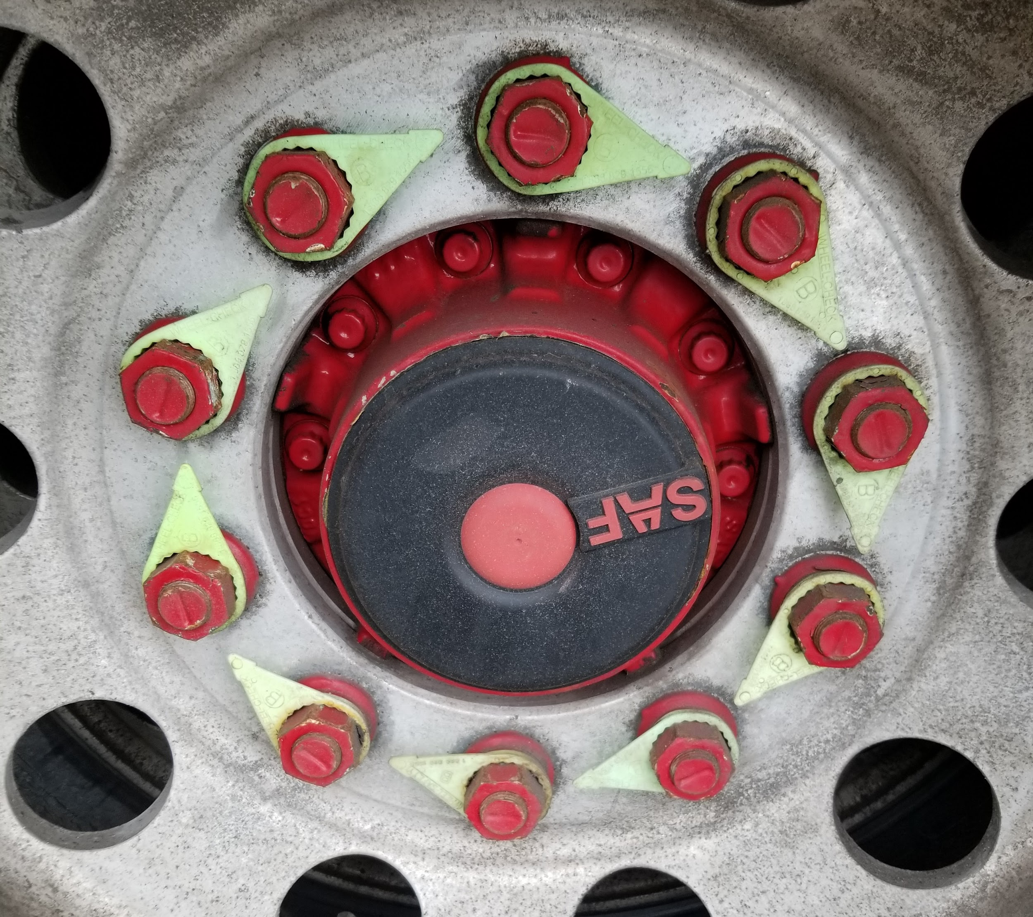
Sealed wheel hub are lubricated with a semi-liquid grease, therefore no risk of leakage.

Slide 13
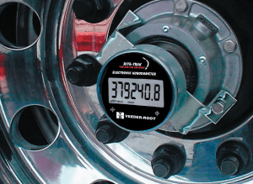
Odometer mounted on a semi-trailer wheel hub
(common name: Hubodometer)
The mileage must be indicated in the Circle Check Report. IMPORTANT: The presence of a Hubodometer is not an obstacle for not checking the oil level in the hub.

Slide 14
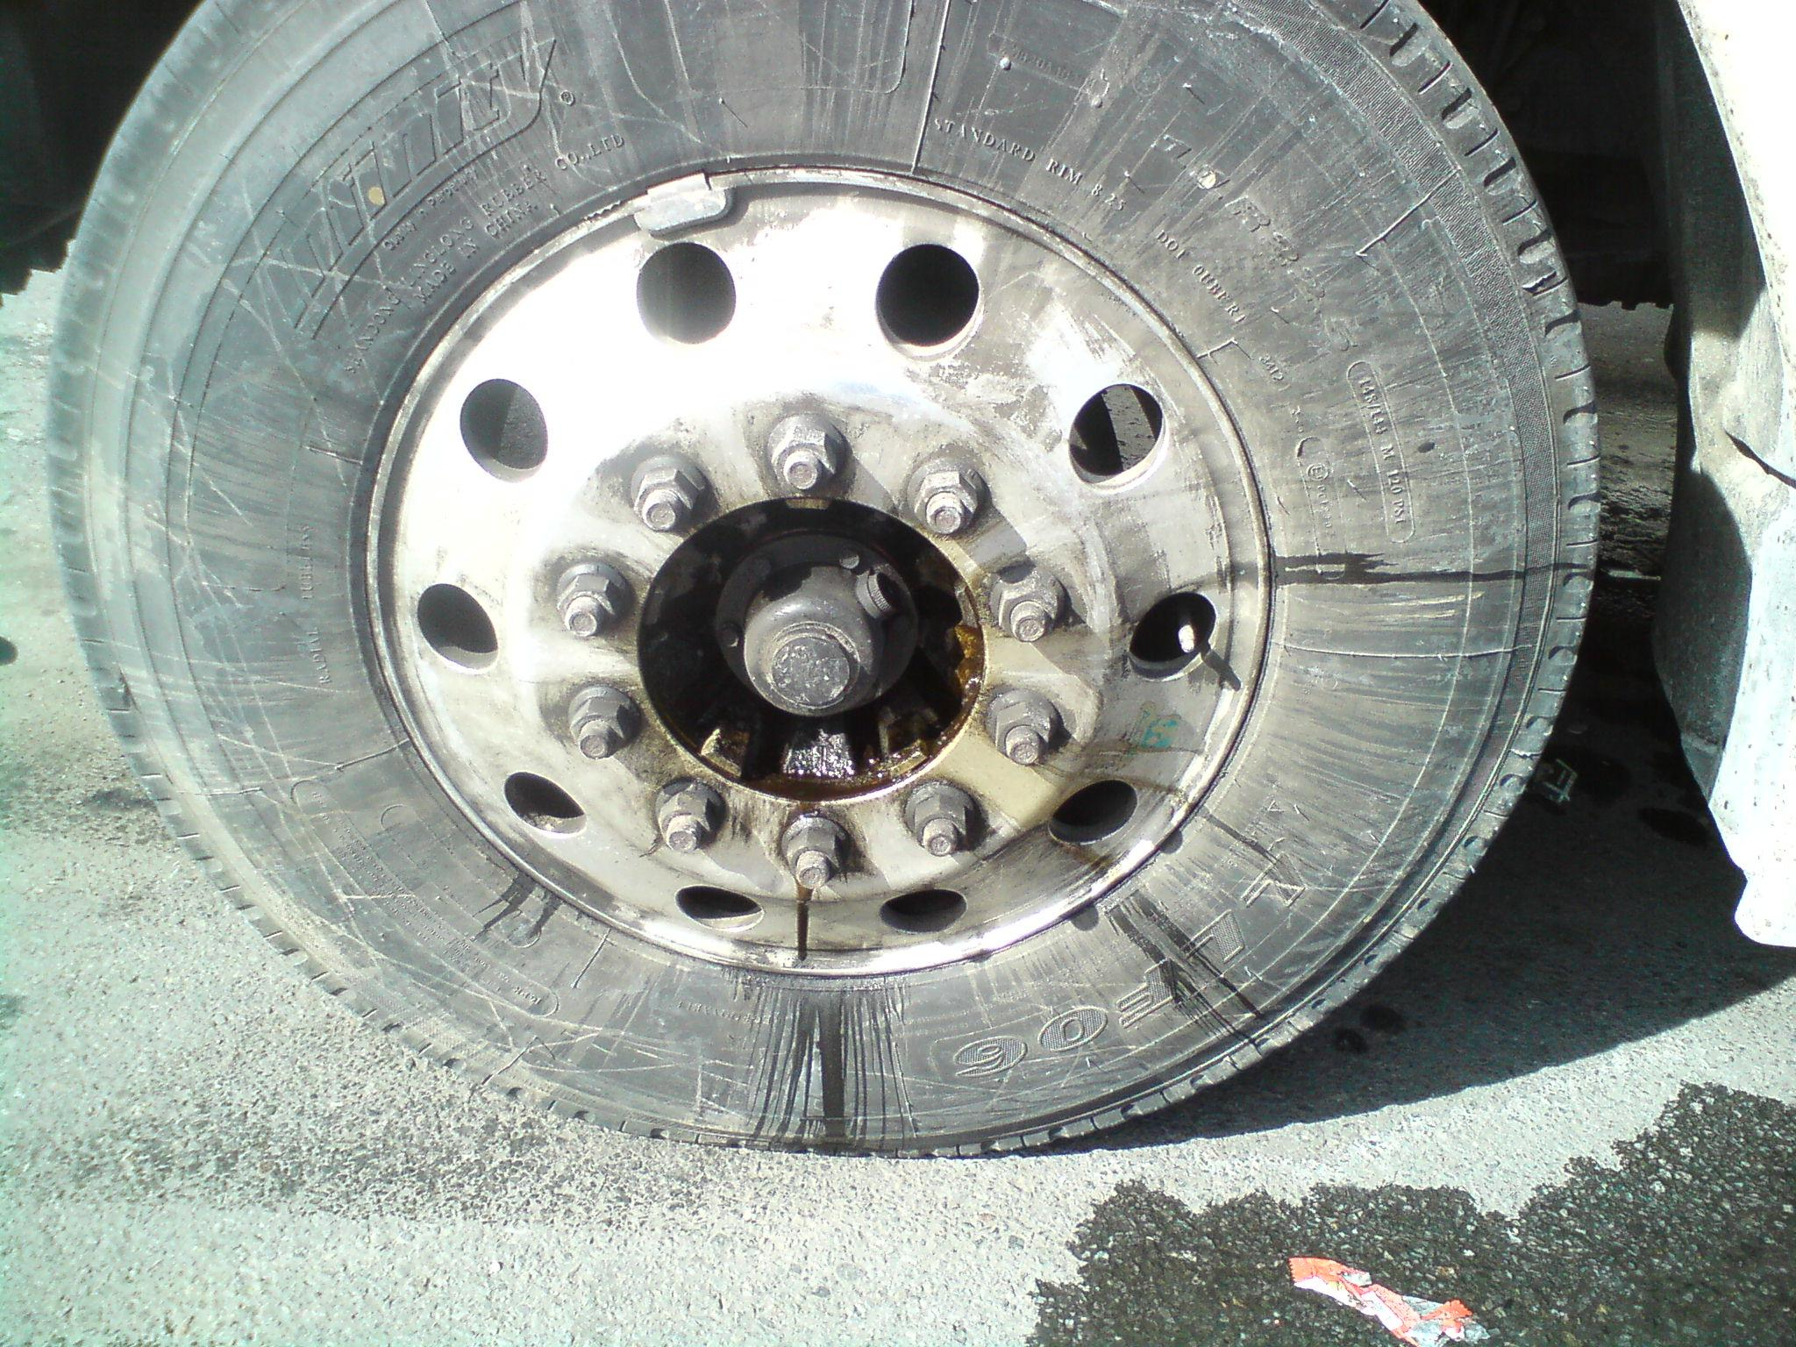
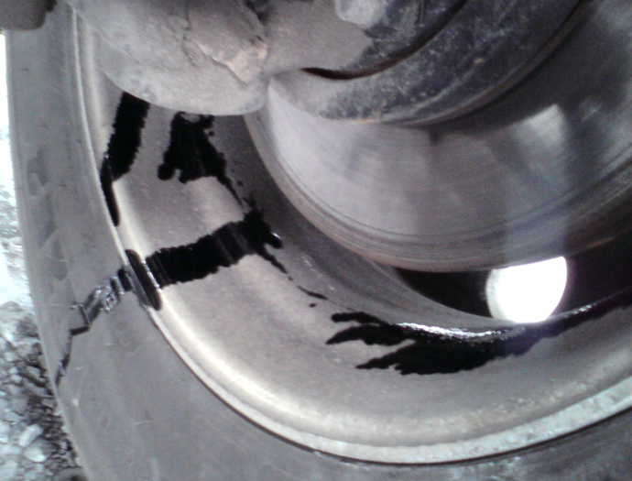
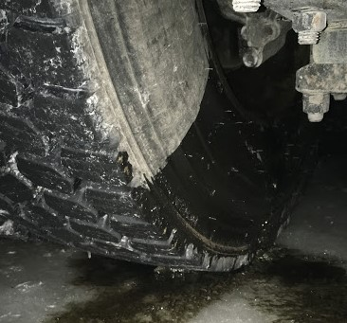
Examples of defects caused by gasket leaks:
Fuite extérieure
Fuites intérieures
Exterior Leak Interior Leak
It could be very dangerous to drive with a wheel hub without the presence of any oil. Lack of oil can destroy the wheel bearing, resulting in wheel lose.

Slide 15
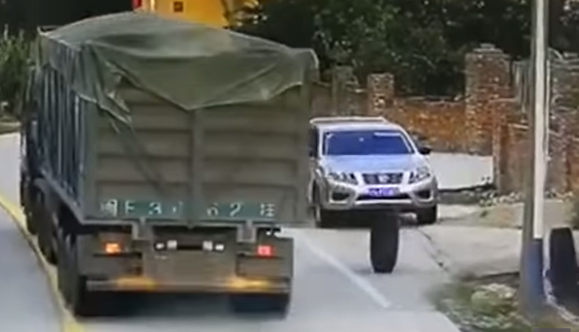
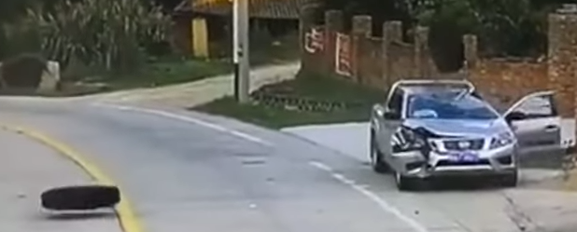
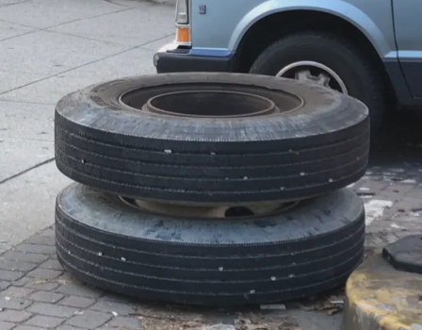
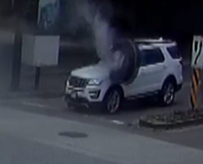
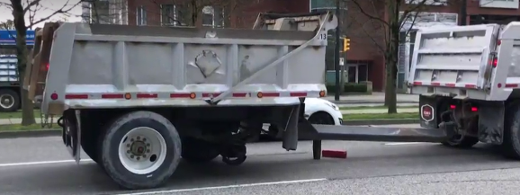
Loose Lug Nuts
LOSE OF WHEEL
Poorly Lubricated Bearings

Slide 16
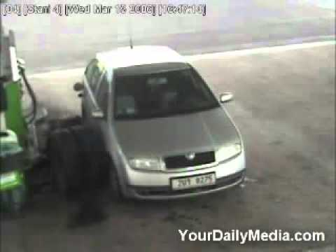

Slide 17
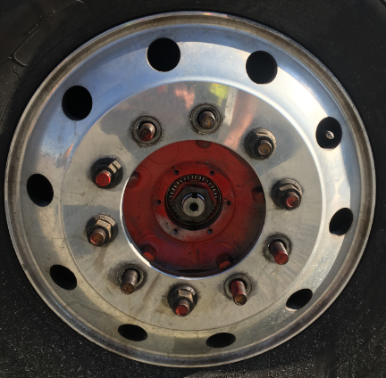
Anomalies (Defects)
What are they?
Recommendation:
When stopping or taking a break, it is important to walk around your vehicle to detect any irregularities. Including a check of the wheels and lug nuts.
Before losing a wheel, the mechanical parts can show you... IT’S UP TO YOU TO SEE THE SIGNS!
Notes:
Discuss the frequency of checking the wheels, lug nuts during stops.

Slide 18
Thank You
for your participation

