Slide 1

Competency 2 Lesson 2.5.2
Tires

Slide 2
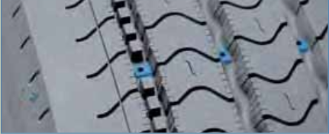
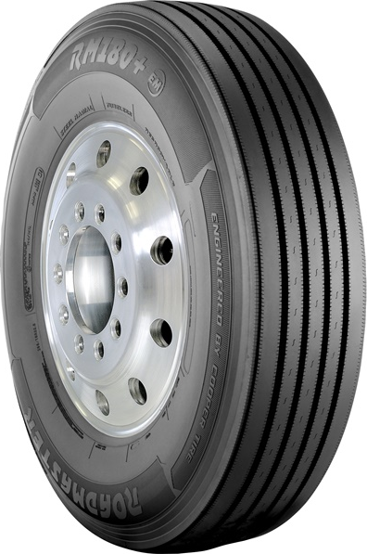
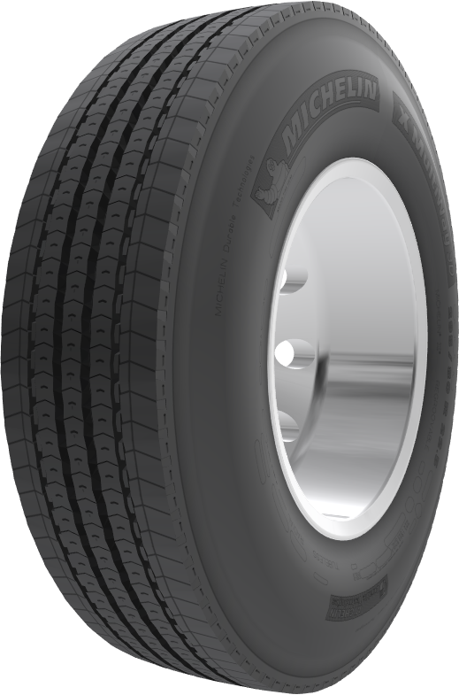
Parts of a Tire
Tire Tread
Tire Treads
Tire Wear Indicator
Outer Sidewall
Inner Sidewall

Slide 3
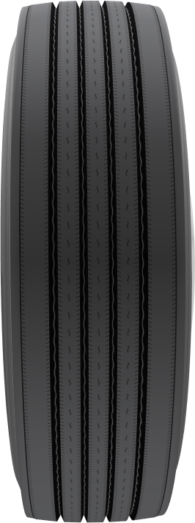
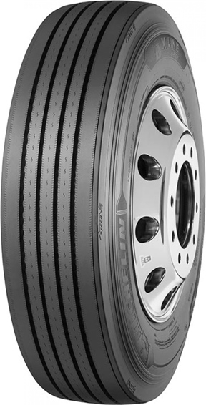
Steering Tire

Slide 4
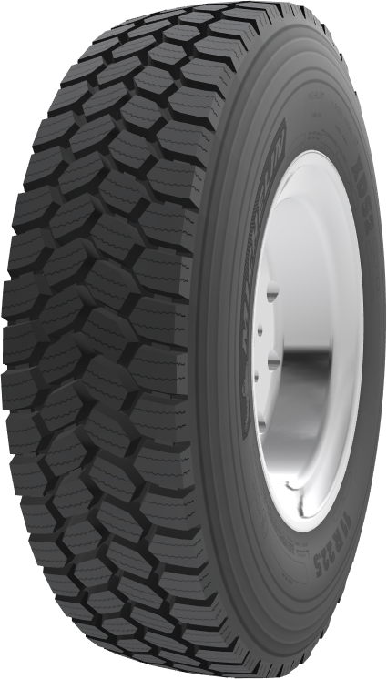
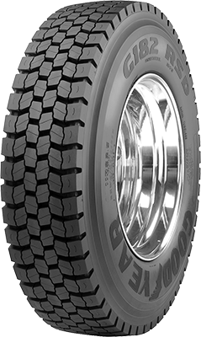
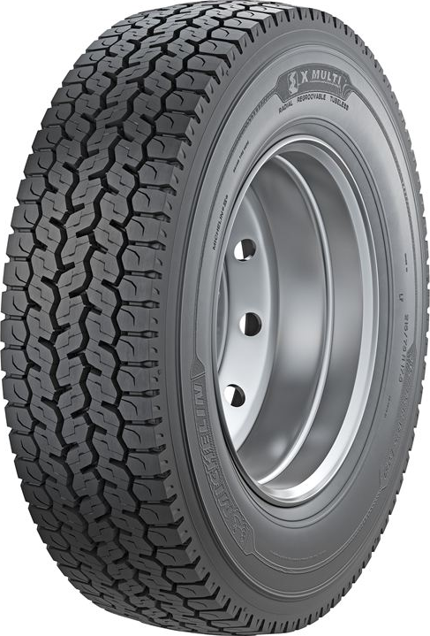
Drive Tires

Slide 5
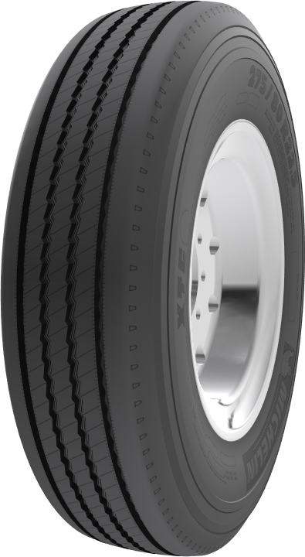
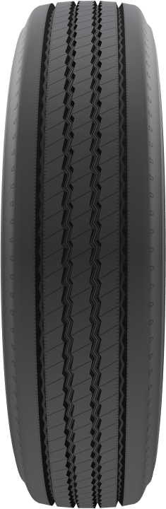
Trailer Tires
Notes:
Steering axle tire wear marks are 4/32 and 2/32 for a semi-trailer

Slide 6
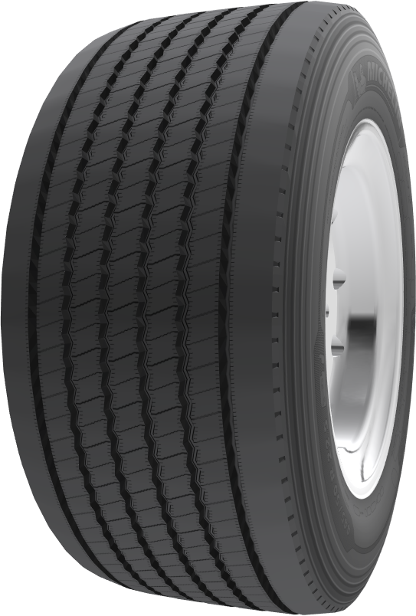
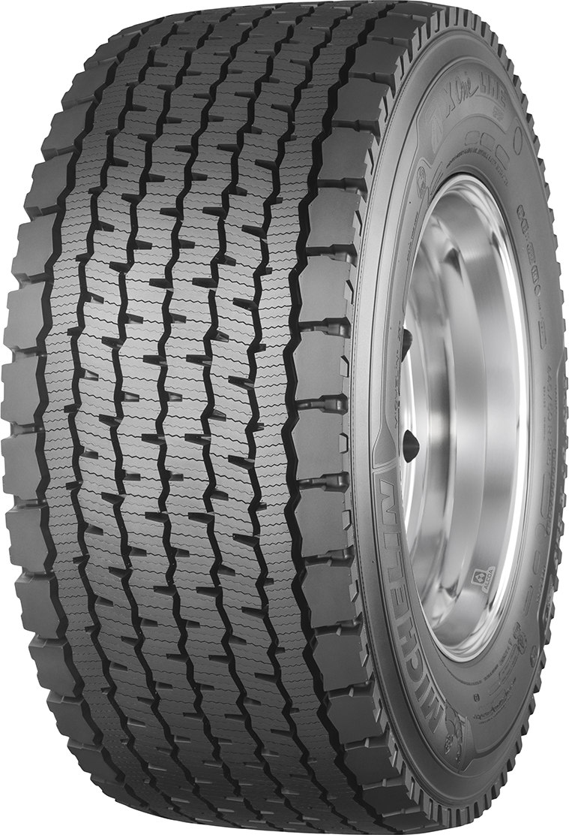
Double Wide single tires (X One) for drive tires and trailer tires
Notes:
The wear marks are 4/32

Slide 7
Retreaded Tires (recaps)
There is also a type of tire called a retreaded tire or recaps. This is a used tire with a new tread glued to its casing for cost savings. All tires seen before can be retreaded. However, in Quebec, the law does not allow them to be used on the steering axle of a heavy vehicle. A casing can be retreaded up to three times according to Bandag (specialist in tire retreading).

Slide 8
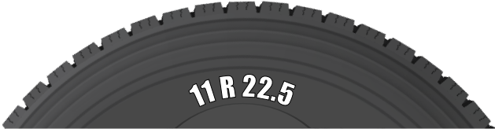
Dimensions
Radial “Type”
Tread width in inches
Diameter of wheel in inches

Slide 9
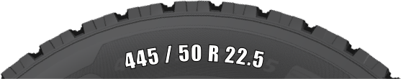
The industry is constantly developing new products, models and sizes that are more and more specific to their needs. Nowadays, there are a lot of metric size tires, for example, 445 50 R 22.5, a wide tire tread. This type of tire is mainly used for its lower resistance to the road, among other things.This results in a reduction in fuel consumption. Another significant advantage is the weight reduction caused by its single frame. The width of the tire is 445 mm. The number 50 represents the height of the sidewall expressed in % (50% of 445 mm).
This wheel can also be installed on a 22.5 diameter wheel.

Slide 10
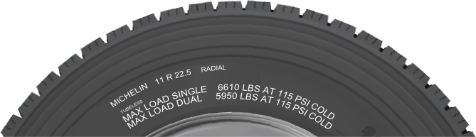
Pressures and Capacities
The maximum inflation of the tire is indicated on the sidewall of the tire by the tire manufacturer. This indication can also be found inside the driver’s door frame. This pressure must be respected in order to be permitted by law to achieve maximum loads.
The carrier may, in conjunction with the tire representative, determine a lower pressure that reflects the value of the loads being carried. This will help to optimize the performance of the tires and increase fuel economy.
The CFTR uses 105 PSI for the steering axle and 80 PSI on the drive and trailer axles.
Notes:
These pressures are adequate due to the fact that we are not loaded to full capacity.
The pressure (duel tires) is reduced in order to compensate for irregularities in the road, bumps, holes, sidewalks, etc.

Slide 11
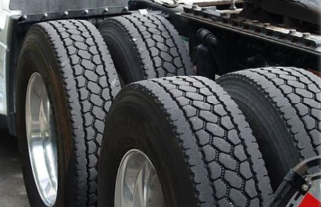
Pressure
Recommendation: It can be difficult to tell if a tire is flat on a dual set, if one of the tires is in perfect condition. So to check this, it is strongly recommended to use a hammer to hit each tire. Listen to hear if there is a different sound. A tire with a lower pressure will sound much different.
DHV page 397

Slide 12
Tire Inflation
It is normal for a tire to have a slight drop in air pressure. Inflation is then recommended. However, certain precautions should be taken. The adjustment should always be done when the tires are cold. Never adjust the tire pressure when the tire is hot, because there is a high risk of explosion (flash rupture of the sidewall). If the tire has a pressure drop of more than 20%, the tire should be removed and inspected before re-inflation.
Also, it is recommended to use an air chuck connection and a hose extension, with a control valve.
The extension therefore makes it possible to stand at least one meter from the tire and not to face the sidewall.

Slide 13
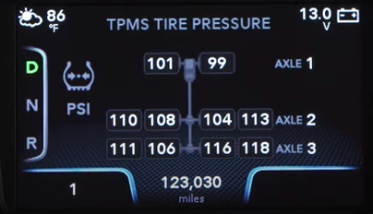
Pressure Monitoring System
Optional on certain vehicles, this system uses pressure sensors in each of the wheels.

Slide 14
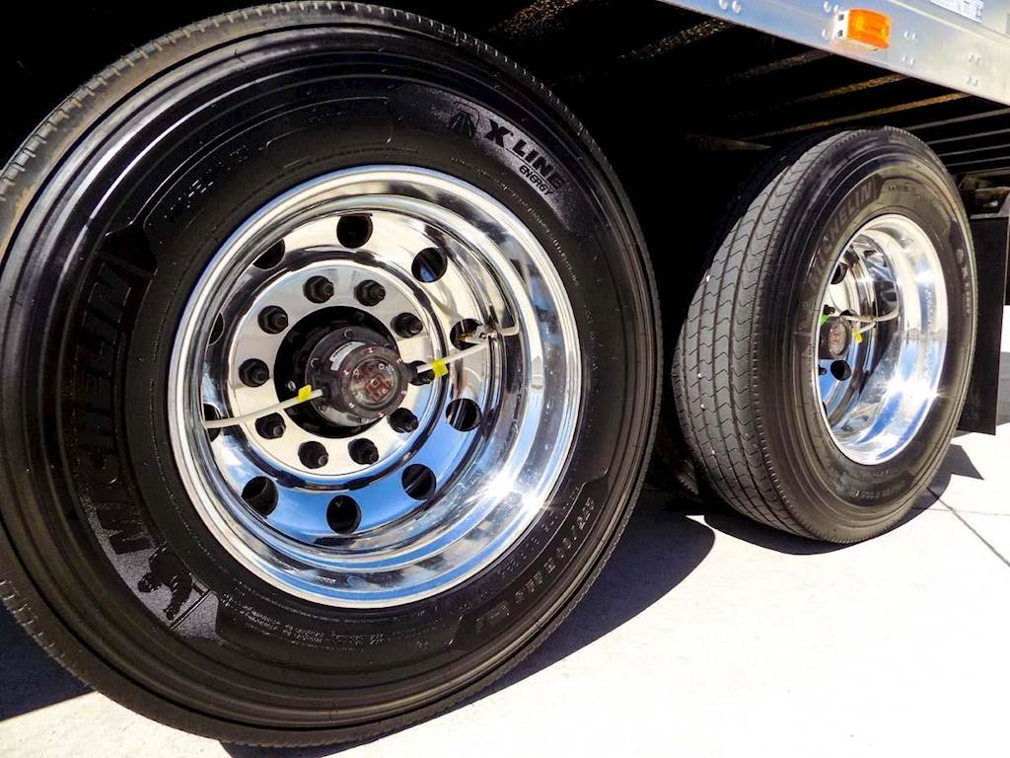
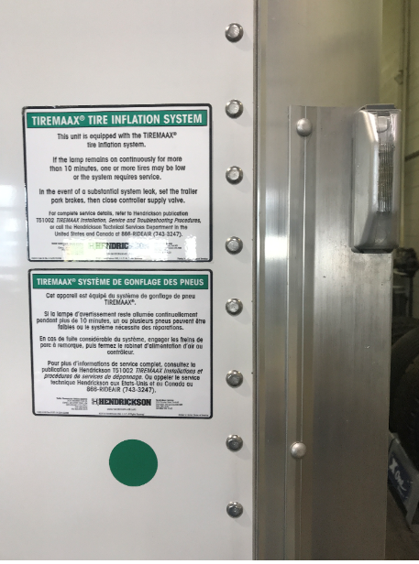
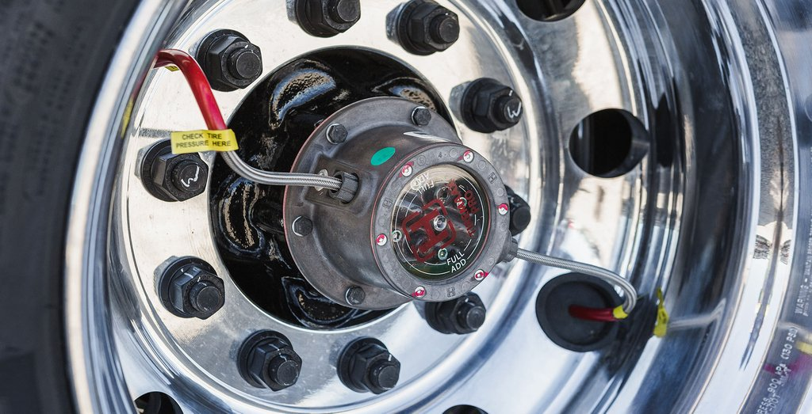
Pressure Control System
As soon as the semi-trailer is supplied with air, this system can intervene if necessary. When a tire has an air pressure lower than the pre-established standard, the system supplies the tire, which has the air leak, with the necessary volume of air from one of the air tanks of the semi-trailer. A warning light on the front of the trailer iindicates the intervention of the pressure regulator. The manufacturer reports that when the light is on constantly for more than 10 minutes, it means that one or more tires are deflated, or that the system is defective.

Slide 15
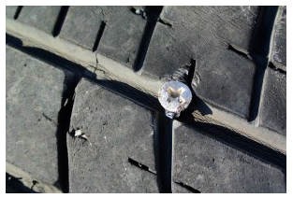
Anomalies (defects):
Foreign objects, abnormal wear, puncture, separation, etc.
Foreign objects with or without a puncture
Flats are often caused by undetected foreign objects in the tread.

Slide 16
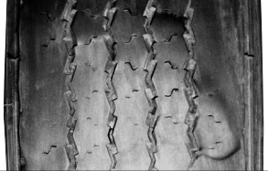
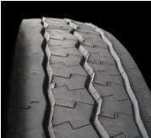
Uneven wear
These deformations are usually caused by mechanical problems with the suspensions. Either shocks or other parts are in poor condition. It may be a faulty wheel alignment. Inadequate air pressure in the tires can also cause unevenness.

Slide 17
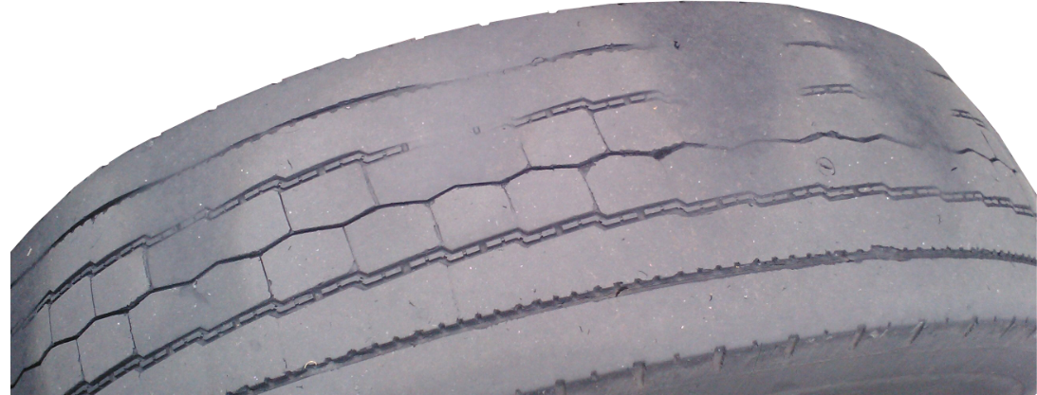

Slide 18
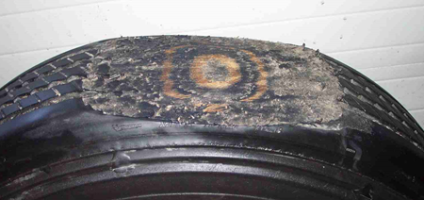
Flat spot
This type of anomaly usually occurs on a trailer, when the operator fails to check the free movement of the wheels prior to departure. Also, such wear can occur during emergency braking or during a wheel blockage caused by a faulty brake system.

Slide 19
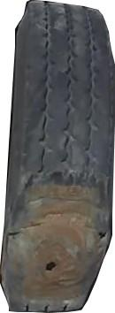
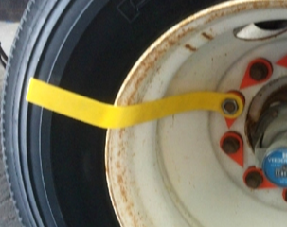
Flat spot
An indicator can be installed under a nut of each wheel. This simple device allows you to better see the movement of each wheel, therefore avoiding to drive with a blocked wheel.
A puncture may happen when you drag the tire (wheel is not turning)

Slide 20
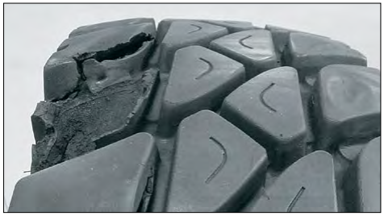
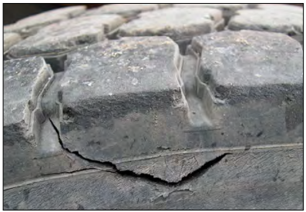
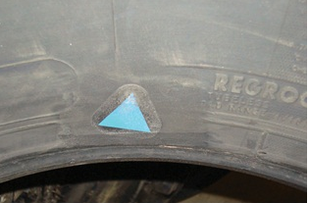
Damaged sidewall or tread
Several cracks can be found on different surfaces of the tires. Regarding sidewall dents and repairs already been made...tolerances should be checked by qualified personnel.
Notes:
Only imperfections allowing the reinforcement fabric of the sole or steel belt to be exposed will be considered anomalies. Vulcanization process (permanent baked repair). Not to be confused with a retreaded tire.

Slide 21
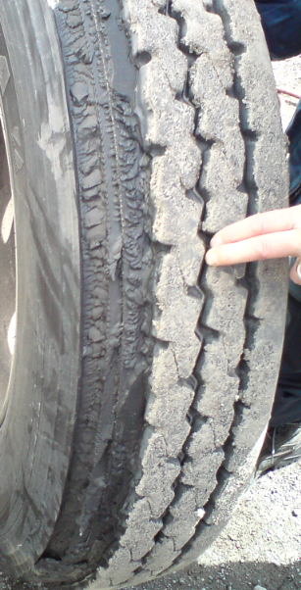
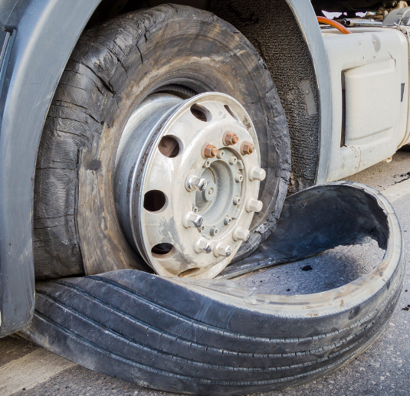
Separation
Separations usually occur on retreaded tires. The sole may separate completely or partially from the carcass.
In the latter case, the tire can continue to roll normally. However, when there is complete separation, the projection of the sole can cause mechanical damage.

Slide 22
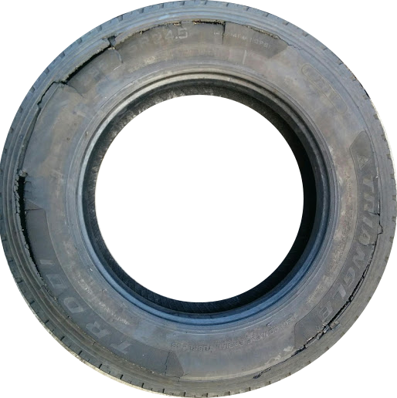
Tire Explosion: (Pyrolysis)
Danger
Pyrolysis is the thermochemical decomposition of organic material that can occur at high temperatures in the absence of oxygen. This decomposition process requires only the presence of rubber and heat. Once started, the decomposition process is irreversible. There is no visible indication that the decomposition process is taking place. Depending on the specific circumstances, an explosion may occur immediately, within a few minutes or several hours after exposure to the source of heat.
In many cases, an explosion can cause the tire and/or its components, to be thrown long distances resulting in serious injury and/or death of workers, as well as serious material damage.
Three situations that can cause Pyrolysis:
1- Over heating of brakes
2- Driving long distances with under inflated tires
3- Overload

Slide 23
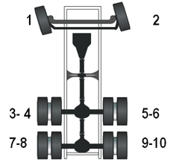
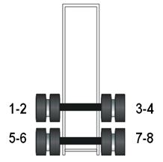
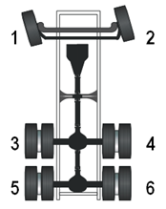
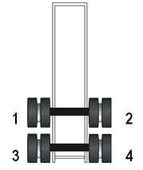
Tire location code used by CFTR
Wheel (single/dual) location code by CFTR
Tire # 4
Wheel # 4

Slide 24
Thank you
for participation

