Slide 1
Competency 2 Lesson 2.5.1
Steering System

Slide 2
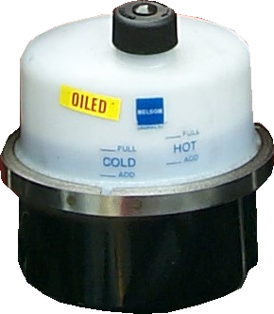
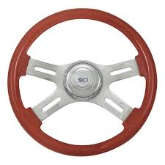
Verification
Steering Wheel:
Solidity and fonction
Oil Level:
Check
Cold or Hot

Slide 3
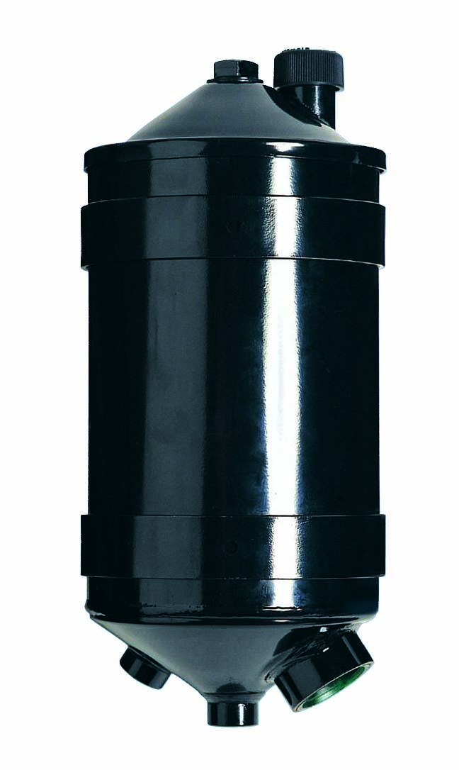
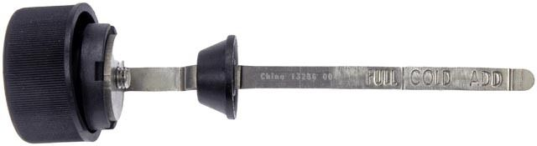
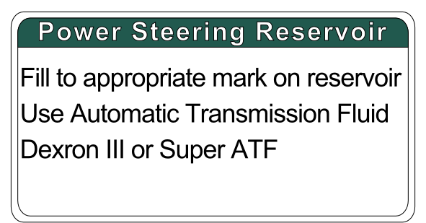
Identification of the gauge (dipstick) on an opaque power steering reservoir.
maximum
add cold
Type of oil used: Dexron III or Super ATF
(generally)

Slide 4
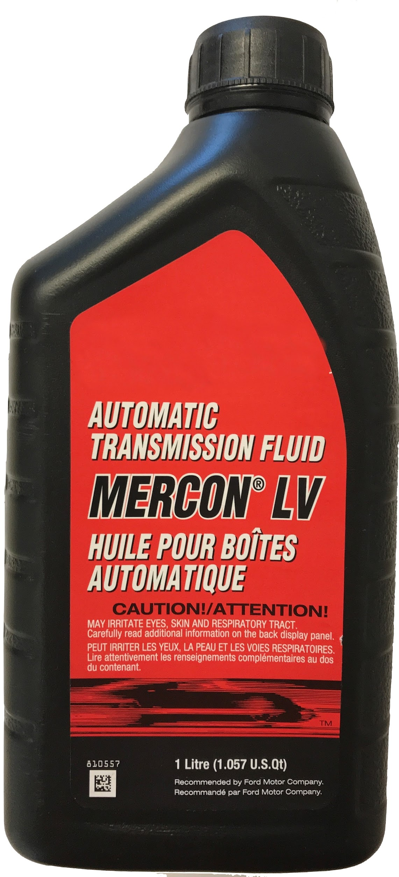
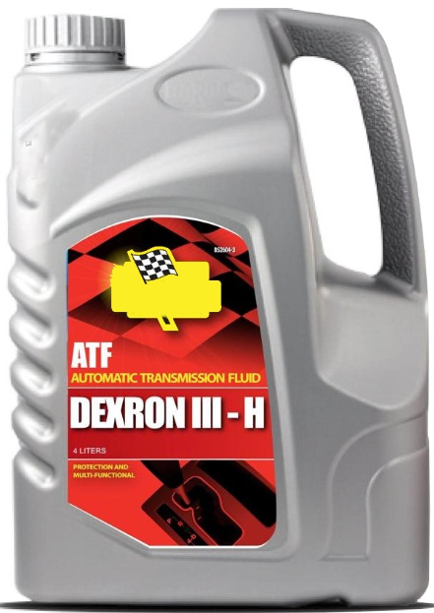
In the example above, it is recommended to use Mercon automatic transmission fluid or Dexron. The color red is a good clue, but not always true.

Slide 5
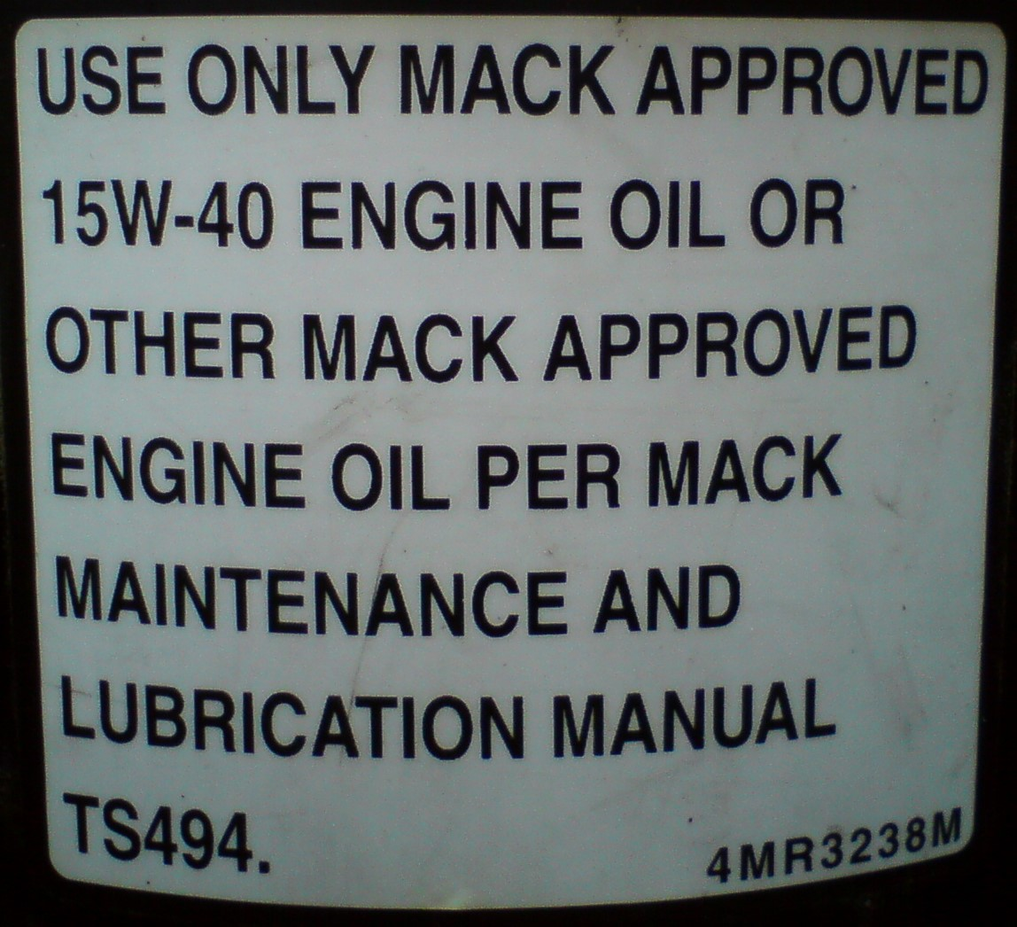
If the information on the type of oil to add is not visible on the power steering reservoir, refer to the truck’s manufacturer’s manual. If this is not available, ask the mechanic of the transport company. It is not necessarily always automatic transmission fluid that is used in the power steering.
This example: 15W-40 Engine Oil

Slide 6
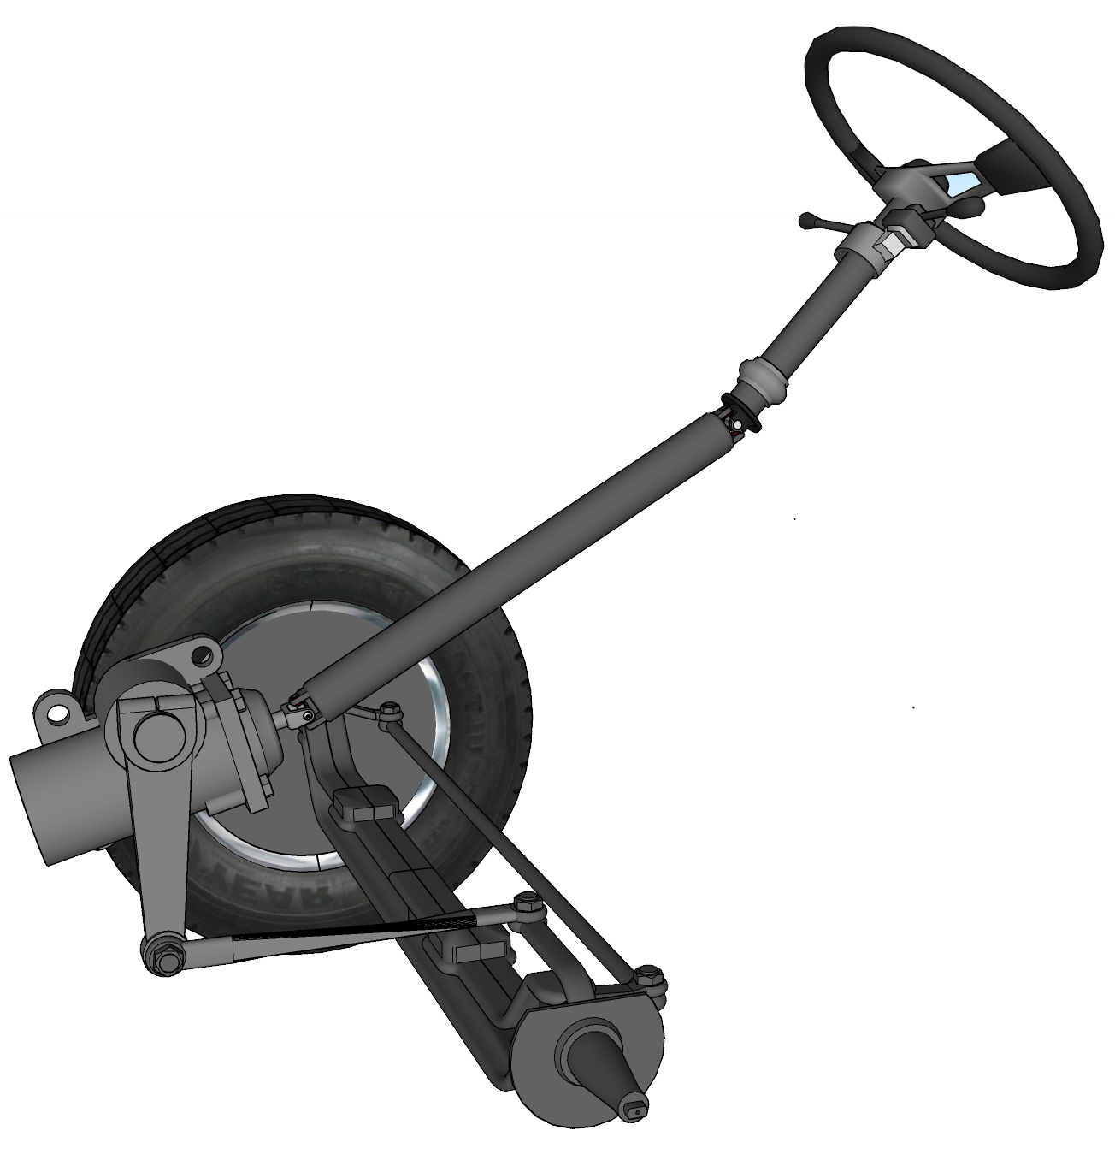
The power steering box and linkage:
Checking the condition of parts and the presence of leaks.
Steering Column
Steering Box
Steering Linkage

Slide 7
Instructions on how to properly maintain the power steering
1. Avoid turning the steering wheel when the truck is not in motion.
2. Avoid turning the steering wheel when the brakes are strongly applied.
3. Avoid turning the steering wheel as far as possible to one side and forcing it to this position.
4. Ensure adequate lubrication of the fifth wheel.
5. Avoid climbing on curbs or sidewalks during turning maneuvers.

Slide 8
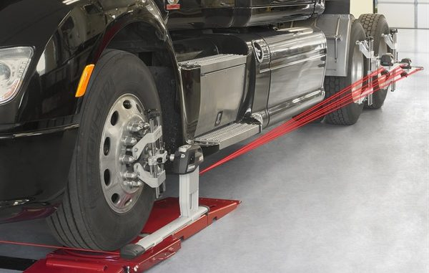
Recognizing a steering problem when the truck is in motion
When driving at high speeds, the truck should drive in a straight line when the steering wheel is not turned.
If the truck pulls to one side of the road, the parallelism of the wheels (alignment) may be the cause.
Notes:
Inadequate air pressure in the steering tires can also affect driving stability.

Slide 9
Good Verification!

