Slide 1

Competency 2 Lesson 2.4.3
Brake System
(3)

Slide 2
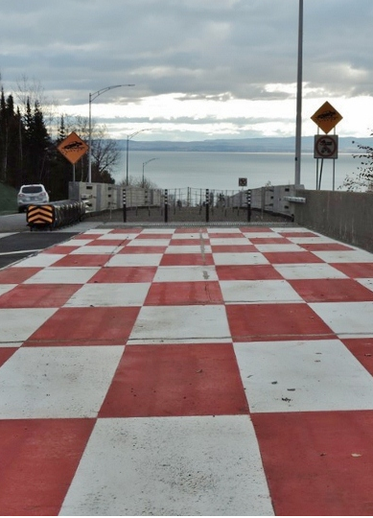

Objectives of the lesson:
Determine relevant means for optimization.
To prepare for the SAAQ air brake theory exam.
DRIVING A HEAVY VEHICLE

Slide 3
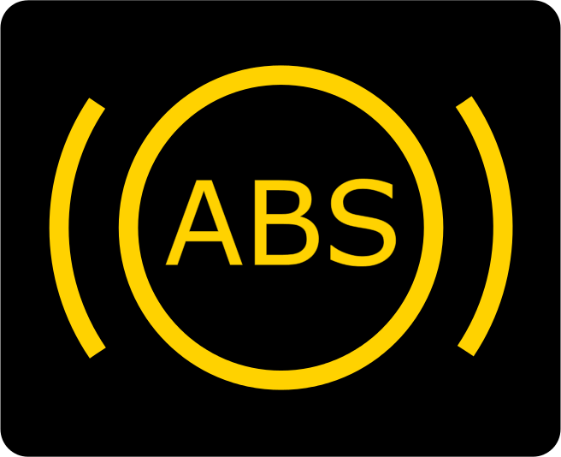
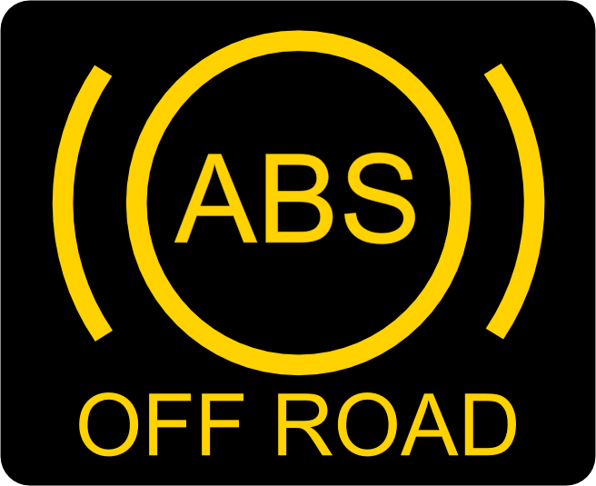
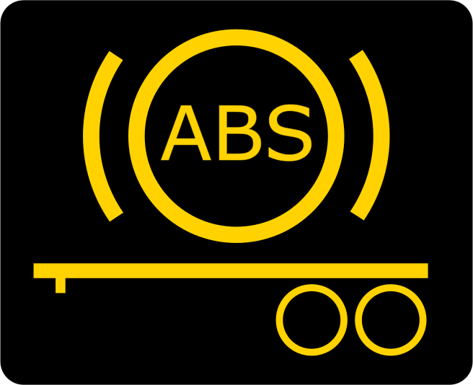
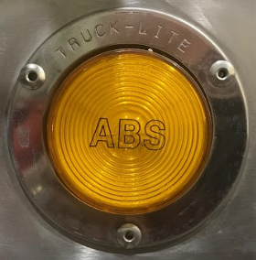
ABS (Anti-lock Braking System):
The anti-lock braking system (ABS) is designed so that the driver can maintain control of his vehicle and prevent it from skidding during braking. When there is loss of traction, the ABS computer uses the wheel speed sensors to determine if one or more wheels are about to lock up during braking. Before a lockout occurs on a wheel, the hydraulic modulator valve releases the brake pressure on it several times per second. The constant rotation of the wheels prevents skidding and helps maintain steering control..
Operation Indicators (warning lights):
The ABS warning light, usually yellow in color, lights up in the instrument panel for a few seconds when the ignition is switched on then goes out. However, if the warning light on the instrument panel or on the trailer remains on constantly, it will inform the driver that the ABS computer has detected an anomaly (defect) in its components and the system is no longer functioning. Nevertheless, the conventional brakes are still working normally. At this time, it is essential to adapt your driving accordingly. In addition, the system should be repaired ASAP as soon as possible.

Slide 4

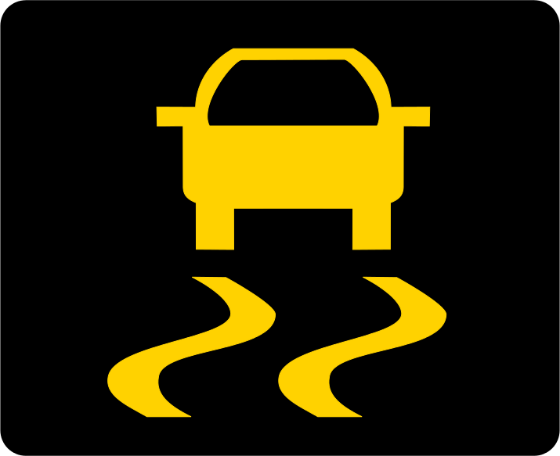

Driver assistance system
Some vehicles are equipped with a driver assistance system. This system uses the vehicle braking system to improve the control and stability of the equipment. A pictogram in the dashboard indicates its presence. It turns on for a few seconds when the ignition is switched to the on position, then turns off. The warning light flashes for each maneuver requiring its intervention. If it remains on, the system is inactive and should be repaired as soon as possible (ASAP).
ESP (Electronic Stability Program)
This system is integrated with the ABS (anti-lock braking system) computer and uses the same sensors and modulating valves. It manages the engine torque and sometimes even the engine brake. Additional sensors are added to convey information to the ECU (Electronic Control Unit) on the steering angle and the lateral displacement of the vehicle. The system may include anti-slip (yaw control) and anti-rollover (RSP).

Slide 5
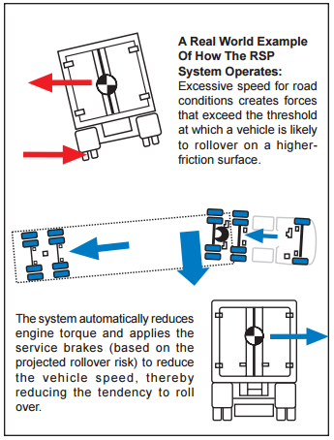
RSP (Roll Stability Program)
The purpose of this system is to prevent rollovers caused by excessive speed during a turn or sudden maneuvers. Under these conditions, it automatically reduces the engine torque and applies the service brakes in order to reduce the risk of overturning.

Slide 6
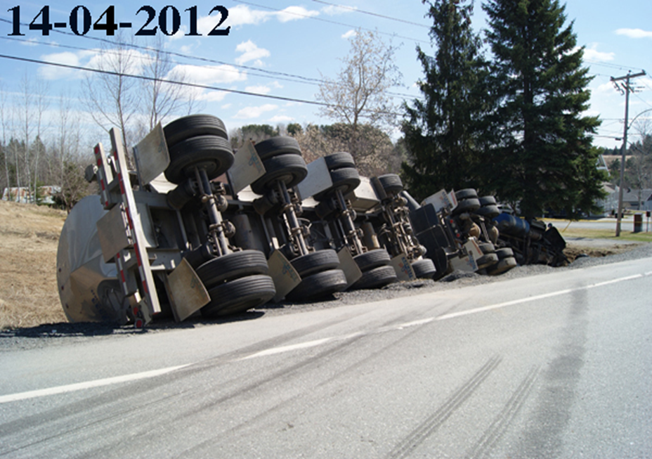

Slide 7
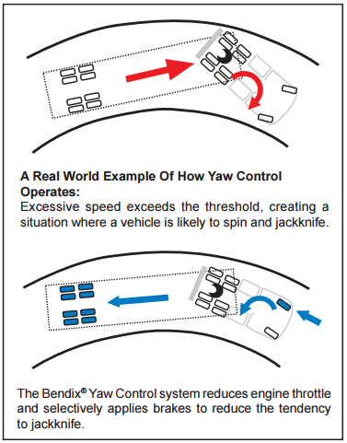
Anti-slip (Yaw Control)
Excessive vehicle speed, can cause slipping or even provoke a jackknife, especially on wet or icy road conditions.
The purpose of this system is to limit slippage, preventing a Jackknife, by reducing throttle control and strategically applying the service brakes.

Slide 8
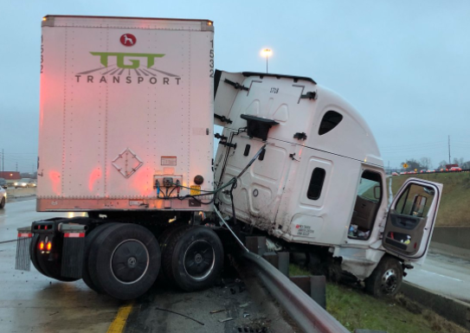

Slide 9
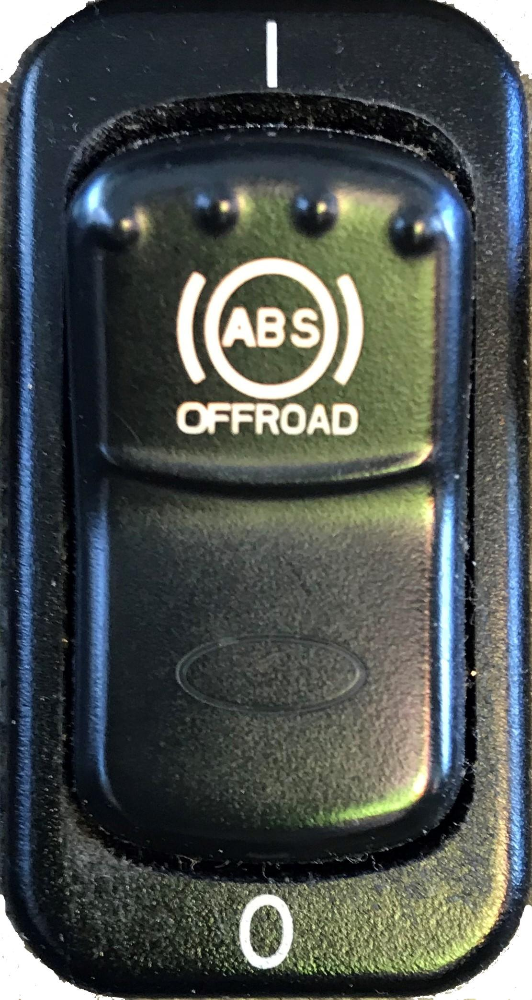
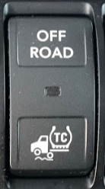


What to know about these systems:
These systems are not foolproof and can lose their efficiency when the steering angle is incorrect or when the load is unstable.
They become inactive in ABS/OFF-ROAD mode or when the ABS/ATC (Automatic Traction Control) system is in fault or is in diagnostic mode.

Slide 10
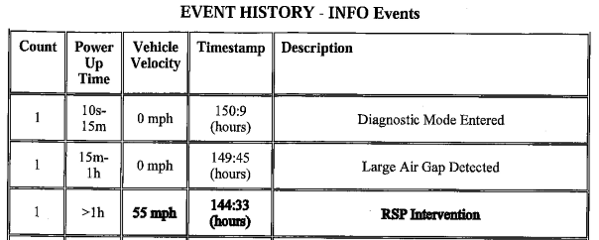
In addition, they can create and record events. Thus, as soon as one of the driver assistance systems intervenes, it can create an event report. In the following example, the anti-rollover system RSP (Roll Stability Program) of a vehicle was activated while it was travelling at 55 mph or 89 km/h.

Slide 11
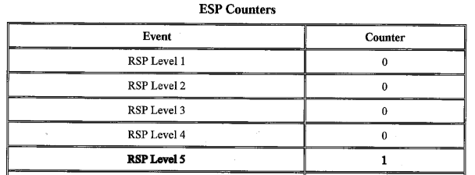
Furthermore, the level of intervention of the system was at its maximum, level 5.
Important: Despite their effectiveness, these driving assistance systems will never replace DEFENSIVE DRIVING applied by a professional driver.

Slide 12

Level 5 Intervention.
Excessive speed during a turn or sudden maneuver.

Slide 13
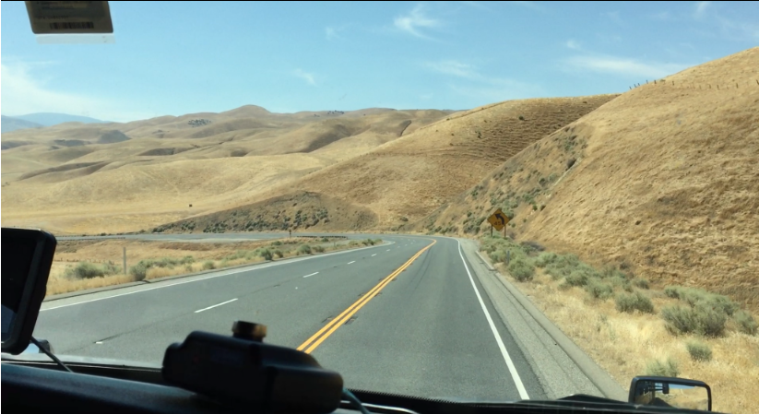
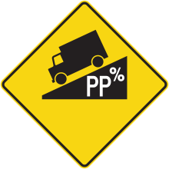

BRAKING TECHNIQUES ON SLOPES AND ON FLAT TERRAIN

Slide 14
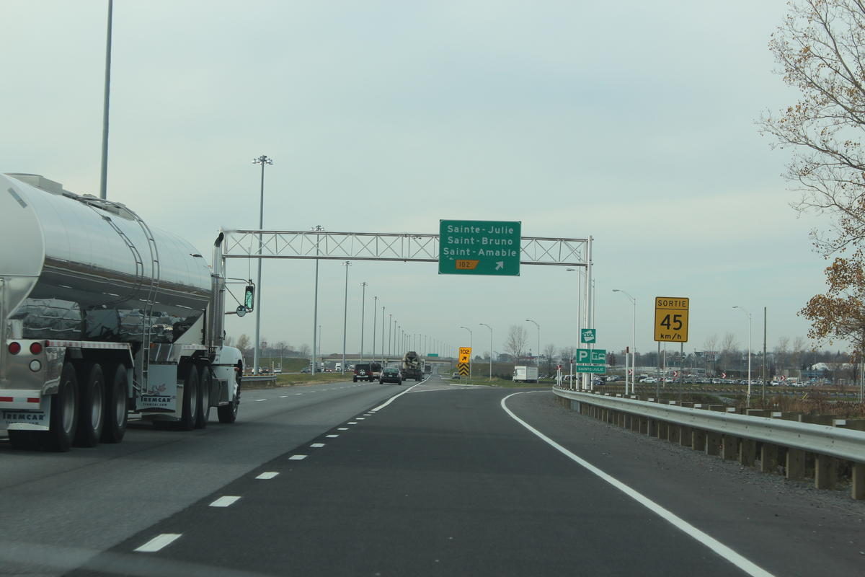

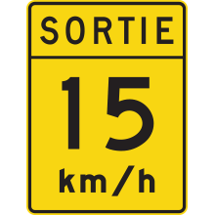
Exit Ramps:
Anticipation of exit ramps is crucial. In order to optimize the stability of the truck, it is best not to brake when the truck is in the curve.The slowdown must therefore be completed before entering the exit. Well anticipated, an exit can even be negotiated without the use of the service brakes. Proper use of the Engine Brake Retarder is necessary.
Photo: Les versants; Transports Québec
Notes:
The service brakes should be used to maintain a constant speed in curves while going downhill.
It might be a good idea to enter these types of curves at slower speed than suggested.

Slide 15
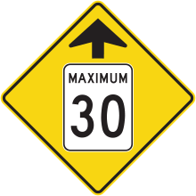



Traffic Light:
When approaching a traffic light, it is strongly recommended that you avoid accelerating too much. Anticipating lights and traffic means less strain on the service brakes by reducing severe deceleration and reducing unnecessary stops.
Short Descents:
As you approach short descents, you should release the accelerator to reduce your speed. Thus, the acceleration caused by the slope, gravity will allow you to maintain your cruising speed without exceeding it. The engine brake can be used but with good judgment.

Slide 16
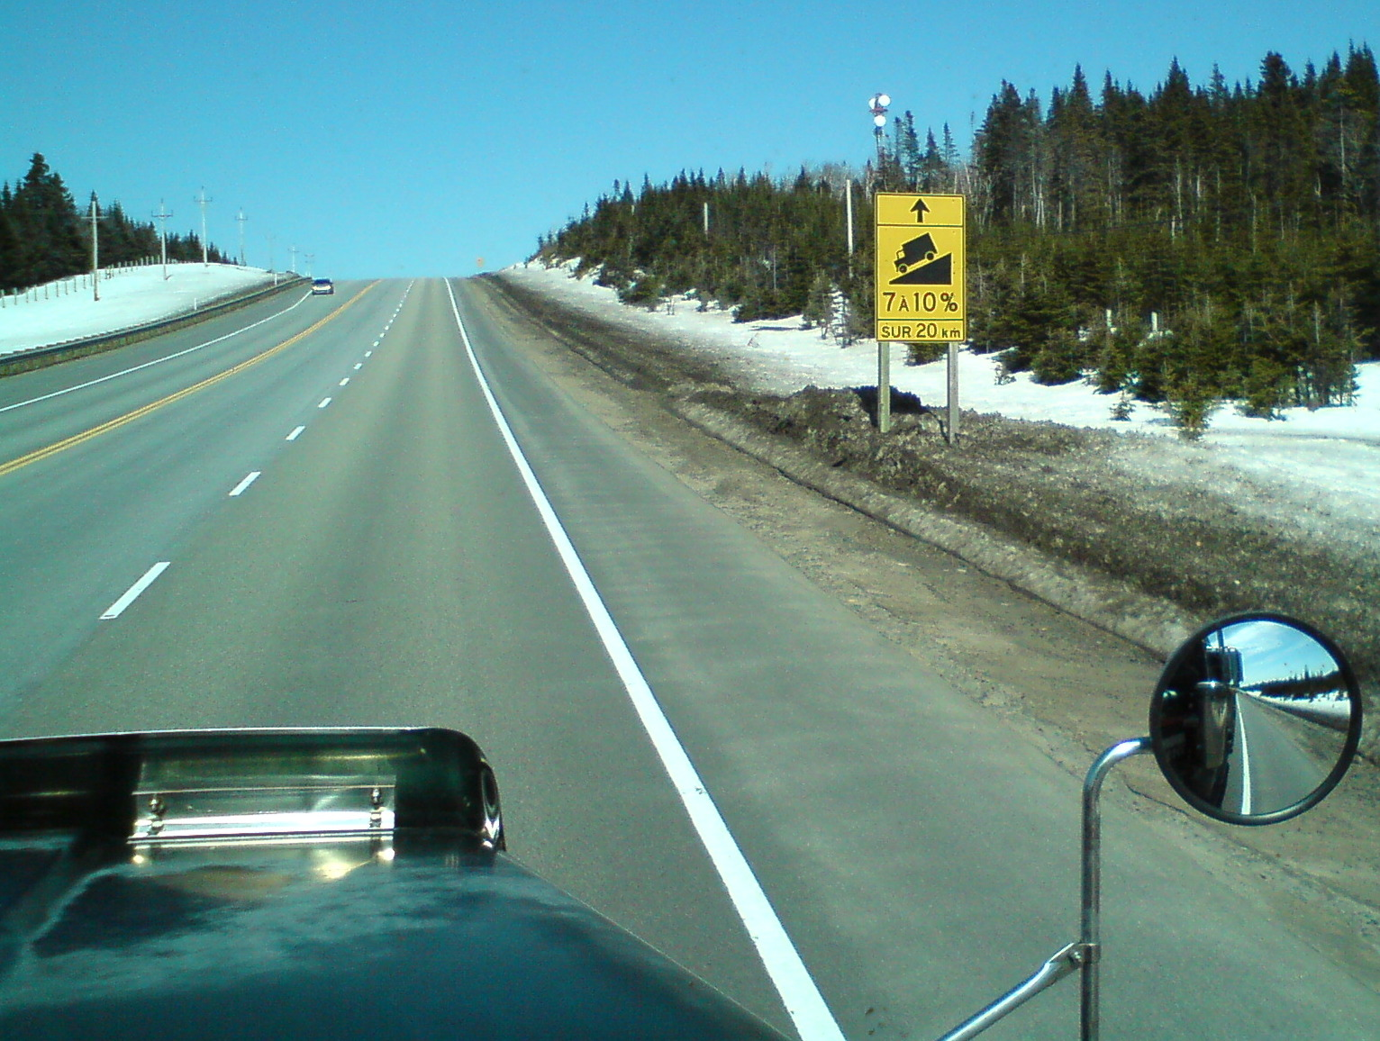
Long Descents:
As we approach a long descent, we must carefully observe the signs and take in consideration weather conditions.
This will make it easier to determine the deceleration required for the vehicle, in these circumstances.
Therefore, the combination of braking and downshifting, before negotiating the slope, will allow you to reach the ideal gear for the descent..

Slide 17
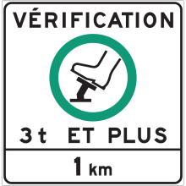
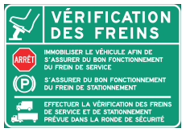
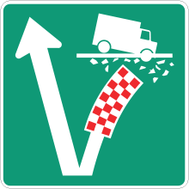

Specific signage for long steep slopes
Brake Check
Runaway Truck Ramps

Slide 18
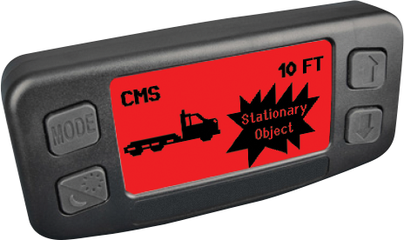
OnGuard from Meritor WABCO.
CMS (Collision Mitigation System)
This optional system uses a radar located in the front bumper. The radar determines the position as well as the speed of vehicles or objects in front of the tractor. It informs the driver of potential dangers by first changing the color of its screen, then emitting an audible signal. Finally, if the risk of collision increases, it can apply the service brakes up to 50% of its maximum power.
Blue: Normal Operation
Green: Vehicule Detected In Front
Yellow: Following To Close Sound Alert
Red: Risk Of Collision Sound Alert

Slide 19
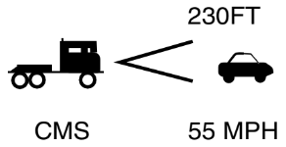
In the following example, a vehicle is detected in front of the truck at 230 feet (70 m) and it is moving at 55 miles per hour (89 km/h)

Slide 20
Thank you
for your participation

