Slide 1

Competency 2 Lesson 2.4.2
Brake System
(2)

Slide 2
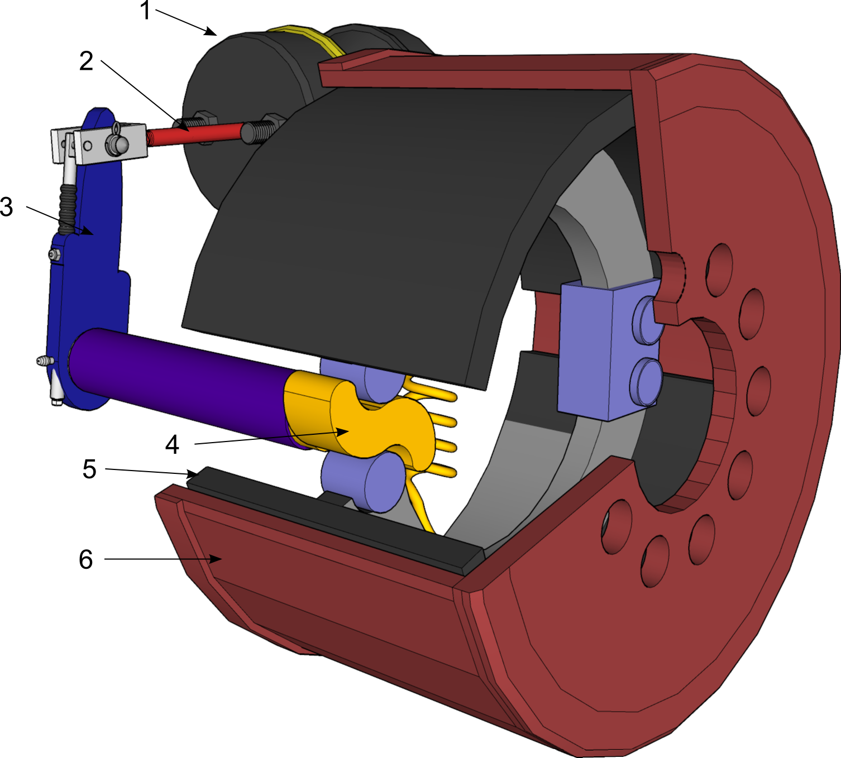
Brake Drum Classification
Particularities :
Loss of efficiency during overheating
Needs adjustment
Needs to be verified during Circle Check
1- Brake Actuator
2- Push Rod
3- Adjustable Lever (Automatic Slack Adjuster)
4- S Camshaft
5- Brake Lining
6- Drum
Notes:
Reference: Page 100 DHV

Slide 3
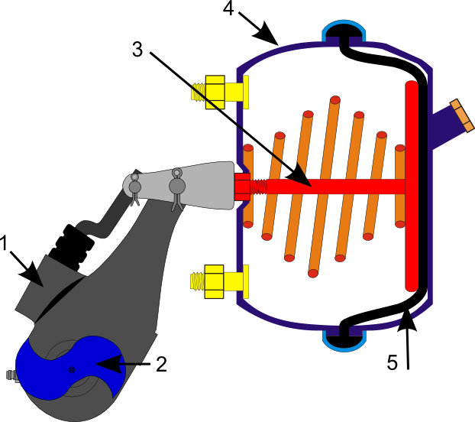
Single Brake Actuator (Booster) Classification
1- Adjustable lever (Automatic Slack Adjuster)
2- S Camshaft
3- Push Rod
4- Service Brake Chamber
5- Diaphragm

Slide 4
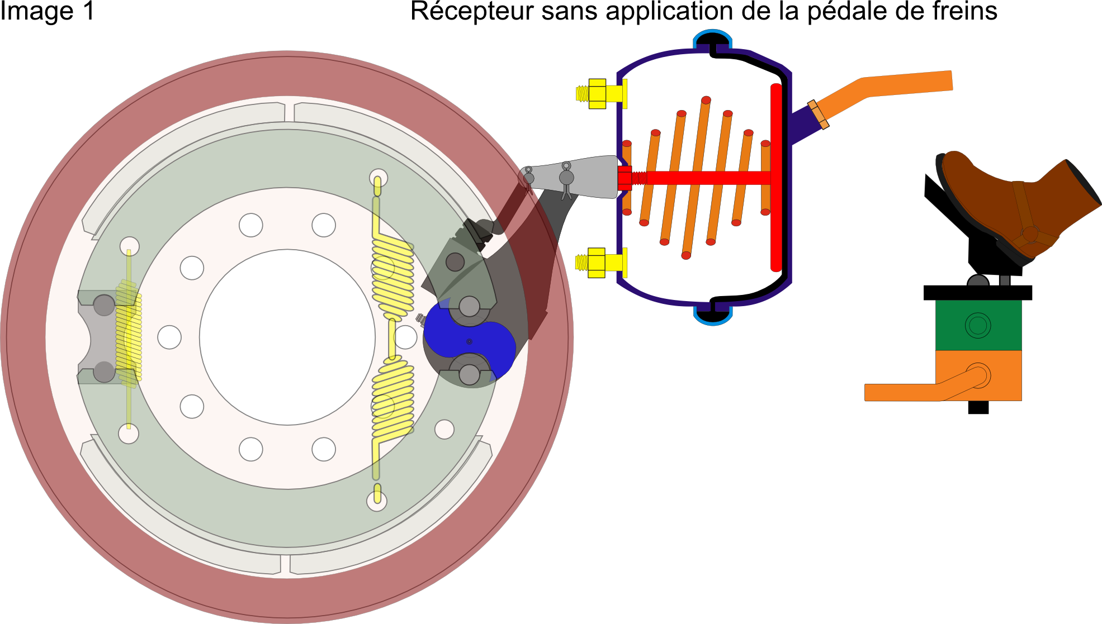
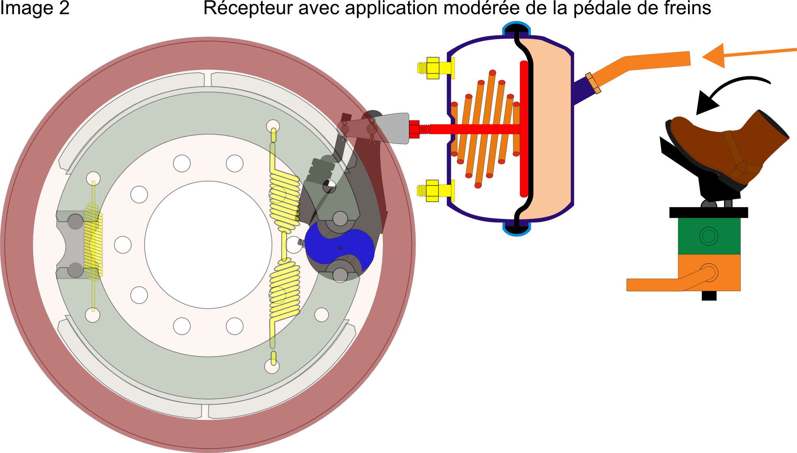
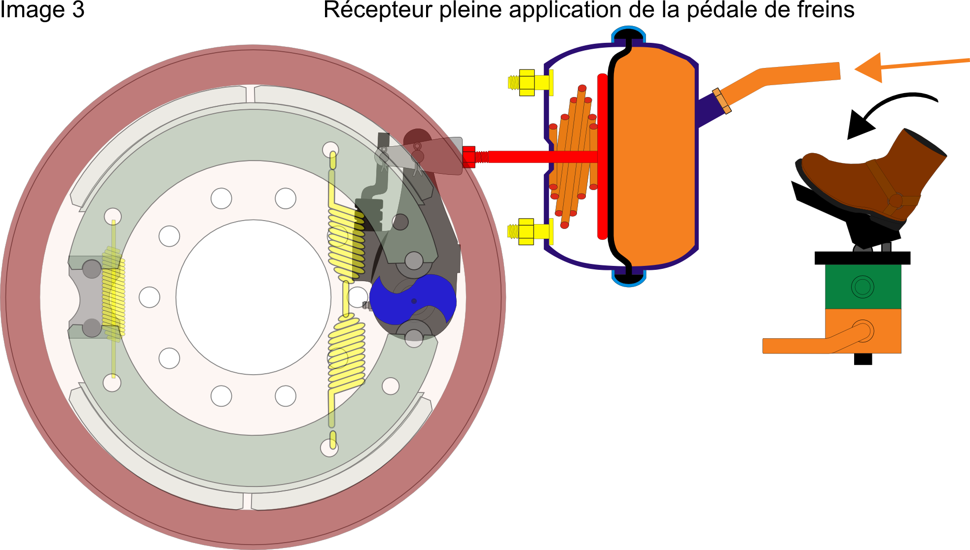
Operation of a single brake actuator
No pedal application
Vidéo frein
Moderate brake pedal application
Maximum brake pedal application
Notes:
Important video from: 38 sec. to 1:05 only.

Slide 5
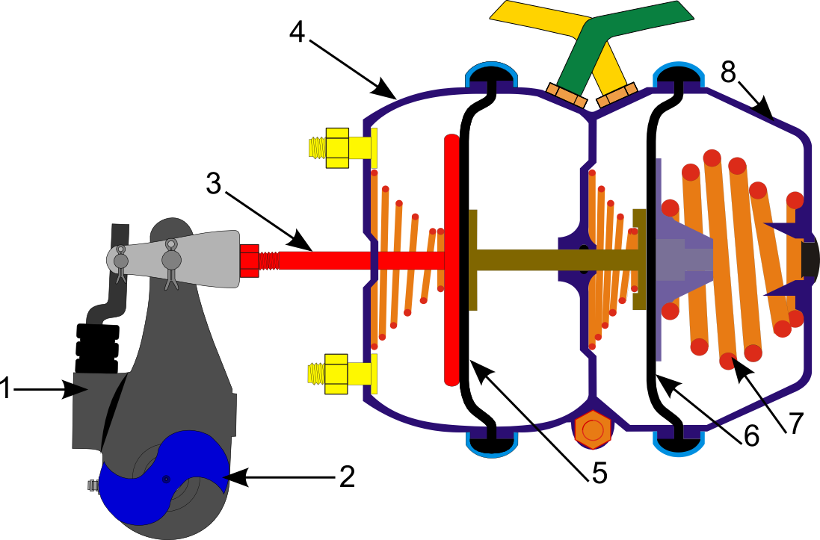
Dual Brake Actuator (Booster) Classification
1 Adjustable Lever (Automatic Slack Adjuster)
2 S Camshaft
3 Push Rod
4 Service Brake Chamber
5 Diaphragm
6 Diaphragm
7 Parking Brake Spring
8 Parking Brake Chamber

Slide 6
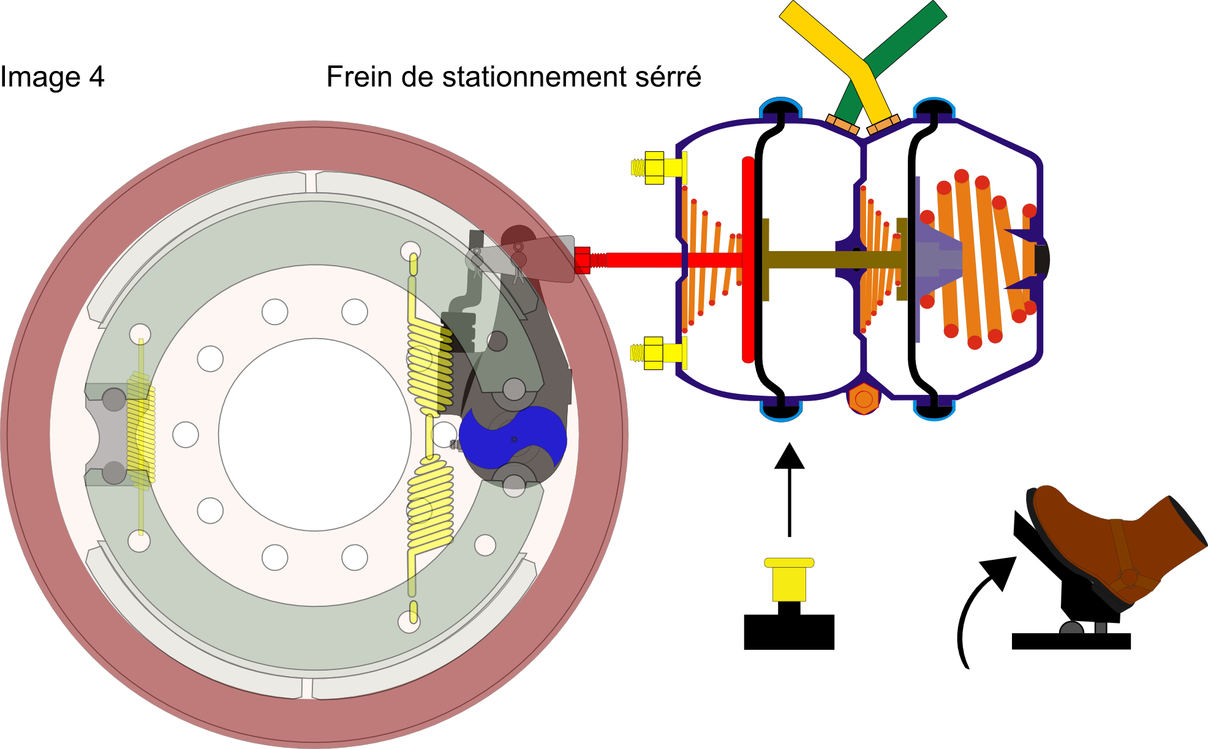
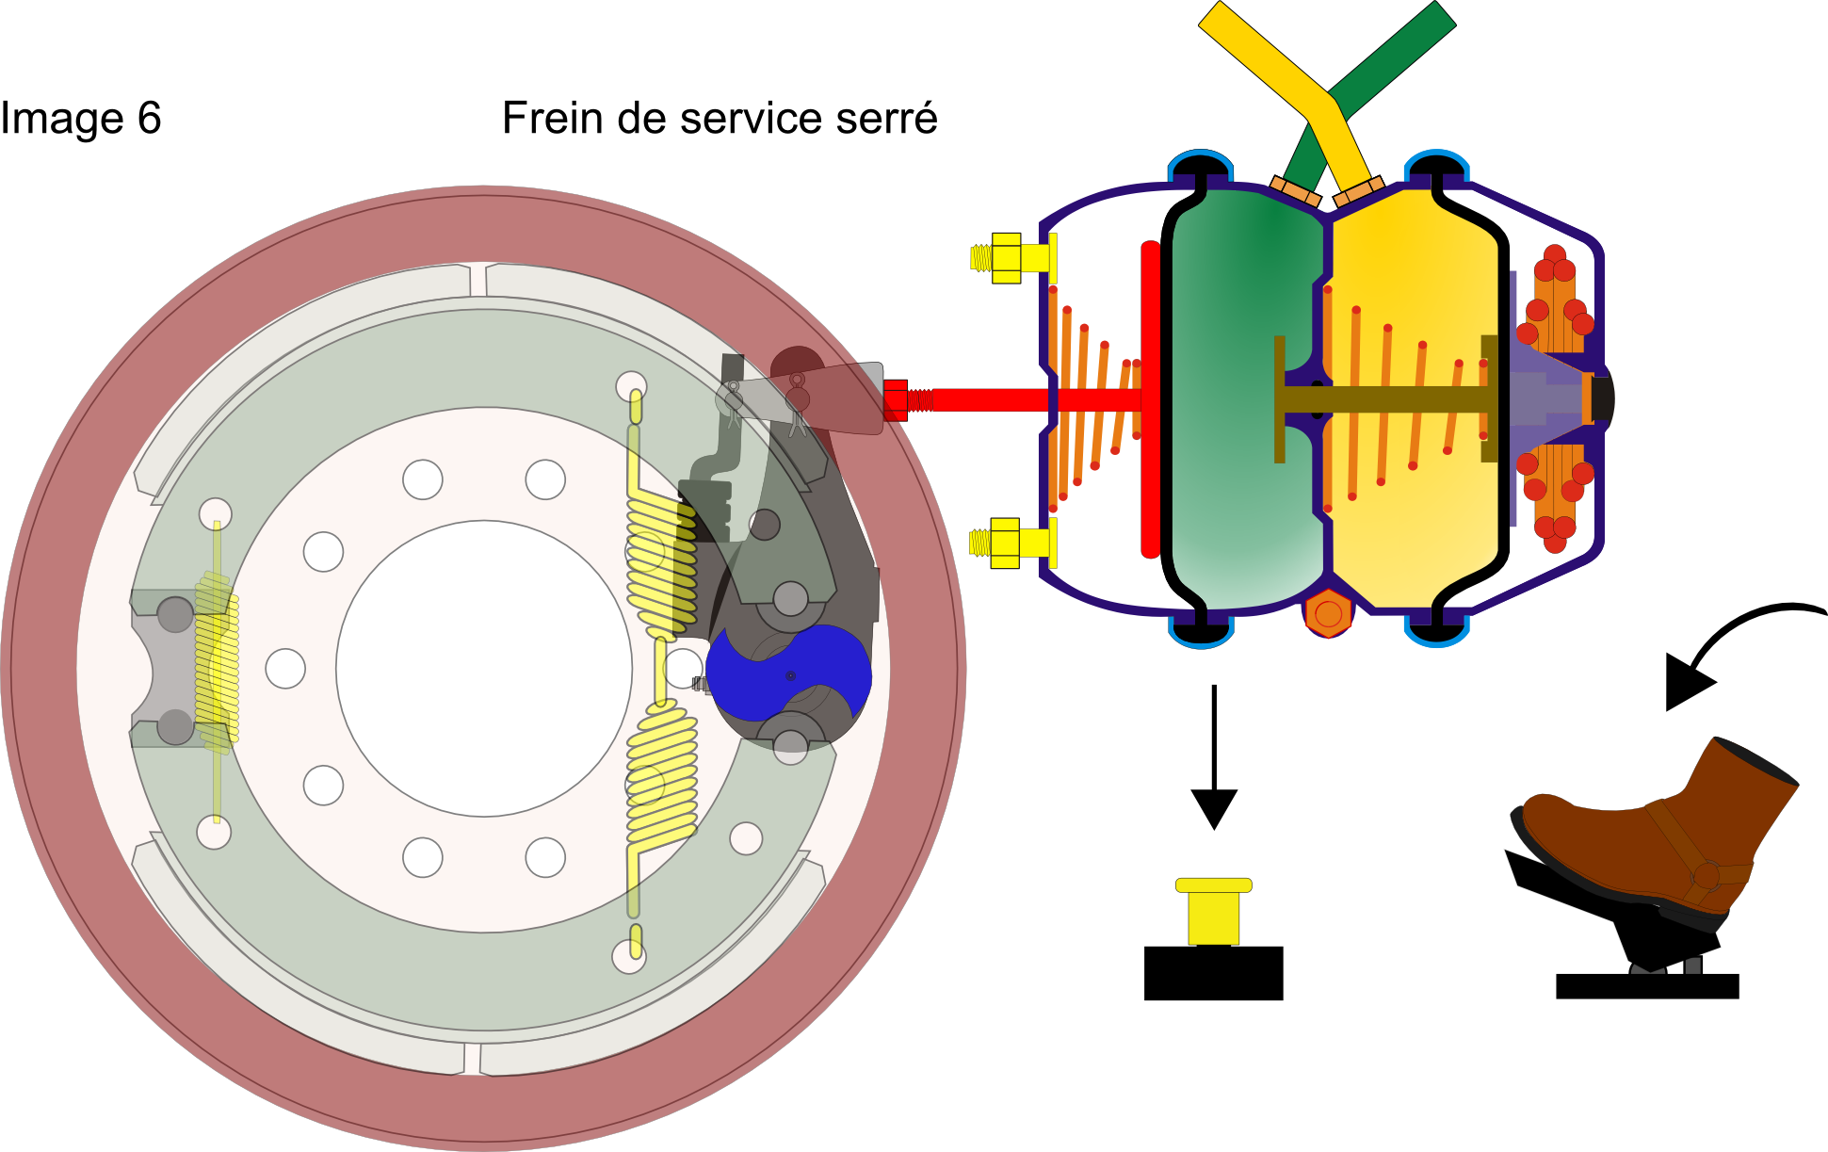
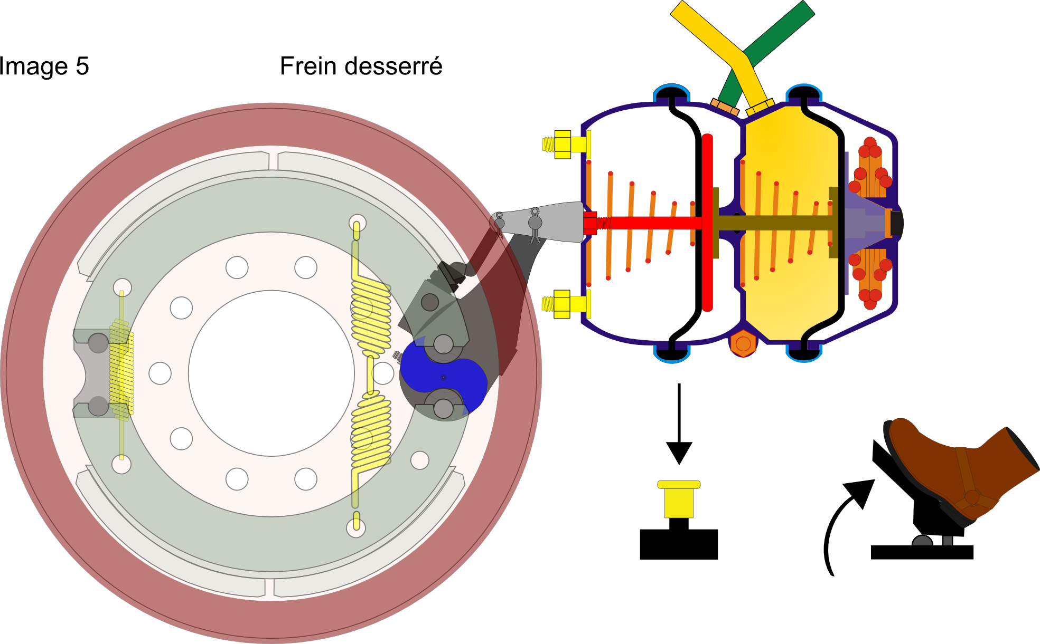
Operation of the dual brake actuator (Booster)
Parking brake applied
Vidéo frein
Service brake applied
Released Brakes
Notes:
Reference: Page.104 DHV
Video from beginning to 1:05

Slide 7
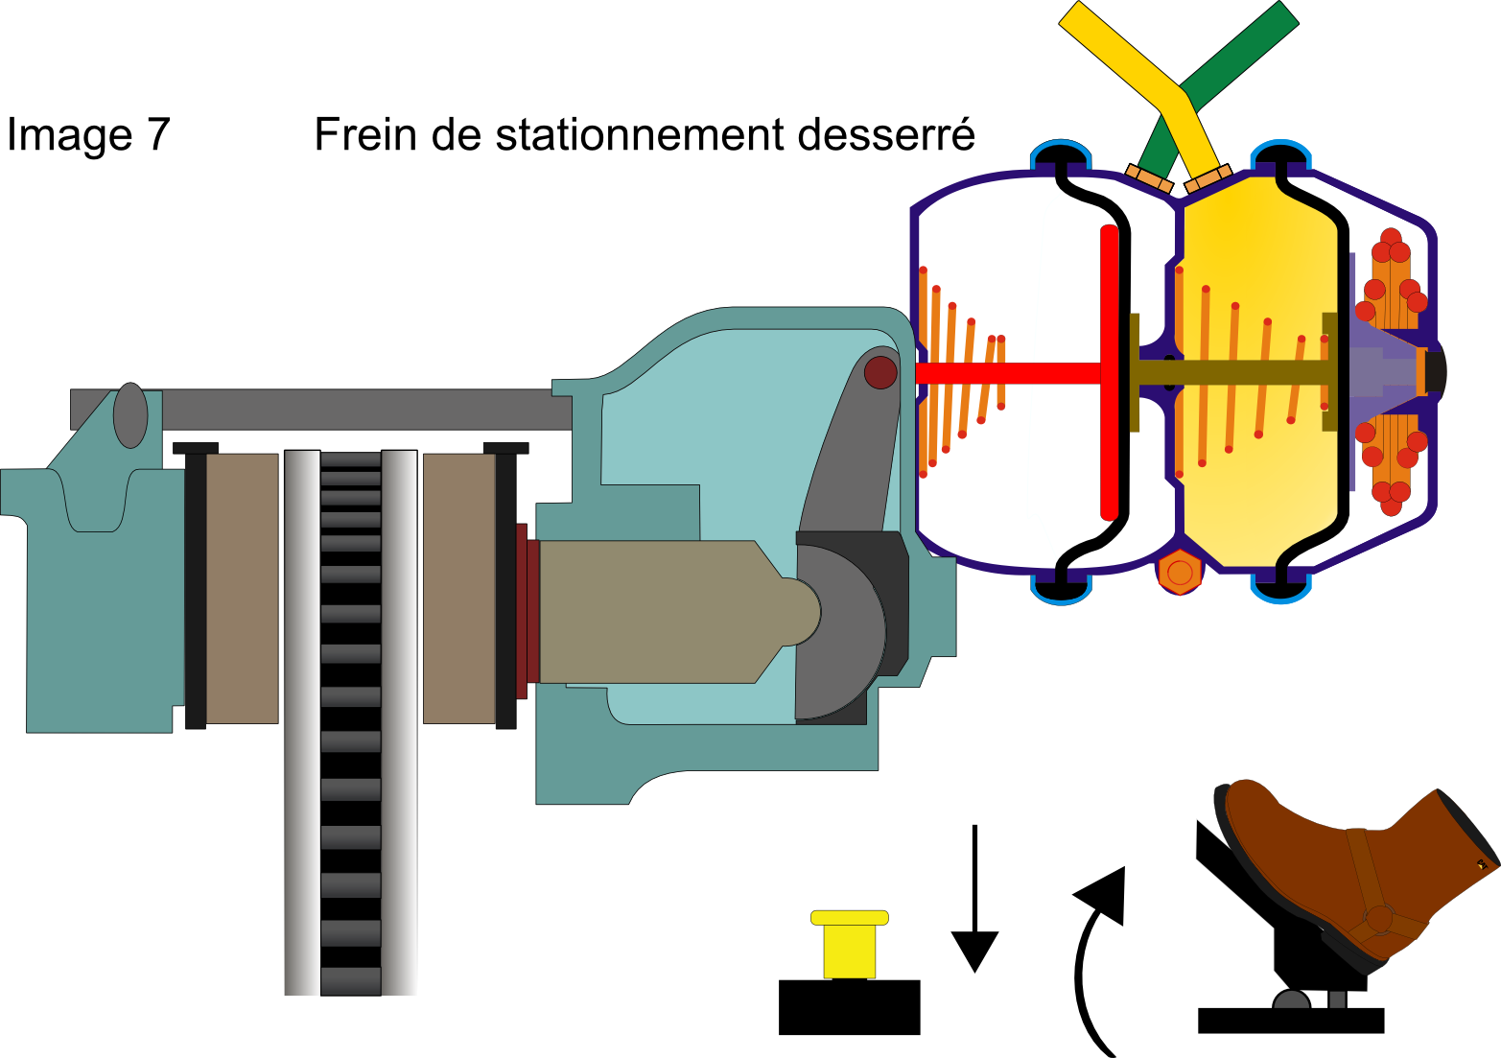
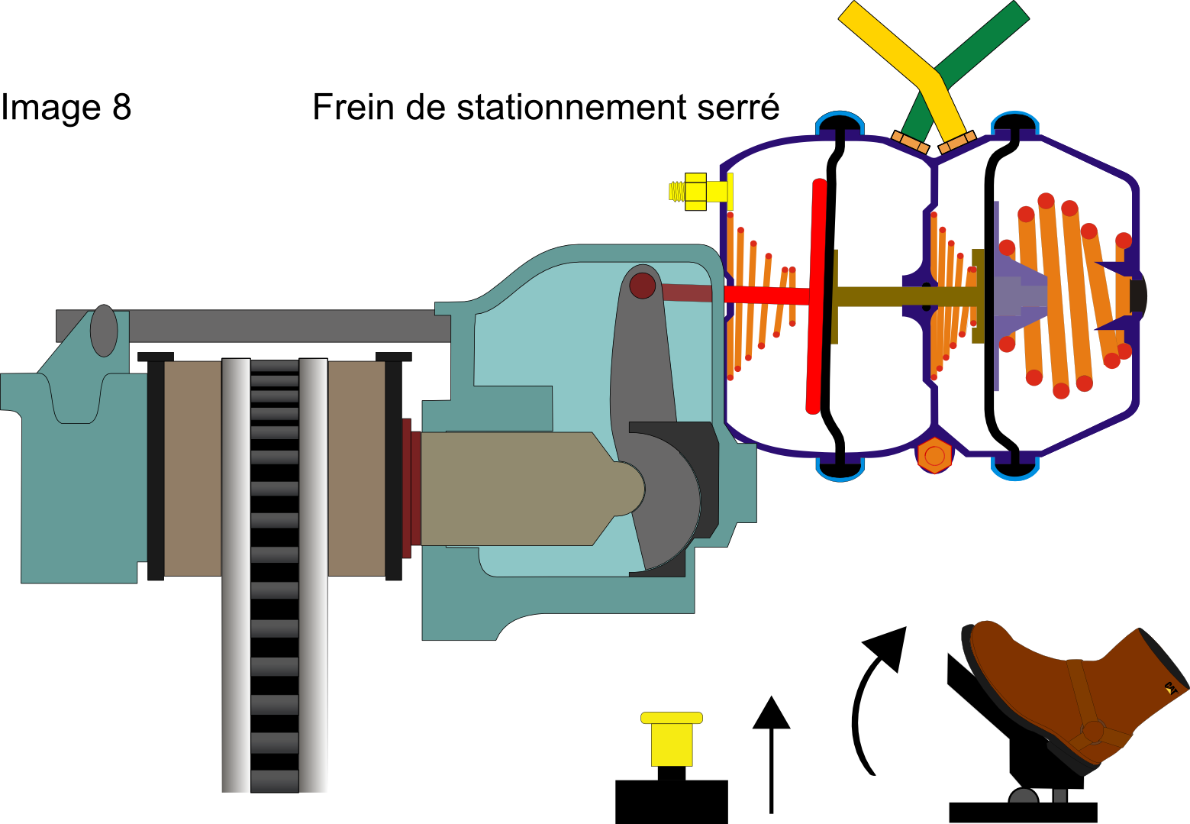
Disc Brake
Particularities: The brake actuator pushes directly on the piston. No adjustment required and no verification during the Circle Check.
Released parking brake
Parking brake applied

Slide 8
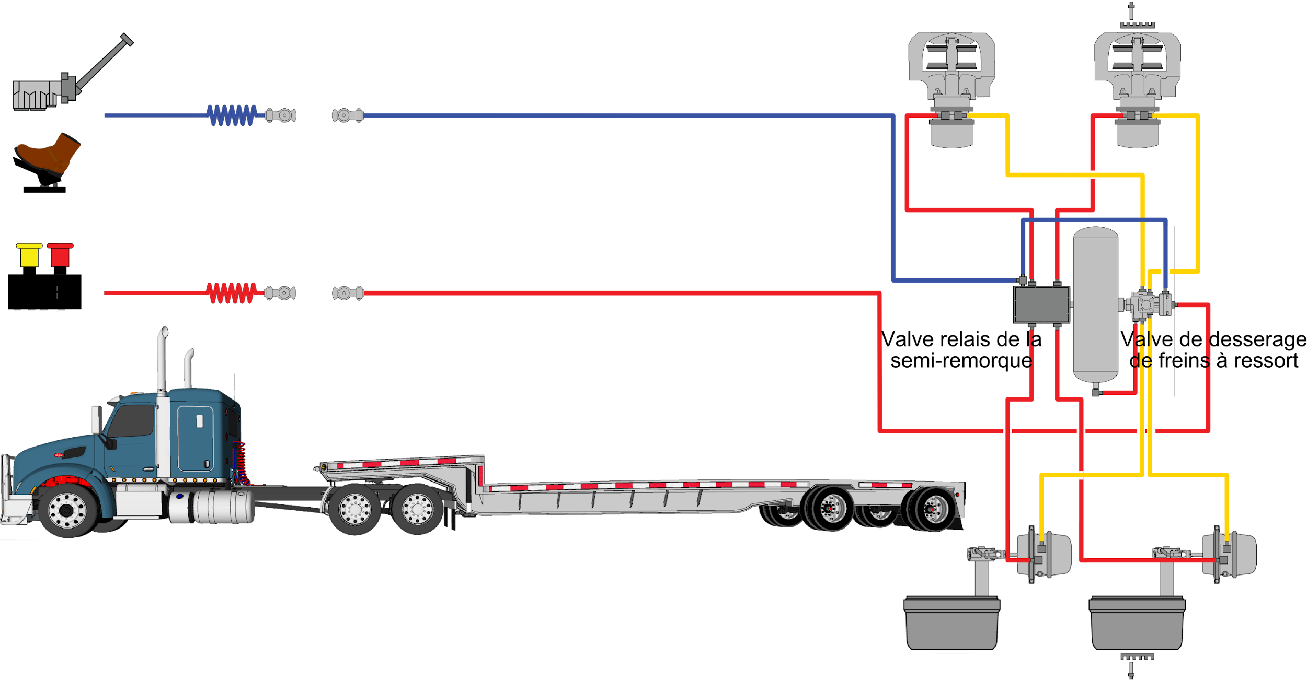
Semi-trailer braking system
Spring brake release valve
Semi-trailer
relay valve

Slide 9


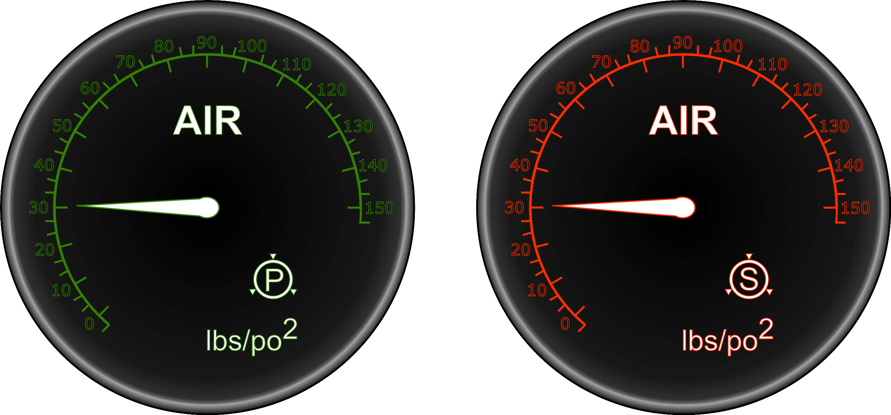


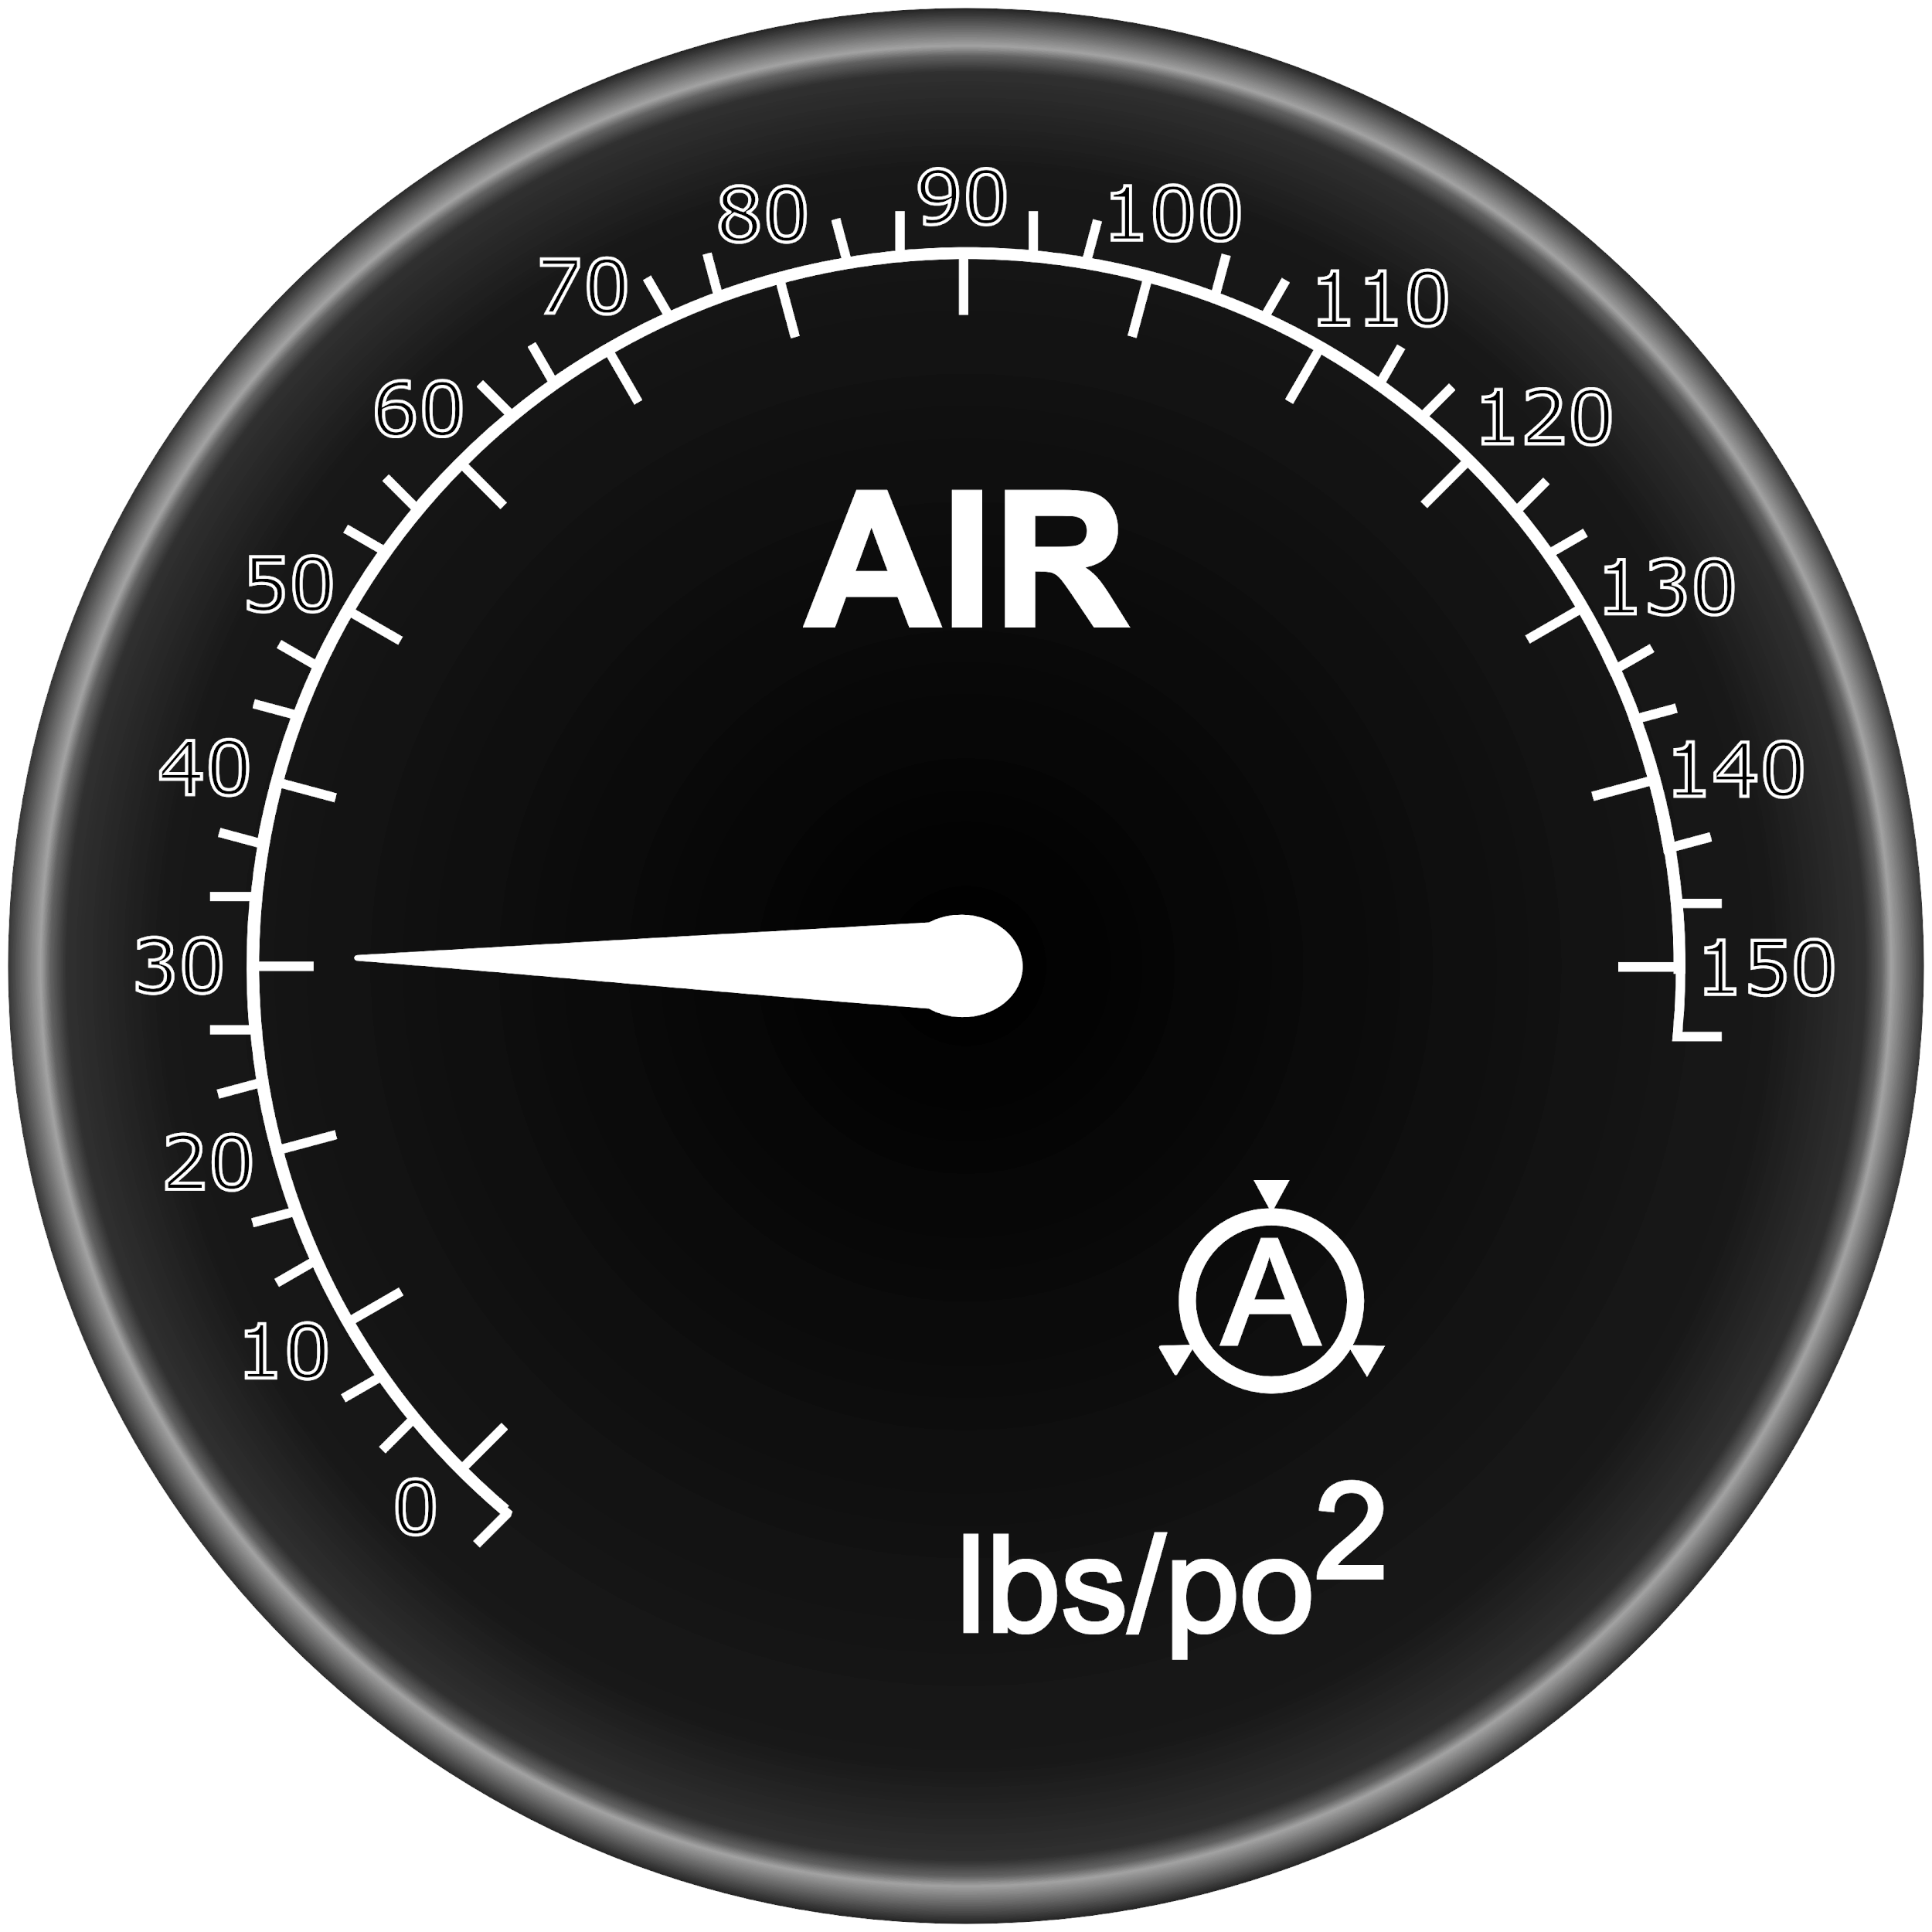


The pictograms and gauges associated with the braking systems
Primary Circuit
Secondary Circuit
Application Gauge

Slide 10





Danger indicators and warning lights
Danger Indicator
Low Air Pressure
Parking brake application warning lights

Slide 11
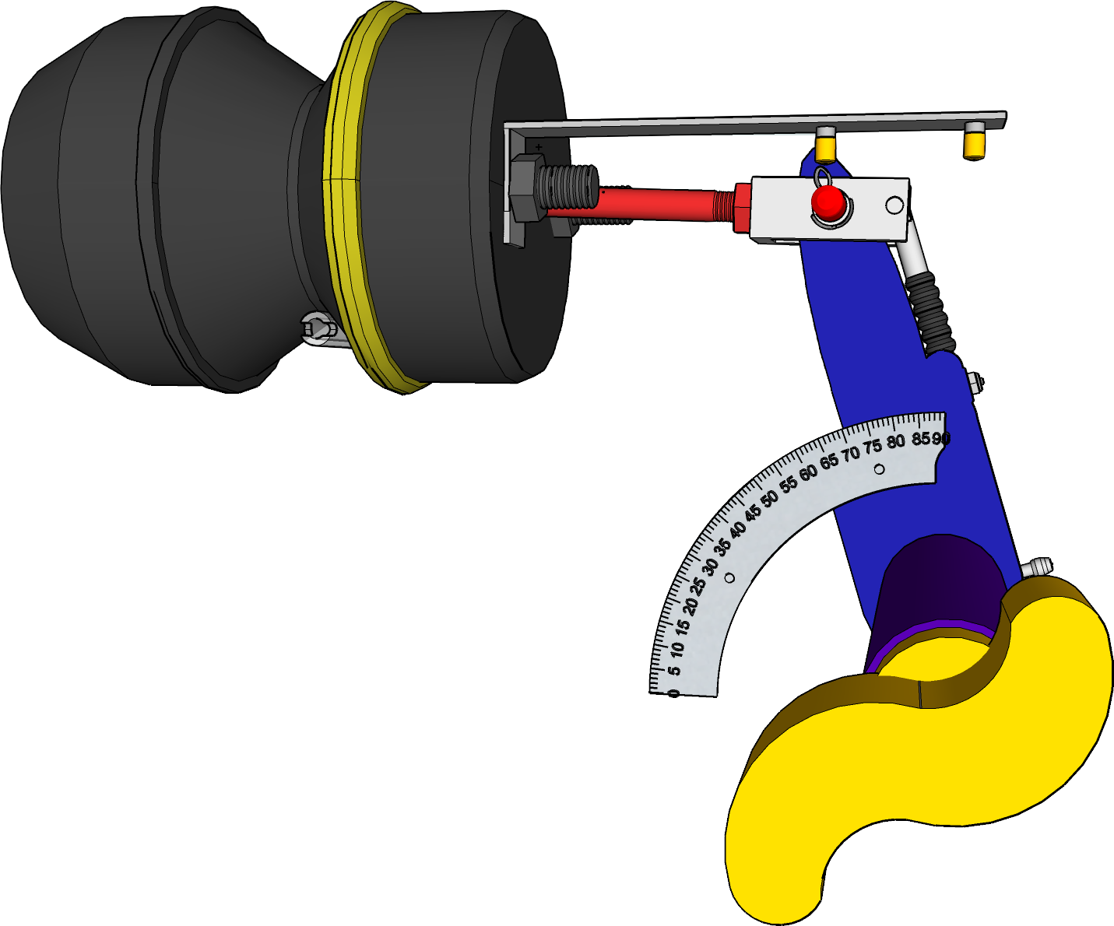
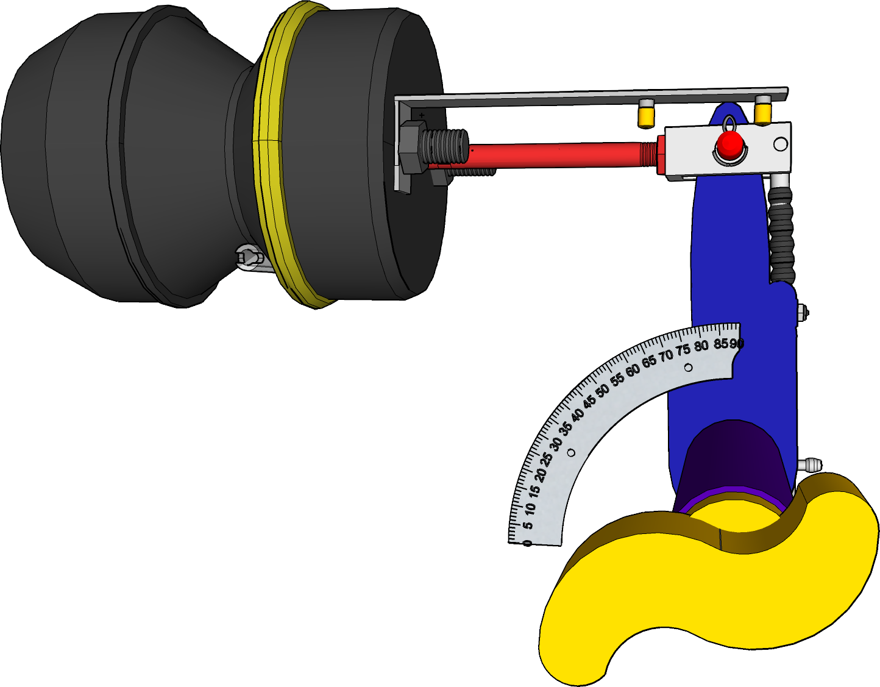
Verification of brake adjustment
Brake not applied
Brake applied
Vidéo frein

Slide 12
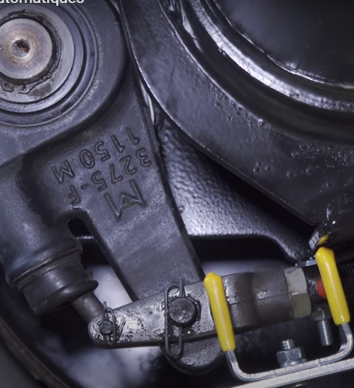
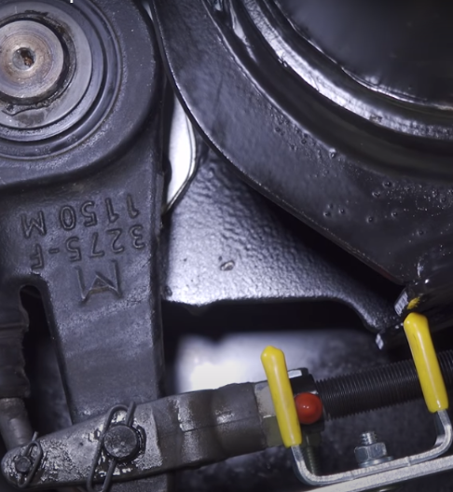
Verification of brake adjustment
Brake not applied
Brake applied
Notes:
Displacement of the push rod: Red indicator and end points are in yellow.

Slide 13
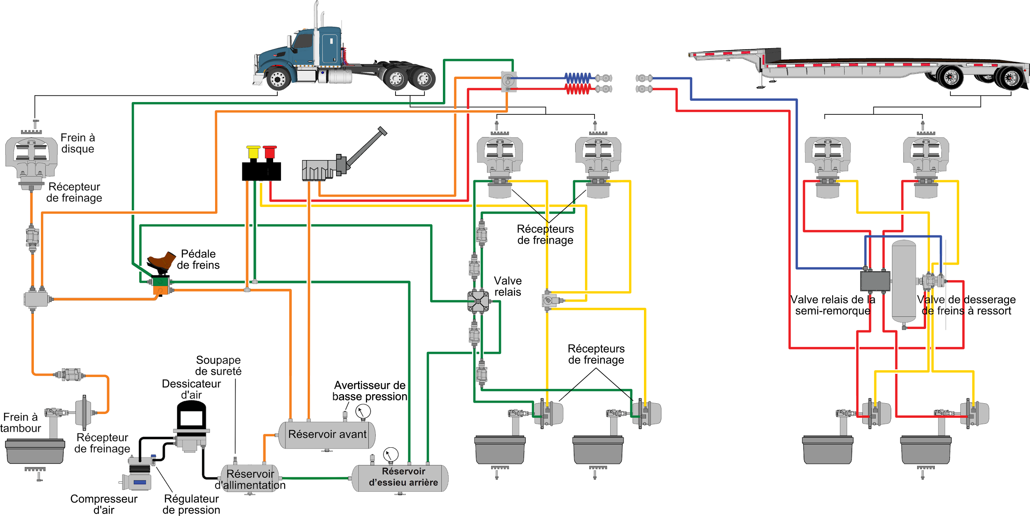
Disc Brake
Brake Actuator
Brake Actuators
Brake Pedal
Relay Valve
Semi-trailer
Relay Valve
Spring Brake
Safety Valve Brake Actuators Release Valve
Air Dryer Low Air Pressure Warning
Disc Brake
Brake Actuator Front Reservoir
Supply Reservoir Rear Reservoir
Air Pressure Regulator
Compressor
Notes:
The whole brake system

Slide 14
Drum brake adjustment procedure
Vidéo frein
Notes:
Look at entire video
Reference: Page 116 of DHV

Slide 15
Thank you
for your participation

