Slide 1

Competency 2 Lesson 2.4.1
Brake System (1)

Slide 2
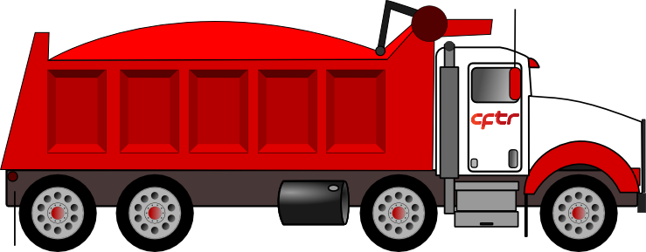
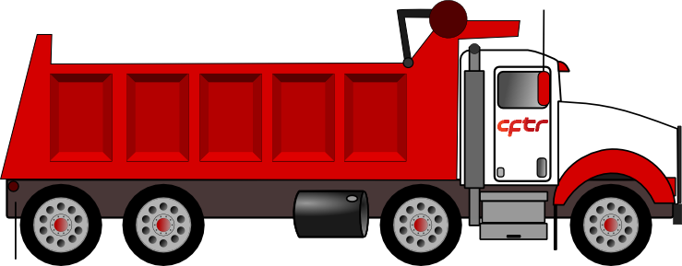

Slide 3
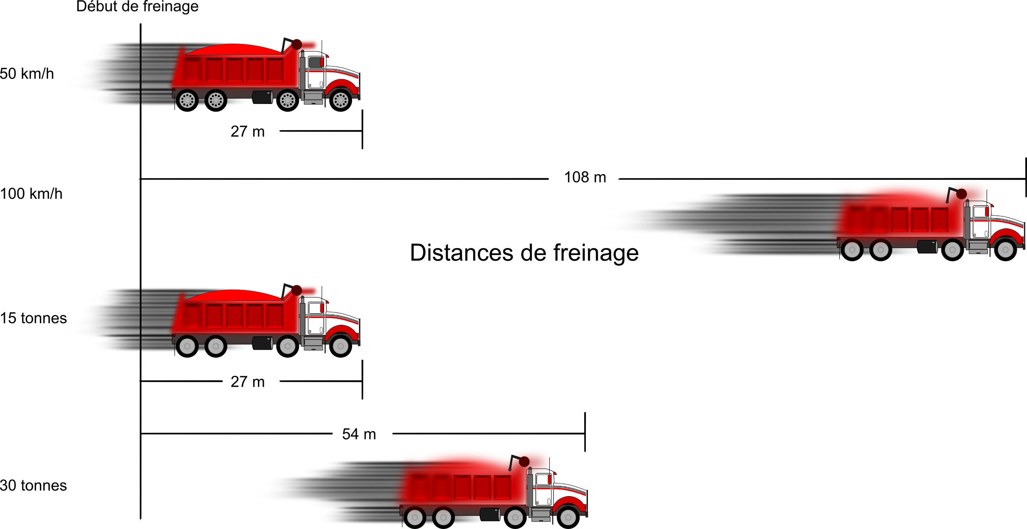
Kinetic Energy
When the vehicle’s weight is doubled, the braking distance is also doubled (2x)
When the vehicle’s speed is doubled, the braking distance quadruples (4x)
When the weight and speed are both doubled, the braking distance is eight times longer (8x)
Start of braking
Braking distance
Notes:
50 km/hr with 15 tonnes is the benchmark and has a braking distance of 27 m Reference::Page 107 and 108 of DHV
50 km/hr with 30 tonnes has a braking distance of 54 m...2x
100 km/hr with 15 tonnes has a braking distance of 108 m...4x
100 km/hr with 30 tonnes has a braking distance of 216 m (no picture)...8x

Slide 4
The coefficient of friction between the tires and the road also affects the braking distance.
It is also through the process of friction that the vehicle brakes.
Friction
Always take into account the condition of the road surface, as this dramatically affects your braking distance (much greater).
Notes:
Reference: Page 108 of DHV

Slide 5
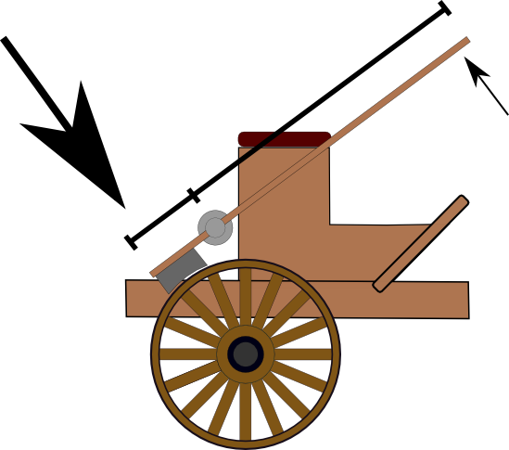
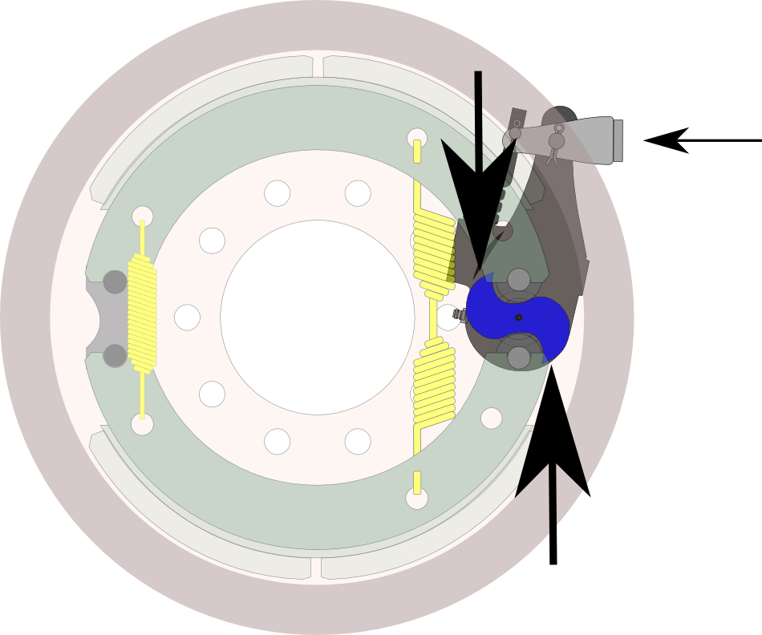
Braking Power
The adjustable lever and the leverage

Slide 6
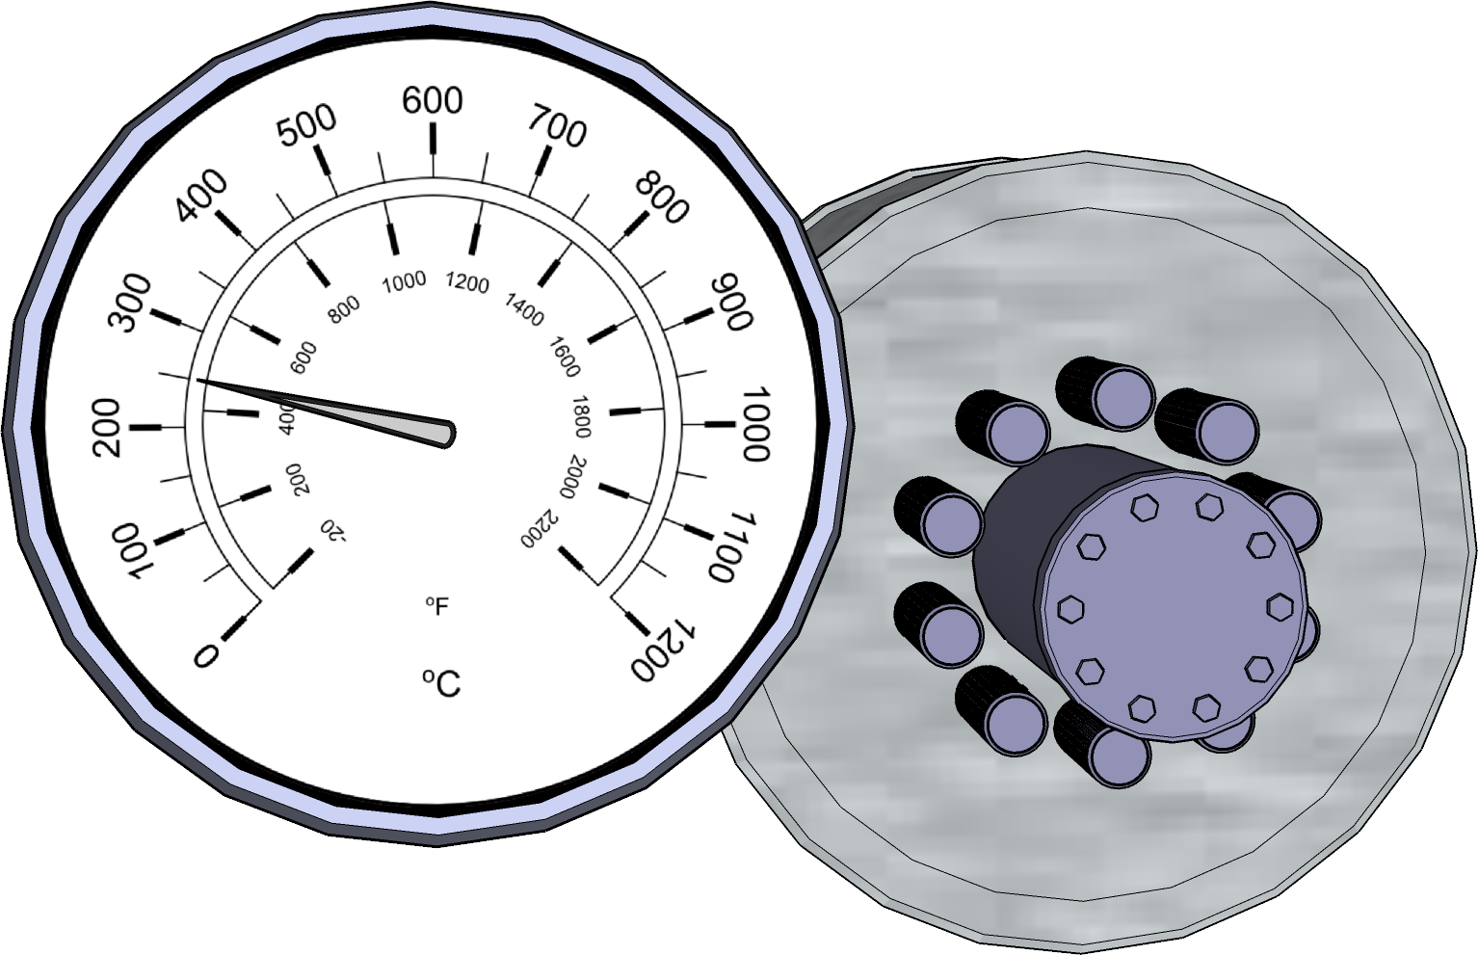
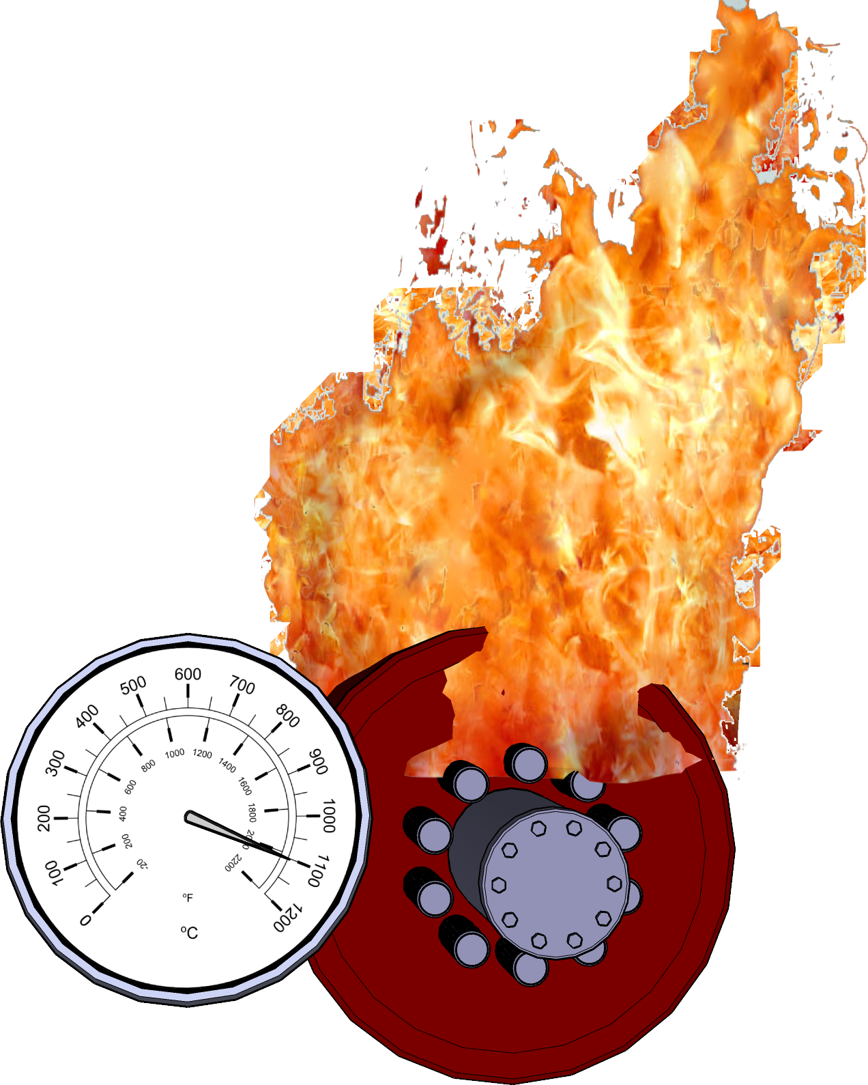
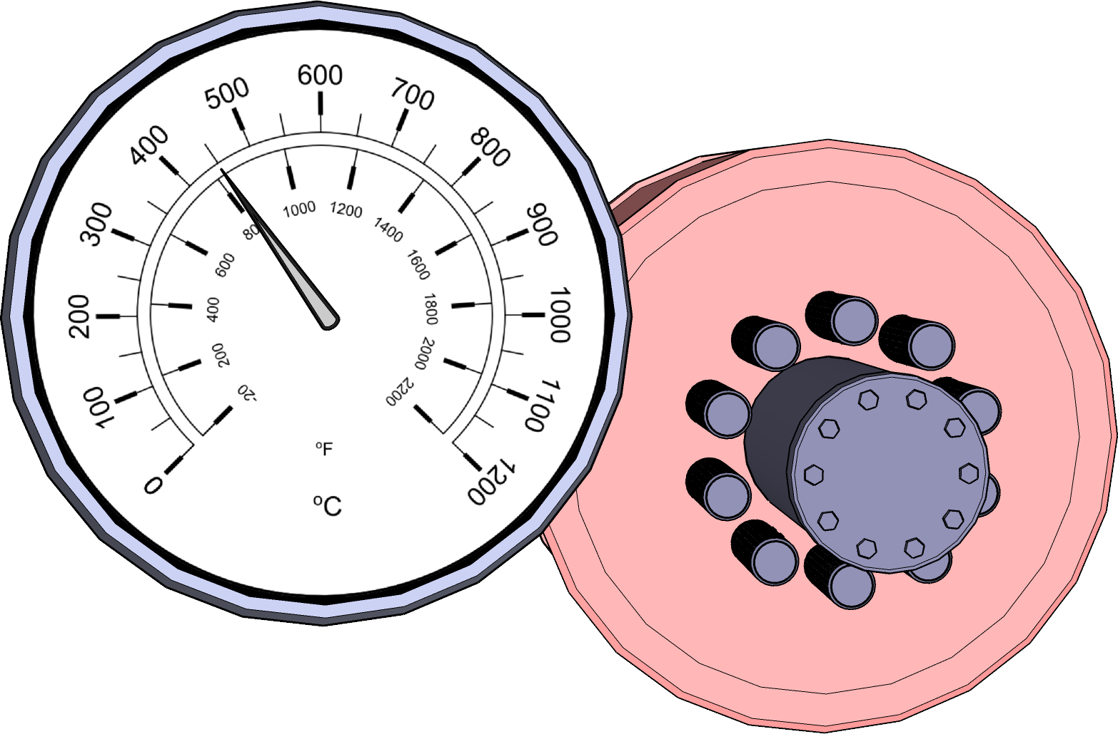
Friction and braking power caused by overheating
Normal braking at low speed
Normal to hard braking going downhill at low speed
Excessive braking on a long descent and speed is way too high
Notes:
Reference: Page 108 of DHV

Slide 7
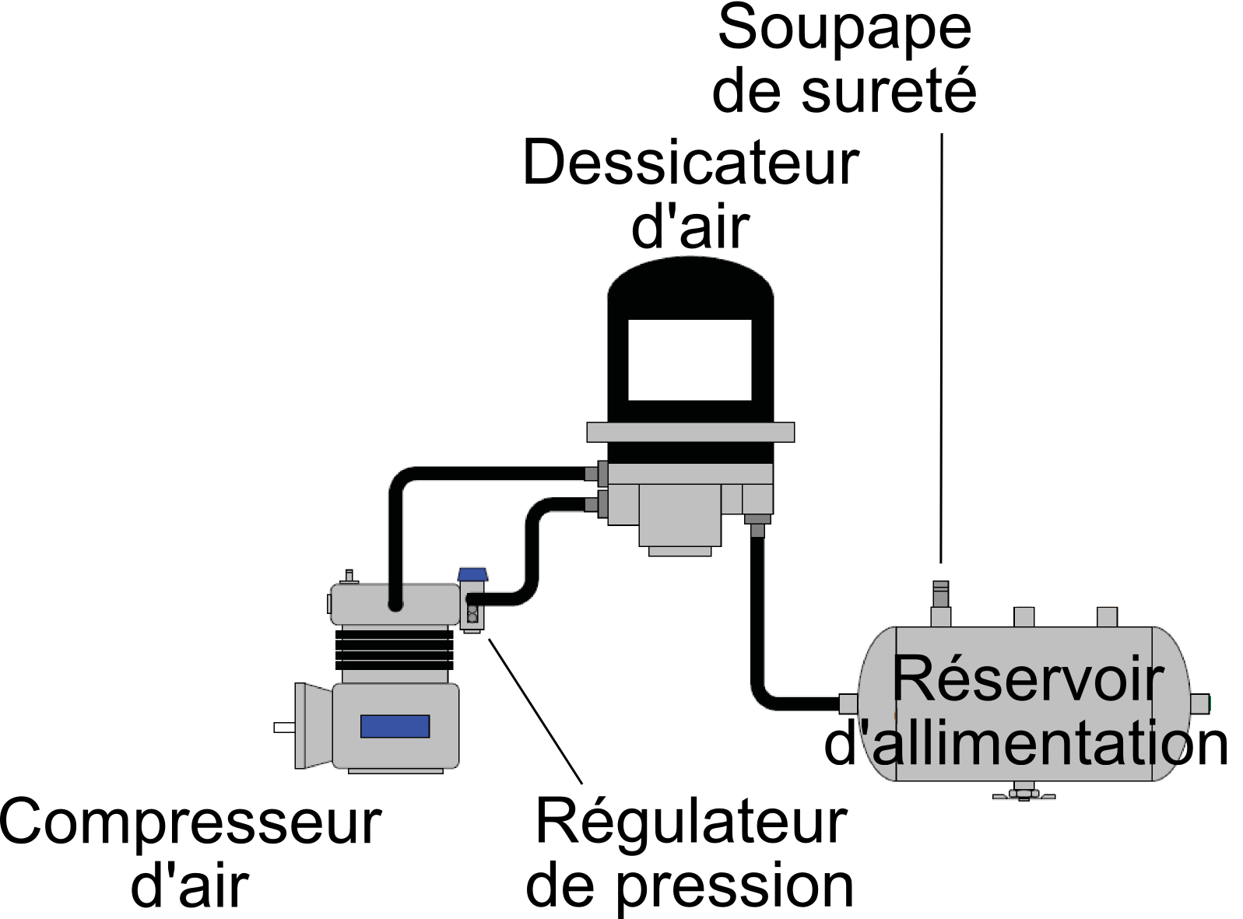
Safety Valve
Air Dryer
VIDEO
Air Supply Reservoir (tank)
Air Compressor
Pressure Regulator

Slide 8
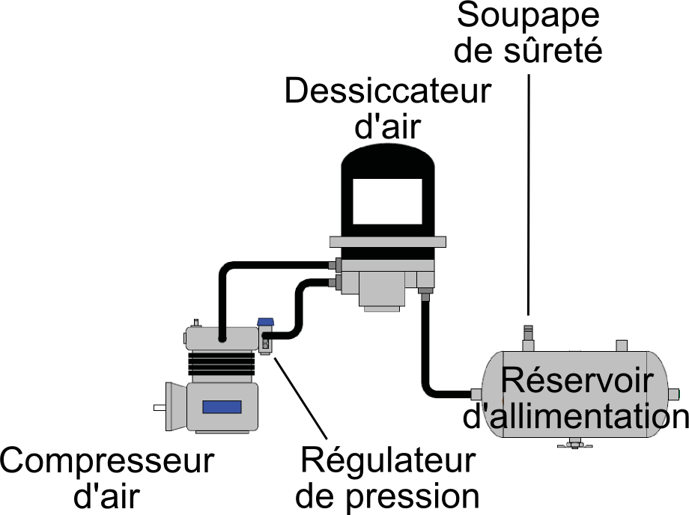
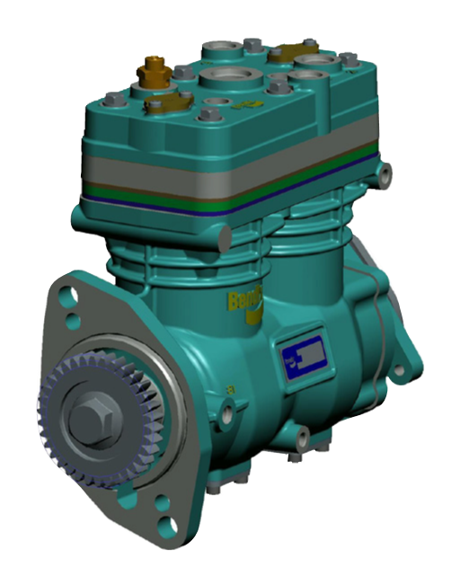
The Air Compressor
Its role: Feed compressed air to the air supply reservoir (tank).
In an air brake system, part of the power required for braking comes from compressed air. The air compressor pumps pressurized air into the tanks.
Notes:
The compressor is driven by the rotation of the engine, it is supplied with air by the engine’s air filter and is lubricated by engine oil.

Slide 9
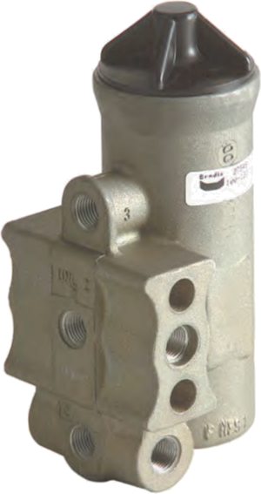
Pressure Regulator
Its role: Start the compressor at a minimum of 80 PSI “start of pumping cycle” and stop between 117 and 137 PSI “end or pumping cycle”
The pressure regulator controls the minimum and maximum air pressures of the pneumatic system. In addition, it controls the purge of the air dryer.
Notes:
The pressure regulator is usually has a preset between 100 to 105 PSI for starting and will end 20 PSI higher. Reference: Page 97 to 98 of DHV for the circuit

Slide 10
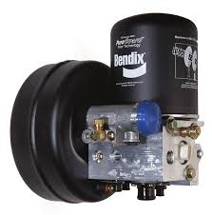
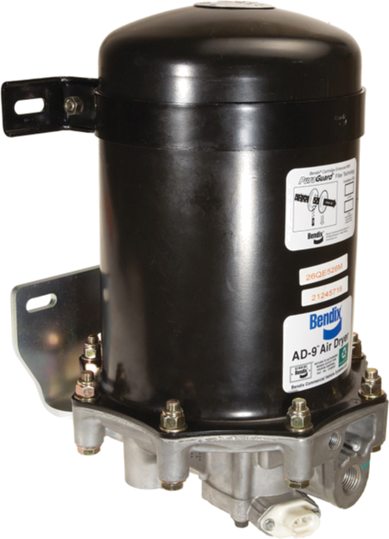
Air Dryer (air purifier)
The air dryer installed between the compressor and the supply tank, evacuates the moisture contained in the compressed air.
Notes:
A heating element is installed under the air dryer to prevent moisture from freezing.

Slide 11
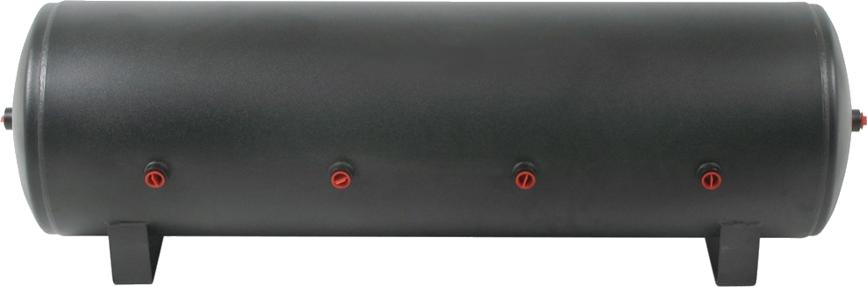
Air Supply Reservoir (tank)
The air supply reservoir (tank) stores the compressed air that comes from the air compressor.
Notes:
It supplies the primary and secondary circuit.

Slide 12
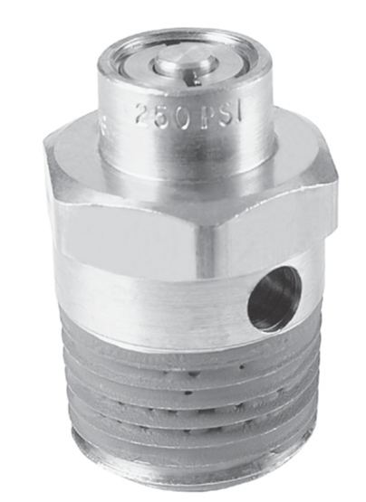
Safety Valve
If the pressure regulator is faulty and wouldn’t be able to send the signal to the compressor to disengage, the safety valve would protect the pneumatic system frome overpressure and explosion.
Notes:
It prevents the air pressure from exceeding 150 PSI in the event of a system malfunction.

Slide 13
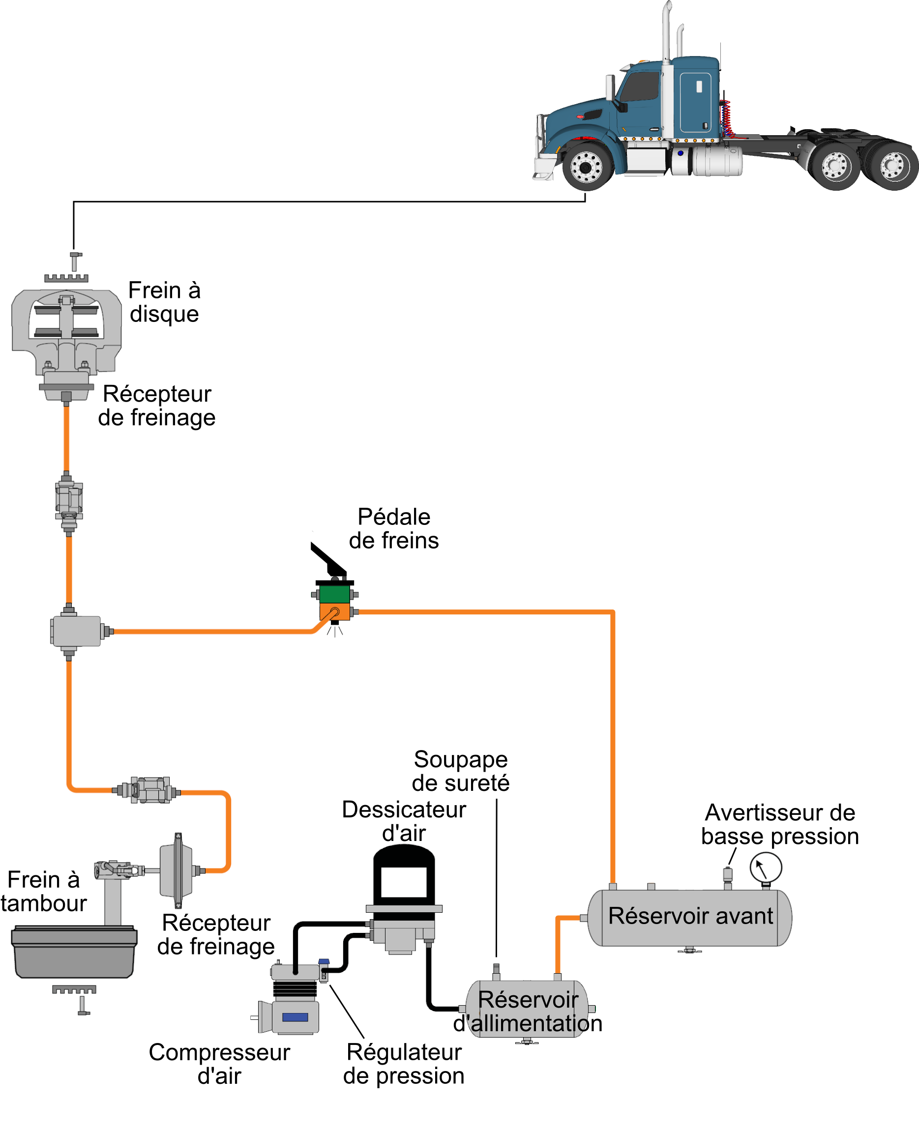
Secondary Circuit
Disk Brake
Brake Actuator
Brake Pedal
Safety Valve
Air Dryer Low Air Pressure Warning
Brake Drum
Brake Actuator Front Reservoir
Pressure
Regulator Air Supply Reservoir
Air Compressor

Slide 14
Secondary Reservoir (tank)
The secondary reservoir stores the compressed air that comes from the air supply tank.
It is equipped with a low air pressure warning alarm.
Notes:
The low air pressure warning device is connected to an indicator light and also makes a warning sound...it must activate at a minimum of 55 PSI.

Slide 15
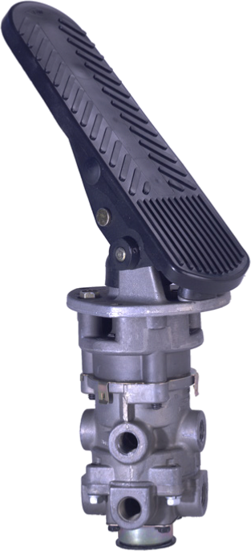
Brake Pedal
The brake pedal allows the driver to apply the brakes.

Slide 16
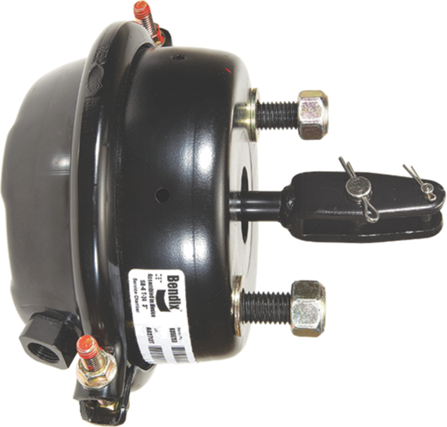
Single Brake Actuator (booster)
The single brake actuator uses compressed air that puts pressure on the adjustable lever (automatic slack adjuster).
Note: This receptor has no parking brake

Slide 17
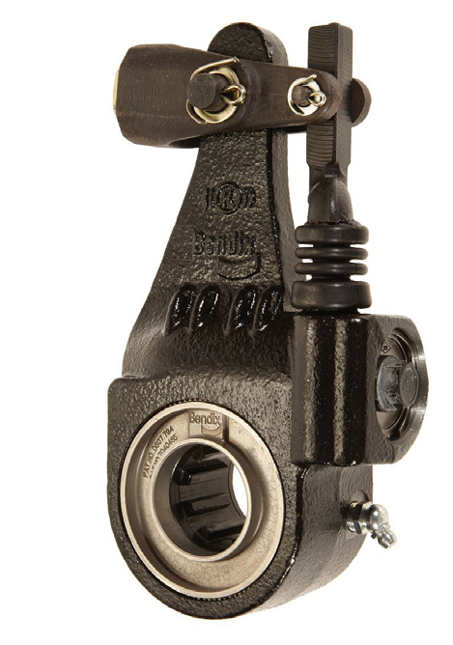
The adjustable lever (automatic slack adjuster)
The adjustable lever or automatic slack adjuster, are designed to continuously and automatically maintain the brakes in proper adjustment during normal use.
Notes:
There are several brands and models.

Slide 18
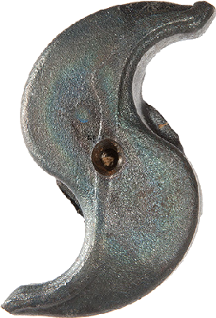
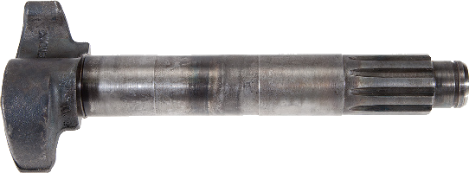
The “S” Camshaft
The S camshaft applies pressure to the brake linings.

Slide 19
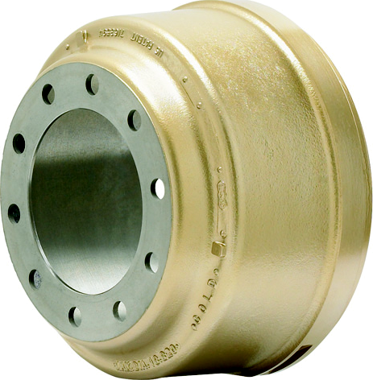
Brake Drum
It is through the process of friction between the brake linings and the brake drum that causes the vehicle to brake.

Slide 20
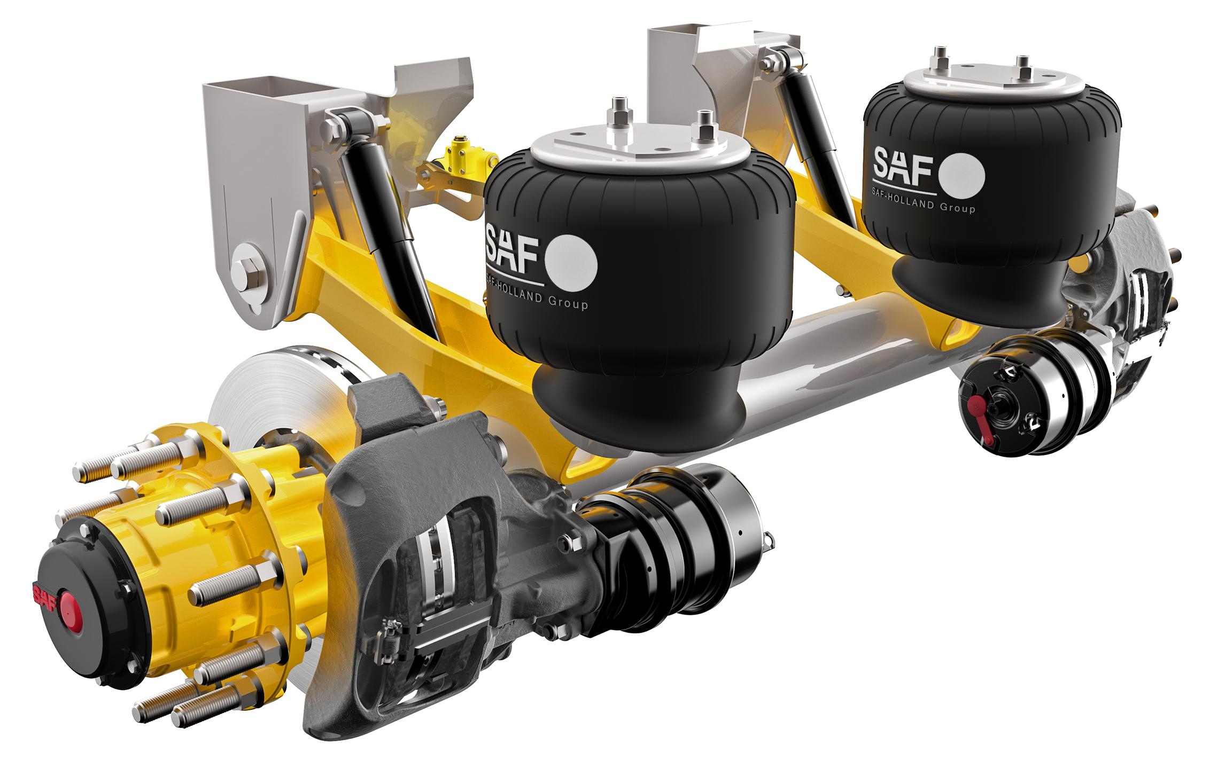
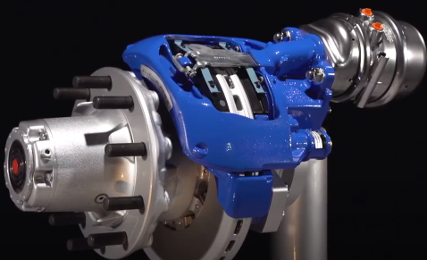
Disc Brakes

Slide 21
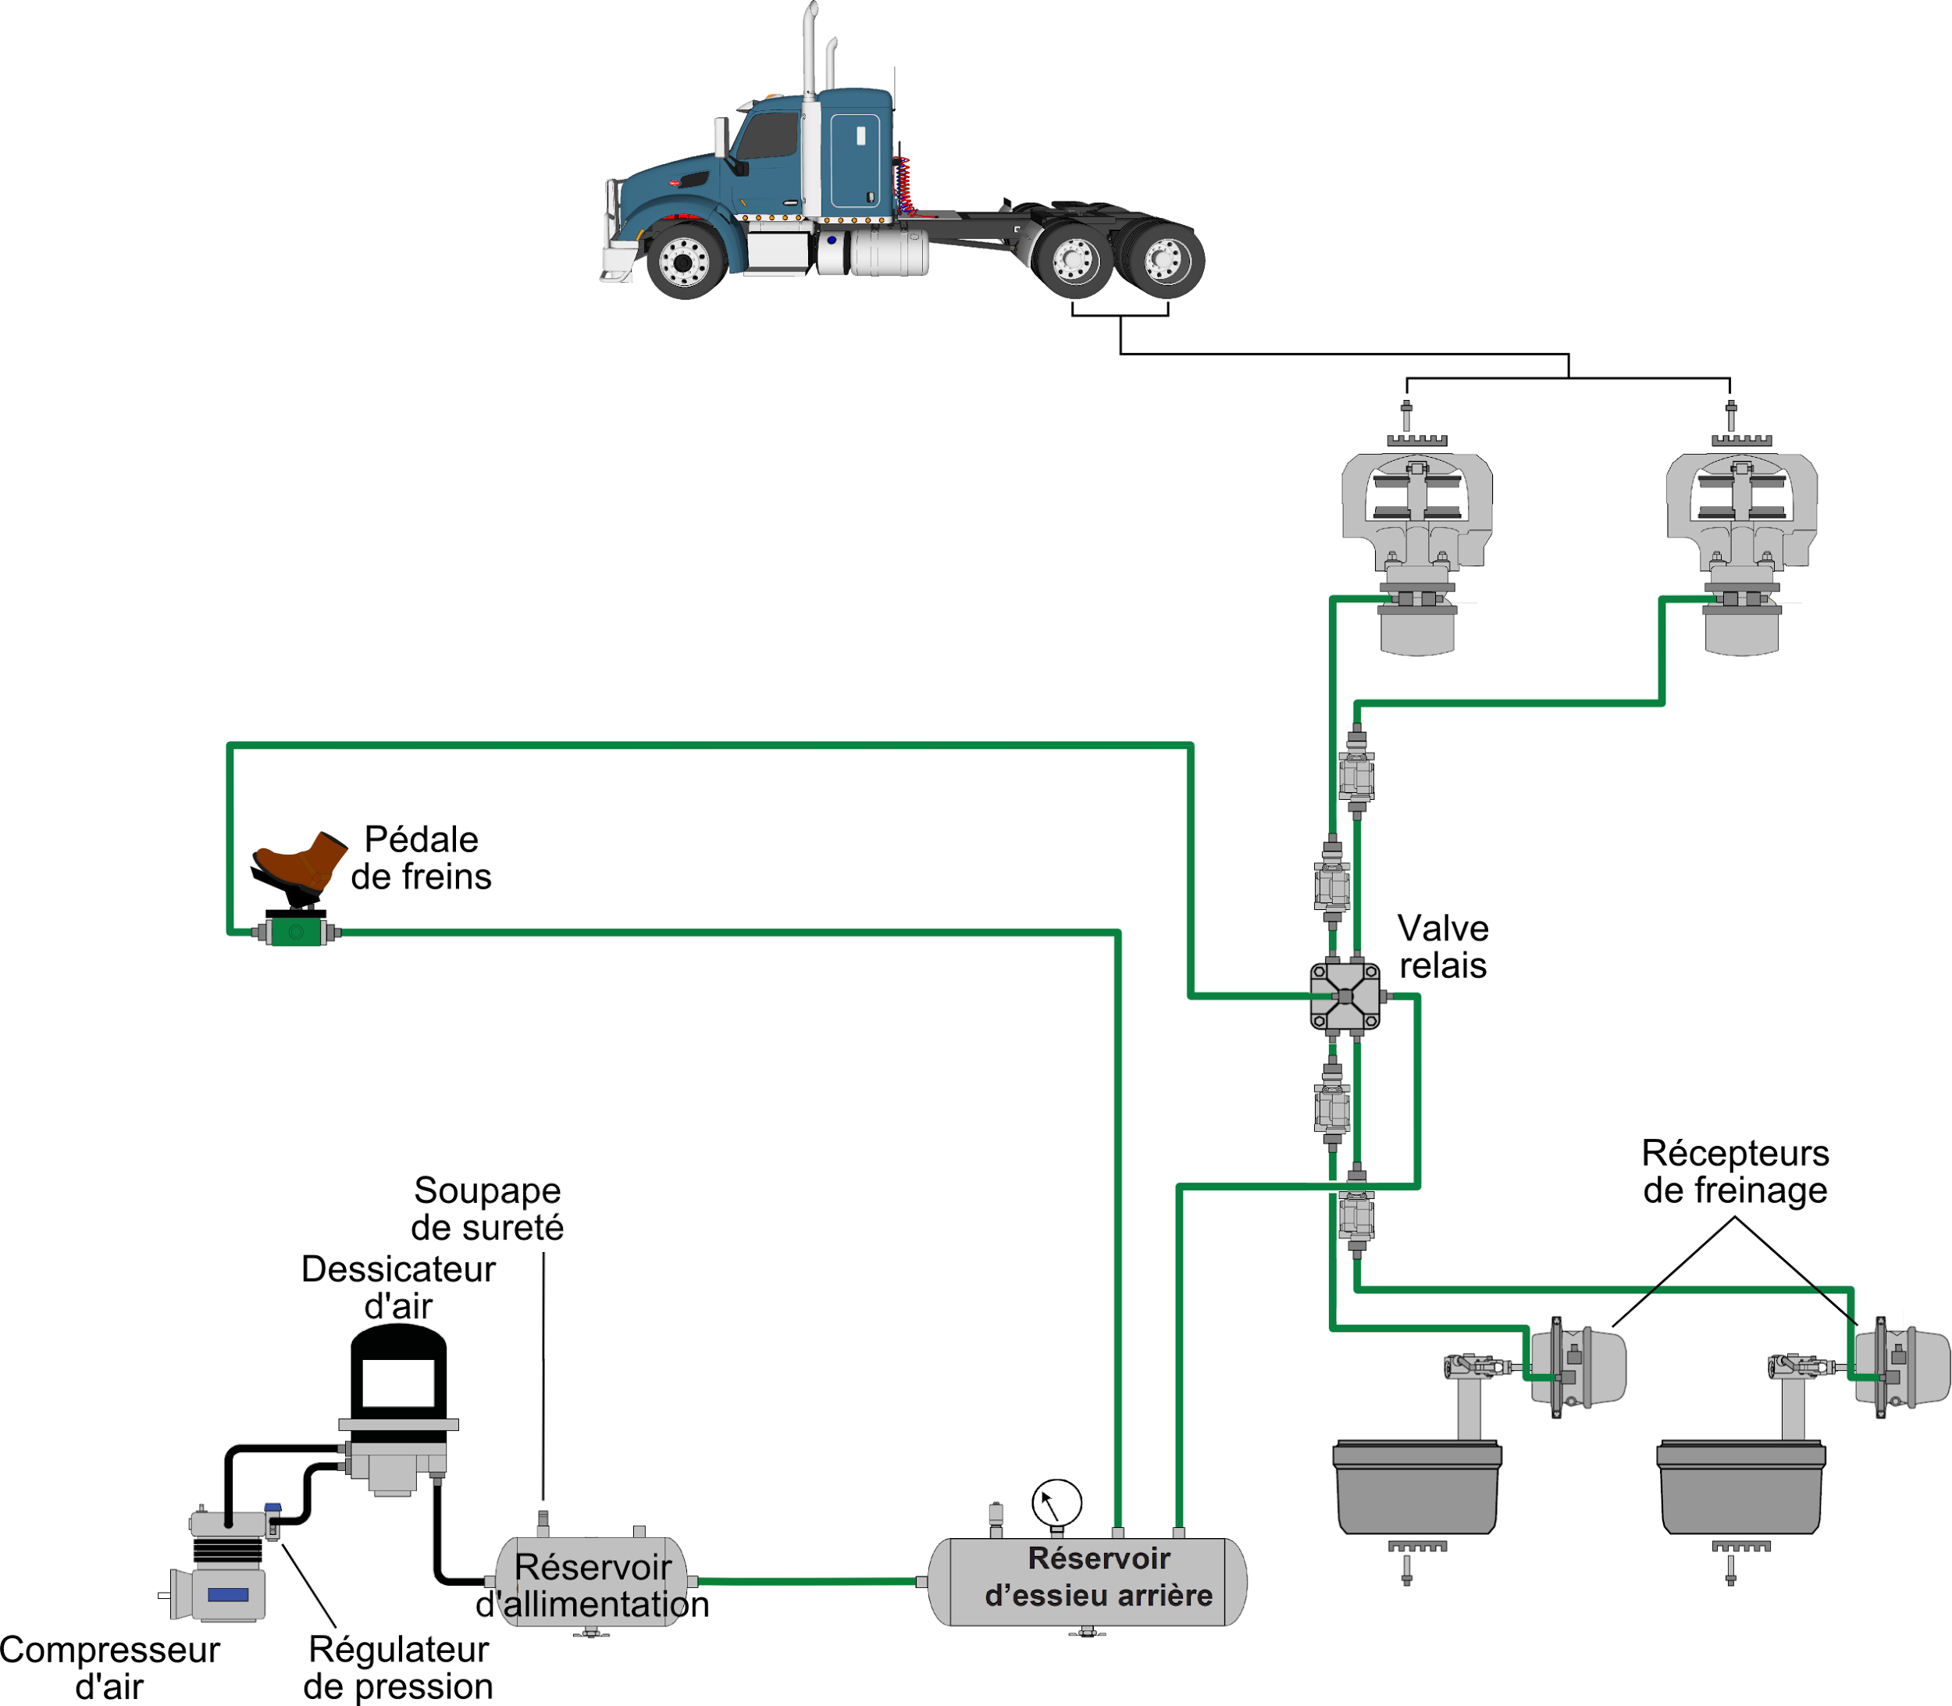
Primary Circuit
Brake Pedal
Relay Valve
Brake Actuators
Safety Valve
Air Dryer
Rear Reservoir
Air Supply Reservoir
Air Compressor
Pressure Regulator

Slide 22
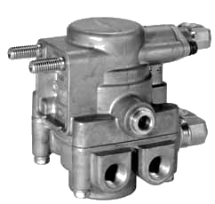
Relay Valve
Compressed air from the brake pedal travels through the service line and activates the relay valve which directs air from the primary reservoir to the vehicle’s rear service brakes.

Slide 23
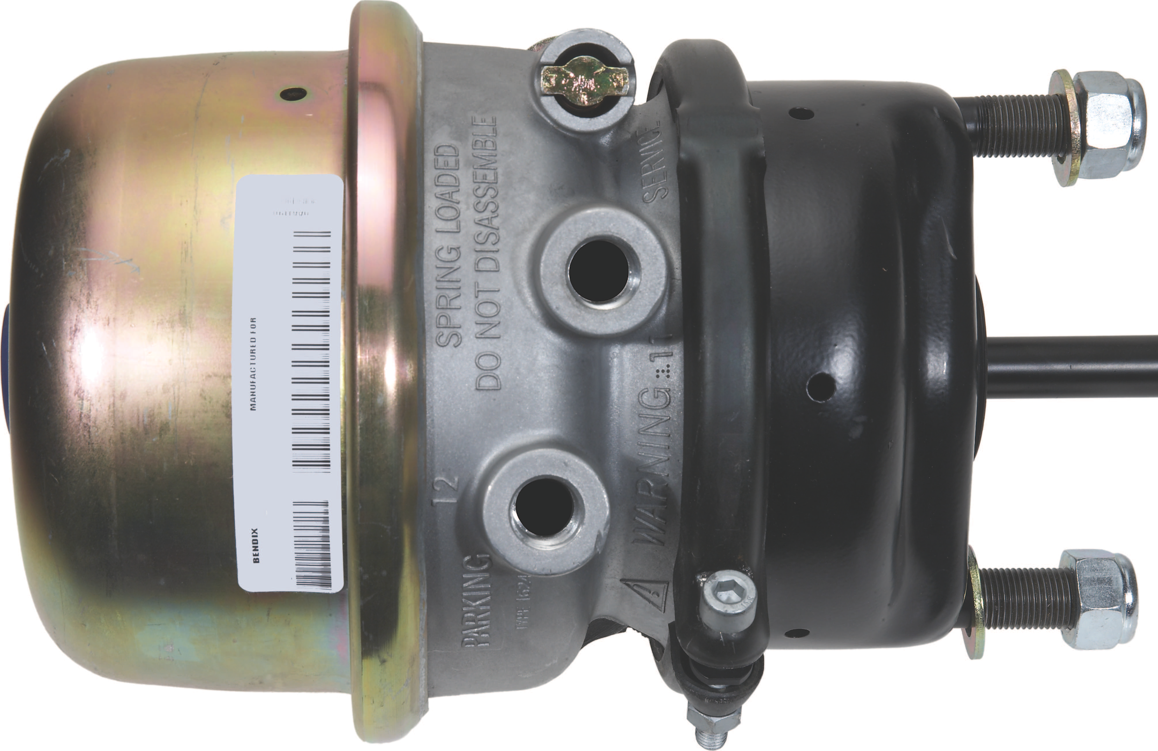
Dual Brake Actuator (booster)
The dual brake actuator, in addition to performing the same action as the single brake actuator it also actuates the parking brake.

Slide 24
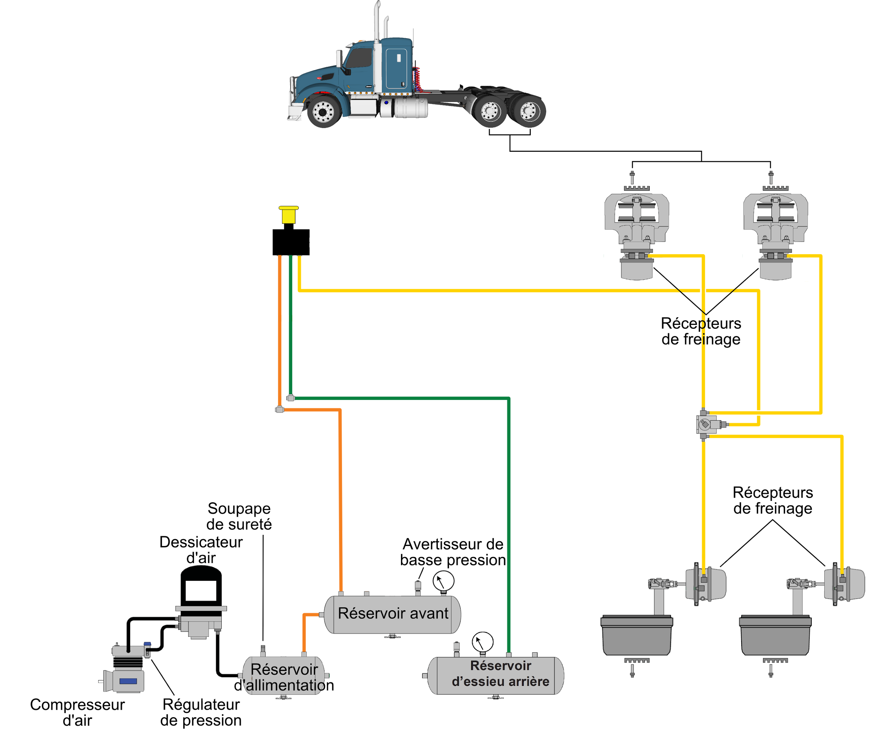
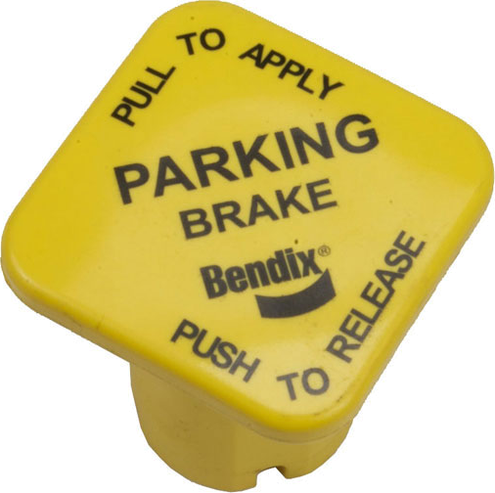
The Parking Brake Circuit (emergency)
Parking Brake Control Valve
Brake Actuators
Safety Valve
Air Dryer Low Air Pressure Warning
Pressure Front Reservoir
Regulator
Air
Supply Rear Reservoir
Air Compresseur Reservoir
The parking brake control valve, when pushed, releases the vehicle’s parking brake.
Compressed air from the parking brake control valve actuates the relay valve which directs air from the primary and secondary reservoirs to the vehicle’s parking brakes.

Slide 25
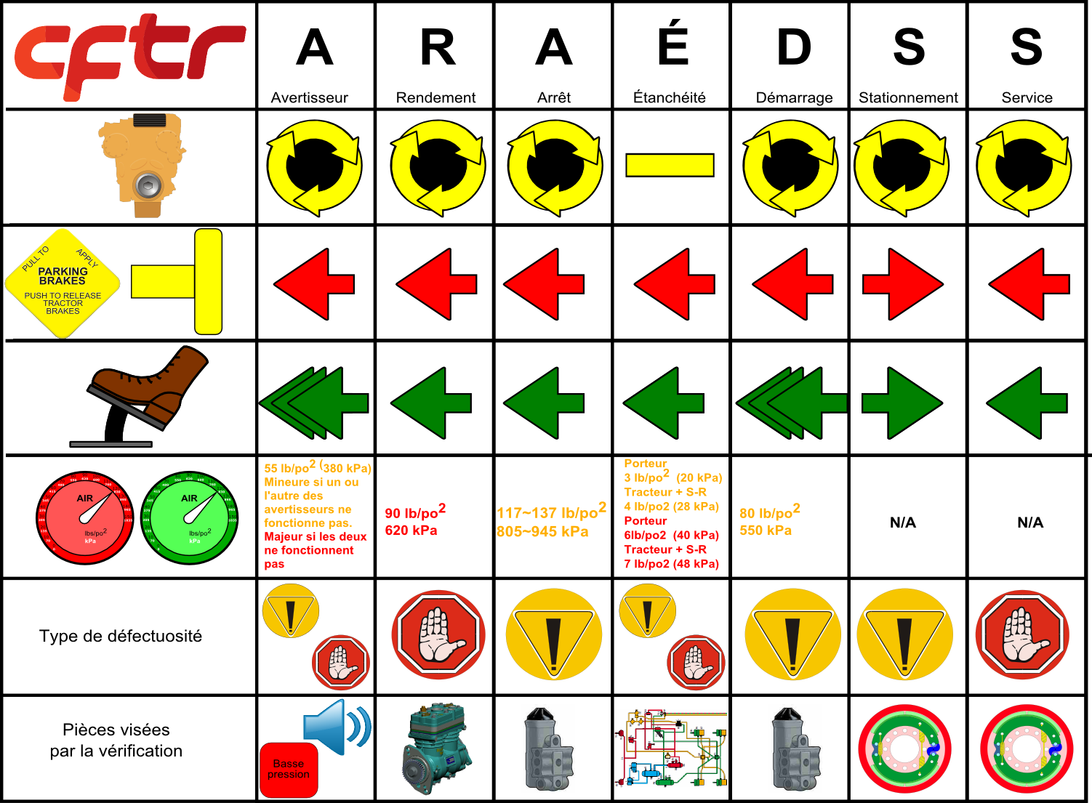
W
Low Air Pressure Warning
E
Efficiency
D
Disengagement
L
Leakage
E
Engagement
P
Parking Brake
S
Service Brake
55 lbs
380 kpa
Minor: if one or the other is not working
Majer: if both not working
90 lbs
(620 kpa)
117-137 lbs
(805-945 kpa)
Straight Truck
3 lbs (40 kpa)
Tractor+S-trlr
4 lbs (28 kpa)
Straight Truck
6 lbs (40 kpa)
Tracto + S-trlr
7 lbs (48 kpa)
80 lbs
(550 kpa)
N/A
N/A
Type Of Defect
Parts Being Verified

Slide 26
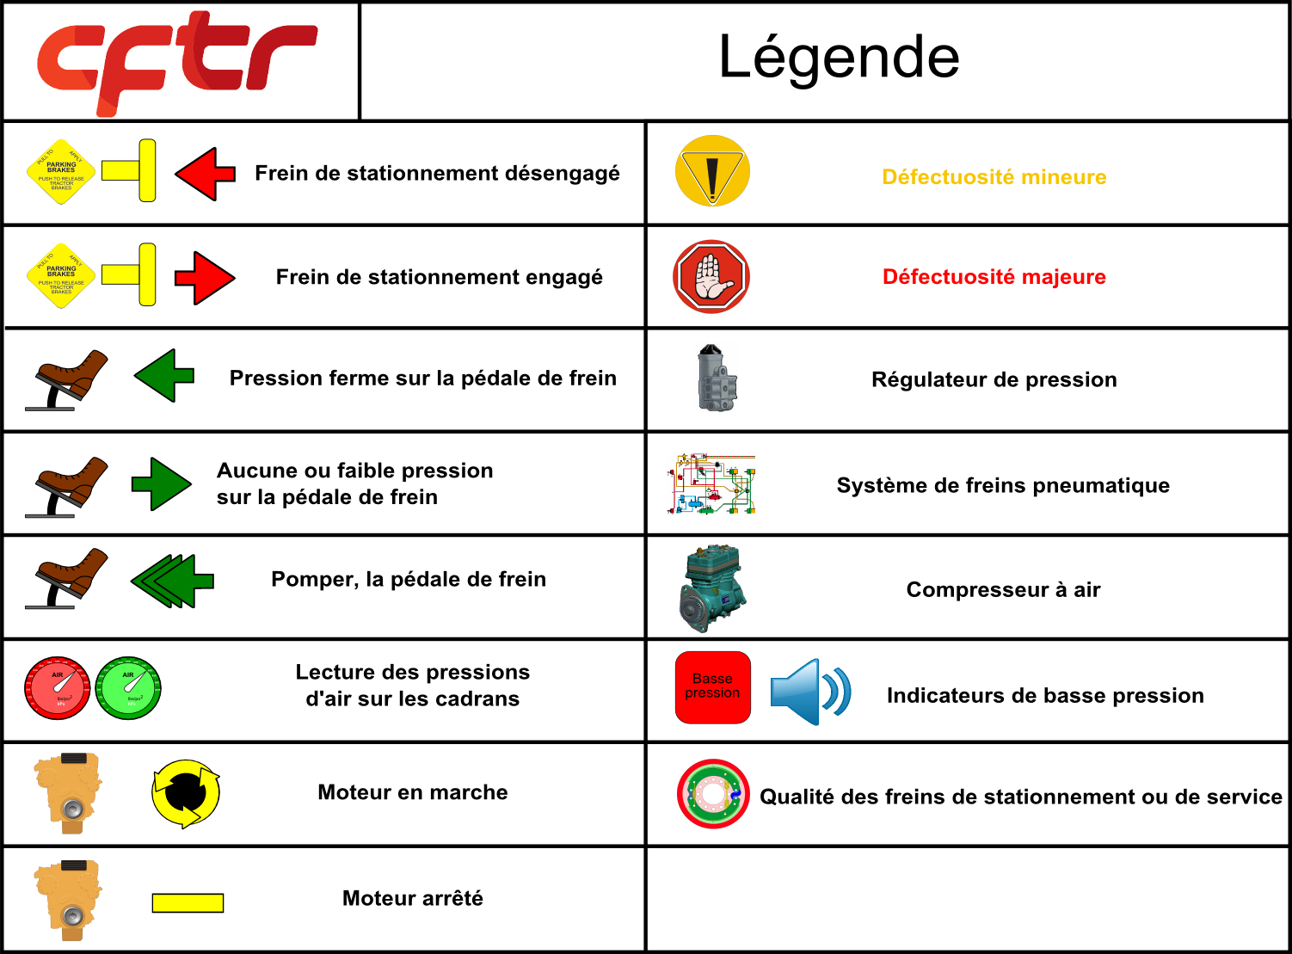
Legend/
Parking Brake Released
Minor Defect
Parking Brake Applied
Major Defect
Apply Firm Pressure On The Brake Pedal
Pressure Regulator
None Or Very Little Brake Pressure On The Brake Pedal
Air Brake System
Pump The Brake Pedal
Air Compressor
Air Pressure Readings On Gauges
Low Air Pressure Warning
Engine Running
Quality Of Parking Or Service Brakes
Engine Off

Slide 27
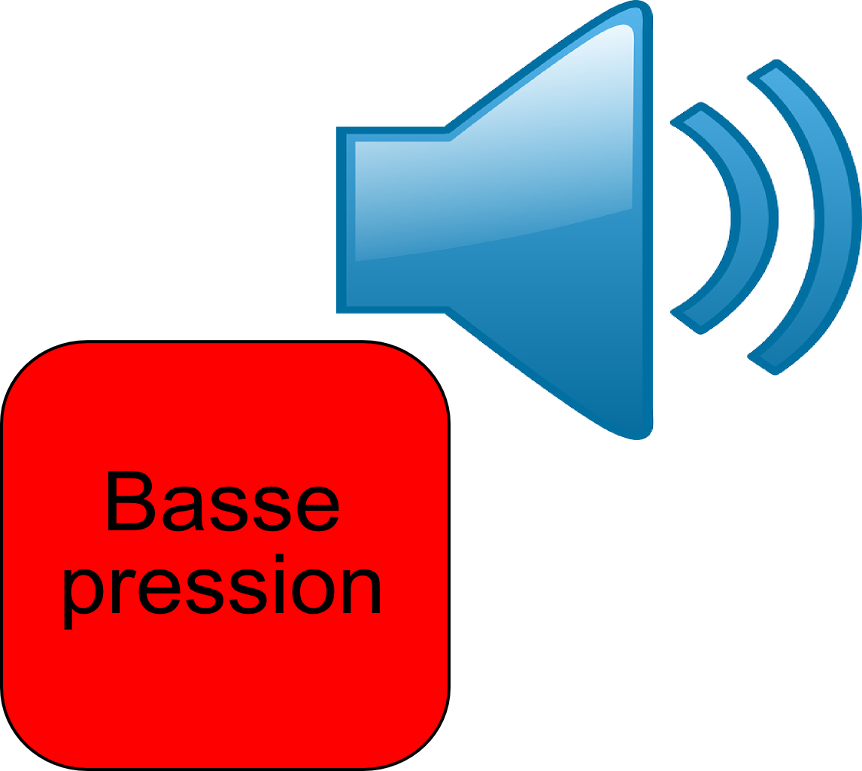
Low Air Pressure Warning
The low air pressure warning device should be seen and heard at a minimum of 55 PSI.
Low
Pressure
Notes:
Note: that the alarm goes off much higher than 55 PSI
It allows the driver to be notified ASAP to park before the emergency brakes apply.

Slide 28
Efficiency
The compressor must be able to maintain 90 PSI under the worst circumstances.
Notes:
This test helps ensure a safe braking distance under all circumstances.

Slide 29
Disengagement
The pressure regulator sends a signal to the compressor to stop between 117 and 137 PSI
Notes:
The compressor should stop somewhere in between 117 and 137 PSI.

Slide 30
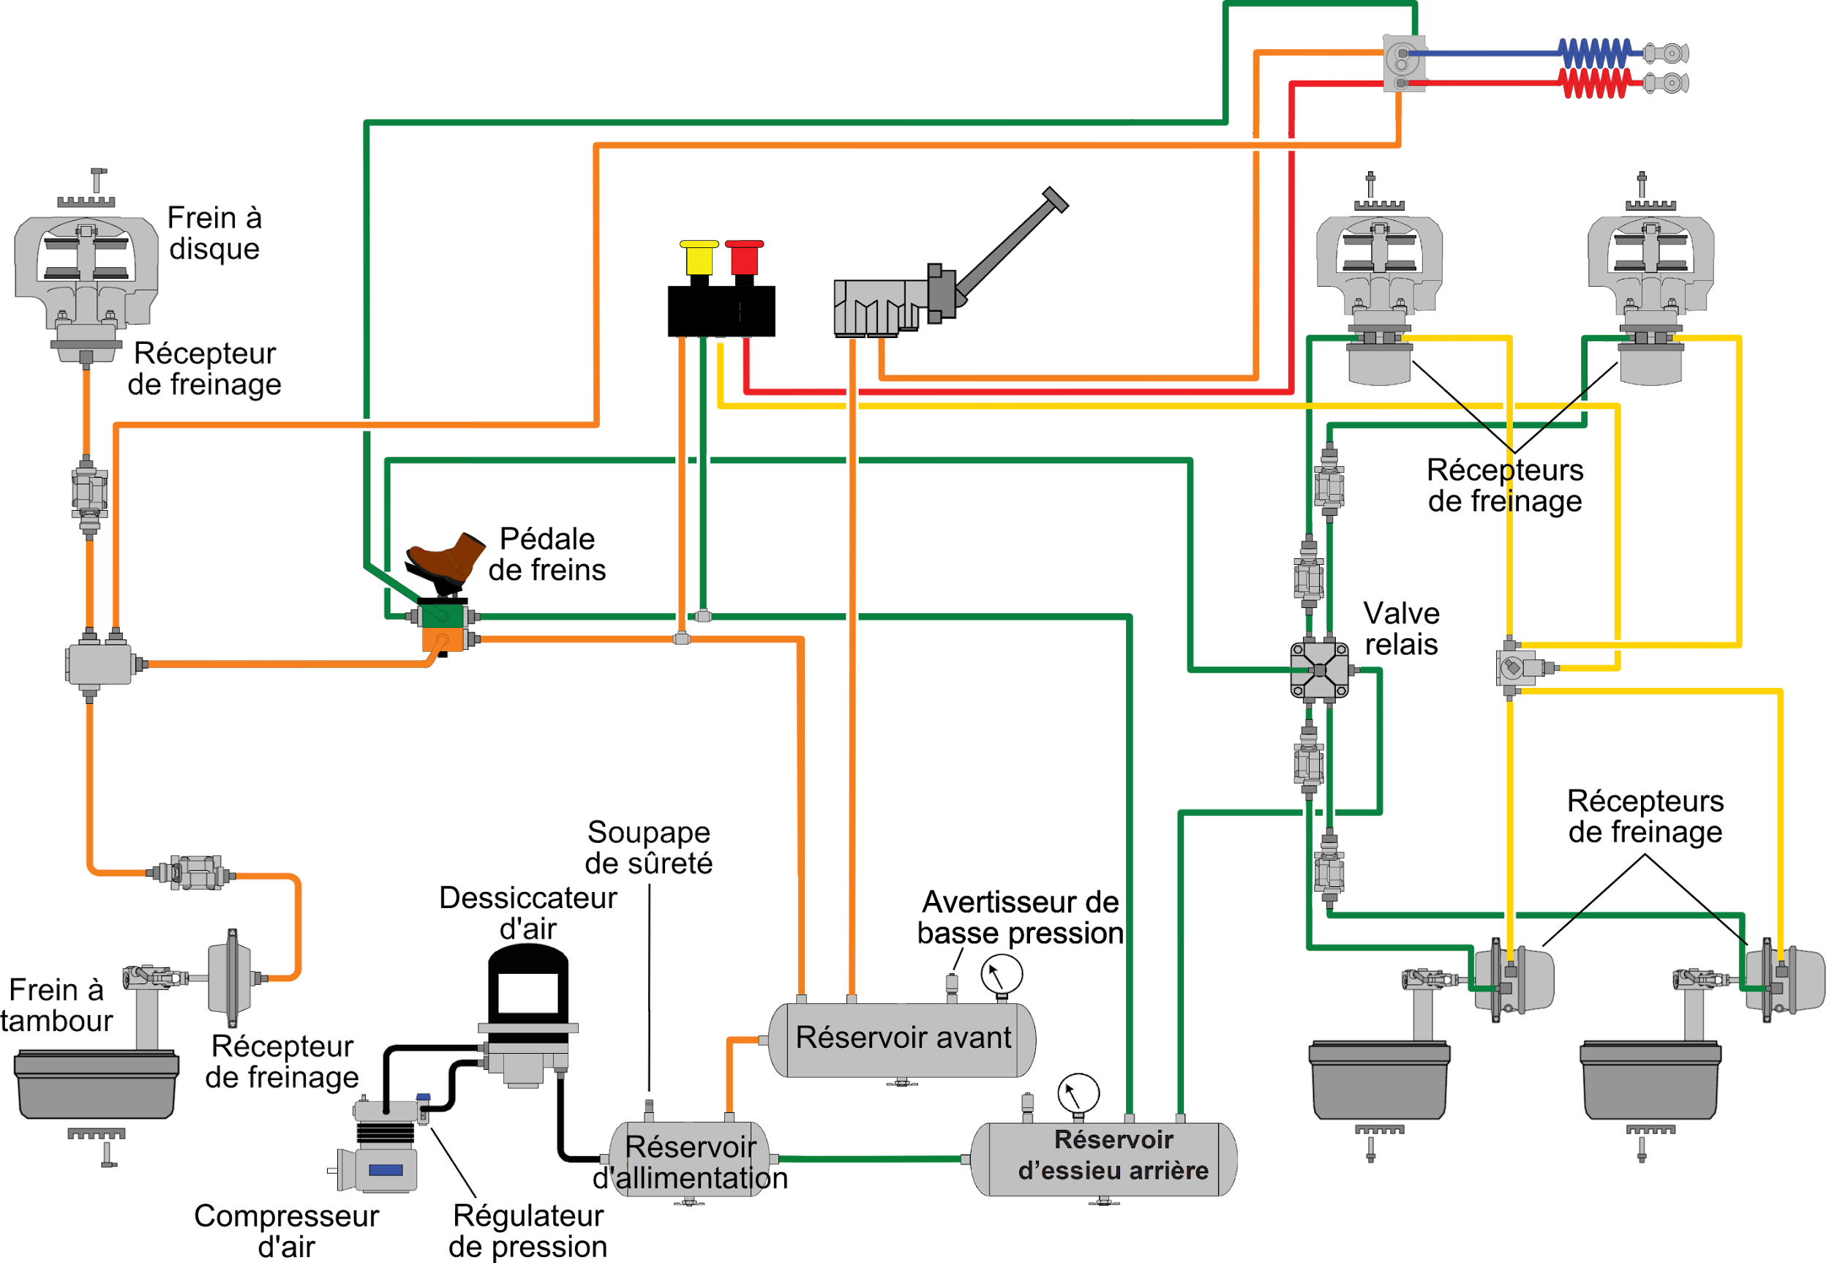
Leakage
The pneumatic system must not have an air lose of more than 6 PSI for one vehicle and 7 PSI for more than one vehicle.
Notes:
This is the only test that is done with the engine off.

Slide 31
Engagement
The pressure regulator sends a signal to the compressor to start at a minimum of 80 PSI.
Notes:
The compressor starts 20 PSI below disengagement.

Slide 32
Parking Brake
The parking brakes must hold the vehicle when trying to move forward.
Notes:
With a manual transmission, it would be wise to engage 2nd or 3rd gear to reduce the torsional force to the driveshaft and axles.
With an automated or automatic transmission, setting the truck in motion may be necessary depending on the manufacturer’s safety type...some transmissions do not engage in “drive” when the parking brake is applied.

Slide 33
Service Brake
The service brakes should easily stop the vehicle when it is in motion.
Notes:
When setting the truck in motion, make sure that all the wheels turn freely.
With a manual transmission, the clutch must be depressed before braking, due to the low speed of the vehicle.

Slide 34
Thank you
for your participation

