Slide 1
Competency 2
Lesson 2.3.4
Transmission In Motion
(Power Divider, Differentials And Traction Control)

Slide 2
Lesson Objective:
Determining the procedures for using the Inter-Axle lock (power divider lock), as well as the Inner-Axle lock (differential lock) and the use of the Traction Control.
Determining what means to take when stuck or spinning.

Slide 3
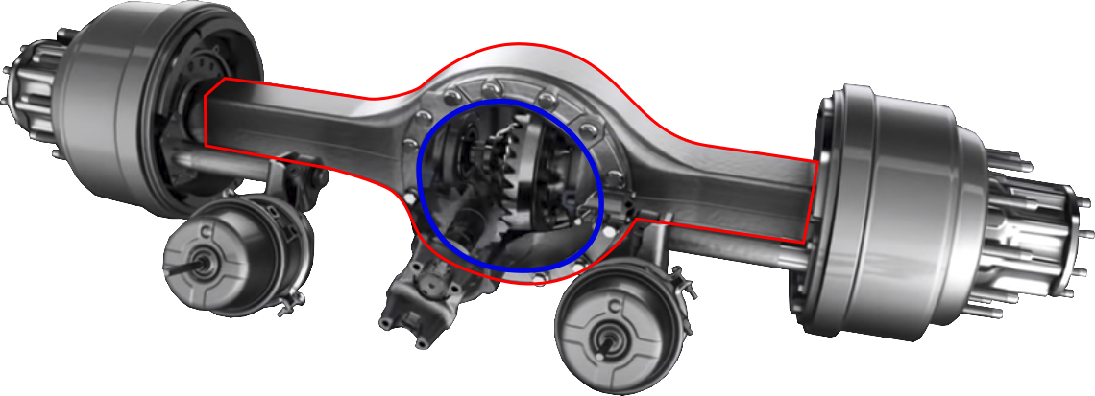
The differential is a gearing system
(circled in blue in the illustration)
It is located in a housing which is called an axle
(highlighted in red in the illustration)

Slide 4
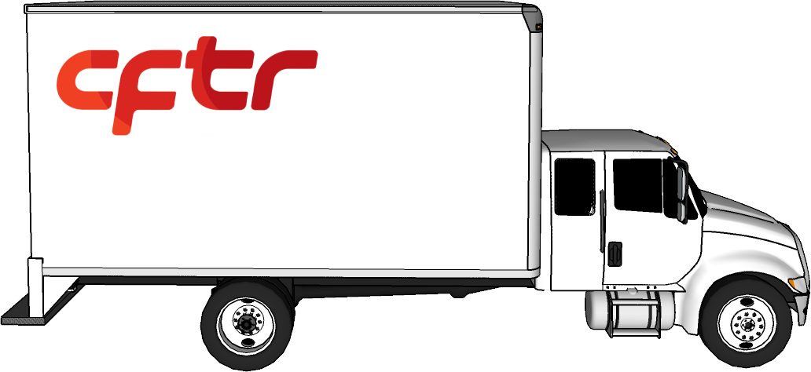
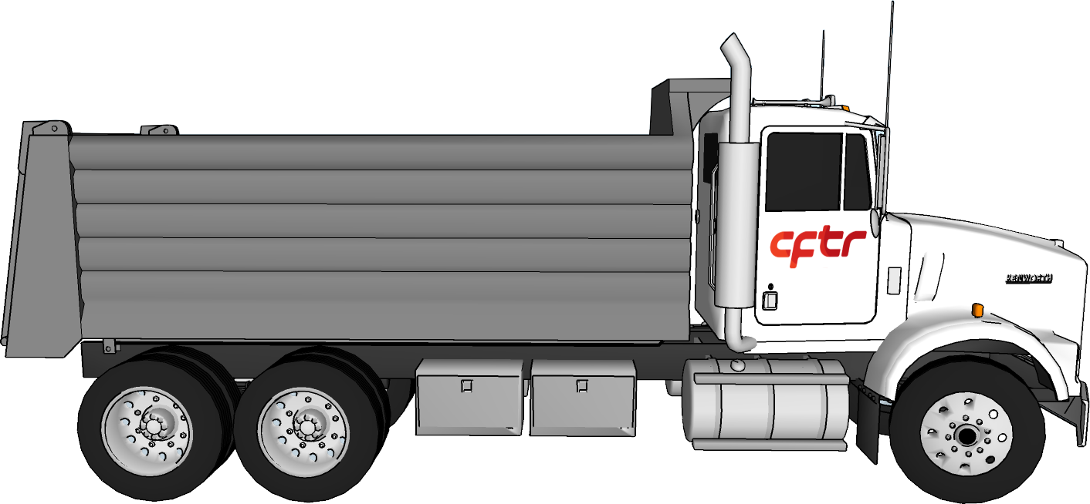
Trucks with a single rear axle
(Single Axle)
Trucks with a double rear axle
(Tandem Axle)

Slide 5
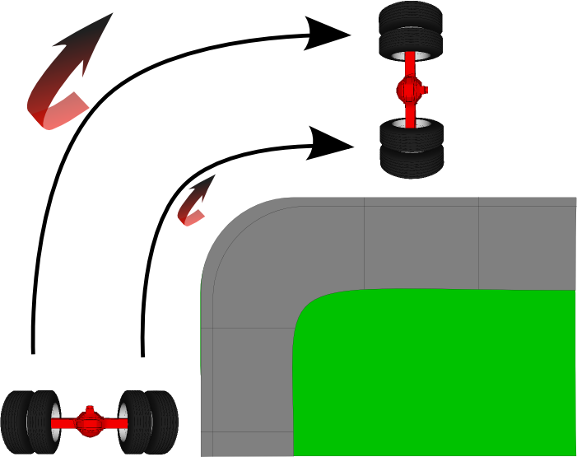
The role of the differential is to transfer power from the engine to the vehicle’s wheels while allowing a difference in rotation between the tire on each side.

Slide 6
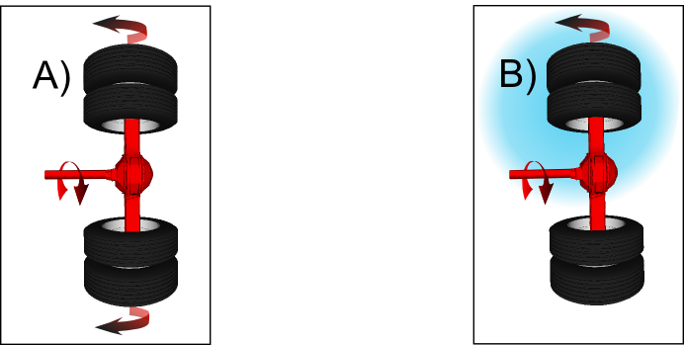
In illustration A, the tire traction is equal on each tire
In illustration B, the traction of the right set of tires is reduced. Therefore, all the power is directed to this set of tires.

Slide 7
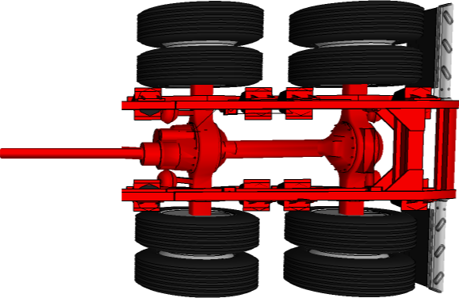
Inter-Axle Lock (Power Divider):
All tandem axle are equipped with an Inter-Axle lock ( Power Divider). It is located on the front axle of the tandem axle. Observe the difference between the two axles.
The role of the Inter-Axle lock (Power Divider) is to transfer power from the engine to the vehicle’s axles while allowing a difference in rotation between the front and rear axles. (50/50)

Slide 8
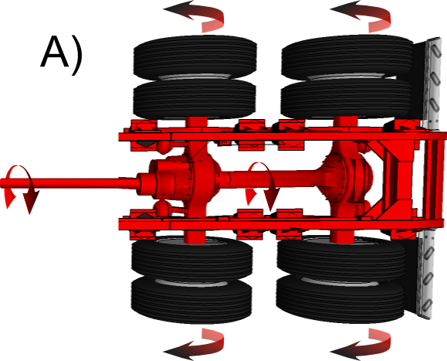
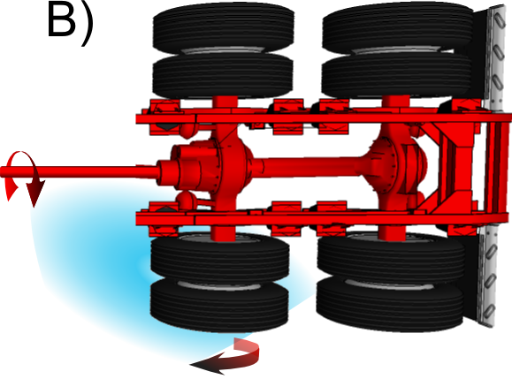
In illustration A, the tire traction is equal on each tire.
In illustration B, the traction of the front left tires are reduced. Therefore, all the power is directed to this set of tires.

Slide 9
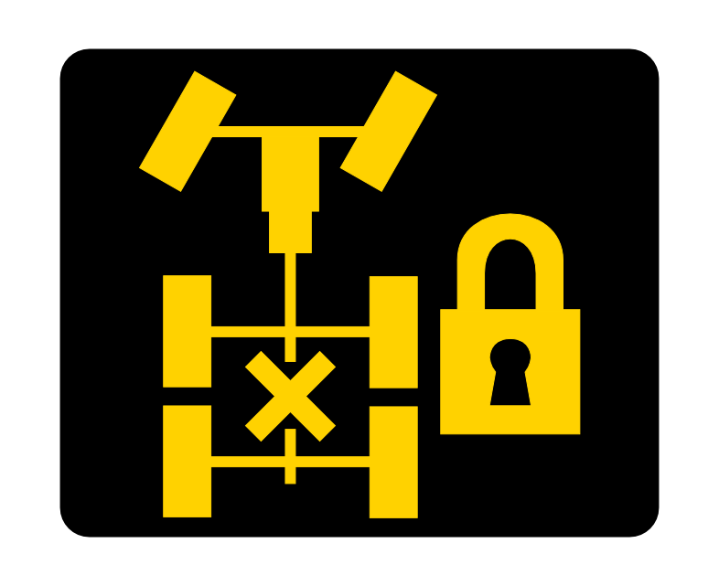
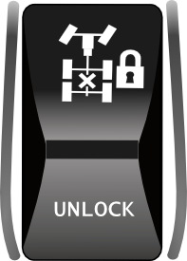
Dangers:
Warning Light
Manufacturers have equipped trucks with systems to overcome these disadvantages, namely: Inter-Axle and Inner-Axle locks and various traction control systems.
Do not engage the Inter-Axle lock if the tires are spinning, mechanical failure could occur.
If you use this system for a long period of time when the pavement is dry, you could damage the locking mechanism or cause the tires to overheat.
Do not use the Inter-Axle lock when going down a hill.
There is no speed limit to engage this lock. However, it must be deactivated when its use is not needed..
Switch

Slide 10
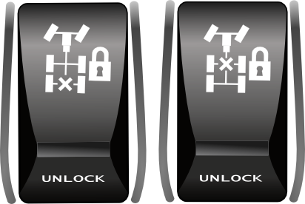
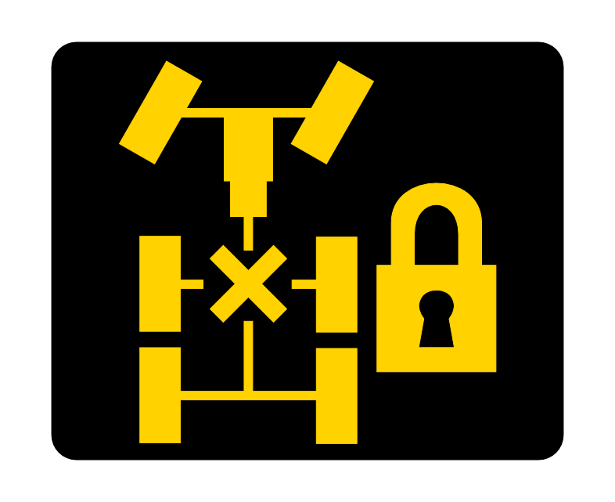

Inner-Axle Lock (Differential Lock)
A differential lock is called an Inner-Axle lock:
The Inner-Axle lock is integrated in the differential. It is optional when purchasing the vehicle. On tandem trucks the Inner-Axle lock can be found on one of the axles or on both.
When the vehicle is equipped with an Inner-Axle lock the driver has the option of engaging it in order to increase traction in specific situations.
Notes:
It is the driver who activates the switch for the Inner-Axle on the dashboard.
Dashboard indicator light when the lock is activated.
Examples of situations:
Approaching a snowy icy uphill slope.
When coupling or uncoupling a semi-trailer.
Terrain, rough pavement.

Slide 11
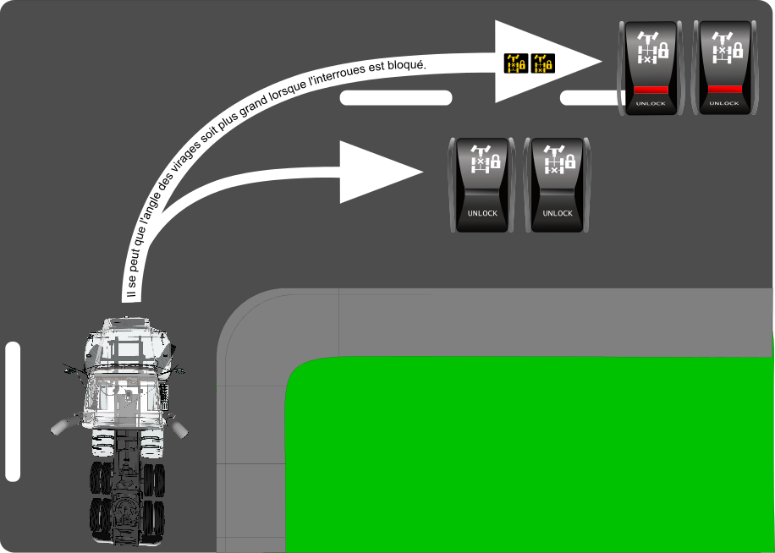
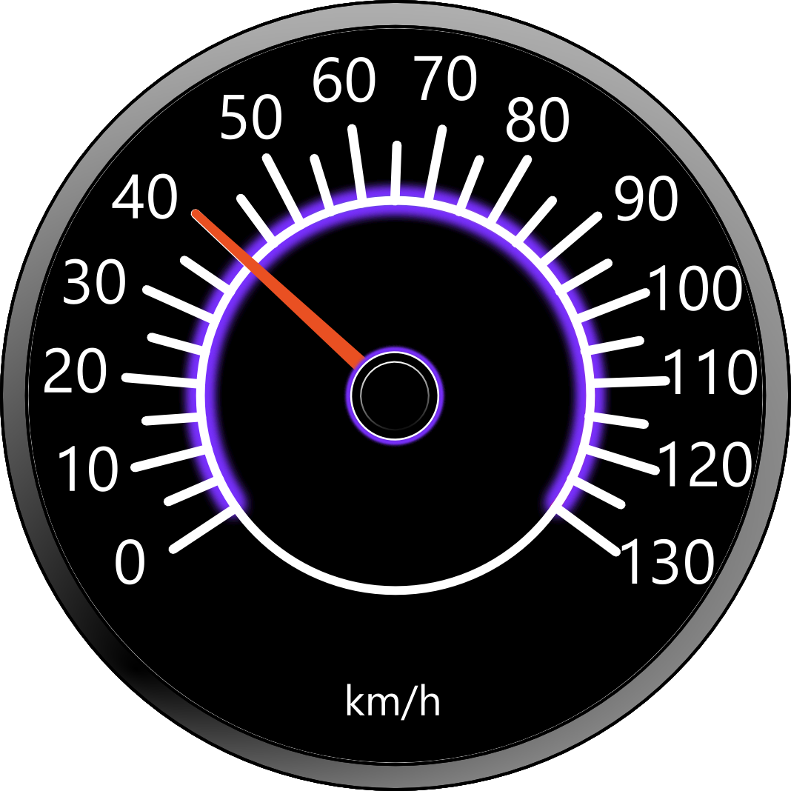
The Dangers:
Do not exceed 40 km/h with the Inner-Axle engaged, as this could result in mechanical breakdown.
When turning and you have the Inner-Axle engaged, the vehicle may tend to “Understeer” and will want to keep going straight.
High possibility of skidding if all tires are spinning.
Do not use on dry pavement, mechanical breakage could result.
Do not use while going down a hill.
The turning radius can be greater when engaged

Slide 12
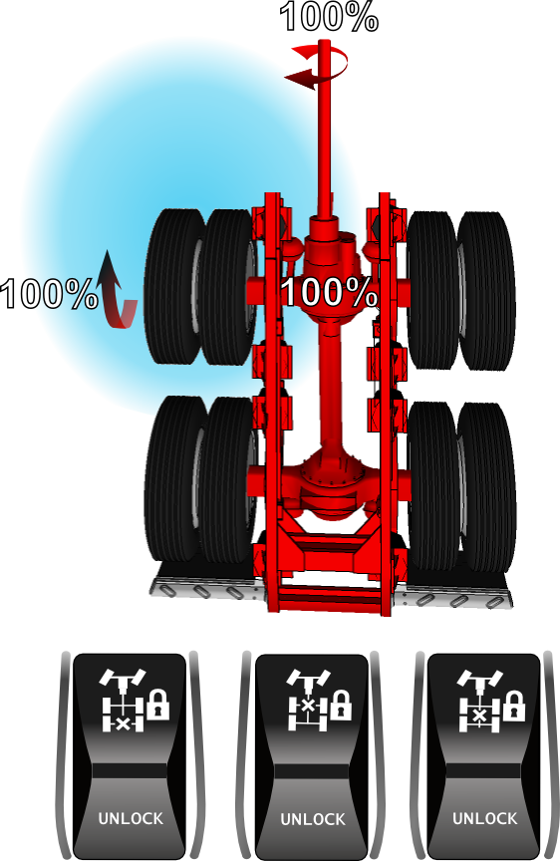
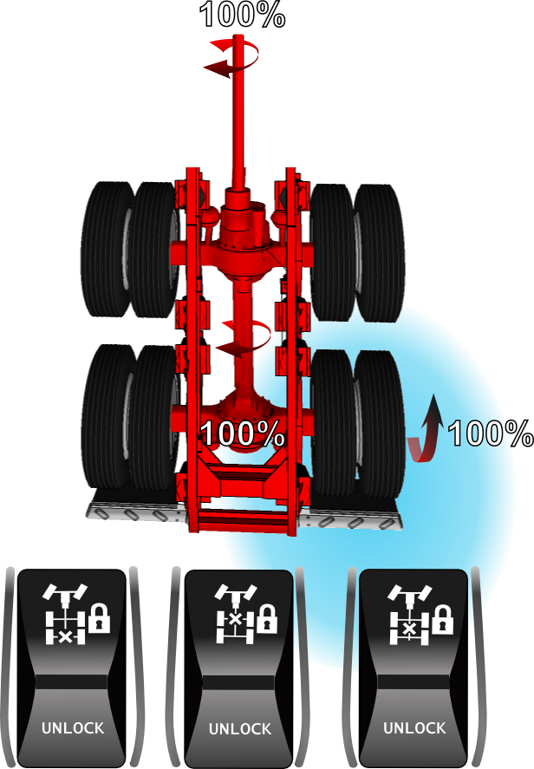
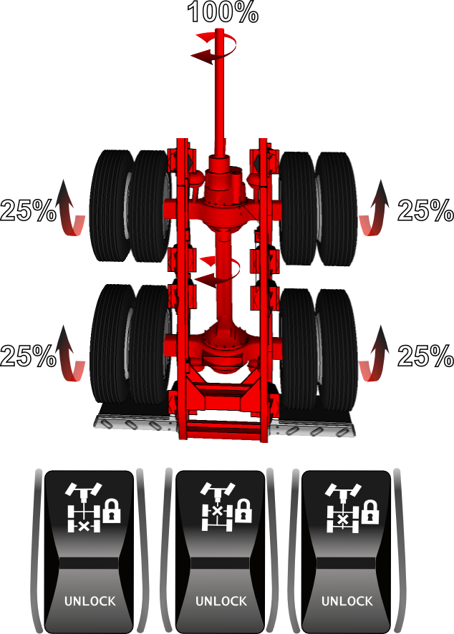
In summary:
Here are some examples of situations that can occur depending on the traction, when engaging the Inter-Axle and Inner-Axle locks.

Slide 13
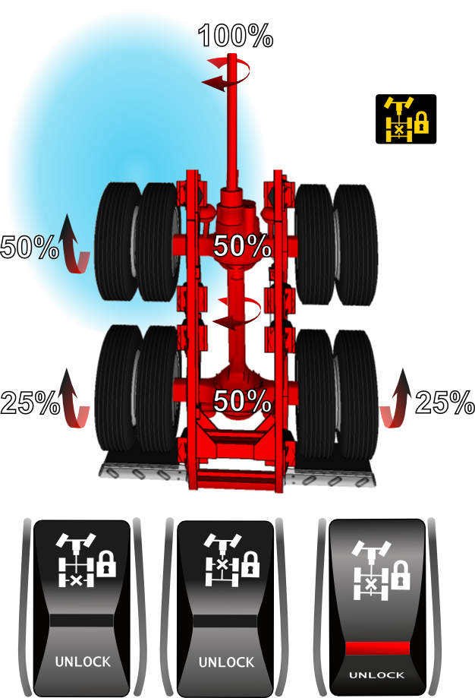
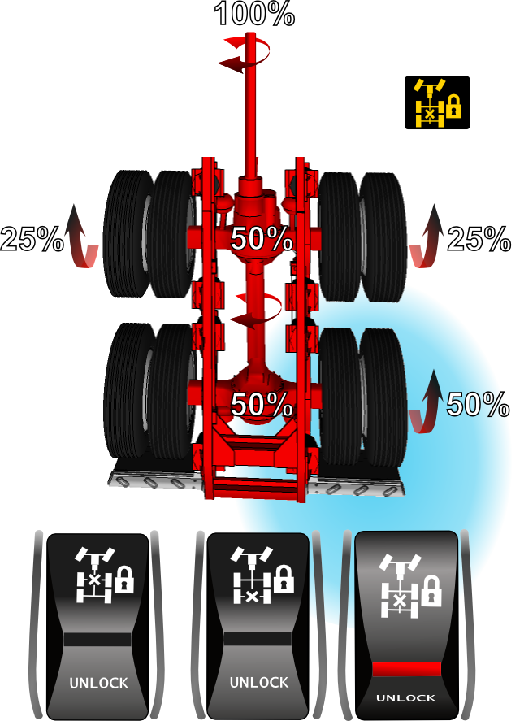
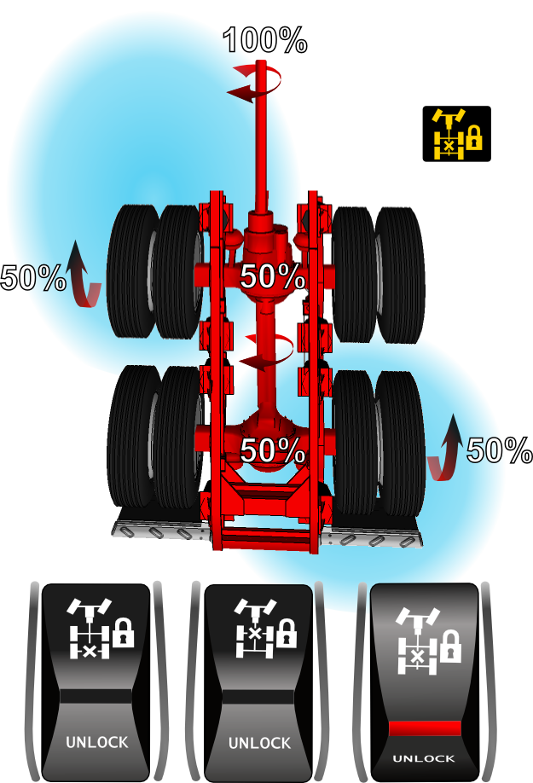

Slide 14
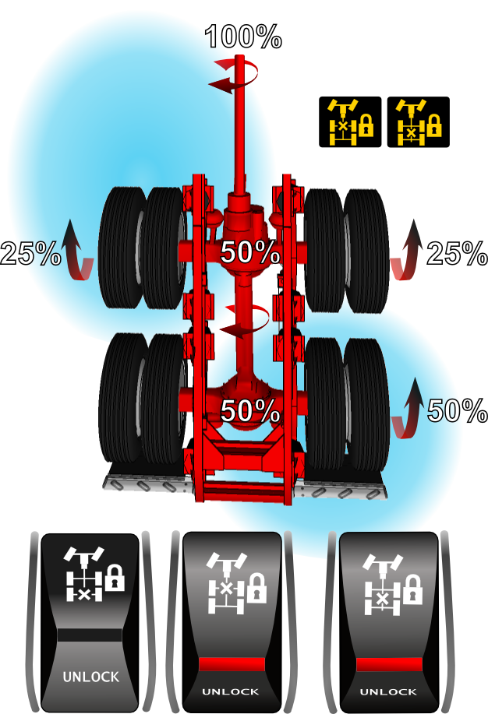
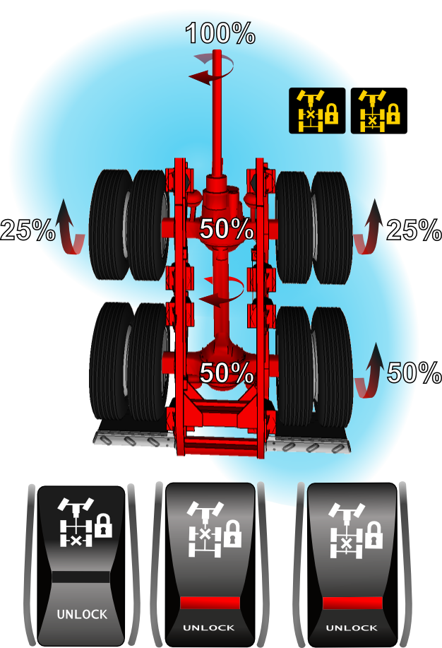
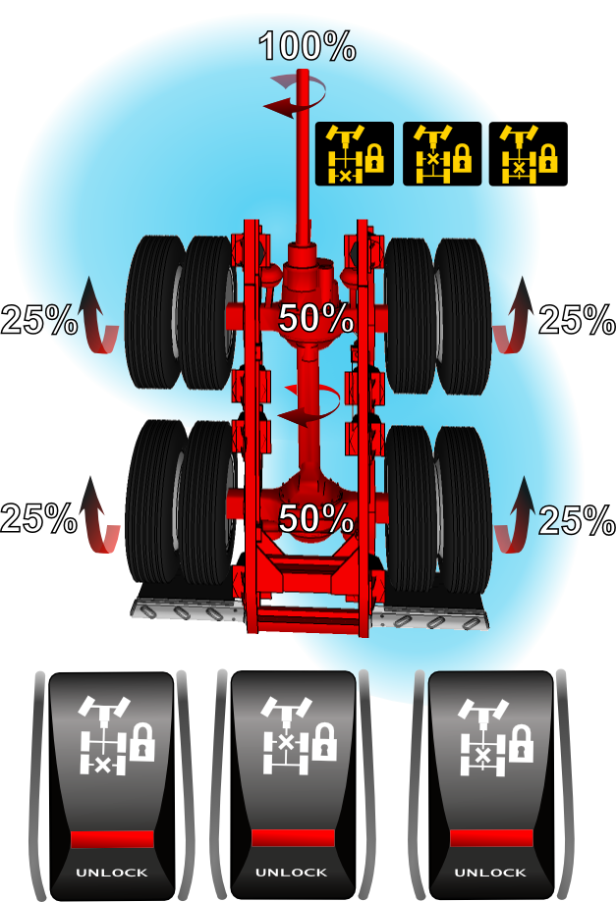

Slide 15
https://www.youtube.com/watch?v=e-d-uOYCrRE

Slide 16
Procedure for engaging Inter-Axle and Inner-axle locks (Stopped or in motion):
Make sure the tires are not spinning and that the truck is in a straight line (not turning)
Engage the switch to “ lock ”
Release and resume the accelerator (Optional: Depress the clutch pedal)
When the system is engaged, an indicator light and/or sound warns the driver.
Note: Inner-Axle do not exceed 40 km/h.
Procedure for disengaging Inter-Axle and Inner-Axle locks (stopped or in motion):
Make sure the tires are not spinning and that the truck is in a straight line (not turning)
Disengage the switch to “unlock”;
Release and resume the accelerator (Optional: Depress the clutch pedal)
When the system is disengaged the indicator light and/or sound goes off.

Slide 17
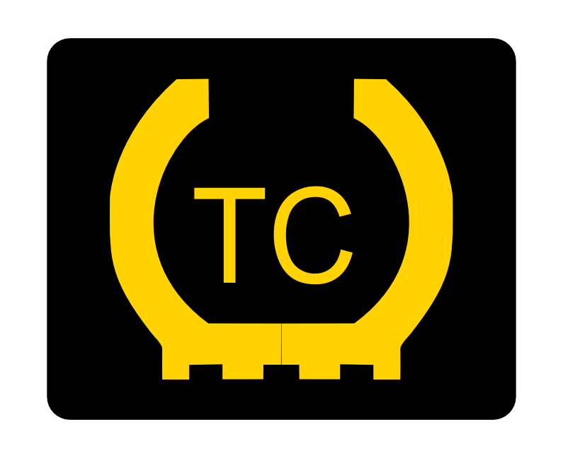
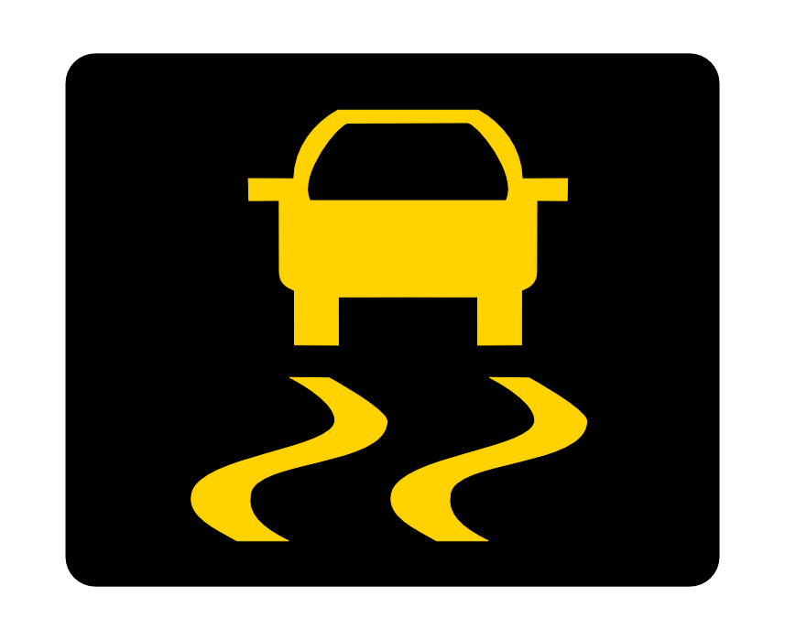
Traction Control:
The Traction Control system controls wheel spin during acceleration to improve traction. It intervenes automatically by applying the brakes on the spinning wheel. This intervention forces the transfer of power from the engine to the other wheels which have better traction. This can be useful to limit the risk of getting stuck.
Note: If all the wheels want to spin, the system reduces engine power and limits engine speed to improve traction. This can be done at any speed.
Notes:
Note: If all the wheels want to spin, the system reduces engine power and limits engine speed to improve traction. This can be done at any speed.
In the driving position, you can find different names of this system. Example: TC, TCS, ATC, ASR, TRAC CTRL.
Note: The operations remains the same for each of the systems.

Slide 18
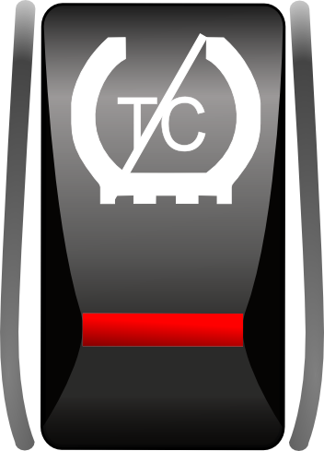
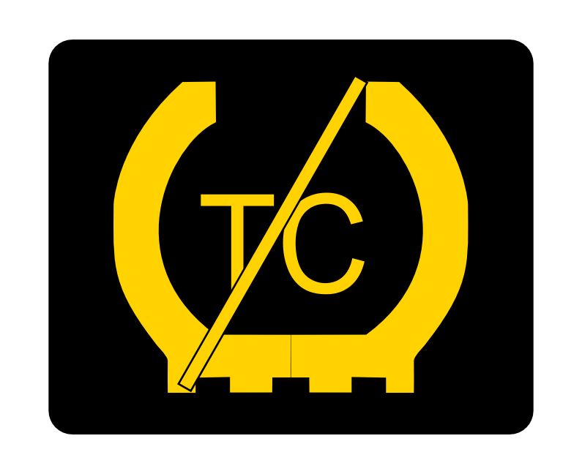
Deactivating Traction Control:
When stuck in deep snow, sleet or mud, the switch can be used to partially deactivate the traction control function. This will have the effect of increasing power to the wheels and limiting braking. Therefore, getting unstuck could be much easier. Some manufacturers use the term Mud/Snow or Off Road.
When the Traction Control function is deactivated, an indicator light indicates/ (flashes) in the instrument panel.

Slide 19
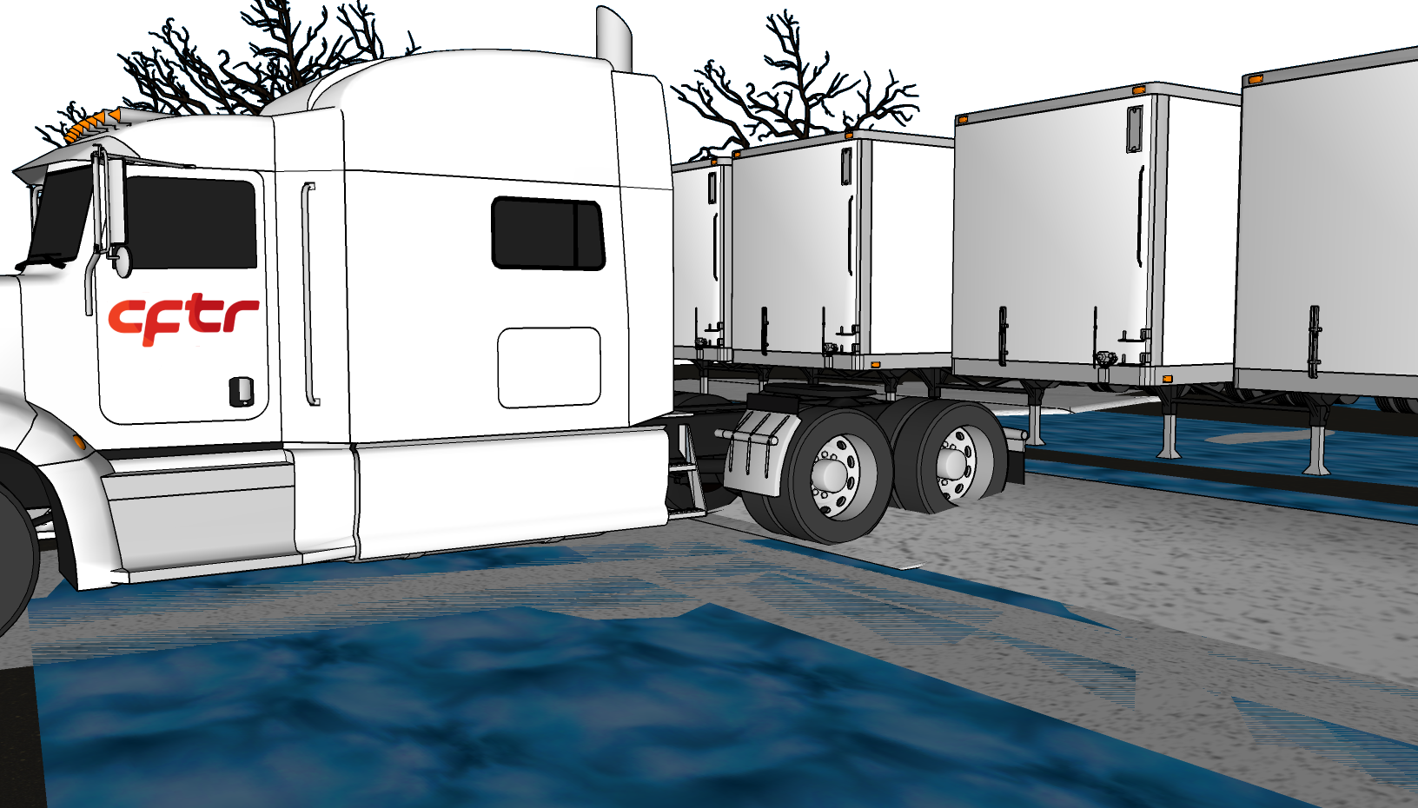
An example of a situation where the ATC system could be disengaged is the coupling of a semi-trailer on a slippery surface.
When the system is deactivated, it gives the driver choices on how to make his maneuvers.
AVANTAGES: The ATC system detects and reacts much quicker than the driver when the tires are slipping, thus limits the risk of skidding and improves vehicle traction.
Note: The ATC system will not work if the ABS brake system is faulty(ABS Warning Light Is On), because they share the same sensors.
DANGER USE CAUTION:
.
Notes:
Prolonged use of the ATC can cause the brakes on the drive wheels to overheat. Engine torque or vehicle speed should be reduced to eliminate wheel slip and prevent excessive use of the ATC system.

Slide 20
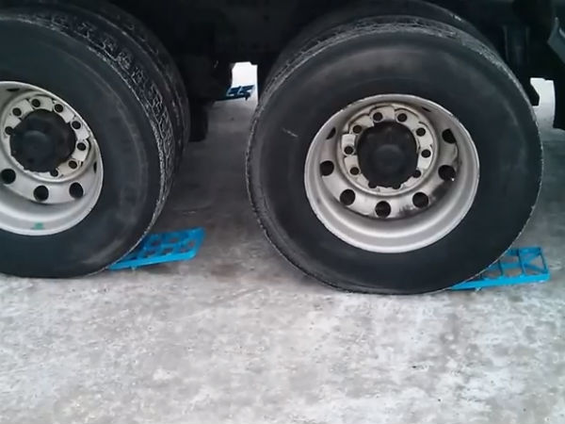
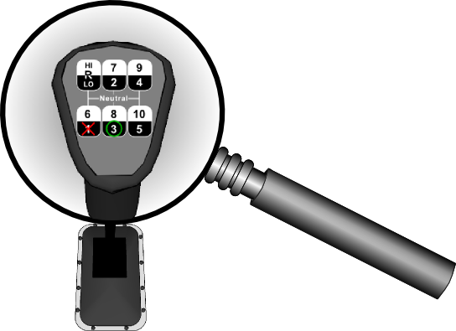
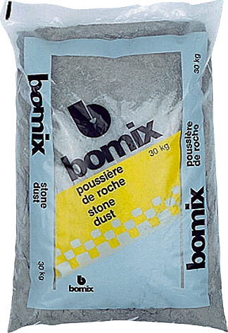
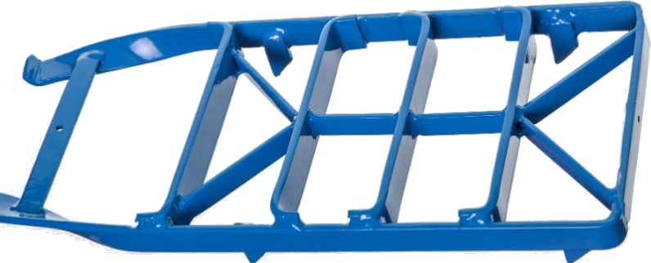
Heavy
Light
Stone Dust Traction Aid
Notes:
In all cases, you must avoid spinning the wheels too much, when the wheels spin too long, they form a hole and can make it more difficult to set the vehicle in motion.
Gears on the high range could be used (Reverse High or 5th or 6th gear)

Slide 21
Thank You
For Your Participation

