Slide 1

Competency 2 Leçon 2.3.1
Transmission in Motion (Clutch)

Slide 2
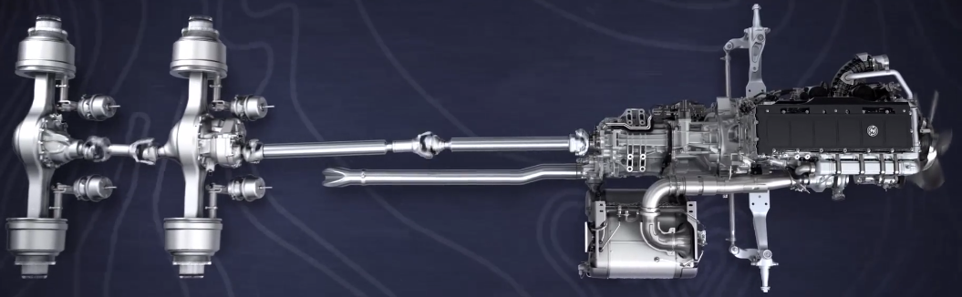
Transmission in motion system:
The clutch, gearbox and rear axles.
The Clutch:
The clutch is a device located between the engine and the gearbox which allows the engaging and disengaging of the latter. It also allows for engagement of gear changes while leaving the engine running when the vehicle is stationary. Thanks to a good choice of initial gear, the engaging will be progressive and will limit vibrations. Otherwise, the engine could stall and damage could occur to some of the components of the transmission system.

Slide 3
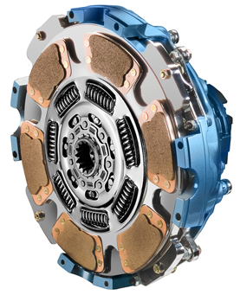
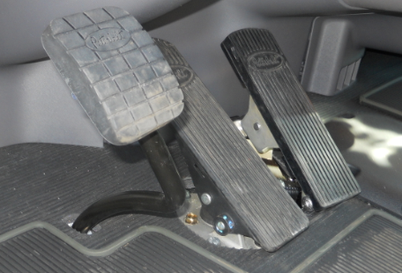

Slide 4
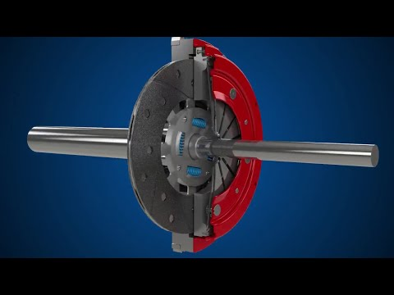
Basic operation of a clutch

Slide 5
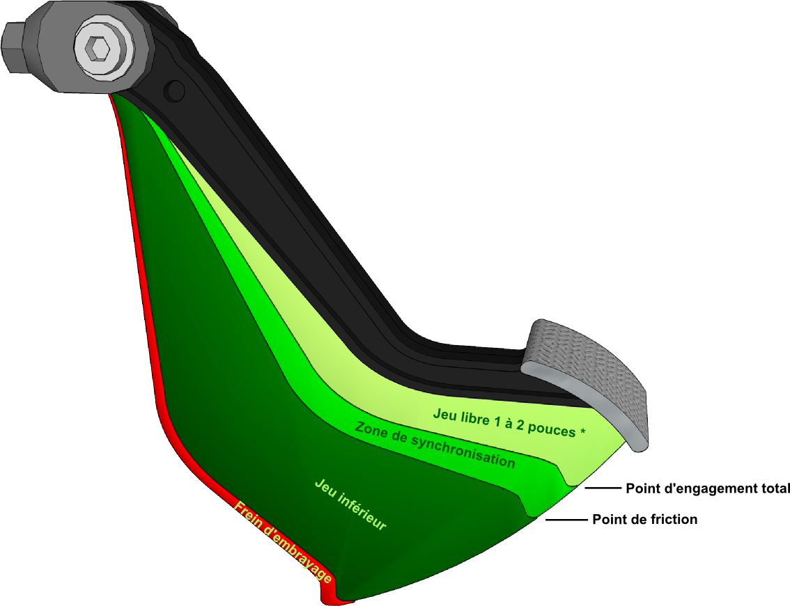
Brake Clutch
Clutch Travel:
Zone exclusively used to engage 1st gear or Reverse. Vehicle must be stationary.
Clutch pedal must be completely applied for 3-4 seconds before engagement.

Slide 6
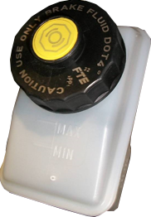
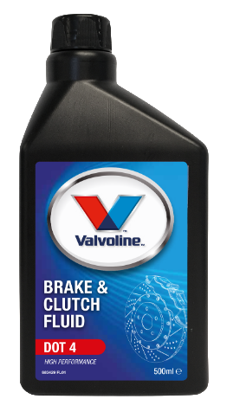
Hydraulic Operation
Some vehicles use a mechanical clutch system, while others are equipped with hydraulic assistance. It is therefore normal for these trucks to have limited free play on the clutch pedal.
it's time for an adjustment when the brake clutch loses its efficiency. Note that these vehicles are usually equipped with an auto-adjusting clutch, so little or no adjustment should be necessary.
The oil level should be checked daily. In our example, DOT 4 brake and clutch oil, should be used. Always check the manufacturer’s specifications and notify the mechanic of any drop in level.
Some manufacturers also offer pneumatic assistance in conjunction with hydraulic, which greatly facilitates the use of the clutch pedal.

Slide 7
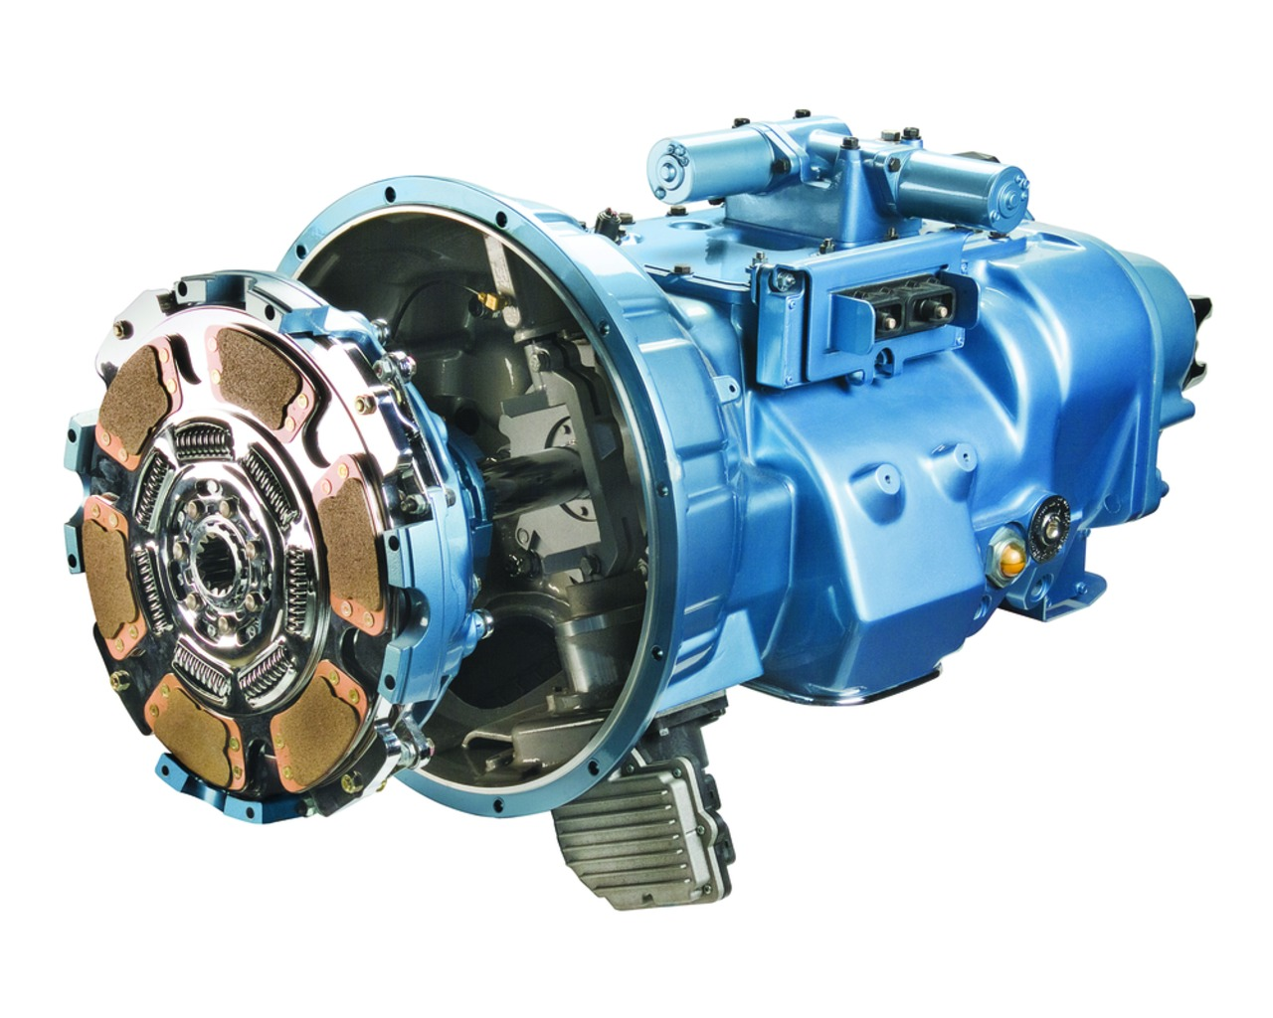
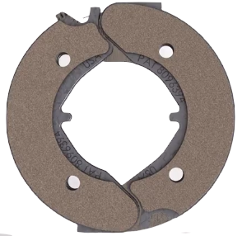
The clutch brake is positioned behind the clutch in between the bearing and the transmission.

Slide 8
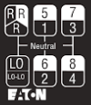
The use of the brake clutch is essential for engaging the initial gear. As its name suggests, it brakes the gears of the transmission which are linked to the engine, while both are turning around 650 RPM. So when the vehicle is stationary, it is easier to pair the stationary gears which are connected to the rear axles with the gears that are connected to the engine.
It is essential to bring the clutch pedal to its friction point in order to have a smooth start. It is not necessary, even not recommended, to press the accelerator when releasing the clutch pedal. The high torque of an idling diesel engine is enough to get the vehicle moving, even on an uphill slope.
When performing maneuvers at very low speeds for example... re-centering in between two trailers or even approaching the fuel pumps... it is very important to choose the smallest possible gear rather than slipping the clutch in second or third. Better to be cautious instead of having an accident.
Use

Slide 9
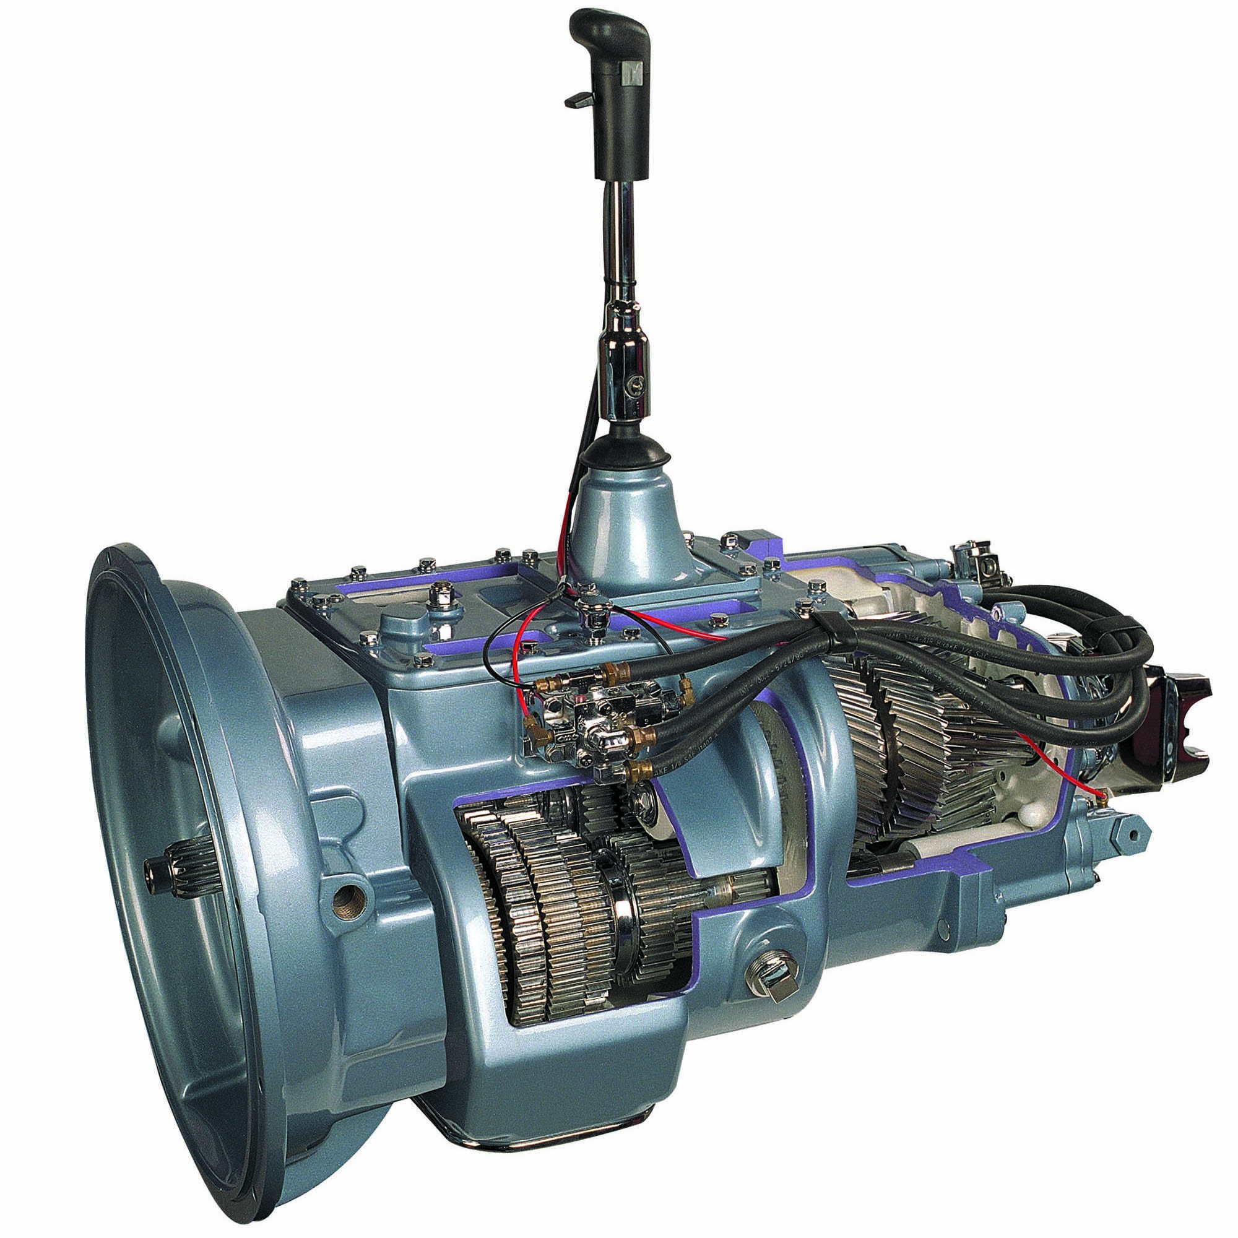
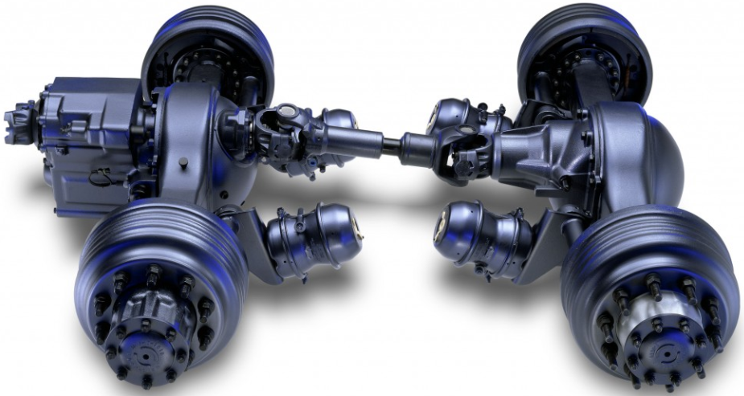
Double-clutch
The main purpose of using the clutch is to reduce the risk of mechanical breakdown while changing gears. Using the clutch properly stops momentarily the the engine torque in the transmission which allows an easier engagement and disengagement of gears. Pressing the clutch when engaging and disengaging gears helps synchronizing the gears, when the clutch is released and thus promotes smoother and more fluid gear changes. This approach therefore eliminates almost all risk of breakage to the transmission, the drive shaft and the rear axles.

Slide 10
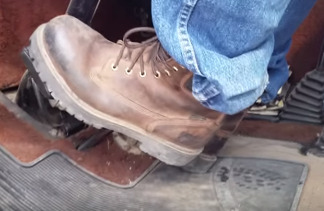
Anomalies (Improper Use)
Driving the vehicle with your foot constantly on the clutch pedal reduces the life of the clutch bearing. It is therefore important to get in the habit of putting your foot back on the floor as soon as you complete shifting. Likewise, when backing up, letting the clutch slide causes overheating and premature wear.
Practicing starts using the friction point will ensure that the vehicle is always stationary when the brake clutch is applied. In fact, using the brake clutch while the vehicle is moving would dramatically decrease its life. Thus, once in poor condition, engaging the initial gear would be very difficult because the transmission gears connected to the engine would be constantly in motion.
Setting the vehicle in motion with your foot on the accelerator or with too high of a gear ratio causes excess slippage and therefore premature wear of the clutch assembly. Additionally, operating a vehicle with a clutch requiring adjustment could dramatically shorten its life or even cause failure.

Slide 11
THANK YOU
FOR YOUR PARTICIPATION

