Slide 1

Competency 2 Lesson 2.2.8
Energy Savings

Slide 2
CONTENT OF THE LESSON:
Recognize the different elements and technologies that influence energy consumption.
Interpret data from an on-board computer in relation to fuel consumption.

Slide 3

USING HEAVY VEHICLES ECONOMICALLY

Slide 4
DID YOU KNOW?
19% of greenhouse gas emissions come from heavy vehicles.
For every liter of diesel burned, 2.8 kg of carbon dioxide is released into the atmosphere.
Exhaust gases cause a lot of smog.
The particles emitted are potentially carcinogenic.

Slide 5
DID YOU KNOW?
Fuel costs are the second largest operating expenses related to fleet operations (after labor costs).

Slide 6
DID YOU KNOW?
Several accessories are available to reduce fuel consumption.
Several mechanical improvements have been made in recent years.
Some companies offer Bonus Programs for fuel-efficient drivers.

Slide 7
SOME EQUIPMENT DESIGNED TO REDUCE FUEL CONSUMPTION:
Wide tread tires (x-one).
Tire pressure monitoring system.
6x2 tractor (only one traction axle).
Deflector for drive axles.
Wheel covers.
Mesh mud flaps.
Side skirts.
Rear deflector for tractors and semi-trailers.
Use of load-bearing (loadable) axles.
Different electronic tools (Ex: Coach ISAAC).

Slide 8
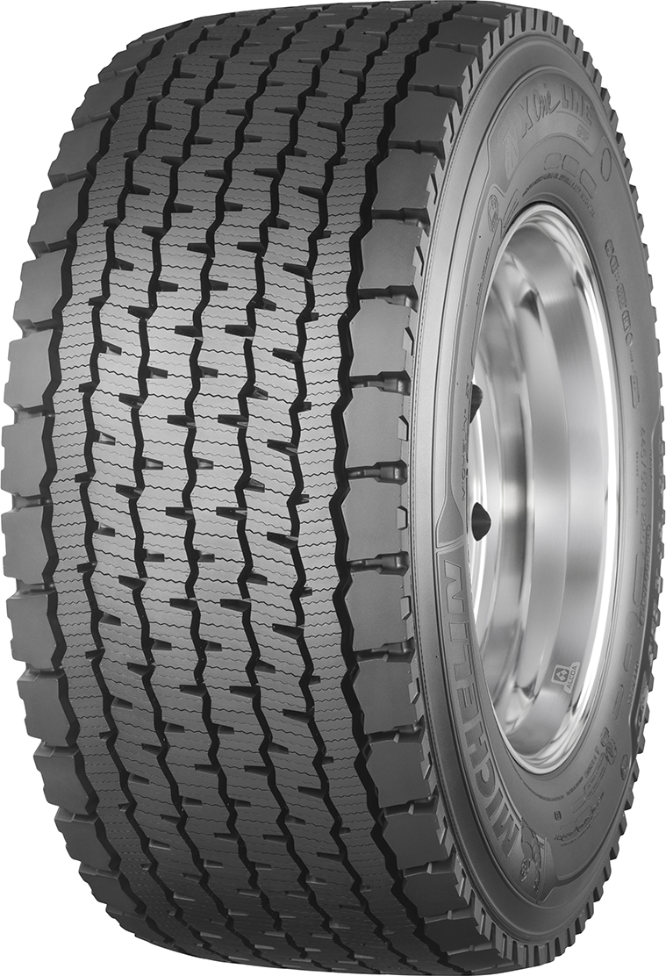

WIDE TREAD TIRES
Savings up to 5% (Rolling resistance).
About 400 kg less for a 5 axle equipment.
-200 kg -200 kg

Slide 9
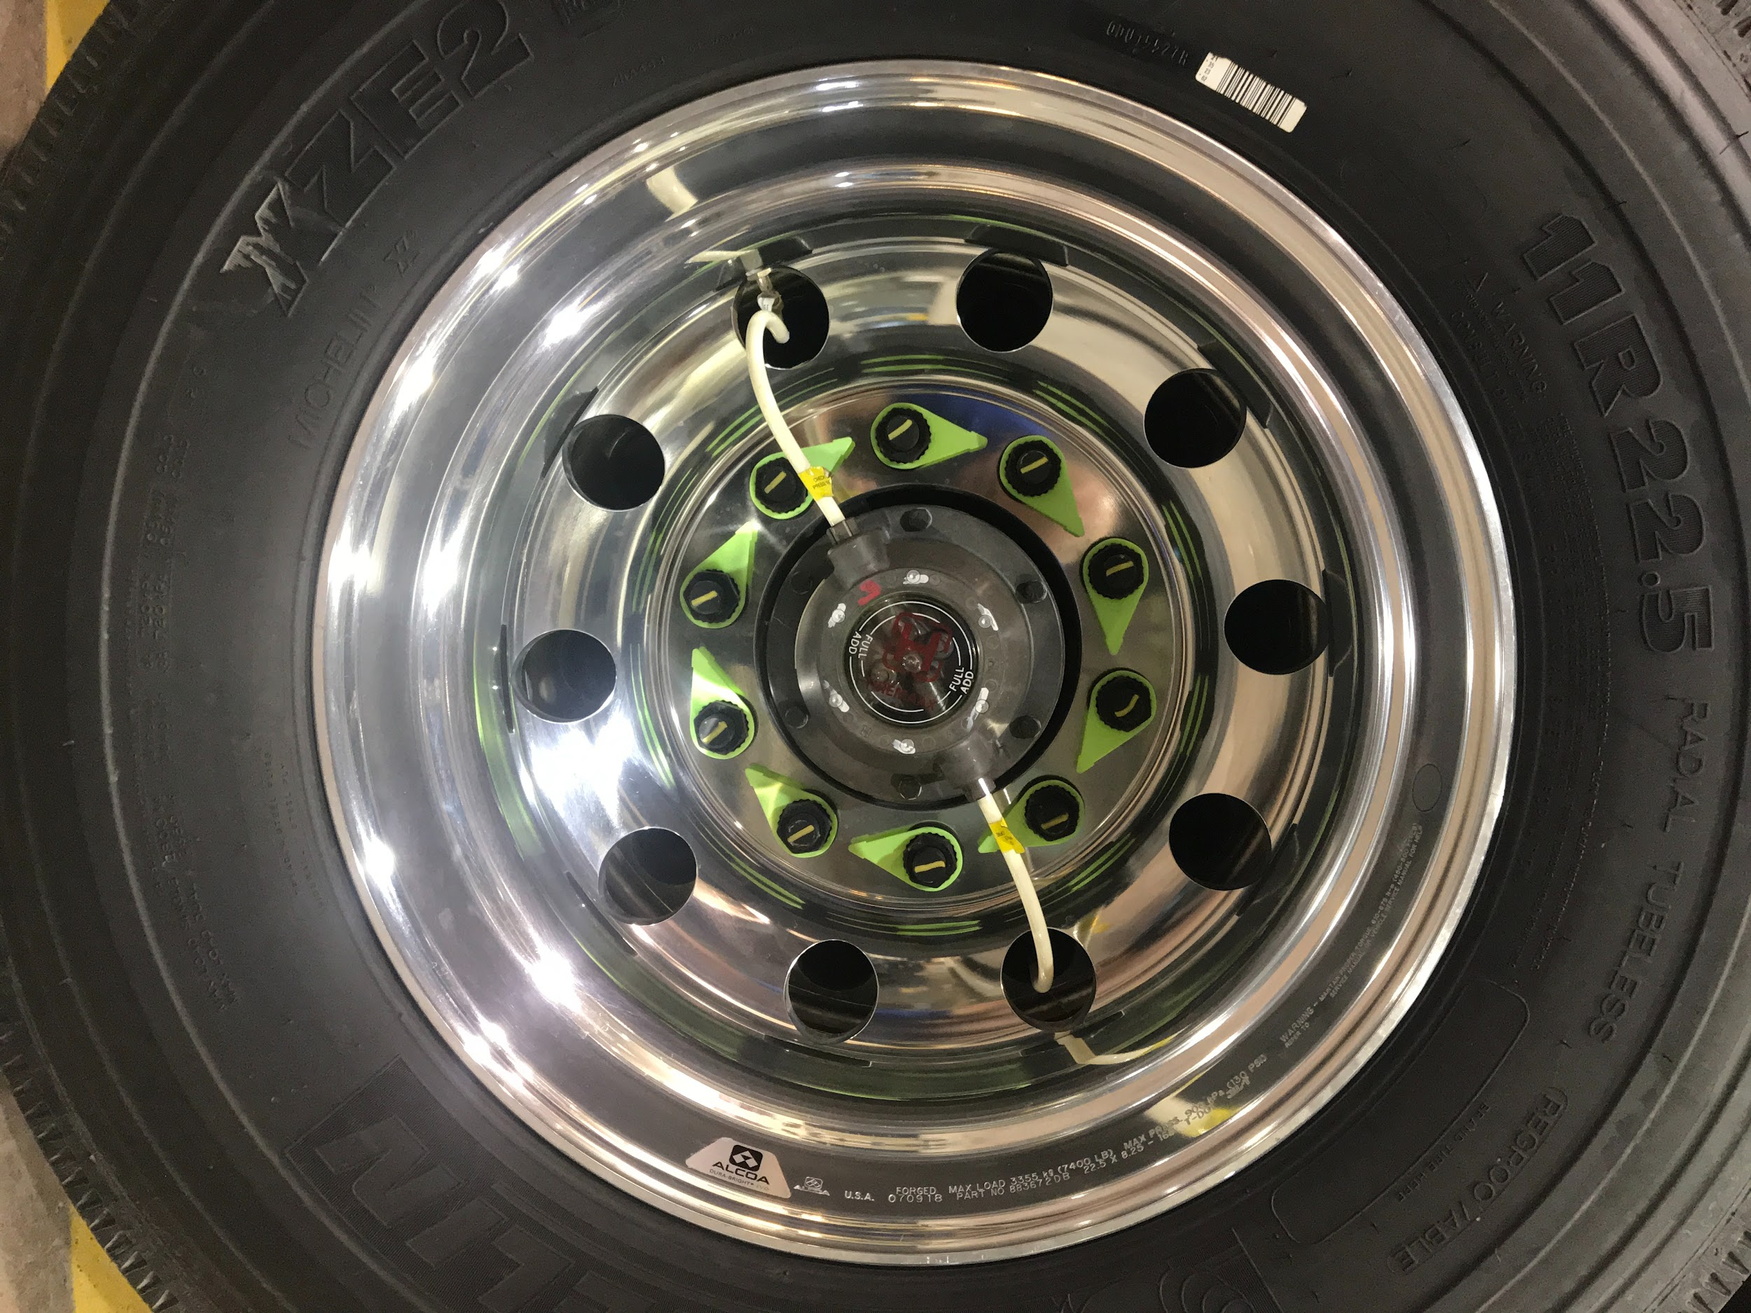
TIRE PRESSURE MONITORING SYSTEM

Slide 10
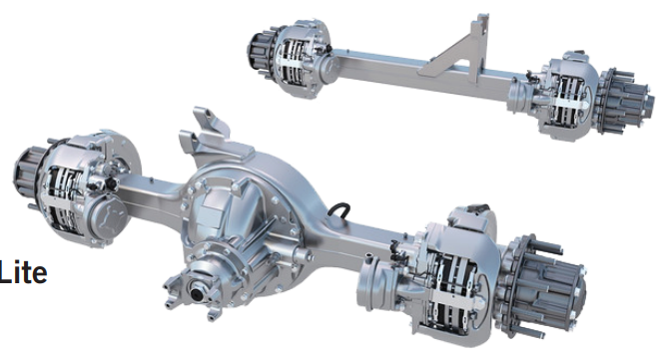
TRACTOR
WITH A 6X2
TANDEM AXLE
Notes:
A single traction axle to reduce friction and weight.

Slide 11
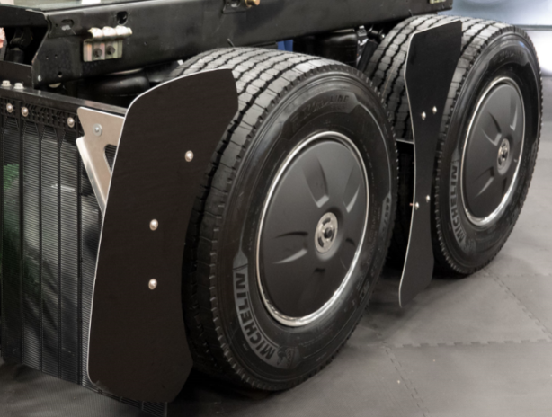
DEFLECTOR BETWEEN AXLES
WHEEL COVERS
MESH MUD FLAPS
Savings of over 2%

Slide 12
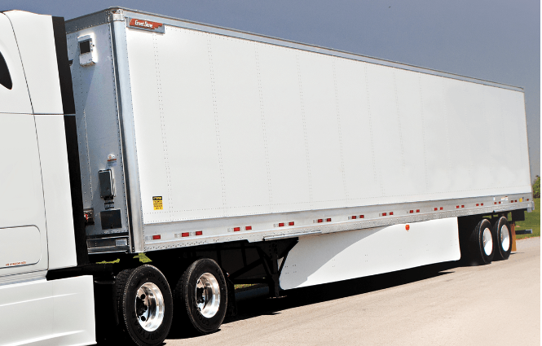
TRACTOR DEFLECTOR
SIDE SKIRT
Savings up to 5%

Slide 13
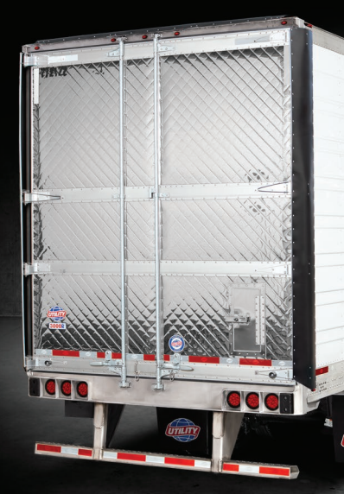
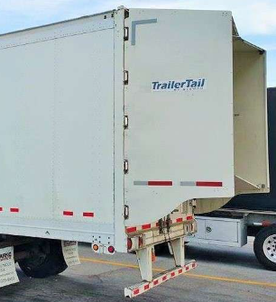
DEFLECTORS FOR SEMI-TRAILER
Savings up to 5%

Slide 14
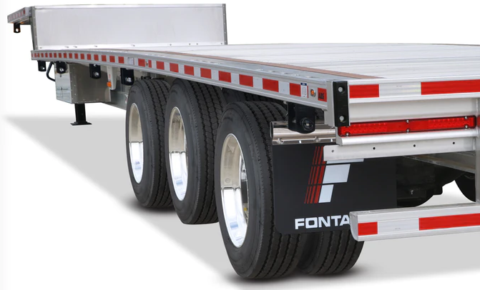
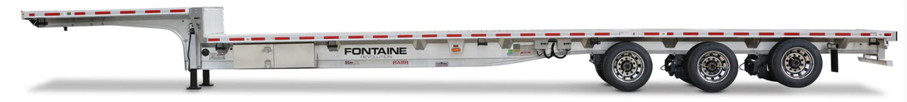

USE OF A LOAD-BEARING (LOADABLE) AXLES

Slide 15

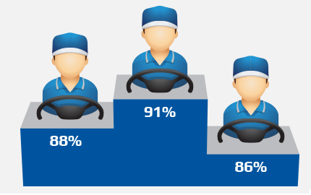
DIFFERENT ELECTRONIC TOOLS (EX: COACH ISAAC)
Notes:
Explain generally...

Slide 16
MECHANICAL IMPROVEMENTS
Engine cruising speeds lowered closer to engine torque.
Predictive cruise control.
Idle management system for extended stops.
Reducing the “GAP” between the tractor and semi-trailer.
Use of more efficient lubricants.
Better control of wheel alignments for the equipment.
Notes:
The regulator uses GPS to anticipate the slopes... “Start/Stop” system ensures minimum voltage and engine temperature. Examples of lubricants: 10w30 vs 15w40; 75w80 vs 80w90...

Slide 17
DID YOU KNOW?
Despite all the improvements presented, the driver remains the most important factor in fuel economy.
Up to 25% improvement by adopting good driving habits.

Slide 18
BEHAVIOR HABITS TO ADOPT
AVOID UNNECESSARY IDLING: An idling engine consumes about 4 liters/hour. 1 hour of idling for an engine is equivalent to 2 hours of wear at cruising speed.
SOLUTIONS:
Warm up the engine by moving slowly and gradually until the engine operating temperature is reached.
Turn off the engine during basic maneuvers. (Circle Check, Coupling, Uncoupling, Storage, etc.).
Turn off the engine during waiting periods. (Customers, Customs, Fuel, etc.)
Go through the last few minutes of a trip without putting a load on the engine to allow it to cool down. Thus, being able to shut off the engine as soon as the parking brake is applied.

Slide 19
SOME NUMBERS!
1 hour of unnecessary idling per day:
4 litres of fuel/day.
250 working days/year
1000 liters/year
1000 liters at $1.40 = $1400/year
For a fleet of 100 trucks:
100 trucks x $1400 = $140 000/year

Slide 20
BEHAVIORAL HABITS TO ADOPT
Know the mechanical specifications of your vehicle’s truck.
Use of engine torque.
Using the gauges and fuel consumption data in the dashboard.
Progressive gear changes.
Anticipation of road changes.
Lower cruising speed.

Slide 21

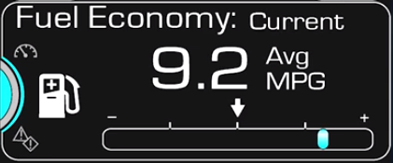

RELEVANT DATA PROVIDED BY THE DASHBOARD
Notes:
Explain the use, the “target”... the “Feed Back” on their driving habits...

Slide 22

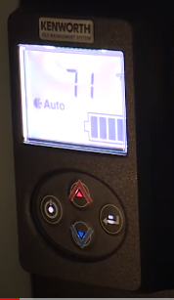

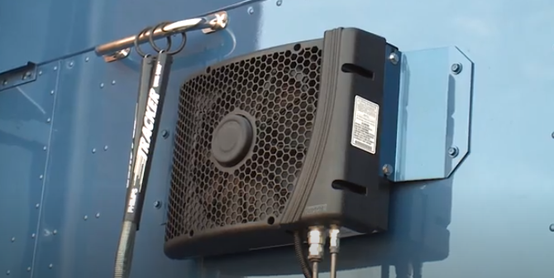
USE OF AN AUXILIARY “APU” HEATING/AIR CONDITIONING UNIT DIESEL AND/OR ELECTRICITY. OPTIONAL AND FACTORY OFFERED “OEM”.
Notes:
For extended downtown. 100% electric factory systems are the most common because they are cheaper and are almost invisible.

Slide 23
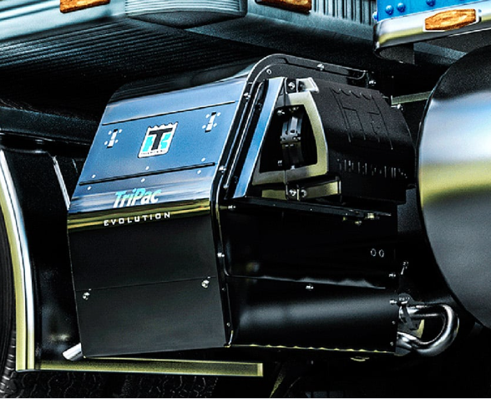
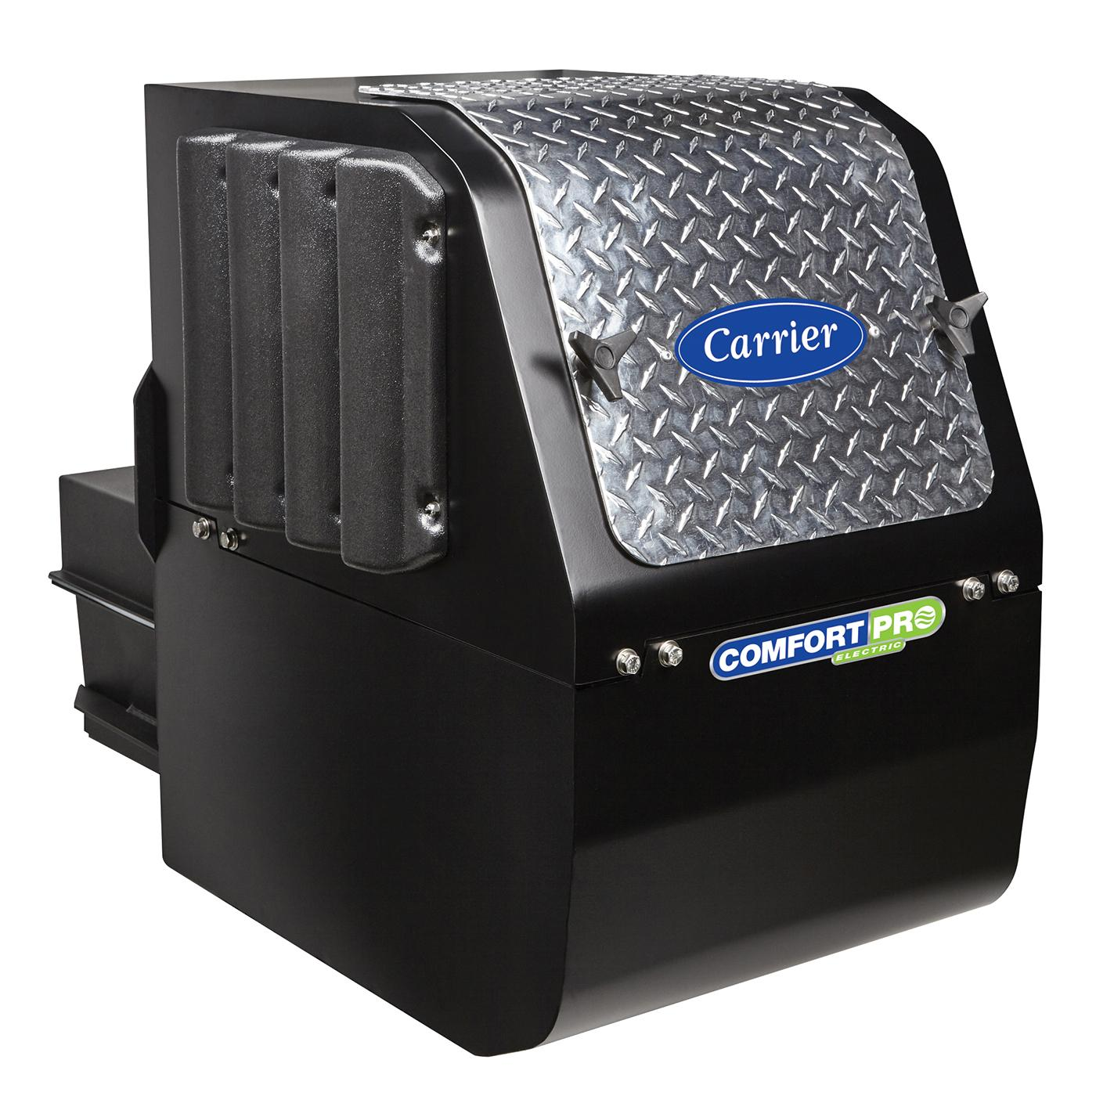
USE OF AN AUXILIARY “APU” HEATING/AIR CONDITIONING UNIT DIESEL AND/OR ELECTRICITY. OPTIONAL “AFTERMARKET”
Notes:
For extended downtime.

Slide 24

ALTERNATIVE ENERGY VEHICLES
Electricity Using Hydrogen
100 % Electric
Liquefied Natural Gas “LNG”
Compressed Natural Gas “CNG”

Slide 25
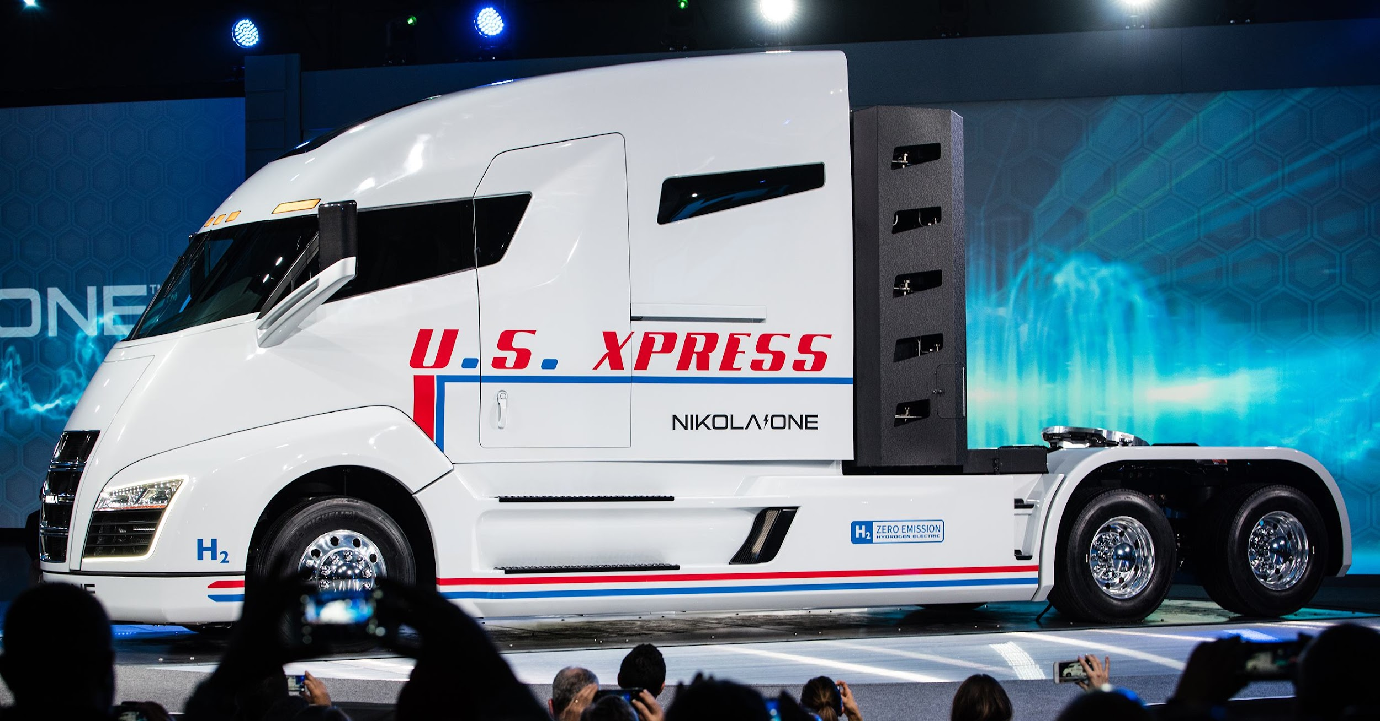
ELECTRIC VEHICLE USING HYDRGEN
NICOLA ONE
Notes:
Vehicle in development. Strong points: power and autonomy. Almost zero hydrogen supply networks.

Slide 26
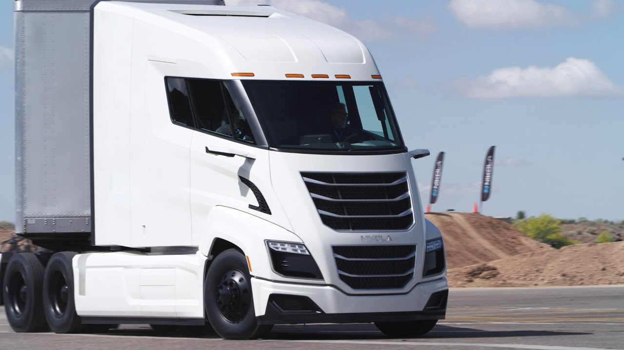
NICOLA TWO
Notes:
Vehicle in development. Strong points: power and autonomy. Almost zero hydrogen supply networks.

Slide 27
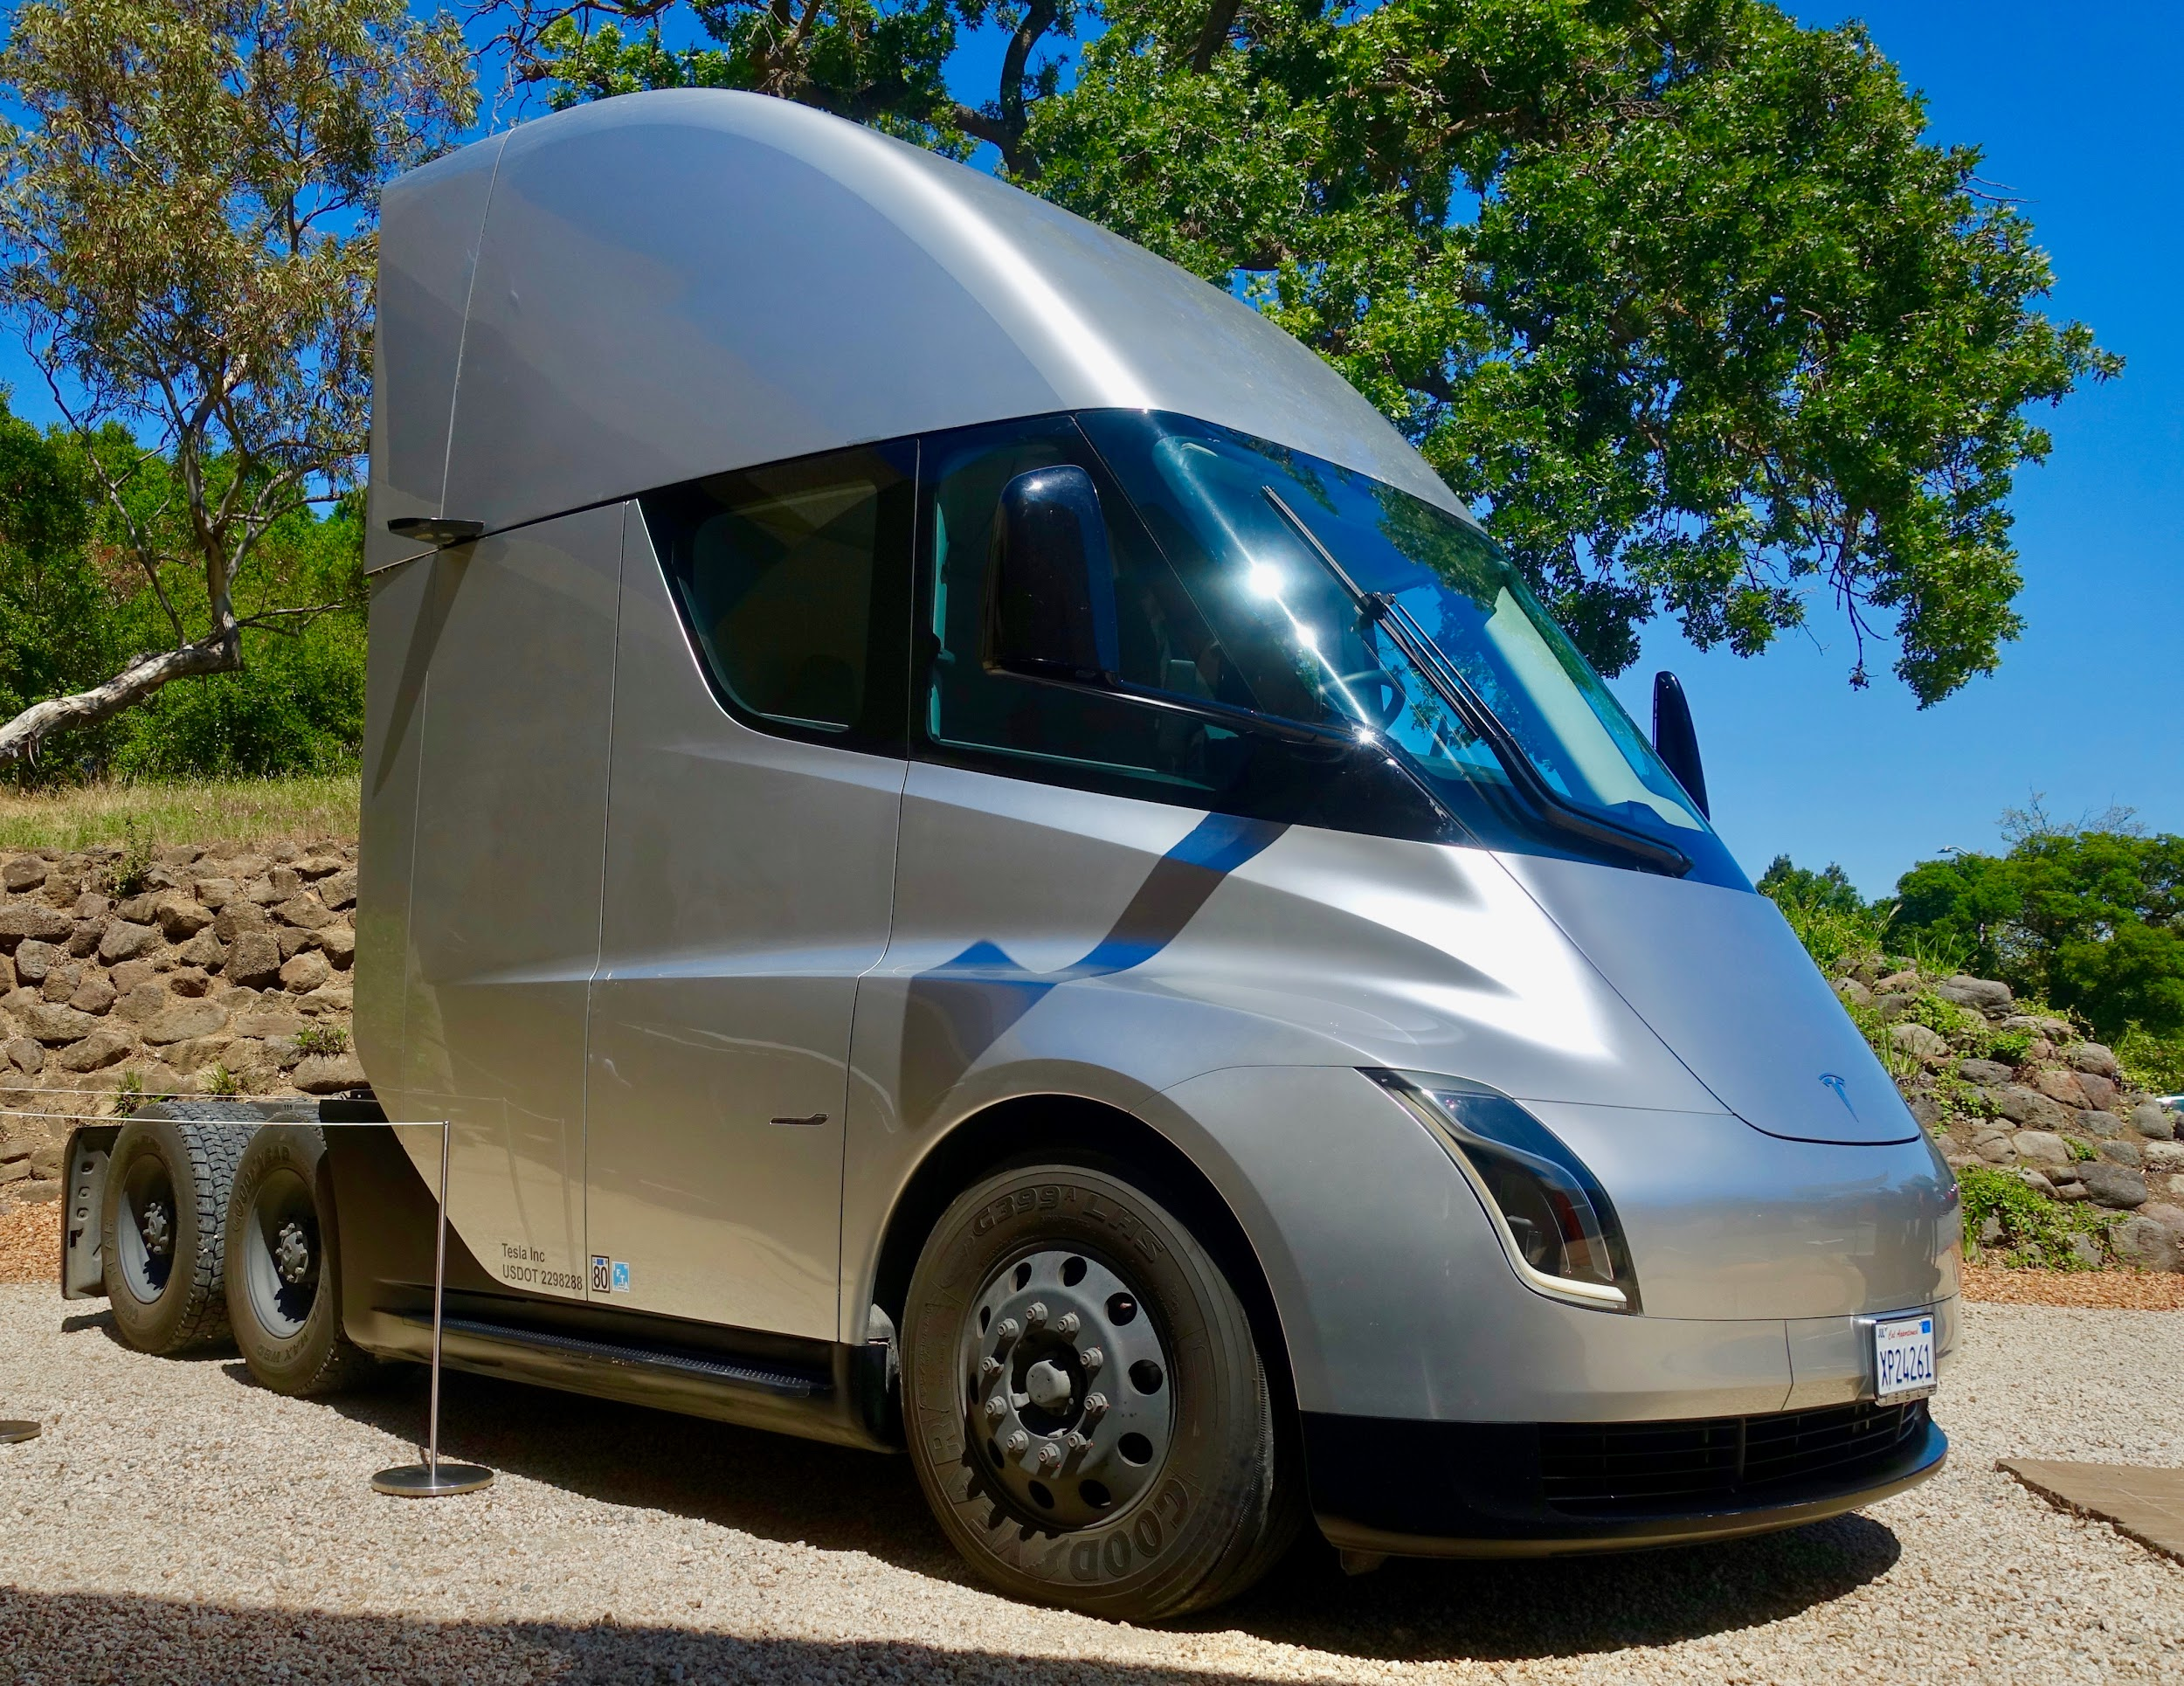
100 % ELECTRIC VEHICLE
TESLA SEMI
Notes:
Vehicle in development. Strong points: power and cost per kilometer.

Slide 28
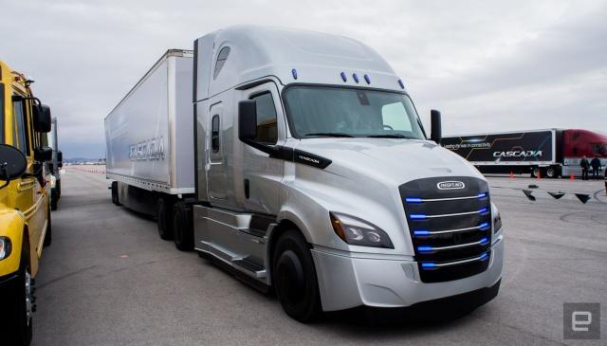
FREIGHTLINER E-CASCADIA

Slide 29
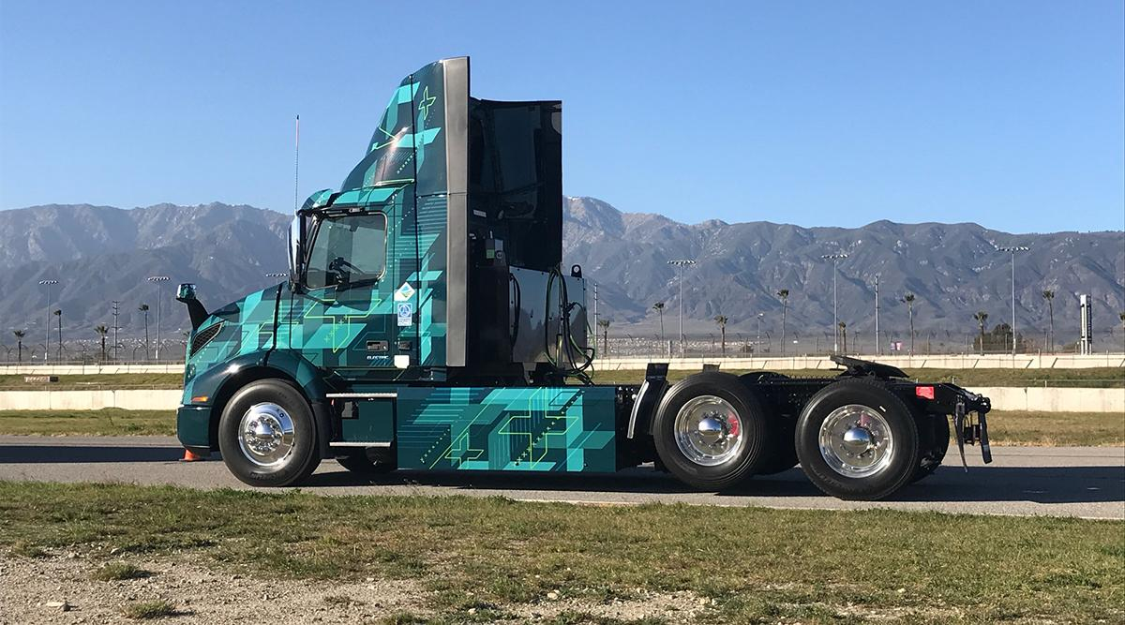
VOLVO ELECTRIC VNR

Slide 30
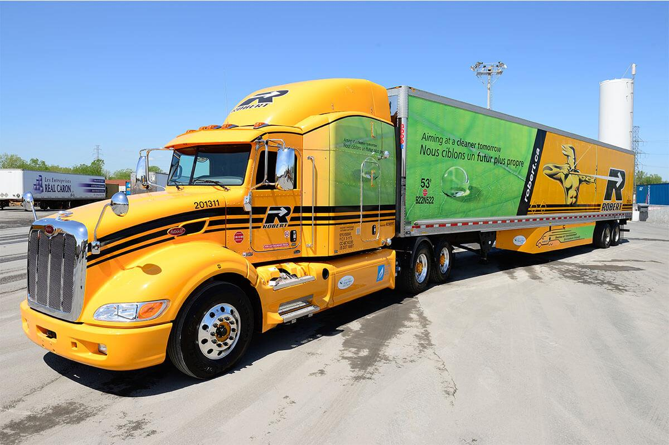
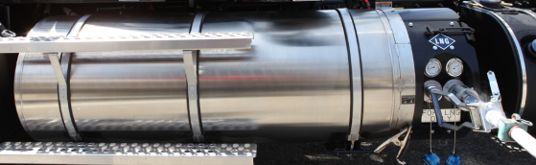
VEHICLE USING LIQUEFIED NATURAL GAS (LNG)
Notes:
Robert transport, has approximately 160 units.They are used on specific corridors. Reduced supply networks. Only 5 stations in Canada (Spring 2020). The tanks are of the “Thermos” type. The gas is liquefied to about 166 degrees C.

Slide 31
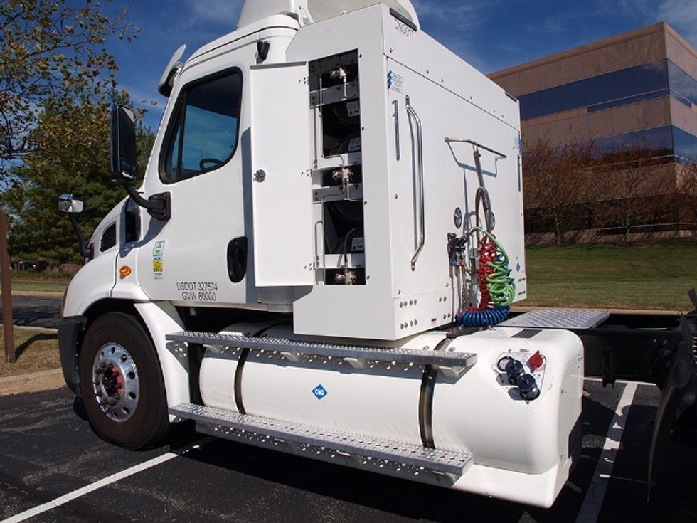
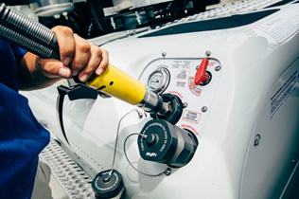
VEHICLE USING COMPRESSED NATURAL GAS(CNG)
Notes:
More developed supply networks. 36 stations in Canada (Spring 2020).

Slide 32
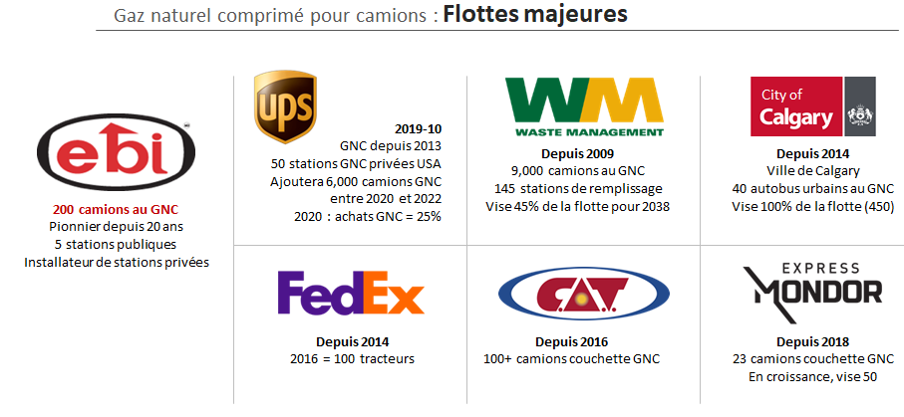
Compressed natural gas trucks:
Major Fleets

Slide 33
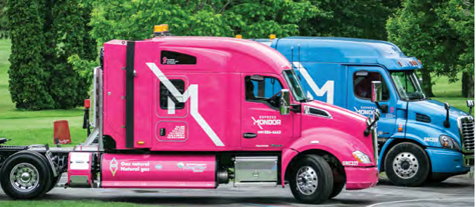

C.A.T.
Express Mondor

Slide 34
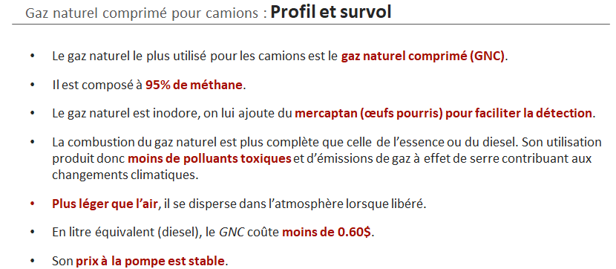
Compressed natural gas for trucks: Profile and overview
The most widely used natural gas for trucks is compressed natural gas (CNG).
It is compressed to 95% methane.
Natural gas is odorless, we add mercaptan (rotten eggs) to facilitate detection.
The combustion of natural gas is more complete than of gasoline or diesel. Its use therefore produces fewer toxic pollutants and greenhouse gas emissions contributing to climate change.
Lighter than air, it disperses in the atmosphere when released.
Equivalent in liter (diesel), CNG costs less than $0.60.
Its price at the pump is stable.

Slide 35
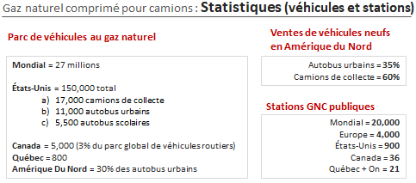
Compressed natural gas: Statistics (vehicle and stations)
Fleets with natural gas
New vehicles sales in
North America
Global = 27 millions
United States = 150 000 total
17 000 Collection Trucks
11 000 Urban Buses
5 500 School Buses
Canada = 5 000 (3% of total fleet of road vehicles)
Quebec = 800
North America = 30% of urban buses
Urban Buses = 35%
Collection Trucks = 60%
Public CNG stations
Global = 20 000
Europe = 4 000
United States = 900
Canada = 36
Quebec + Ontario = 21

Slide 36
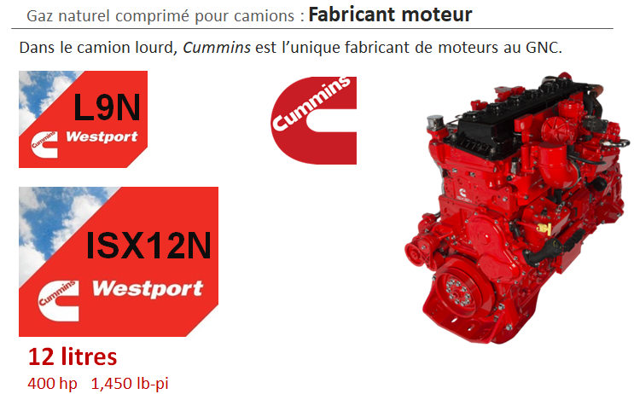
Compressed natural gas for trucks:
Engine Manufacturer
In the heavy vehicles Cummins is the sole manufacturer of CNG engines

Slide 37
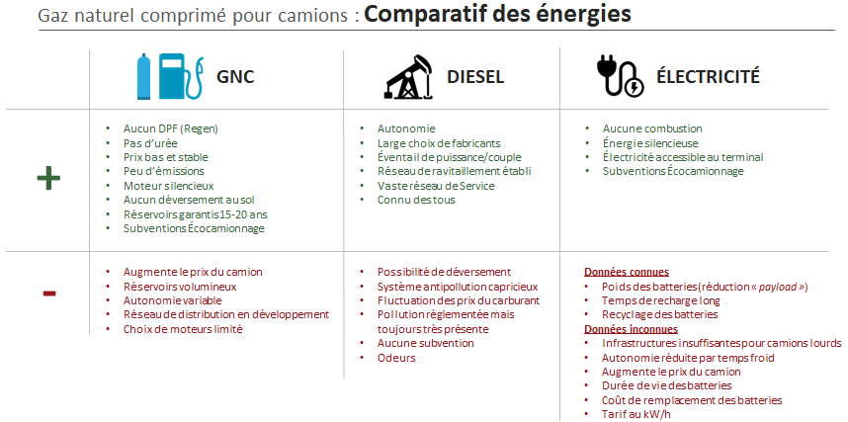
Compressed natural gas for trucks: Comparative energies
CNG
Electric
No DPF (Regen)
No DEF
Low cost and stable
Low emissions
Quiet engine
No spills
Tank guarantee of 15-20 years
Eco-truck subsidies
Autonomy
Large choice of manufactures
Power/torque range
Supply network established
Extensive service network
Known to all
No combustion
Silent energy
Electricity accessible at terminal
Eco-truck subsidies
Increases the price of the truck
Large reservoirs
Variable autonomy
Distribution network in development
Limited choice of engines
Various possibilities
Squeamish emission control system
Fluctuation of fuel prices
Regulated pollution but still very present
No subsidies
Odors
Known Data:
Battery weight (reduction in payload)
Long charging time
Battery recycling
Unknown Data:
Limited infrastructures for heavy vehicles
Reduced autonomy in cold temperatures
Increase in price for trucks
Lifetime of batteries
Price of replacement battery
Rate per kwh

Slide 38
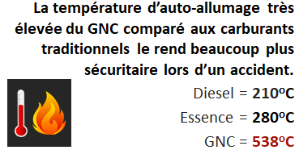


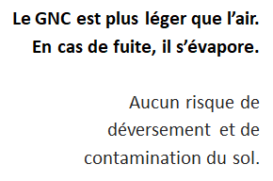

CNG SAFETY
The very high auto-ignition temperature of CNG compared to traditional fuels makes it much safer in an accident.
Diesel = 210 ºC
Gasoline = 280 ºC
CNG = 538 ºC
TANKS MUCH MORE RESISTANT
than gasoline/diesel tanks.
CNG is lighter than air.
In the event of a leak, it evaporates.
No risk of spillage and soil contamination

Slide 39
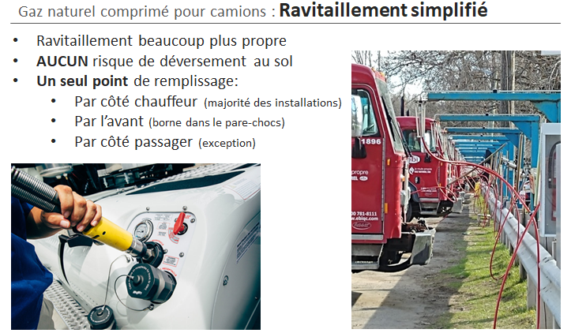
Compressed natural gas for trucks: Refueling simplified
Much cleaner refueling
No risk of spillage on the ground
A single filling point:
- by driver side (most installations)
- from the front (Terminal in bumper)
- from the passenger side (exception)

Slide 40
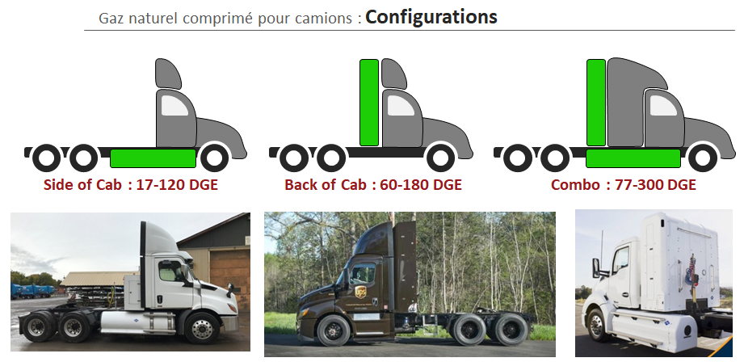
Compressed natural gas for trucks:

Slide 41
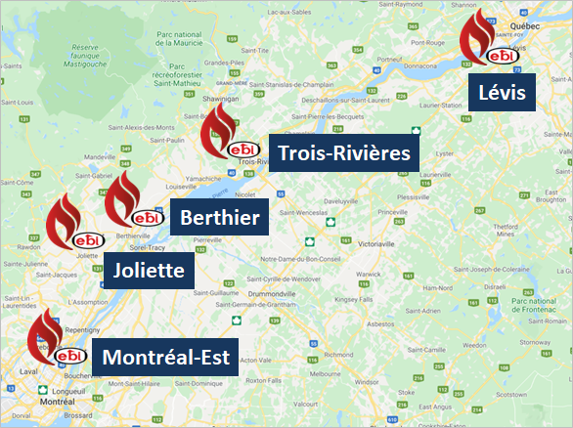
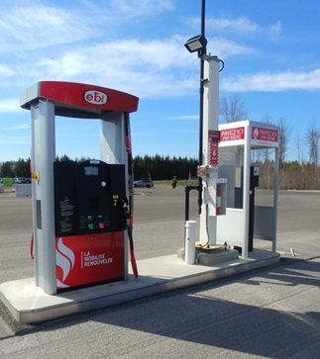
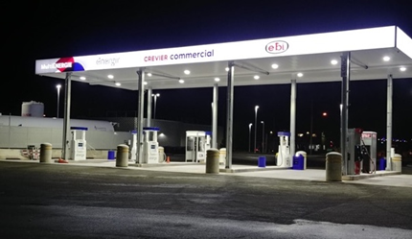
Public Stations
EBI

Slide 42
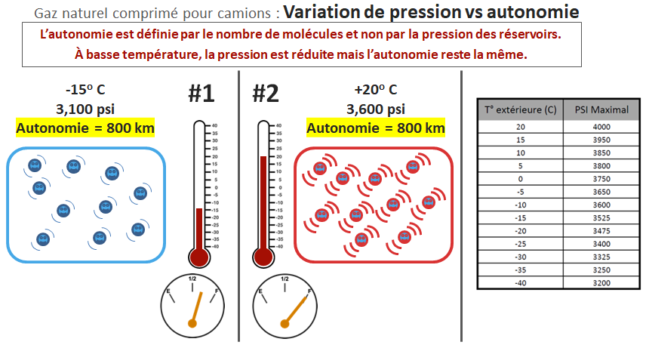
Compressed natural gas for trucks: Pressure variation vs autonomy
Autonomy is defined by the number of molecules and not by the pressure of the reservoirs. At low temperature, the pressure is reduced but the autonomy remains the same.
Exterior temp. (C)
Maximum PSI
Autonomy = 800 km
Autonomy = 800 km

Slide 43
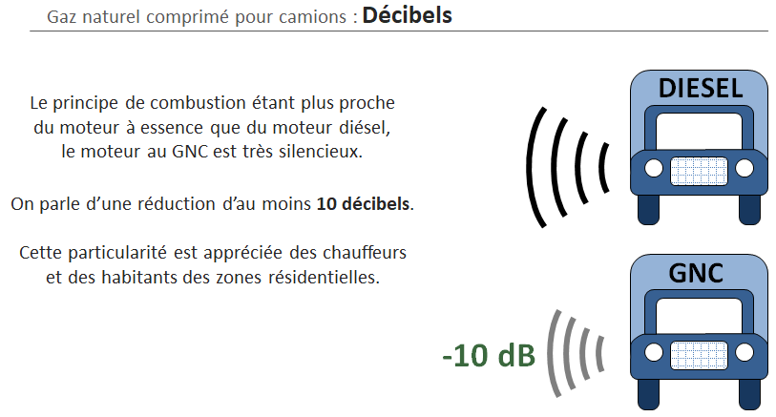
Compressed natural gas for trucks: Decibels
Since the combustion principal is closer to a gasoline engine than a diesel engine, the CNG engine is very quiet.
We are talking about a reduction of at least 10 decibels.
This particularity is appreciated by drivers and residents in residential areas.
CNG

Slide 44
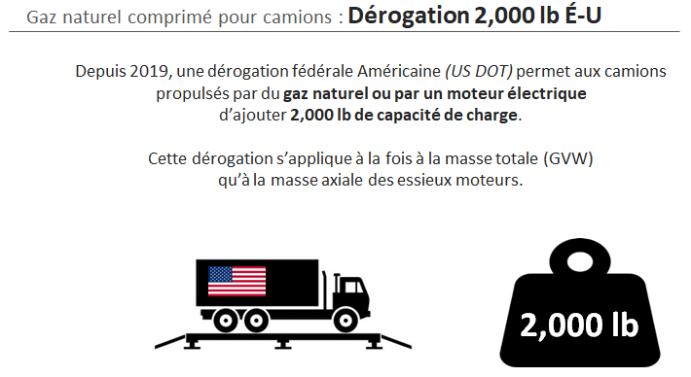
Compressed natural gas for trucks: US waiver of 2 000 lbs.
As of 2019, an American Federal Waiver (US DOT) allows trucks powered by natural gas or an electric motor to add 2 000 lbs of payload.
This waiver applies both to the total mass (GVWR) and to the maximum axle weight of the drive axles.

Slide 45
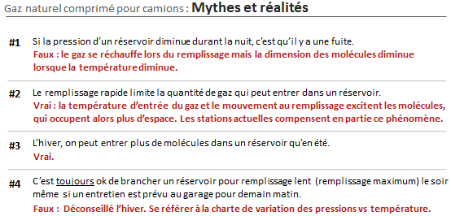
Compressed natural gas for trucks: Myths and Facts
If the pressure in a tank decreases overnight, there is a leak.
False: The gas heats up when filling up but the size of the molecules decreases when the temperature decreases.
Rapid filling limits the amount of gas that can enter a tank.
True: The gas inlet temperature and movement during filling excite the molecules, which then occupy more space. The current stations partly compensate for this phenomenon.
In winter, more molecules can enter a reservoir than in summer.
True
It is always ok to connect a tank for slow filling (maximum fill up) in the evening even if maintenance is scheduled at the garage in the morning.
False: Not recommended in winter. Refer to the pressure vs temperature chart.

Slide 46
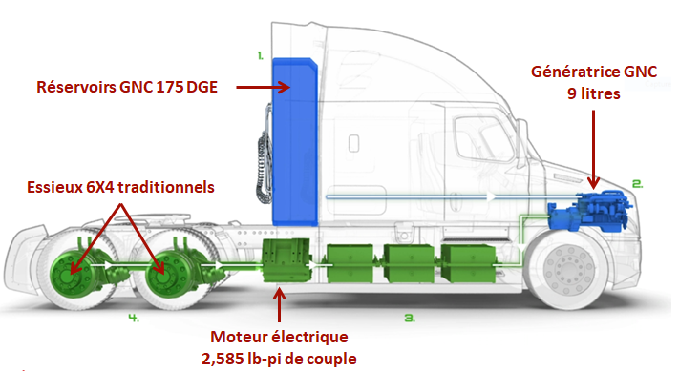
HYBRID ELECTRIC TRUCK WITH CNG GENERATOR
CNG GENERATOR
9 liters
CNG 175 DGE TANK
TRADITIONAL 6X4 AXLES
ELECTRIC MOTOR
2585 LB/FT OF TORQUE
Notes:
Very promising future given its torque.

Slide 47
Thank You
Have A Good Trip!
Source: GNC pour camions Richard Prévost EBI

