Slide 1
Competency 2 Lesson 2.2.7
Use Of Engines

Slide 2
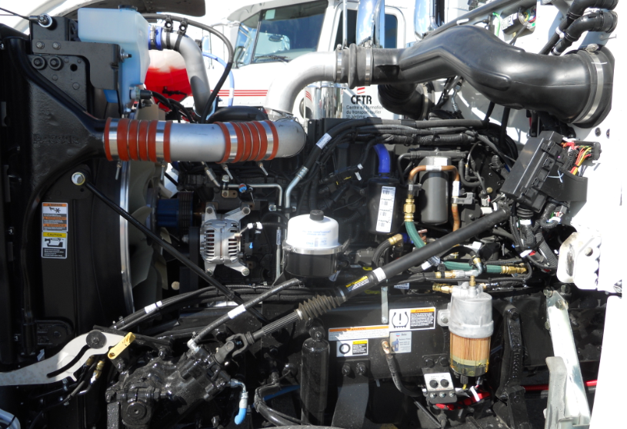
Lesson Objective:
Associate the use of the engine according to its capabilities.

Slide 3
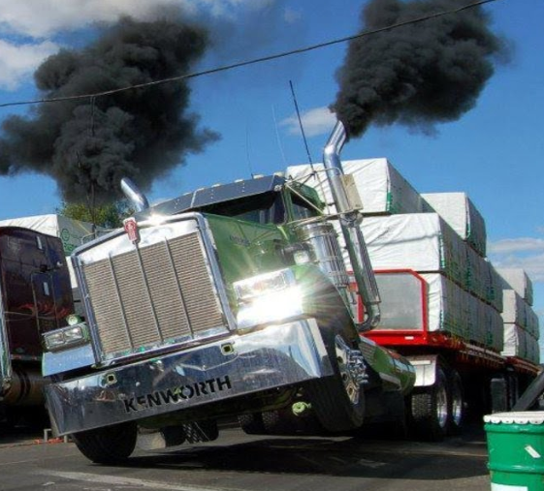
Torque or HP?
In order to get the most efficiency from his engine, the driver must understand how it works.
It is better to use torque rather than HP when operating the vehicle.
Today’s vehicles are designed for this purpose and their focal point is on fuel efficiency.
There are certain circumstances where working with the HP (horse power) may be necessary.

Slide 4
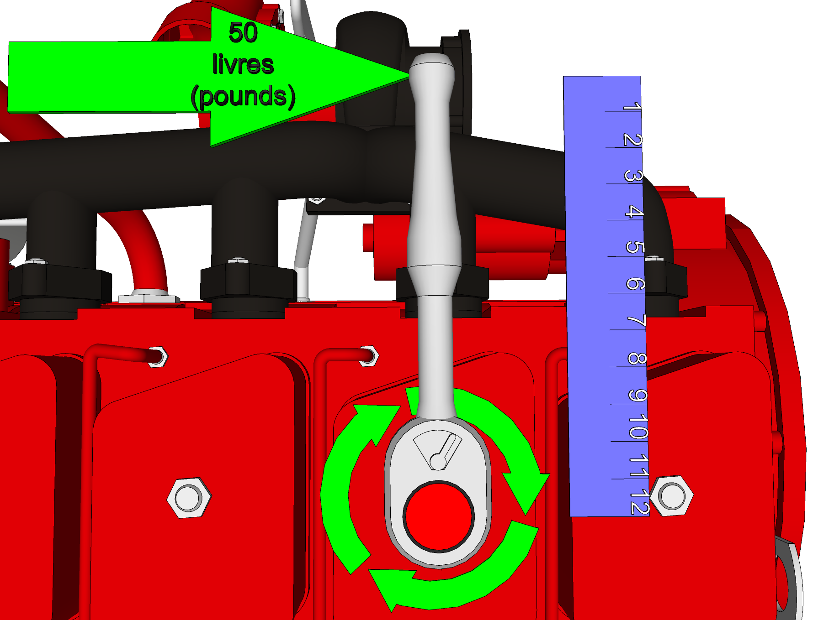
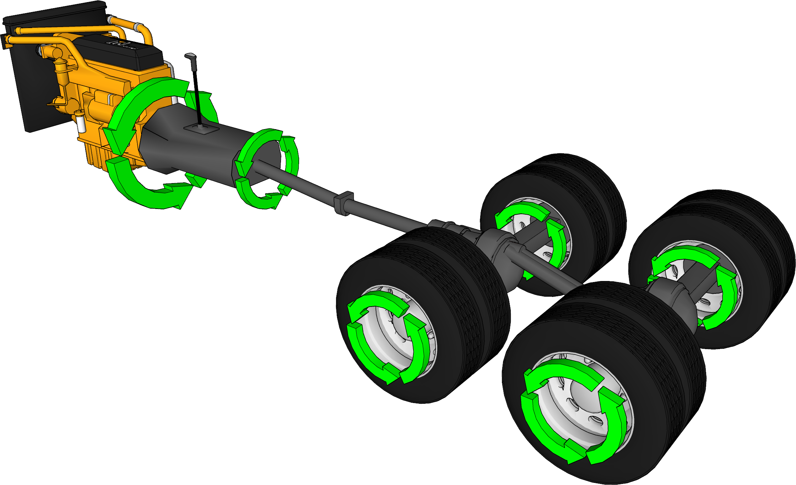
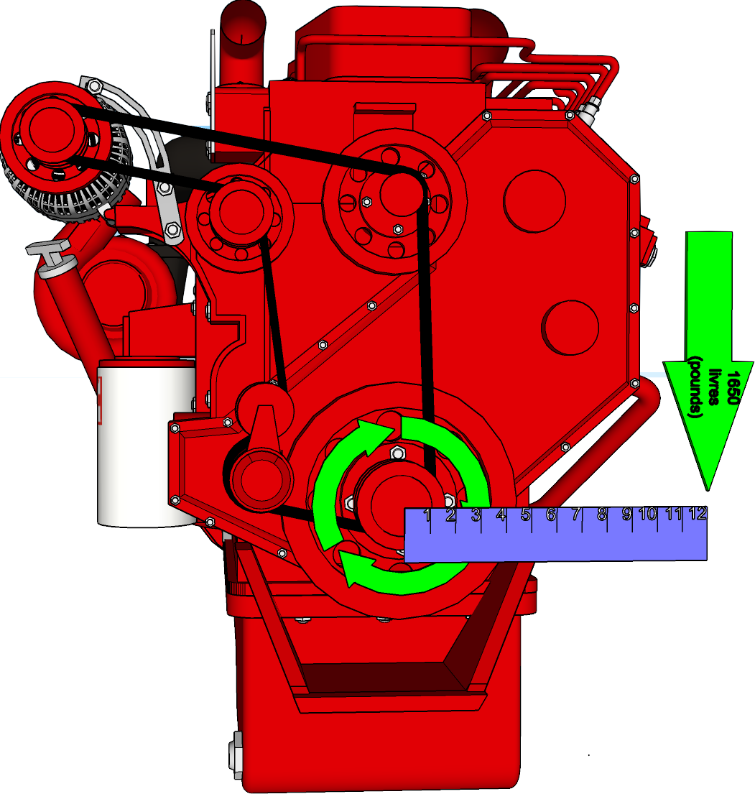
Torque
Torque is:
Increased: Ex: 1st gear...
Equalized: Ex: 7 Hi
Decreased: Ex: 8 Lo-Hi
In Pounds/Feet
Transmitted to the wheels
Notes:
Using torque: When climbing steep grades, when upshifting with a very heavy load. etc.
Torque is transmitted to the transmission… increased in low range… equalized in middle range ...decreased in higher range.
It is than directed to the rear axles and to the wheels.
At high revolutions the torque decreases significantly.

Slide 5
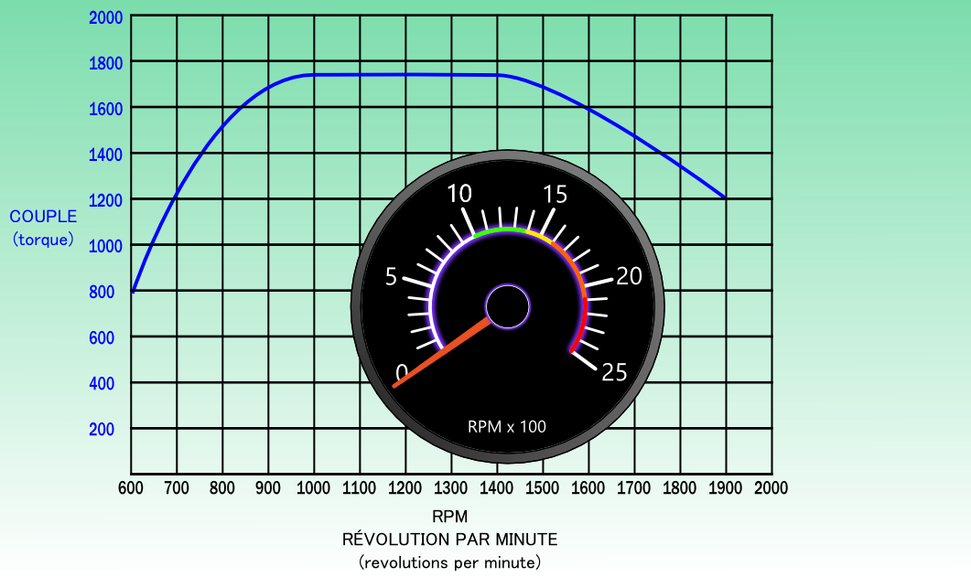
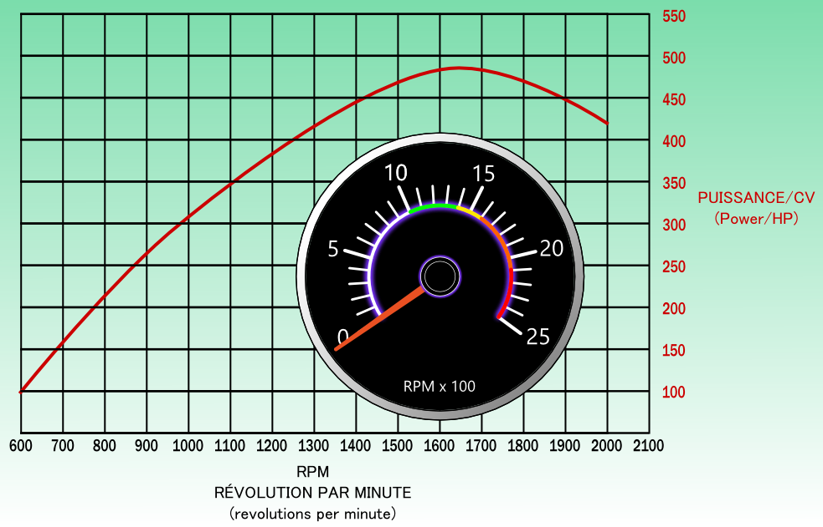
RPM: Torque vs HP
Torque HP
Notes:
Note: The torque is found within an operating range of several RPMs.
Note: The HP is more often found with a peak point, so it increases gradually and decreases gradually.
The colors in the tachometer reflect the efficiency of the revolutions per minute RPM

Slide 6
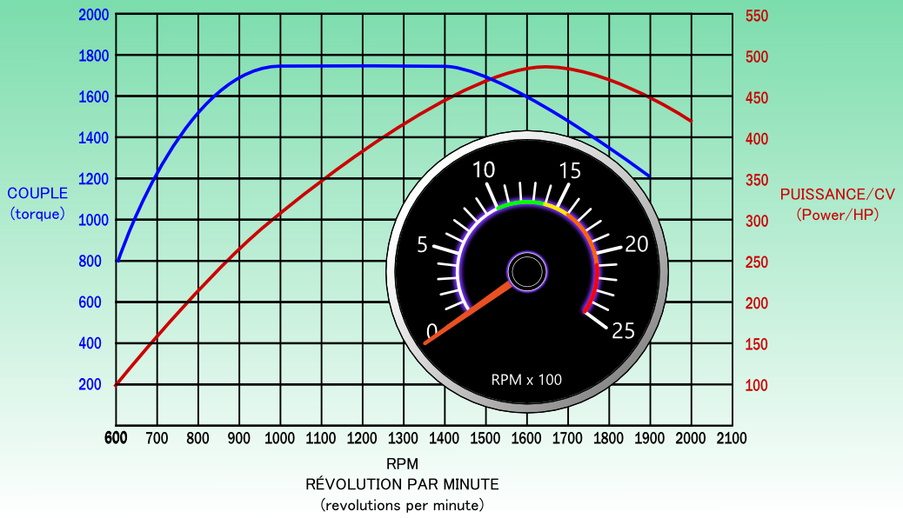
Terminology
Start of Peak Torque
End of Peak Torque
Progressive shifting (economical):
Low range: Shifts may occur below Peak Torque, at less than 1000 RPM.
High range: Shifts must recover at Peak Torque, at 1000 RPM.
Peak Torque:
Useful during upshifts in high range and when climbing in all gears.
Ideal Range (Sweet Spot):
Where the torque is at its maximum 1000-1425 RPM according to this chart.
Notes:
Due to the significant increase in torque through low range, it is not necessary to recover at peak torque. The recovery at 800 RPM could therefore be acceptable in normal driving situation.

Slide 7
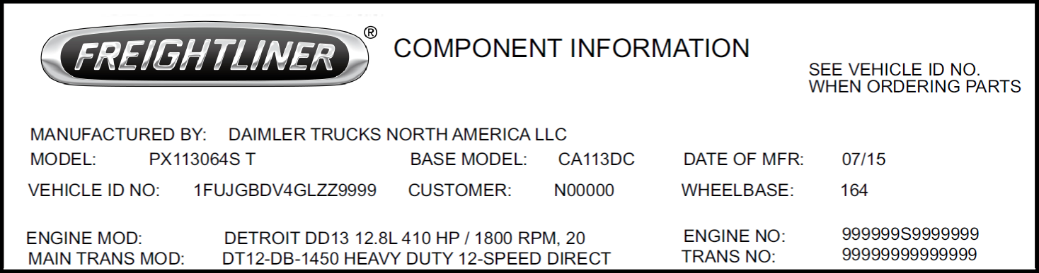
Terminology
HP (horsepower):
Often used during powerful acceleration in high range. During steep climbs.
Maximum HP:
When exceeded, there is a significant drop in HP (horsepower) and torque. So a loss of efficiency.
Notes:
In some types of transport it might be useful to increase the maximum RPM in order to increase the speed of the truck in the same gear, example: Forestry.

Slide 8
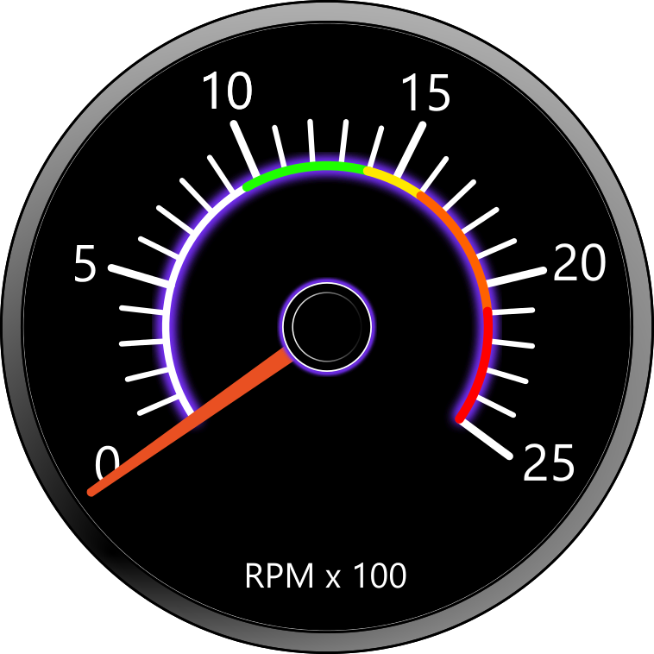
Terminology
6. Engine Speed: Common name: RPM.
Tachometer:
Usually in increments of 500 revolutions, some Mack trucks have increments of 200 RPM.
Idle:
Avoid to increase fuel economy and to reduce engine wear.
Notes:
Fast Idle is used when loading or unloading by a pump with the use of a PTO (power take off).

Slide 9
Terminology
9. Fast Idle:
By using the switch Cruise Control.
10. Maximum Engine Speed:
Engine speed that should never be exceeded.
11. Engine under load:
When the truck pulls a load, the engine becomes under load.

Slide 10
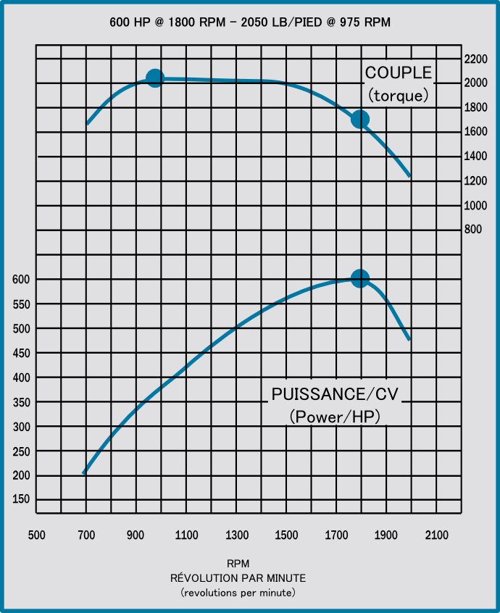
In this second example: 16 liter engine develops
2050 lb/ft of torque @ 975 RPM
Over this torque range which extends over approximately 400 RPM, The number 975 therefore represents the Minimum RPM to be observed under load.
In addition, this engine develops
600 HP @ 1800 RPM
The number 1800 therefore represents the Maximum RPM to be reached in order to obtain the maximum power from the engine..

Slide 11
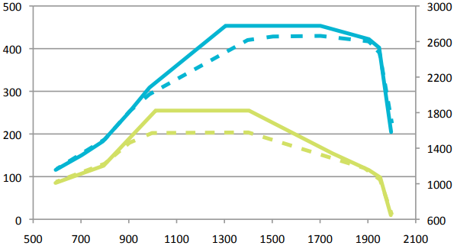
Multi-Torque/Eco-Torque
Engine manufacturers offer optional multiple torque configurations called Multi-Torque/Eco-Torque. Usually, the higher curve (green solid line) is programmed for the last gear ratios while the other allows savings when more torque is less needed.
Horsepower
455 HP
Torque
lb/ft
1850
1550
RPM

Slide 12
Explanatory Video:
DAF Eco training: Episodes: 1, 2 and 3
https://www.youtube.com/watch?v=dI5aAn-fPds
https://www.youtube.com/watch?v=a4I3SV3nBlI
https://www.youtube.com/watch?v=V05SnGuDu3Q
Notes:
Episode 3 will be presented at lesson 2.2.8.

Slide 13




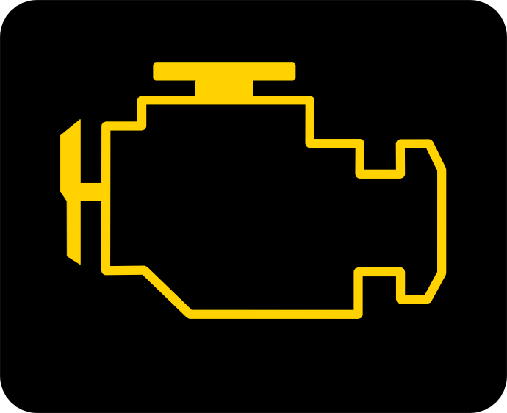
Indicator Lights And Warning Lights
Check Engine: You need to verify your gauges for any Faults. The vehicle can be driven. Notify the mechanic at next stop.
Engine Shutdown: This indicator is linked with an audible signal. This indicates a serious engine failure.
You must stop safely and turn off the engine within 30 secs.
Cold Start Aid System: Wait until light goes out before starting engine.
Cooling Fan: This light indicates that the thermostatic fan is on.
Fault (defect): Related to the anti-pollution system. The vehicle can be driven. Notify the mechanic at next stop.
Notes:
Remember to always do a cluster light check when doing your Circle Check.
Yellow Light: Simply make out a mechanical report ASAP (Warning)
Red Light: Serious engine failure. The driver can use the override switch to get out of the lane. It would be in his best interest to use it before the truck comes to a complete stop.

Slide 14
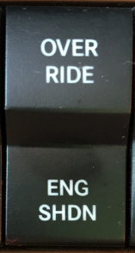
Engine Override
When the Engine Shutdown warning light is on, it may be necessary to use the Override switch in order to start and move the vehicle.
This switch is usually associated with Detroit Diesel engines.
Notes:
More than one Override may possible if needed. Note: the ECM records all sequences...

Slide 15
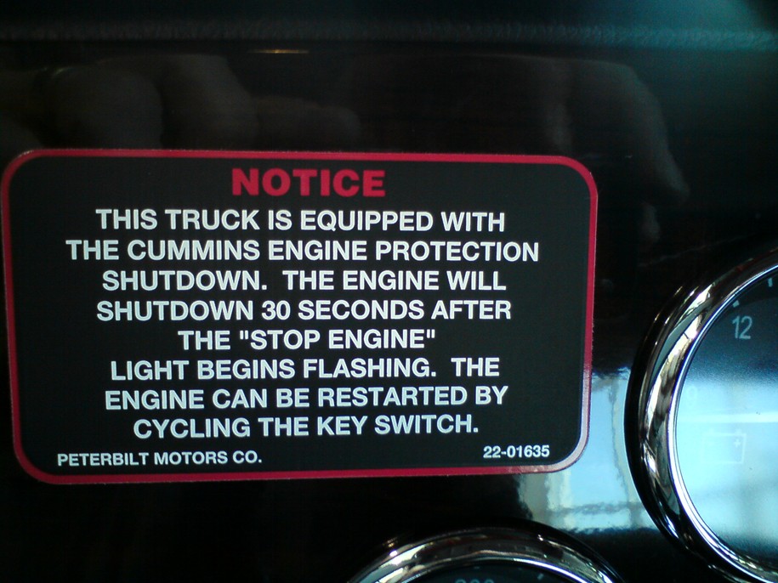
Cycling The Key Switch
Notes:
Procedures for vehicles without an Override switch.

Slide 16
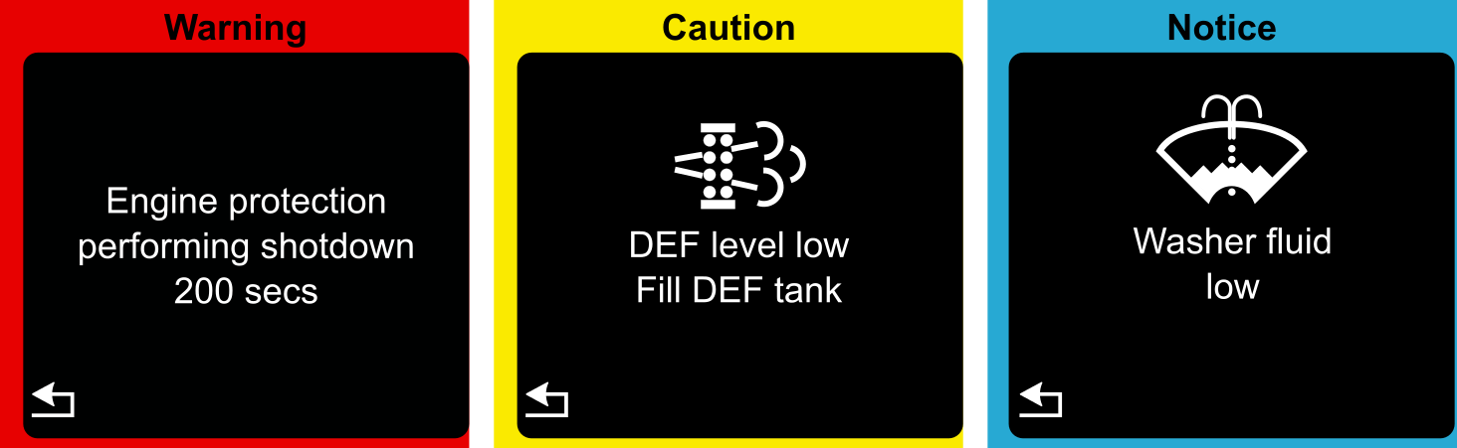
Electronic Display
Several other icons may appear
https://www.youtube.com/watch?v=tb5BNsVO780

Slide 17
Thank You
For Your Participation

