Slide 1
Competency 2 Lesson 2.2.6
Auxiliary Brakes
(Engine Brakes)

Slide 2
Lesson Objective:
Determine the utility of an auxiliary brake system.
Learn the role of engine compression.
Learn how to establish optimum performance during use.
Auxiliary Brakes (Engine Brakes)

Slide 3
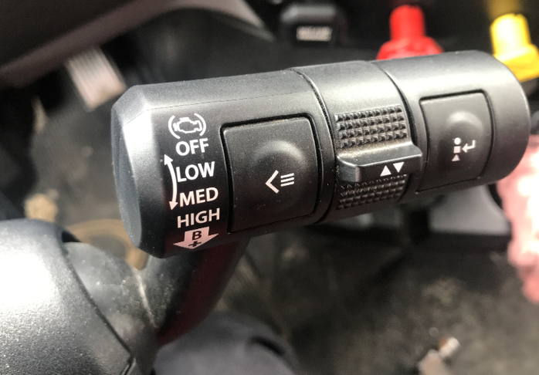


Auxiliary Brakes: (SAAQ: Complementary)
A valuable tool:
They reduce the load on the service brakes and provide additional braking.
Example: The majority of well-anticipated autoroute exit ramps can be negotiated without the use of the service brakes. Likewise, the use of auxiliary brakes is part of the procedures in managing a safe descent during long slopes.
Notes:
Reference: DHV Page.154
The portion of “Complementary Brakes” is relevant..
The portion “Slowing Down On A Hill Using The Transmission And Engine Compression” is grossly overrated. It would be appropriate to mention to the students that first gear is not helpful.

Slide 4
OPERATION METHODS:
The engine even without an auxiliary brake system, can act as a brake system. You can see its effect when you downshift. This is called compression retardation.
There are mainly two types of auxiliary brakes (engine brakes). These systems work in pairs with compression retardation.
1. One of these systems works by restricting the output of exhaust gases, common name:(Exhaust Brake). It is installed at the outlet of the turbocharger.
2. The other system works by increasing the compression, common name: (Jacob Brake or Jake Brake). This is an optional system integrated into the engine. In addition, the thermostatic fan is sometimes used to further increase the deceleration force.
The basis of these two systems is to decrease the rotation of the engine (making it more difficult to rotate) thus slowing down the vehicle. The engine then acts as a retarder rather than an accelerator.
In both cases, the higher the engine speed the more effective the retarder (auxiliary brake) will be.
Attention! However, it is extremely important to respect the maximum engine speed from the manufacturer’s specifications.

Slide 5
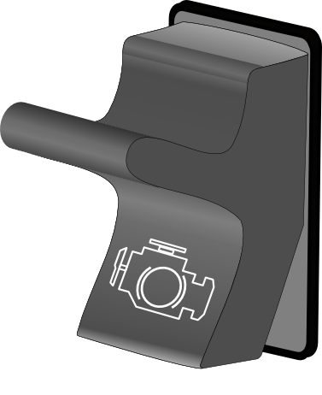


Some types of switches and levers associated with the operation of the retarder.
Associated Pictogram
Single Switch With 2 Levels Of Restraint
Double Switches With 3 Levels Of Restraint

Slide 6
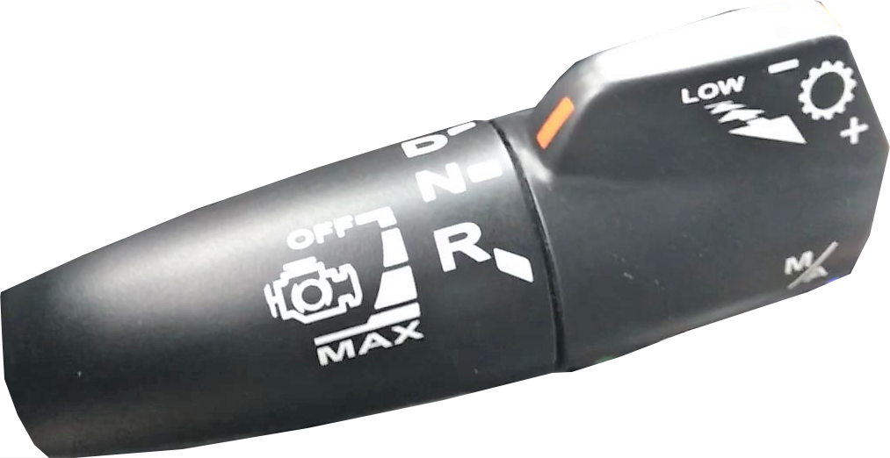

The automated transmission lever can also be used to control the starting as well as the various retarding powers. A warning light illuminates in the dashboard upon activation.
The clutch and accelerator pedals are equipped with switches. These allow the engine brake to be interrupted as soon as one or the other is applied. In addition, the retarder cannot come into action at an engine speed lower than 1000 RPM.

Slide 7
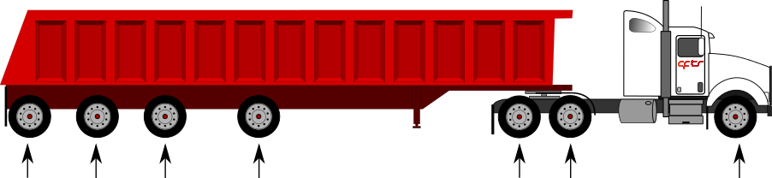

Service Brakes VS Auxiliary Brakes
Service Brakes
Auxiliary Brakes

Slide 8





Proper Use:
Ideally, the engine brake should not be used when approaching towns or villages. Although today’s auxiliary brakes are quieter and more efficient than in the past, even in places where the use of engine braking does not appear to be restricted, judgement must be used to keep the surrounding population peaceful. Fines may apply where prohibited.
ENGINE BRAKE PROHIBITED

Slide 9


Slide 10
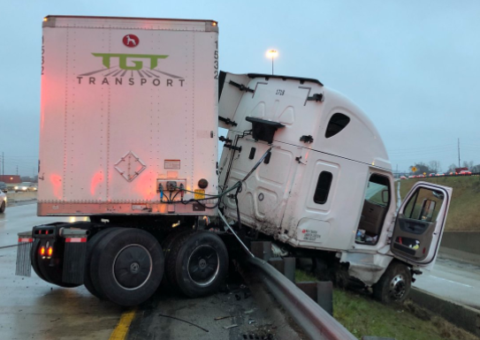
When is it risky to use?
ATTENTION: When driving a vehicle equipped with an automated transmission, you must be very careful before choosing the maximum level of restraint. In fact, this level can cause intense downshifts which could surprise the driver and especially compromise the behavior of the vehicle. And this even if the vehicle is equipped with an ABS anti-lock system.
Consequently, on a slippery road, the restriction offered by the drive wheels of the truck could lead to loss of control of the vehicle. In fact, the higher the restraint power demanded the greater the risk of skidding caused by locking the wheels.
This is why under these conditions, manufacturers do not recommend using the maximum level.

Slide 11
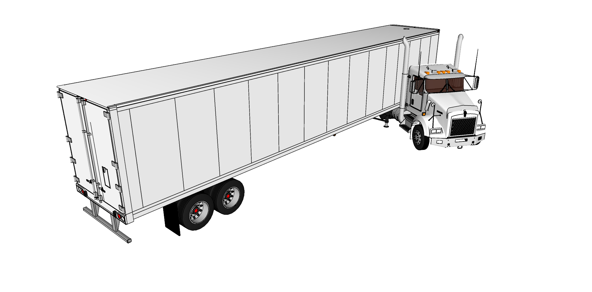
IMPORTANT: At the start of a skid caused by ethier engine brake application or by a downshift, the first action to take, while counter-steering is to press the clutch pedal to cut the power to the drive wheels and thus regain control of the vehicle.
The push of the semi-trailer, due to kinetic energy, could eventually cause Jackknifing.

Slide 12
Thank You
For Your participation

