Slide 1
Competency 2 Lesson 2.2.5
Air Supply
and
Exhaust Systems

Slide 2
Lesson objective:
Recognizing the role of each component and how to optimize their performance.

Slide 3
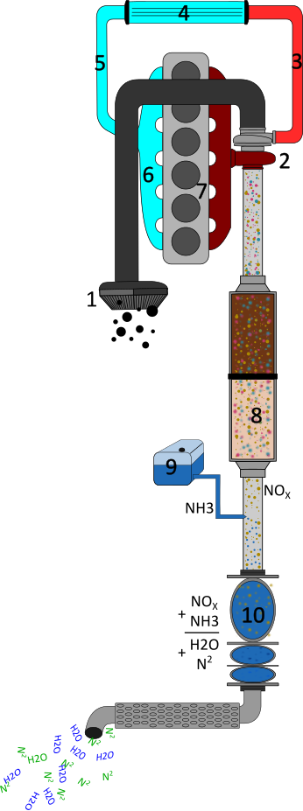
The Air intake and Exhaust system

Slide 4
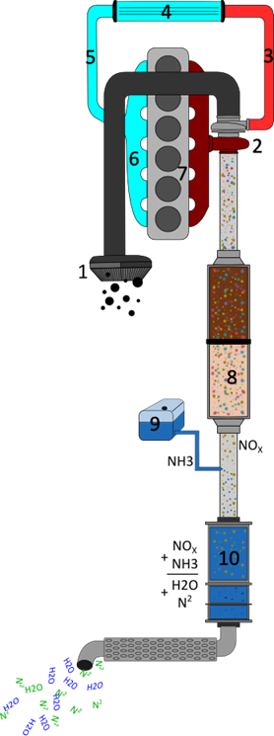
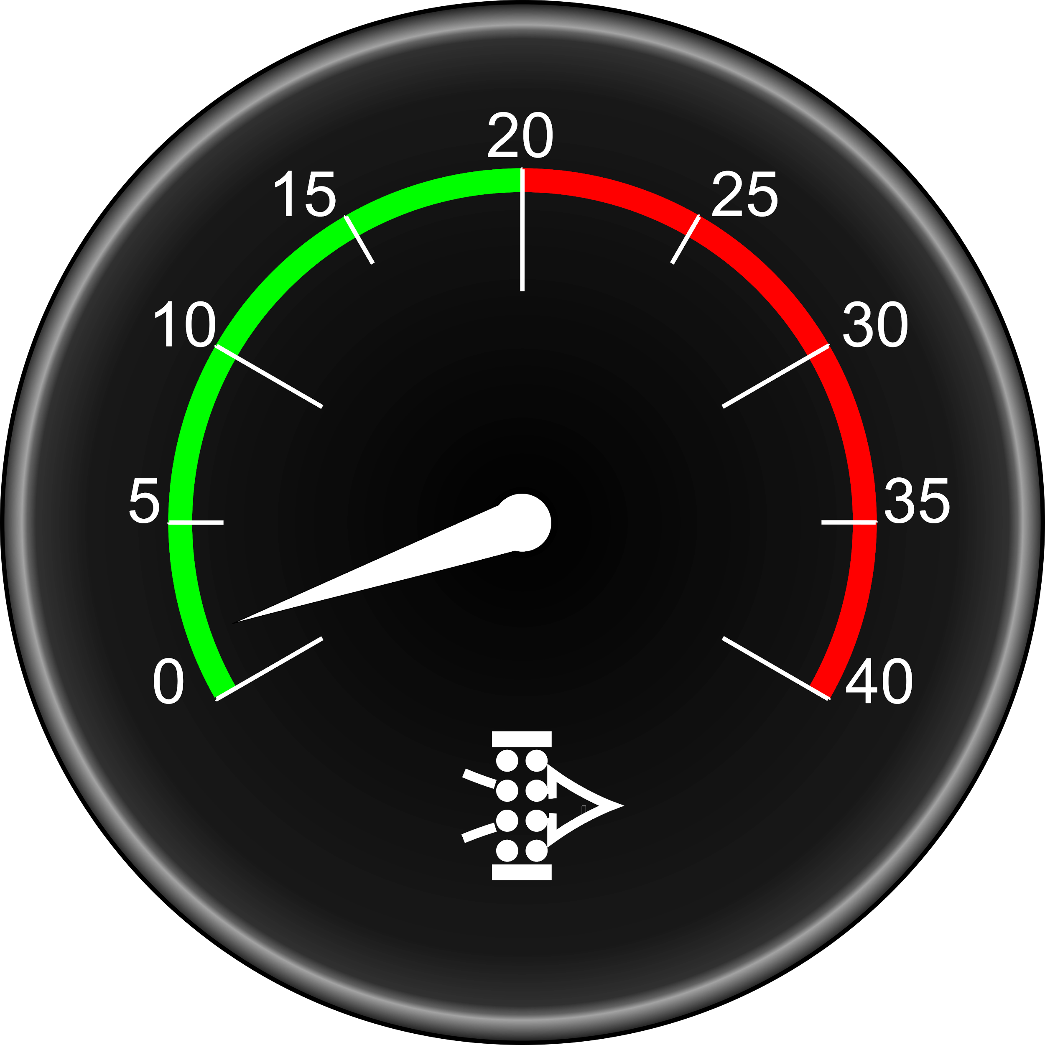
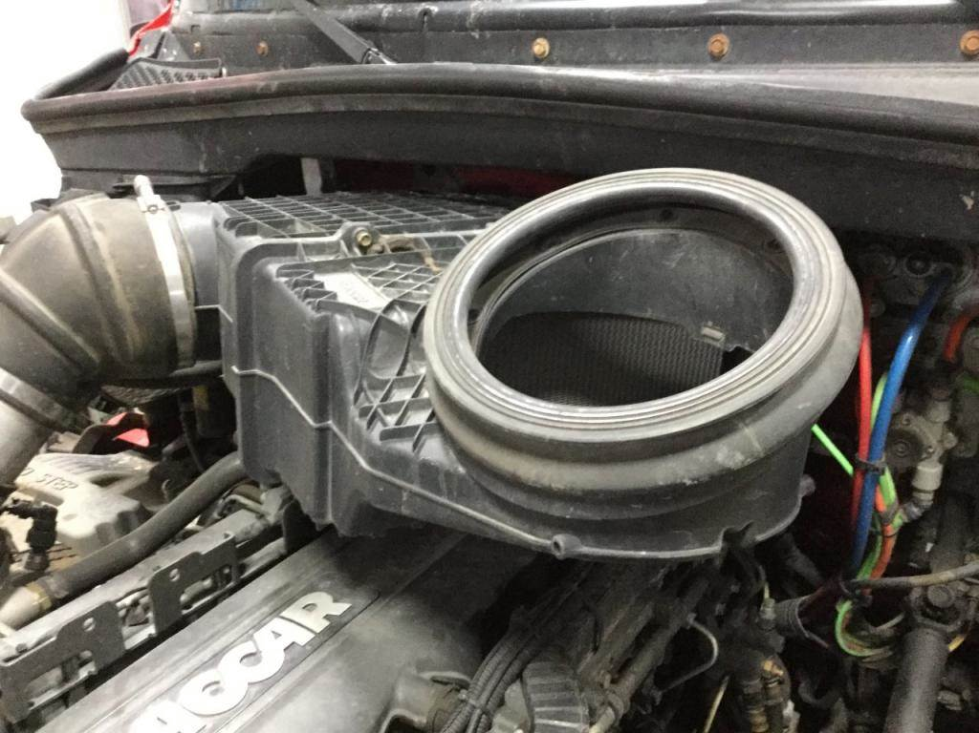
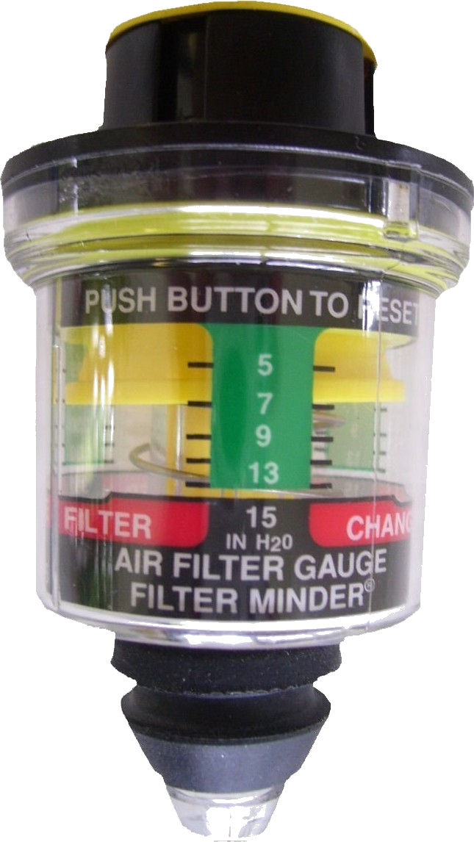
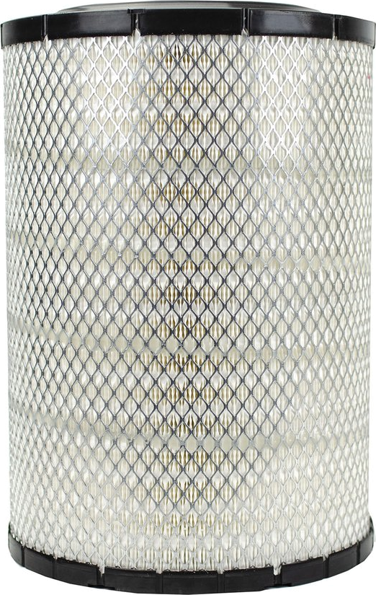
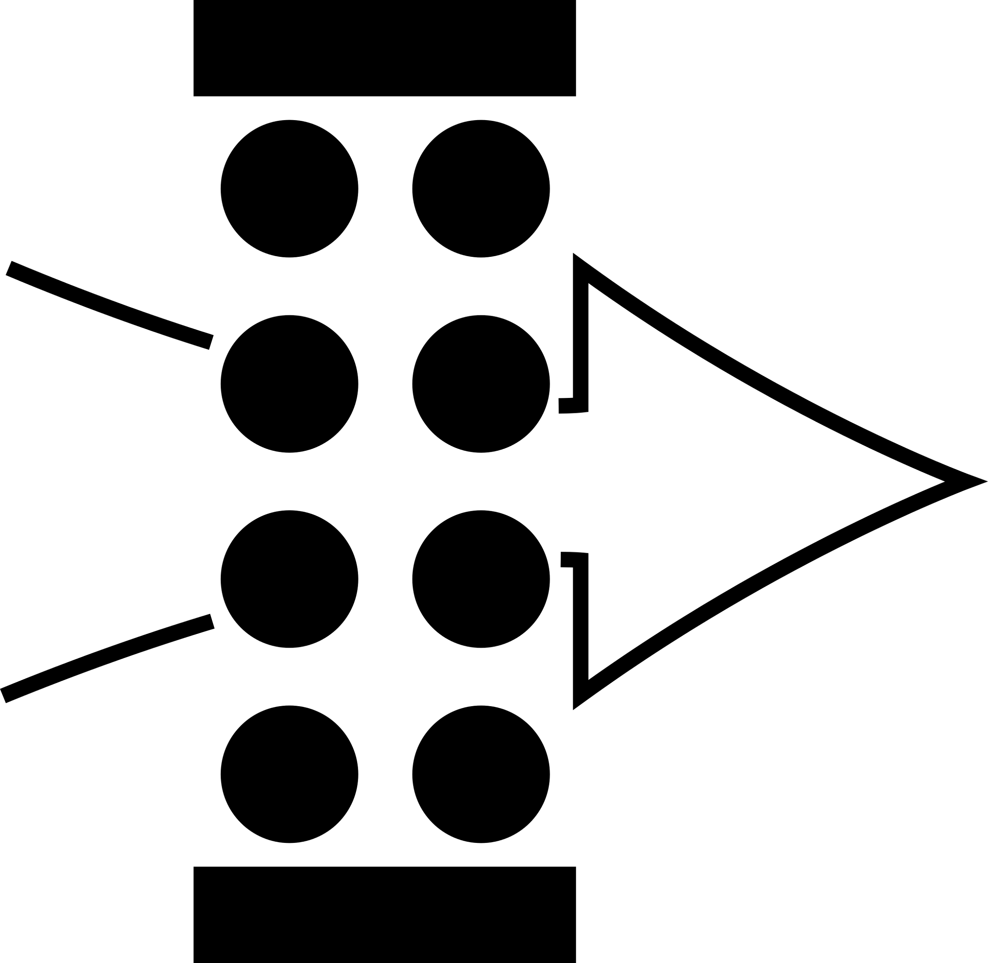
The Air Filter (1)
Under the hood
From the dashboard
Associated gauge
Associated pictogram
Under the hood

Slide 5
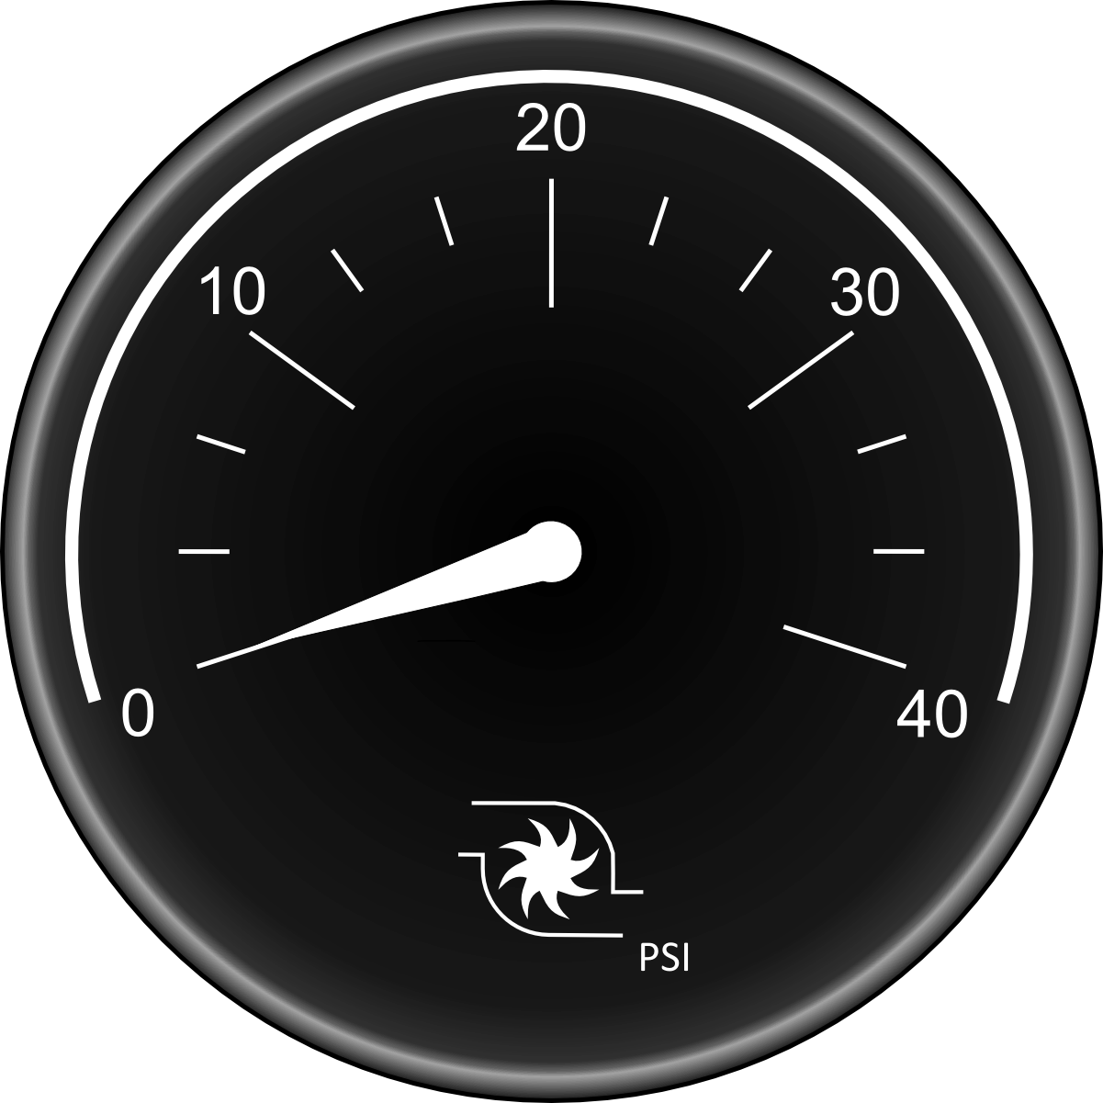
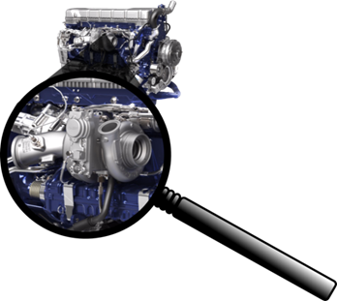

The Turbo Compressor
Associated pictogram

Slide 6
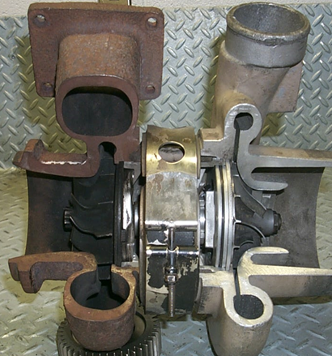
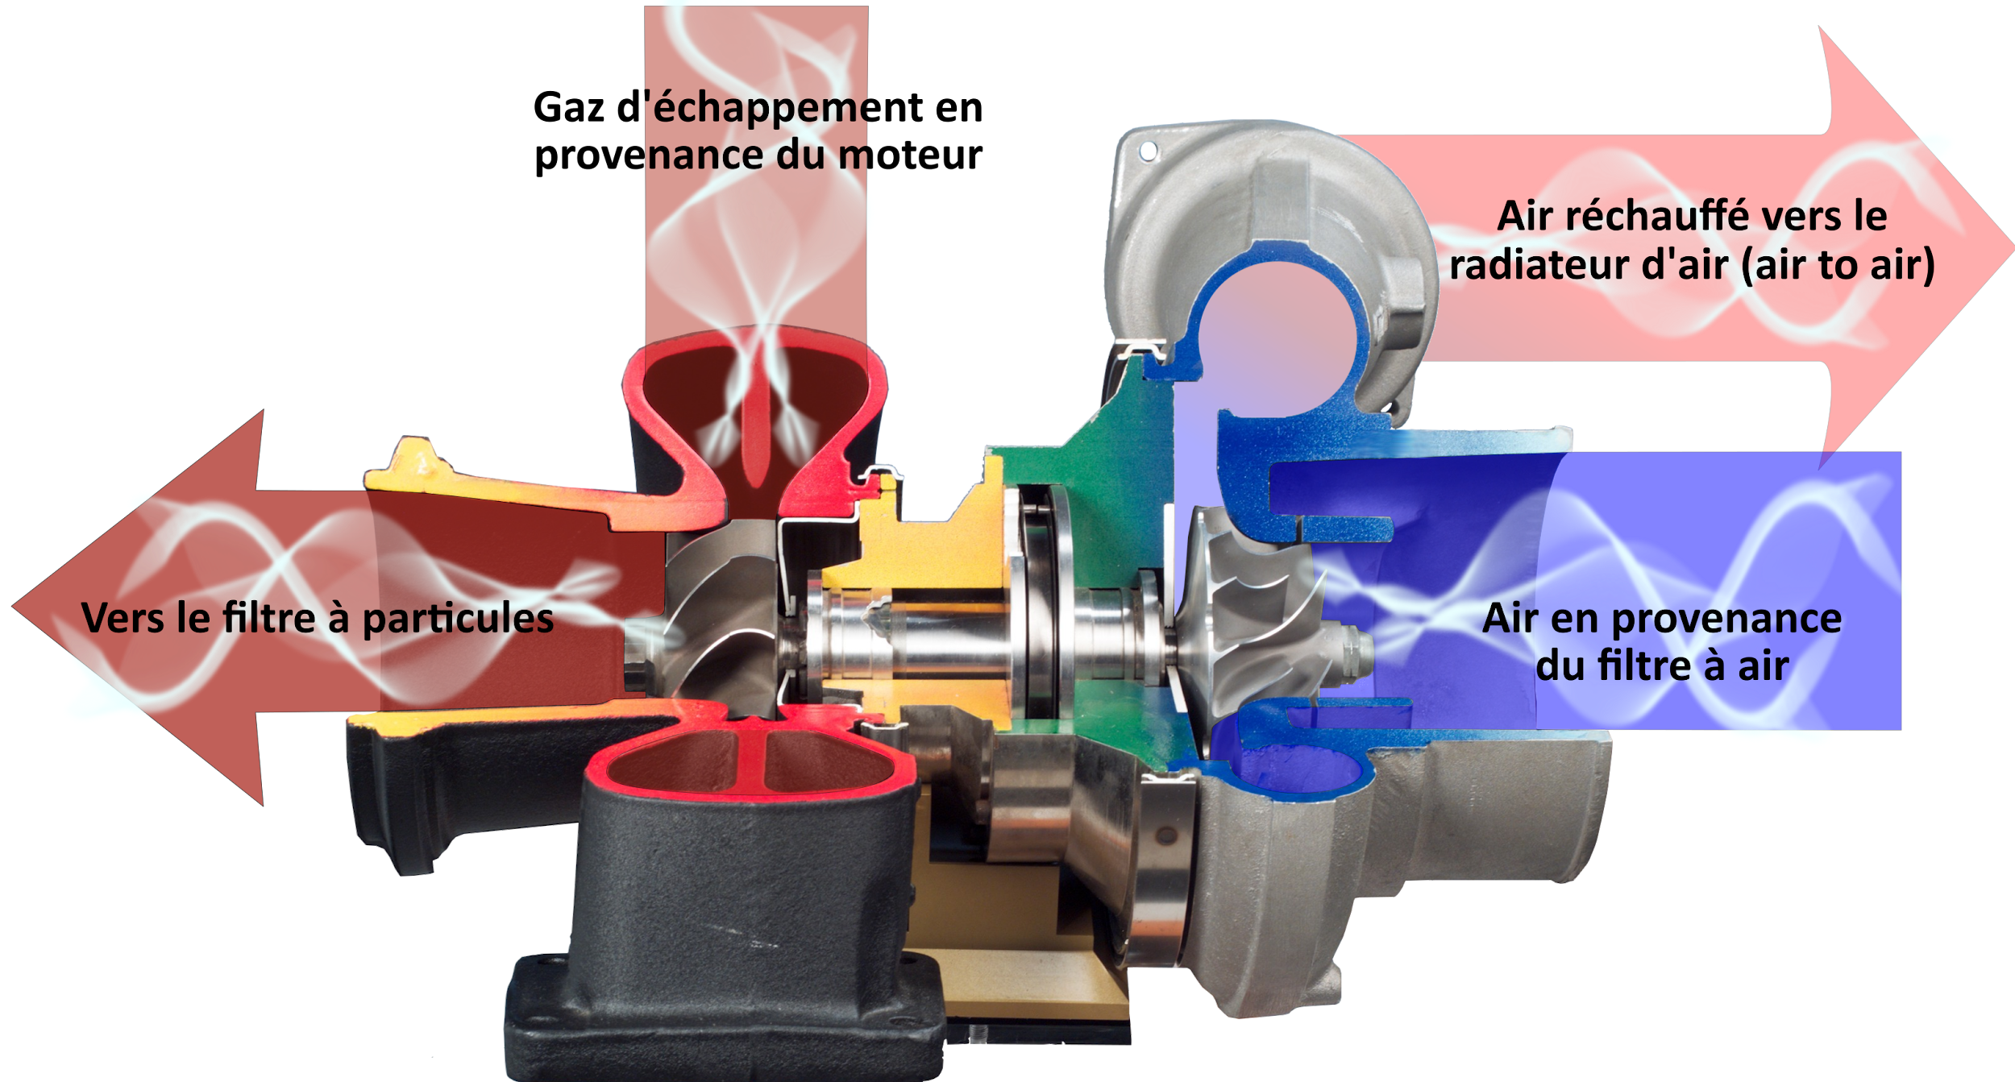
Sectional view of Turbo
Notes:
The exhaust gases are used to heat up the gases passing through the particulate filter more quickly.

Slide 7
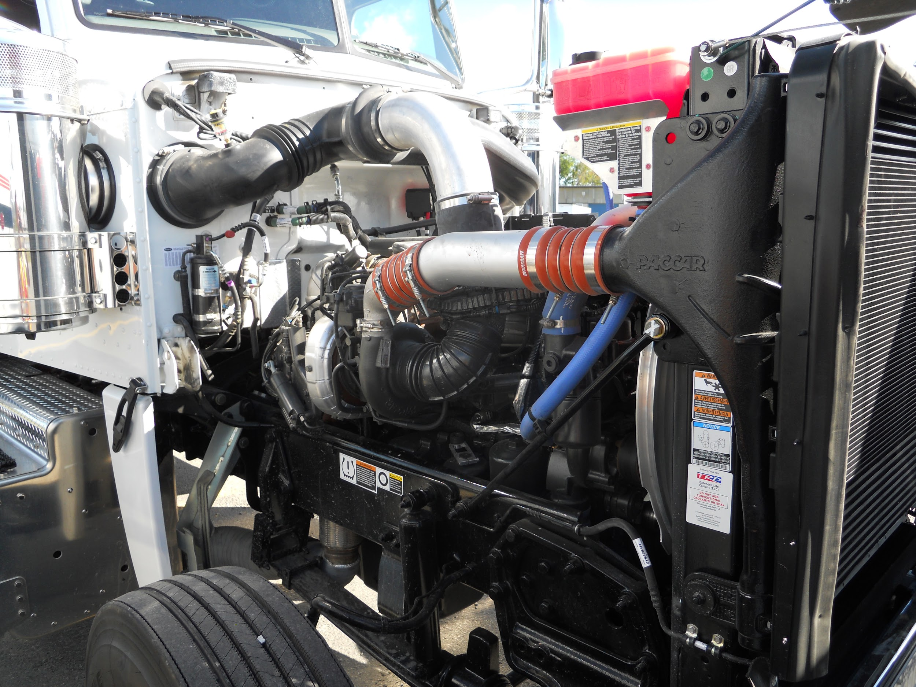
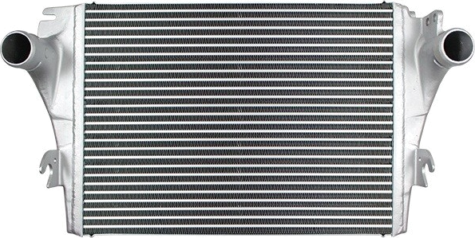
Passageway of Air
(4)
radiator air to air
(3)
Flexible tubing
(5) (3)
Connections to flexible tubing

Slide 8
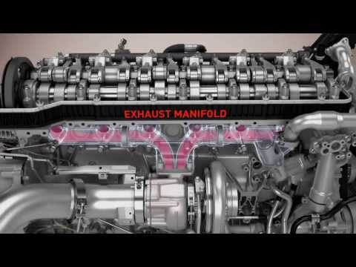
Now let’s look at the passageway of the air

Slide 9
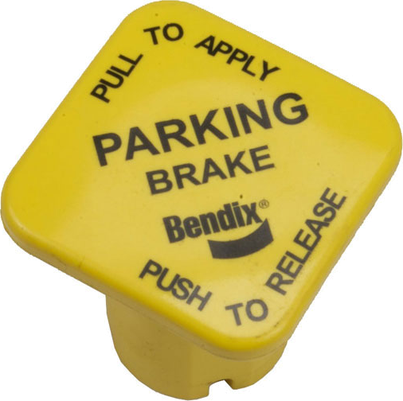
Regeneration of the anti-pollution system (Post-treatment)
Three types of regeneration:
Passive (in movement): Initiated by the computer. Without driver intervention.
Active (in movement): Initiated by the computer. Without driver intervention.
Stationnary: Initiated by the driver by using a switch.
Notes:
Passive: The high temperature of the exhaust makes it possible to transform all the soot into ash autonomously, while Active Regen requires the addition of diesel in order to raise the internal temperature.

Slide 10
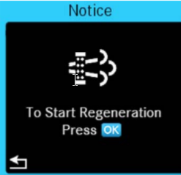




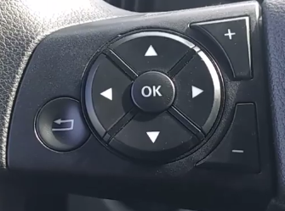
Driver-induced stationary regeneration
Indicator lights
The 4 prerequisites:
Engine temperature should be around 170 degrees F
Transmission must be in neutral
Parking brakes must be applied
The switch should be held for about 5 seconds
Note: Fast idol should commence
Power switches and buttons

Slide 11

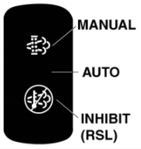
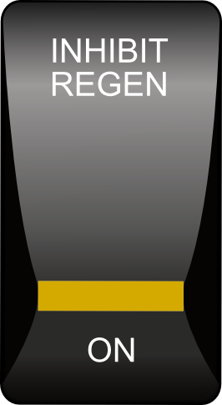
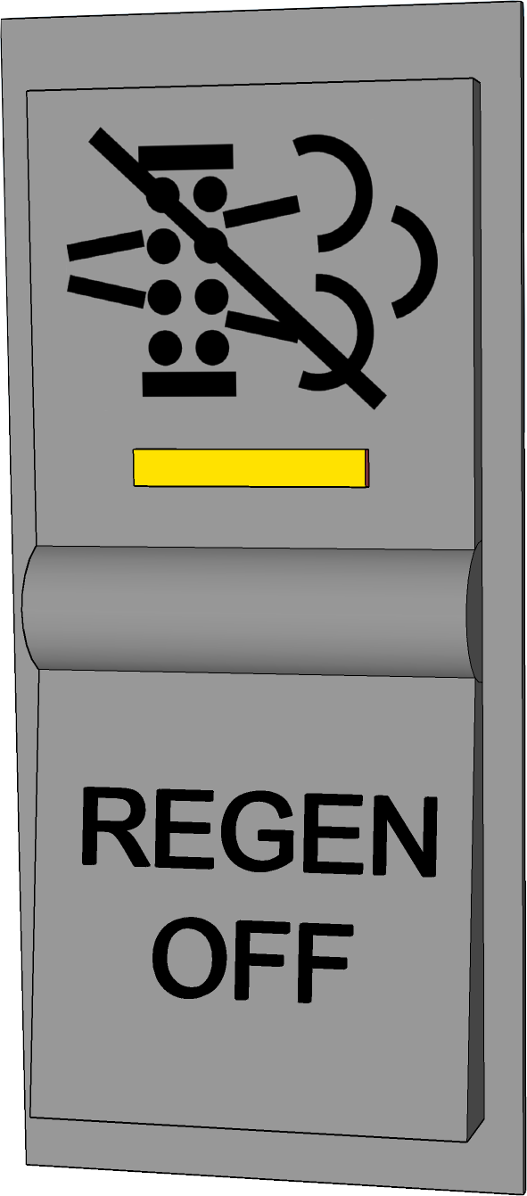
Optional two-way switches. Normal position “OFF”
Function: Allows the driver or mechanic to avoid or stop all forms of regeneration.
NB: This option should be used strictly for security reasons. Examples: Parking (engine running) in a garage or near flammable products.
Three position switch which combines start-up and stop of regeneration. Normal position: “Middle” or “AUTO”

Slide 12





Pictograms associated with the particulate filter (8) and their meanings
Pictograms |  | Meaning | Actions to be taken
 | Level1 (Warning light) | Regeneration of exhaust filter is recommended. | While driving on the highway at authorized speeds or initiating a regeneration process while parked.
 | Level 2 (Warning light flashing) | Exhaust filter regeneration required | En roulant sur l'autoroute aux vitesses permises ou entamez le processus de régénération en stationnement.
 | Level 3 (Warning light is on and flashing, in addition “Engine YELLOW Warning” light is on) | The filter has reached its maximum capacity. Exhaust filter regeneration required. Engine power will be reduced. | En roulant sur l'autoroute aux vitesses permises ou entamez le processus de régénération en stationnement.
 | Level 4 (Warning light is on and flashing, “Engine YELLOW Warning” light is on and also “Engine Red Shutdown” light is on) | The exhaust filter has exceeded its maximum capacity Exhaust filter regeneration is required. | The vehicle must be parked and the regeneration process begun. The engine may stop and a Road Service may be required.
 | The exhaust temperature is really high “DANGEROUS” | Because of high temperature coming from the exhaust, pay attention where to park before doing the regeneration process.

Slide 13
Regeneration Procedures
Parked Regen GHG17 - Full Training Video
https://www.youtube.com/watch?v=1z8iE61v0cI&t=128s

Slide 14




Pictograms associated with the particulate filter (9) and their meanings
Pictograms |  | Meaning | Actions to be taken
 | Level 1 (Warning light)) | “DEF” level is low fill soon | Initial warning, the engine is operating normally. DEF level is at 10% or lower. Fill up.
 | Level 2 (Warning light on and flashing) | “DEF” level is low fill soon | The engine is operating normally. DEF level is at 5 % or lower. Fill up.
 | Level 3 (Warning light is on and flashing, in addition “Engine YELLOW Warning” light is on) | “DEF” level is low fill immediately Engine power will be reduced. (Engine is derating) | Engine performance is LIMITED. DEF level is at 2,5% or lower. Fill up.
 | Level 4 (Warning light is on and flashing, “Engine YELLOW Warning” light is on and also “Engine Red Shutdown” light is on) | “DEF” level is low fill immediately Engine power will be reduced to 8 km/h. (Engine is downgraded) | The speed of the vehicle is limited to 8 km/h. Fill up.

Slide 15
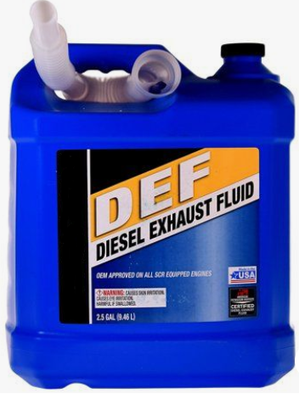
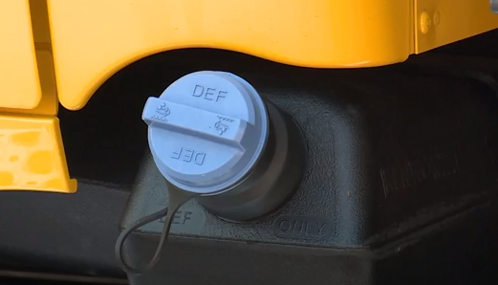
The frequency of refills depends on two factors:
First the fuel consumption. In fact, the consumption of DEF represents about 2% of total diesel consumption. Second, the total capacity of the DEF tank. Depending on the application, the tank can contain between 20 and 80 litres of DEF.
Blue cap
Notes:
Discuss storage conditions, handling, freezing temperatures, etc.

Slide 16
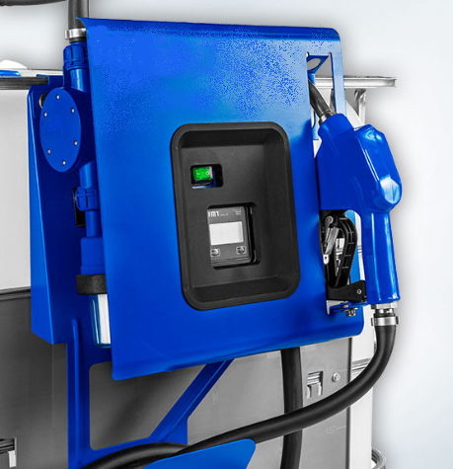
Driver Training: Detroit BlueTec Emissions Technology
DIESEL EXHAUST FLUID “DEF”

Slide 17
Thank you
for your participation

