Slide 1
Competency 2 Lesson 2.2.4
The Electrical System

Slide 2
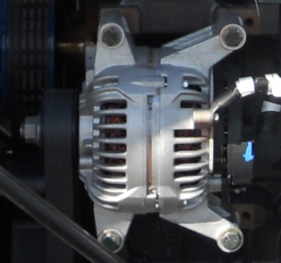
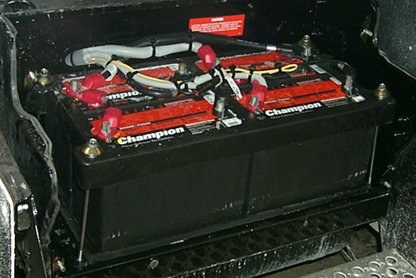
The electrical system of trucks is composed of two main elements, the alternator and the batteries.
The role of the alternator is to generate current as soon as the vehicle is started to produce electricity to charge the batteries. In addition, it will provide the current necessary for the proper functioning of the electrical components.
The batteries have a dual function: First, provide the electrical power to the starter to crank the engine and secondly, to power the truck’s electrical components in the event that the alternator fails.

Slide 3

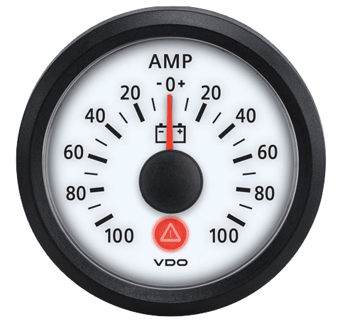
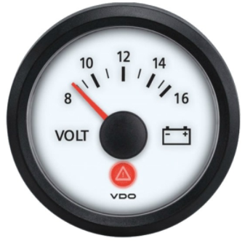
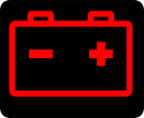
An ammeter (optional gauge) allows you to measure the intensity of an electric current. Its normal reading is slightly above zero. If there is a high demand for currant, the reading will increase on the positive side. On the other hand, if the alternator doesn’t work, the reading will go on the negative side.
The alternator supplies current to the charging system. The voltage on the voltmeter should read between 12.5 and 14 volts.
12.5 being the minimum when cold and a maximum of 14,5 in operation.
Pictogram associated with the charging system
Warning lights signaling an anomaly with the charging system

Slide 4
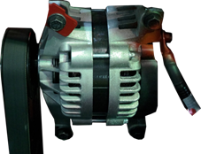
While doing the Circle Check I must make sure that:
The belt and its connections are in good condition
As for the batteries (usually 4), inspection is performed by a mechanic during periodic inspections. Between 2 to 4 times a year.

Slide 5
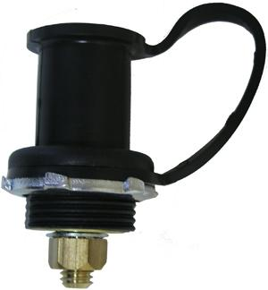
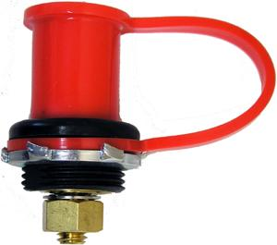
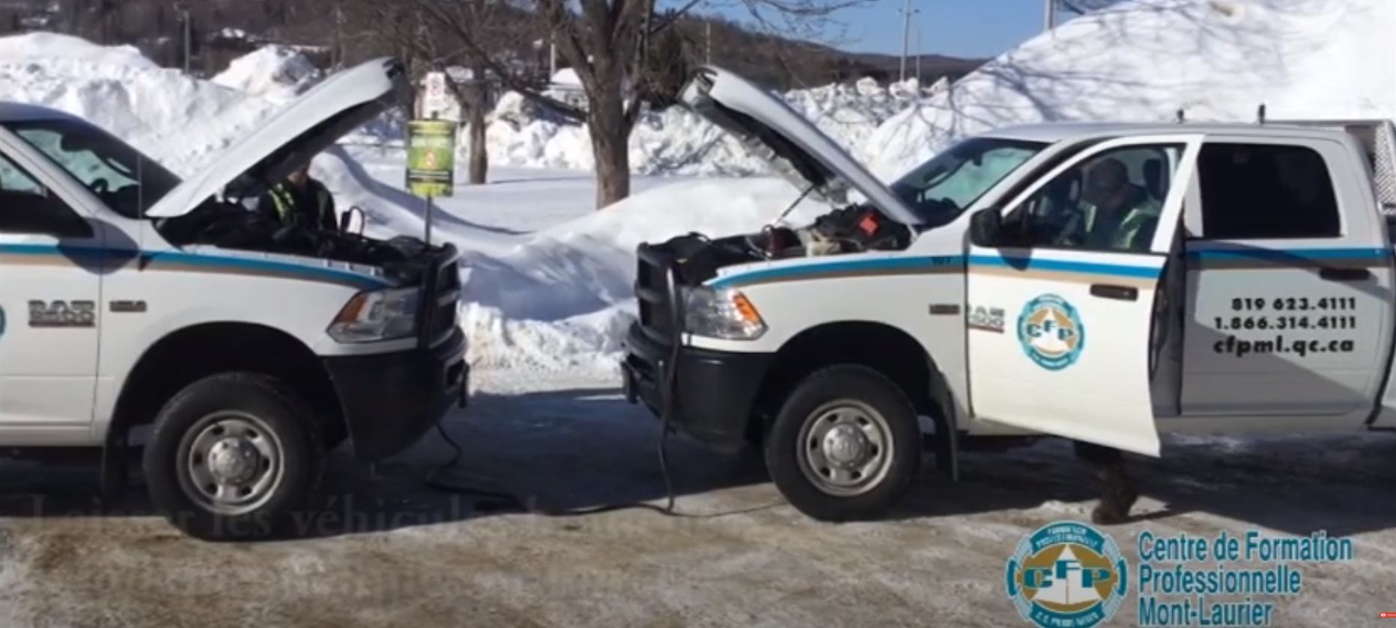
Terminals with the colour red (positive +) and black (negative -) are usually located near the engine on the left side of the frame. These terminals are used to boost the batteries in the event of failure.
Boost Techniques

Slide 6
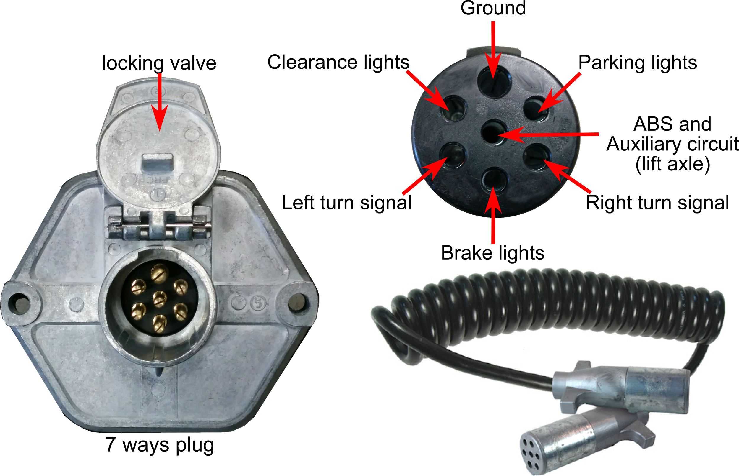
The electrical connection of the semi-trailer
The condition of the locking valve as well as the 7 ways plug should be inspected during coupling and uncoupling.

Slide 7
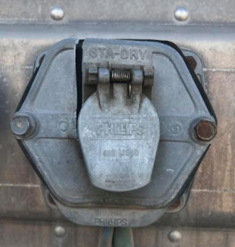
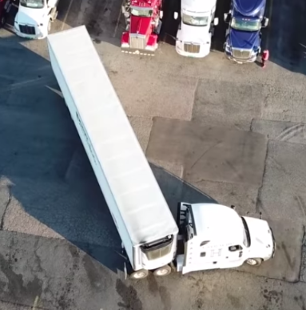
When backing up at a sharp angle it is possible to damage (break) the locking valve and/or the electrical plug on the trailer.

Slide 8
Thank you for your participation

