Slide 1
Competency Lesson 2.2.3 Engine Lubrication System

Slide 2
Engine Lubrication System
Lesson Objective:
Recognize the main components of the system and the means to optimize its performance.
Notes:
Presentation of objective:

Slide 3
Main Function Of The Engine Lubrication System:
Reduce resistance due to friction of moving parts in order to increase engine efficiency.
Notes:
Presentation of objective.

Slide 4


Associated Pictogram
Notes:
Explain the different pictograms

Slide 5
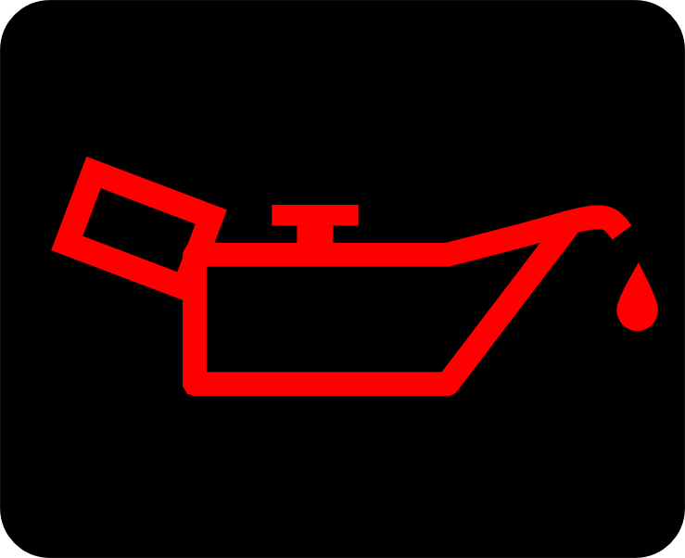
Danger Warning Light
Notes:
What to do when this indicator appears.

Slide 6
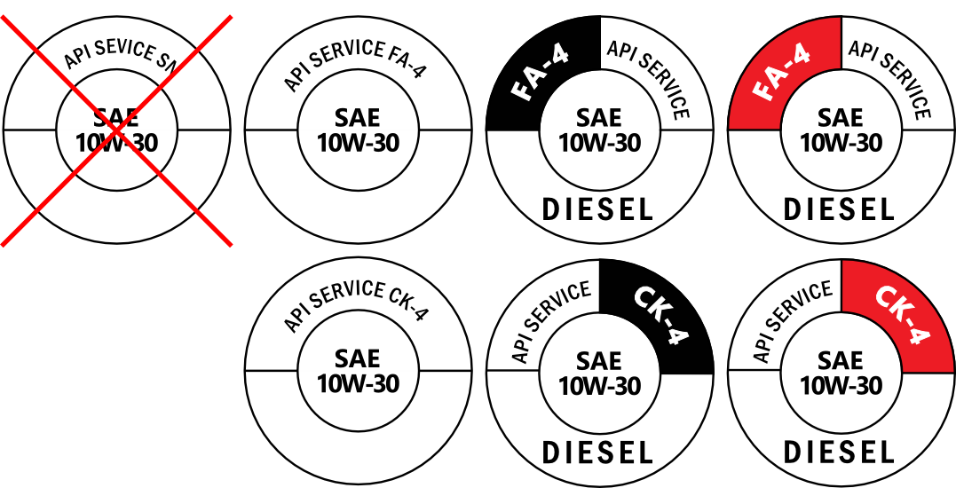
Always choose the correct type of DIESEL engine oil.
Owners are responsible for correctly identifying the oil to be used or to supply the correct products.
Notes:
Do not put gasoline engine oil in a diesel engine. CK-4 oils are compatible with modern engines but todays engine oils FA-4 (2017 and up) focus on enhanced fuel efficiency.
Note: Make sure you add the correct oil.

Slide 7
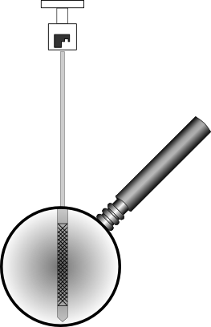
Oil Dipstick
Notes:
How and when to take the oil level reading.
The amount of oil shown on the dipstick is approximately 4 liters

Slide 8
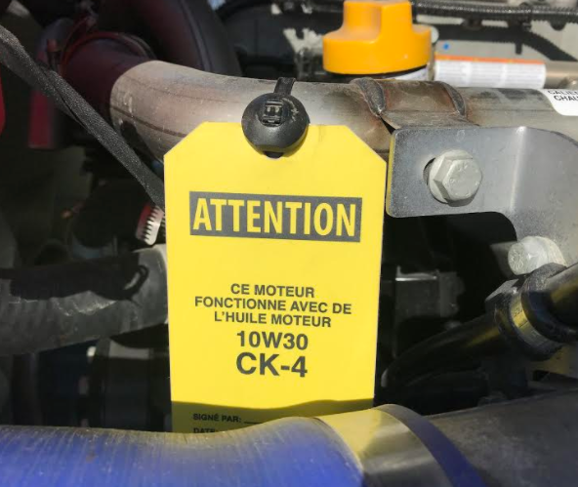
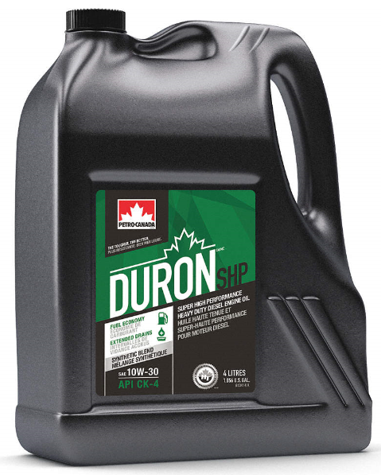
Viscosity

Slide 9
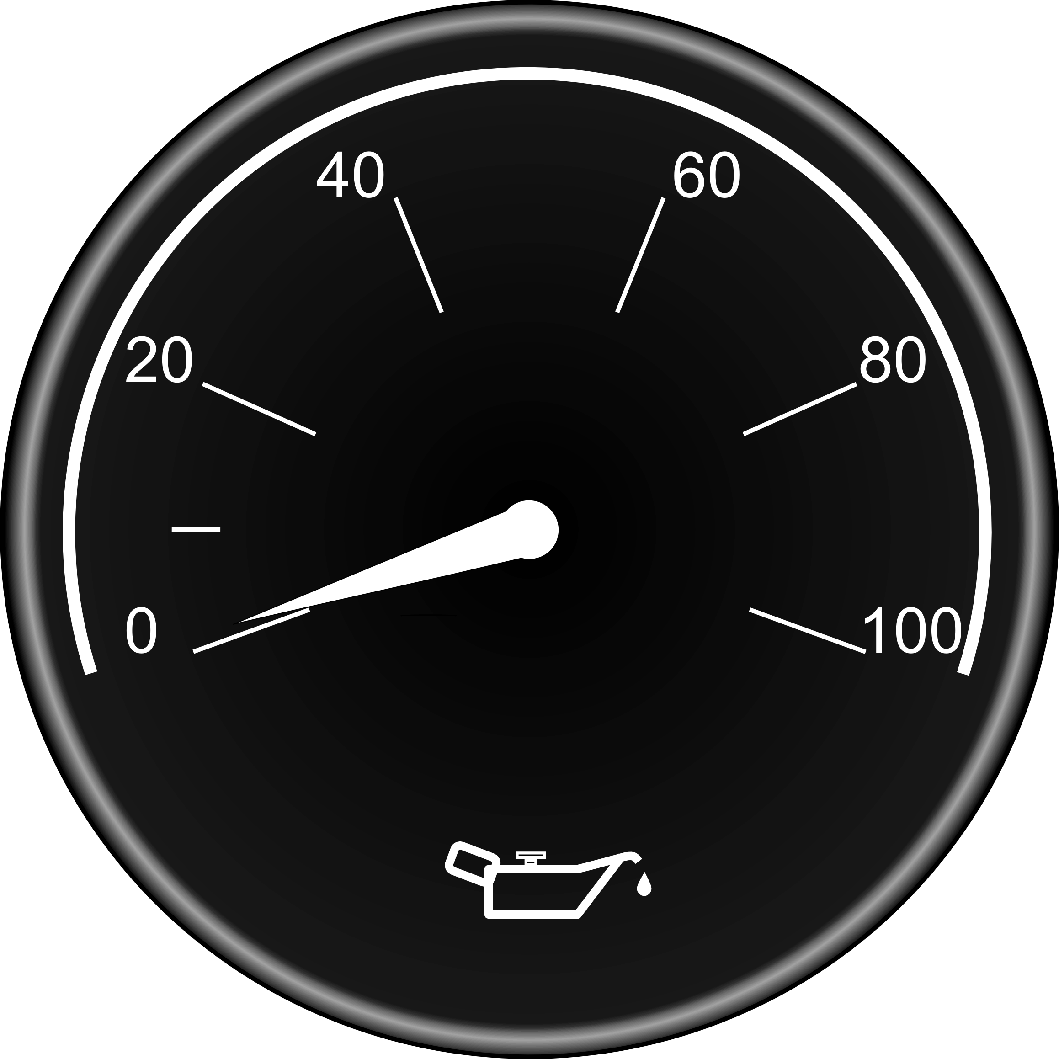
Oil Pressure Gauge
Notes:
Normal running oil pressures.
Check the oil pressure on engine start (usually higher)

Slide 10
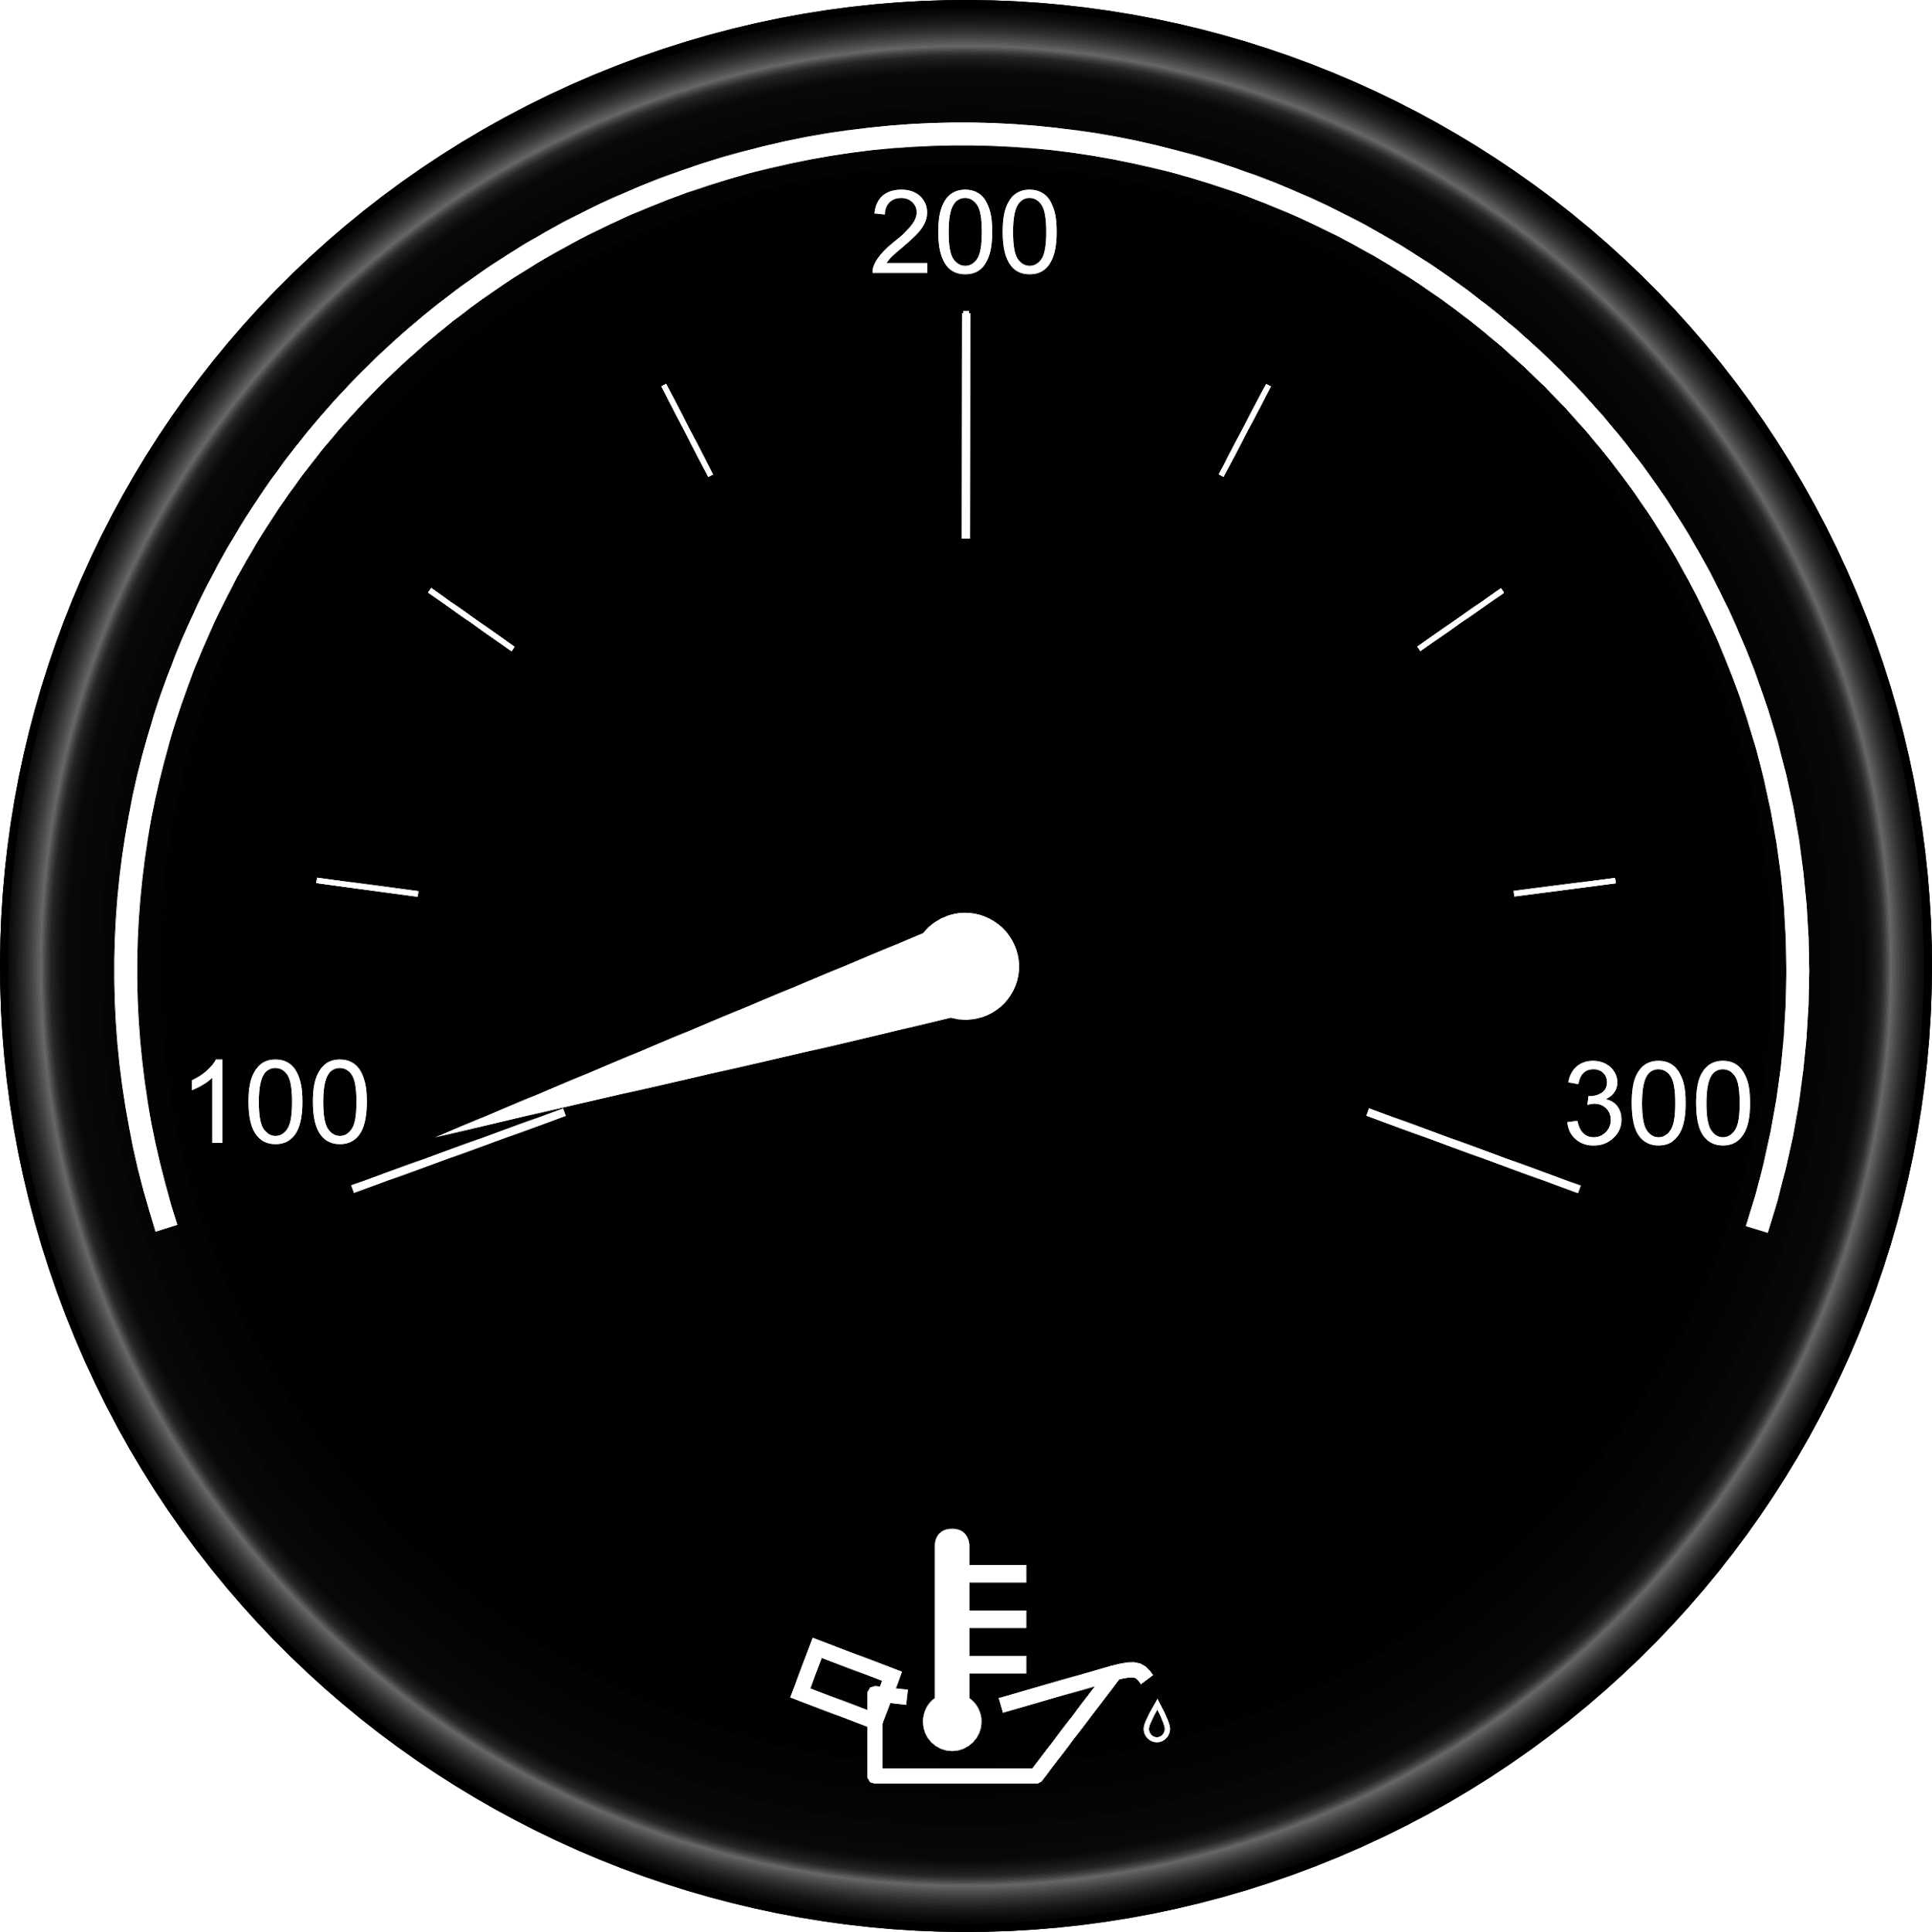
Oil Temperature Gauge
Notes:
Normal oil temperatures...Maximum oil temperatures
Explain the variations of oil temperatures.
Température maximale

Slide 11
Thank You
For Your Participation

