Slide 1
Competency 2 Lesson 2.2.2
Cooling System

Slide 2
Cooling System
Lesson Objective:
Recognize the role of the system components and the means to optimize its performance.
Notes:
Presentation objective.

Slide 3
Functions Of The Cooling System
1- Ensure the rapid rise in temperature of the engine.
2- Maintain a constant operating temperature.
3- Avoid overheating of the engine.
In addition, the cooling system will make it possible to heat the interior of the truck.
Notes:
Give explanations.

Slide 4
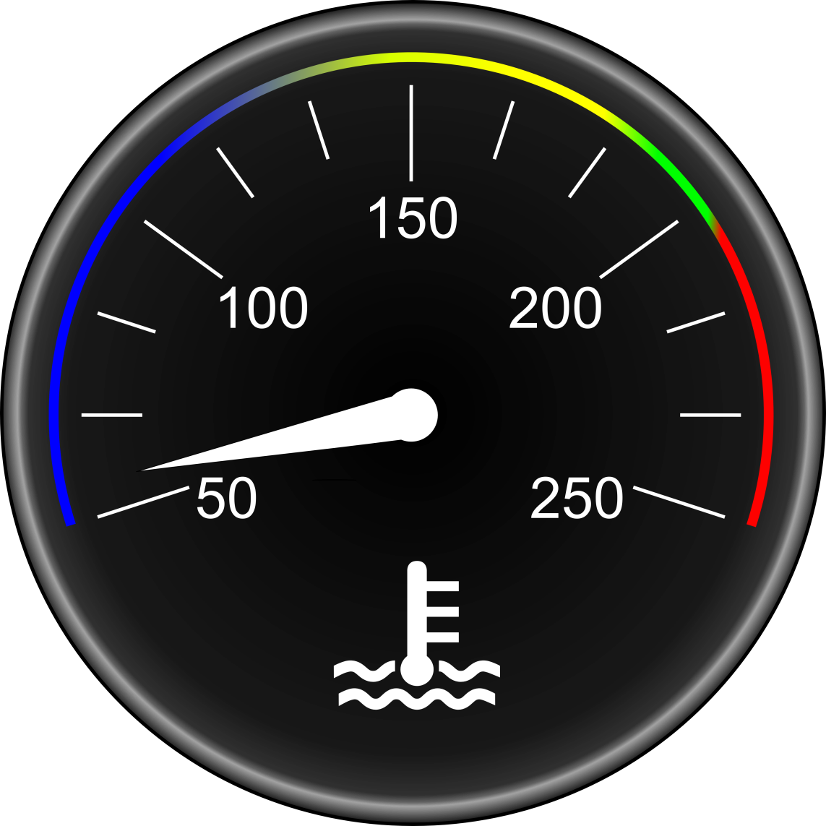

Operating Temperatures
Associated Pictogram
Notes:
Explain the average operating temperatures according to the manufacturers in general.
For more precise information refer to the engine manufacturer’s guide.
How to treat the operation of the engine according to its temperature.

Slide 5

Associated Pictogram
INDICATOR LIGHT
Low Warning Indicator
Means coolant is very low
Notes:
LOW LEVELS MAY BE ASSOCIATED WITH ENGINE CODES OR FAULTS:
The decisions to be made: Top up only when cold...Visible leaks...Cooling system contains approximately 45 liters of coolant.

Slide 6

Associated Pictogram
INDICATOR LIGHT
High Temperature Warning
Associated with the engine overheating. It can turn on by itself or be accompanied by an other warning light.
Notes:
Means to take in case of overheating: Immobilization...transmission in neutral... RPM 1100 approximately 2 to 3 min… Check the oil pressure, etc.

Slide 7

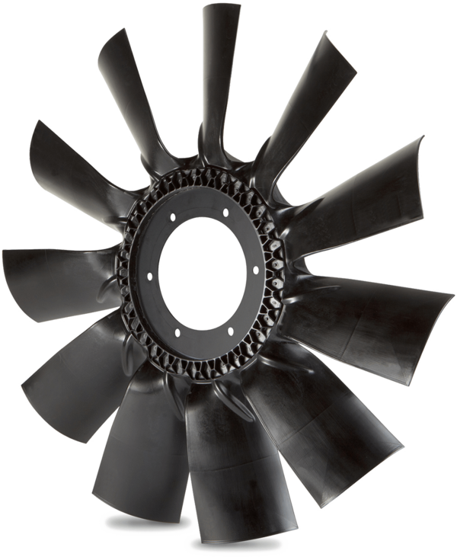

Fan Operation Indicator
Manuel Fan Activation Switch

Slide 8
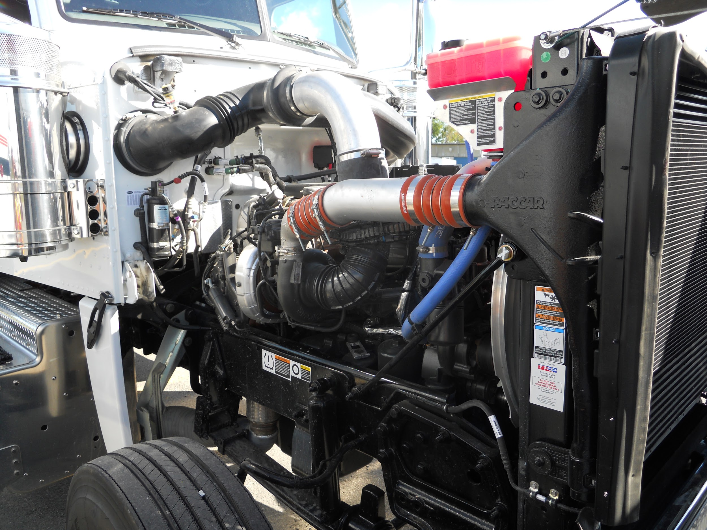
Expansion Coolant Tank (buffer zone)
Coolant Hoses
Notes:
Check the solidity of the radiator (radiator supports)
Notice the location of the expansion tank (buffer zone)

Slide 9
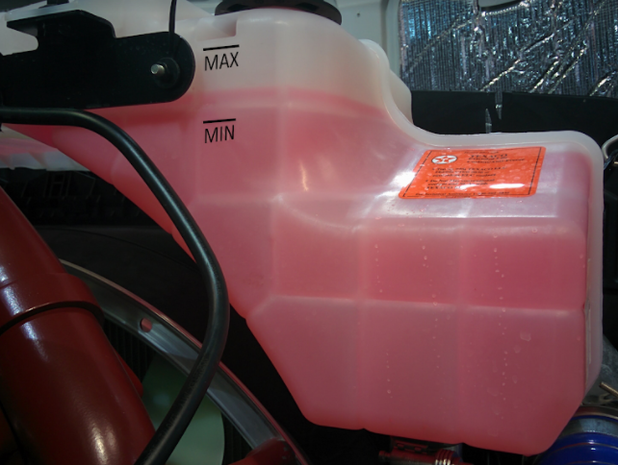
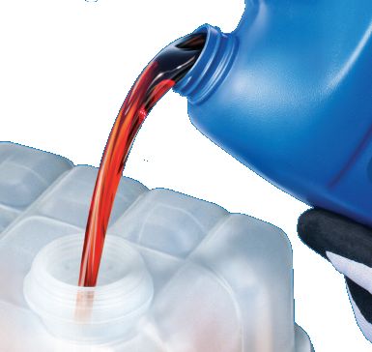
Only Fill When COLD
Notes:
Explain the role of the surplus tank and the appropriate level of fluid.
CHOICE OF COOLANT: CHOOSING AN ANTIFREEZE...MORE THAN A TYPE OF COLOR...DO NOT COMBINE AUTOMOTIVE ANTIFREEZE WITH ANTIFREEZE FOR HEAVY VEHICLES. If you need to add more, do not rely on the colors. We used to say not to mix colors but now color codes don’t mean anything. The same color could be found in two types of liquids with different properties which would not suit your vehicle. Pay attention to the manufacturer’s specifications or ask the mechanic for more information.
https://www.lautomobile.ca/features/on-ne-voit-de-toutes-les-couleurs/
https://lamecaniquepourlesfilles.com/quel-liquide-de-refroidissement-choisir/

Slide 10
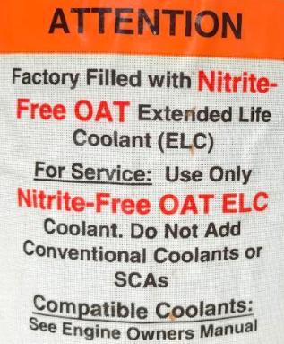
Always Follow The Manufacturer’s Recommendations.

Slide 11

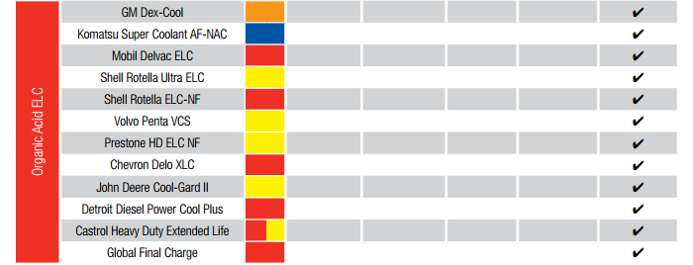
Cross-Reference Guide For Different Engine Manufacturers
Paccar
Volvo

Slide 12
Coolant Radiator
Air Conditioning Condenser

Slide 13
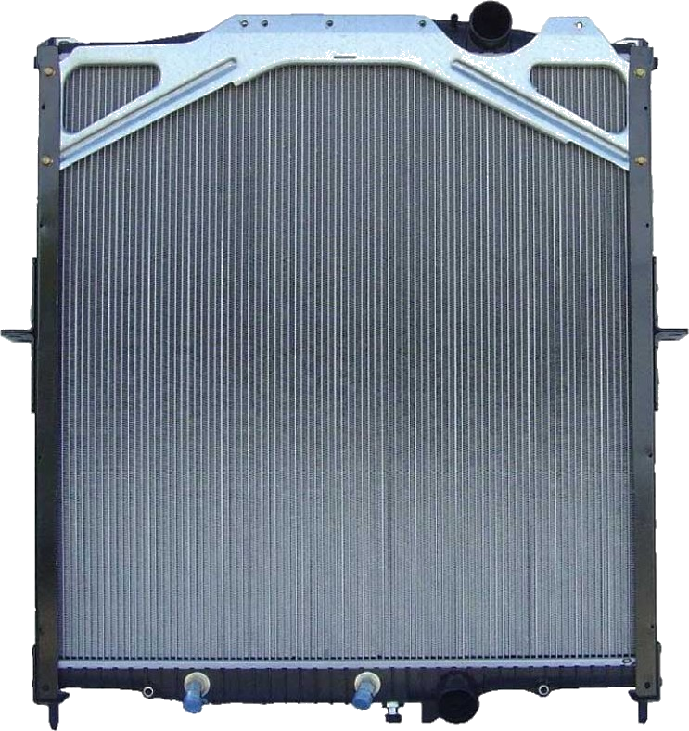
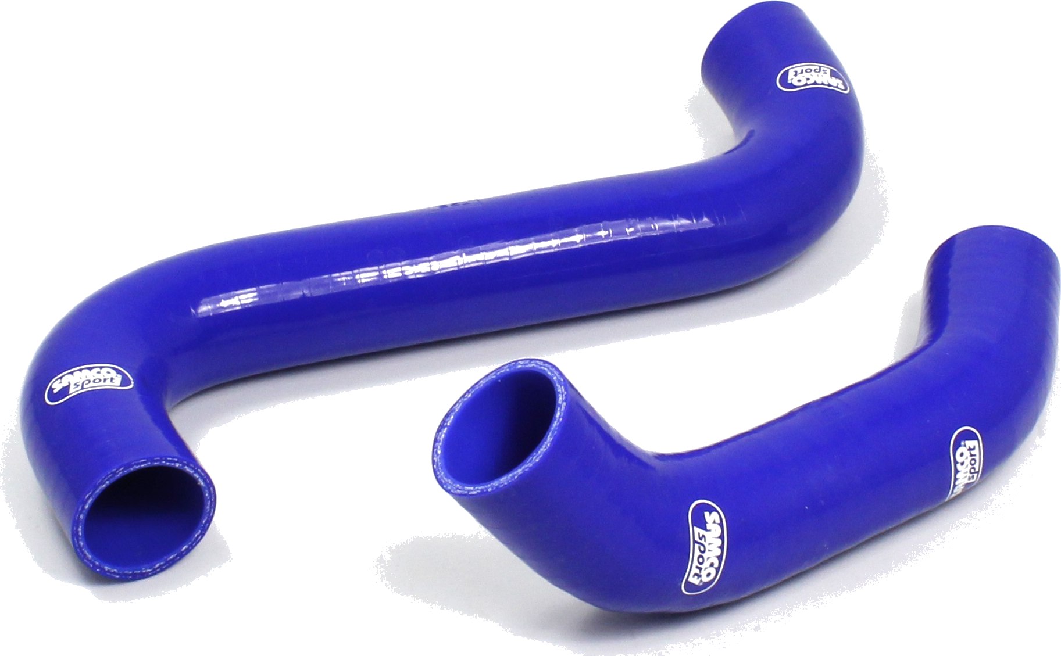
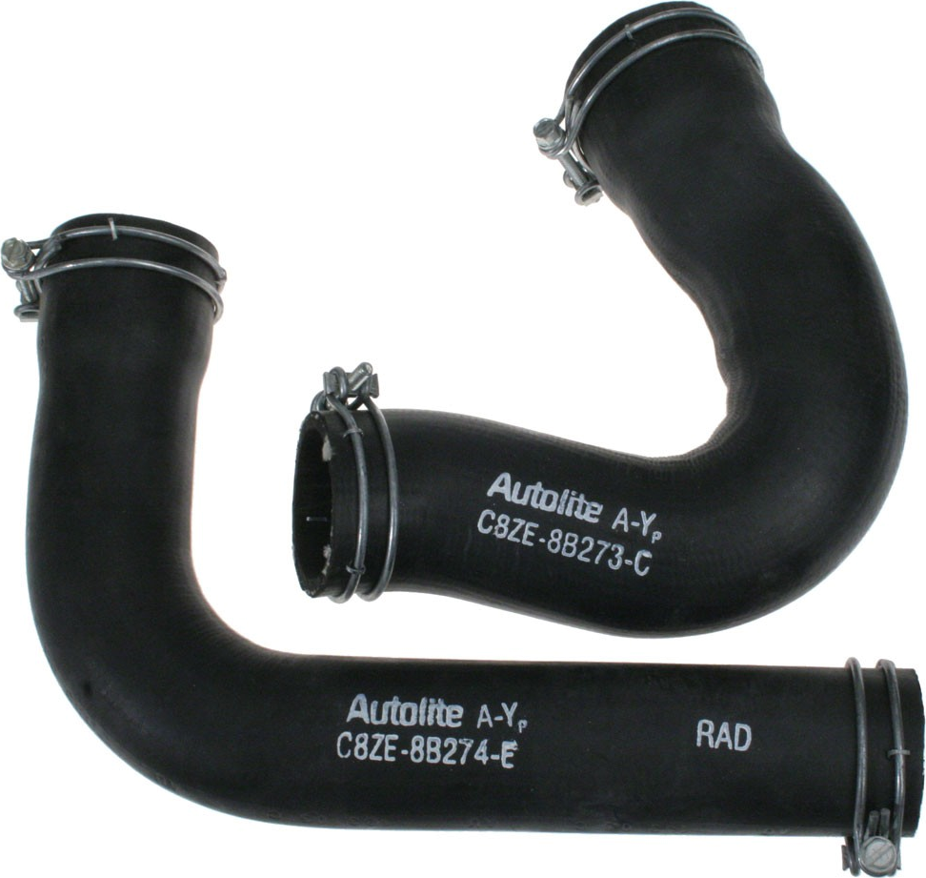
Radiator Honeycomb
Hoses
Clamps
Notes:
Checking the radiator: Honeycomb, reservoir clamps and hose clamps, leaks, etc.

Slide 14
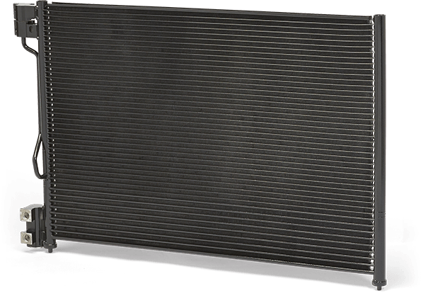
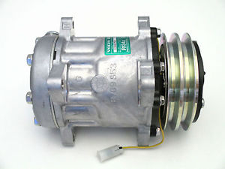
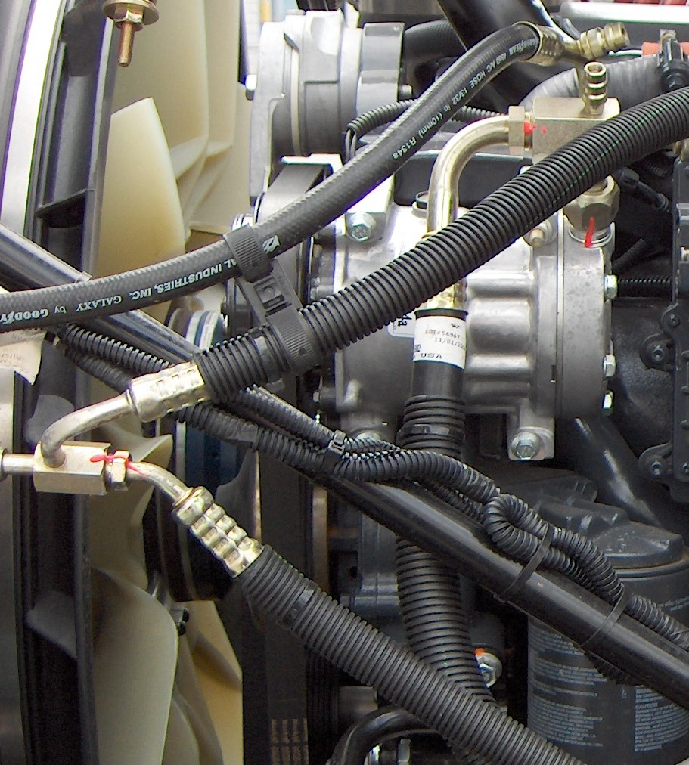
Compressor And Air Conditioning Hoses
Air Conditioning Condenser
Notes:
Describe the parts of the air conditioning system.

Slide 15

Video
Notes:
Describe the relationship between the cabin heater and the cooling system.

Slide 16
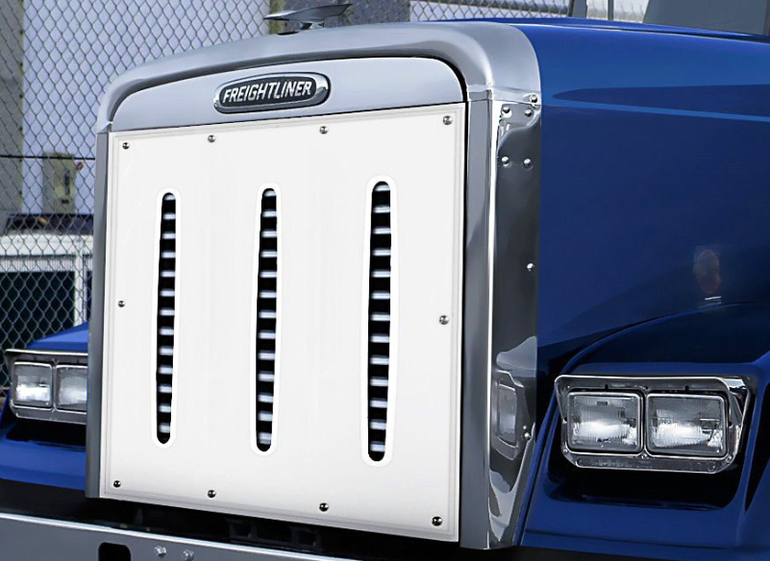
In cold weather, the use of a “Winter Front” cover is recommended in order to reach and maintain operating temperatures faster.

Slide 17
Thank You
For Your
Participation

