Slide 1
Competency 2
Lesson 2.2.1
Engines
(Makes, Models and Specifications)

Slide 2
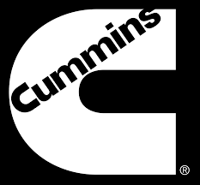


Engine manufacturers and their associated truck
X12, X15
All makes.
Cummins is an independent engine manufacturer. This is why its large displacement engine is offered in most brands of trucks for the needs of their customers.
DD13; DD15; DD16 Freightliner; Western Star
A26 International

Slide 3
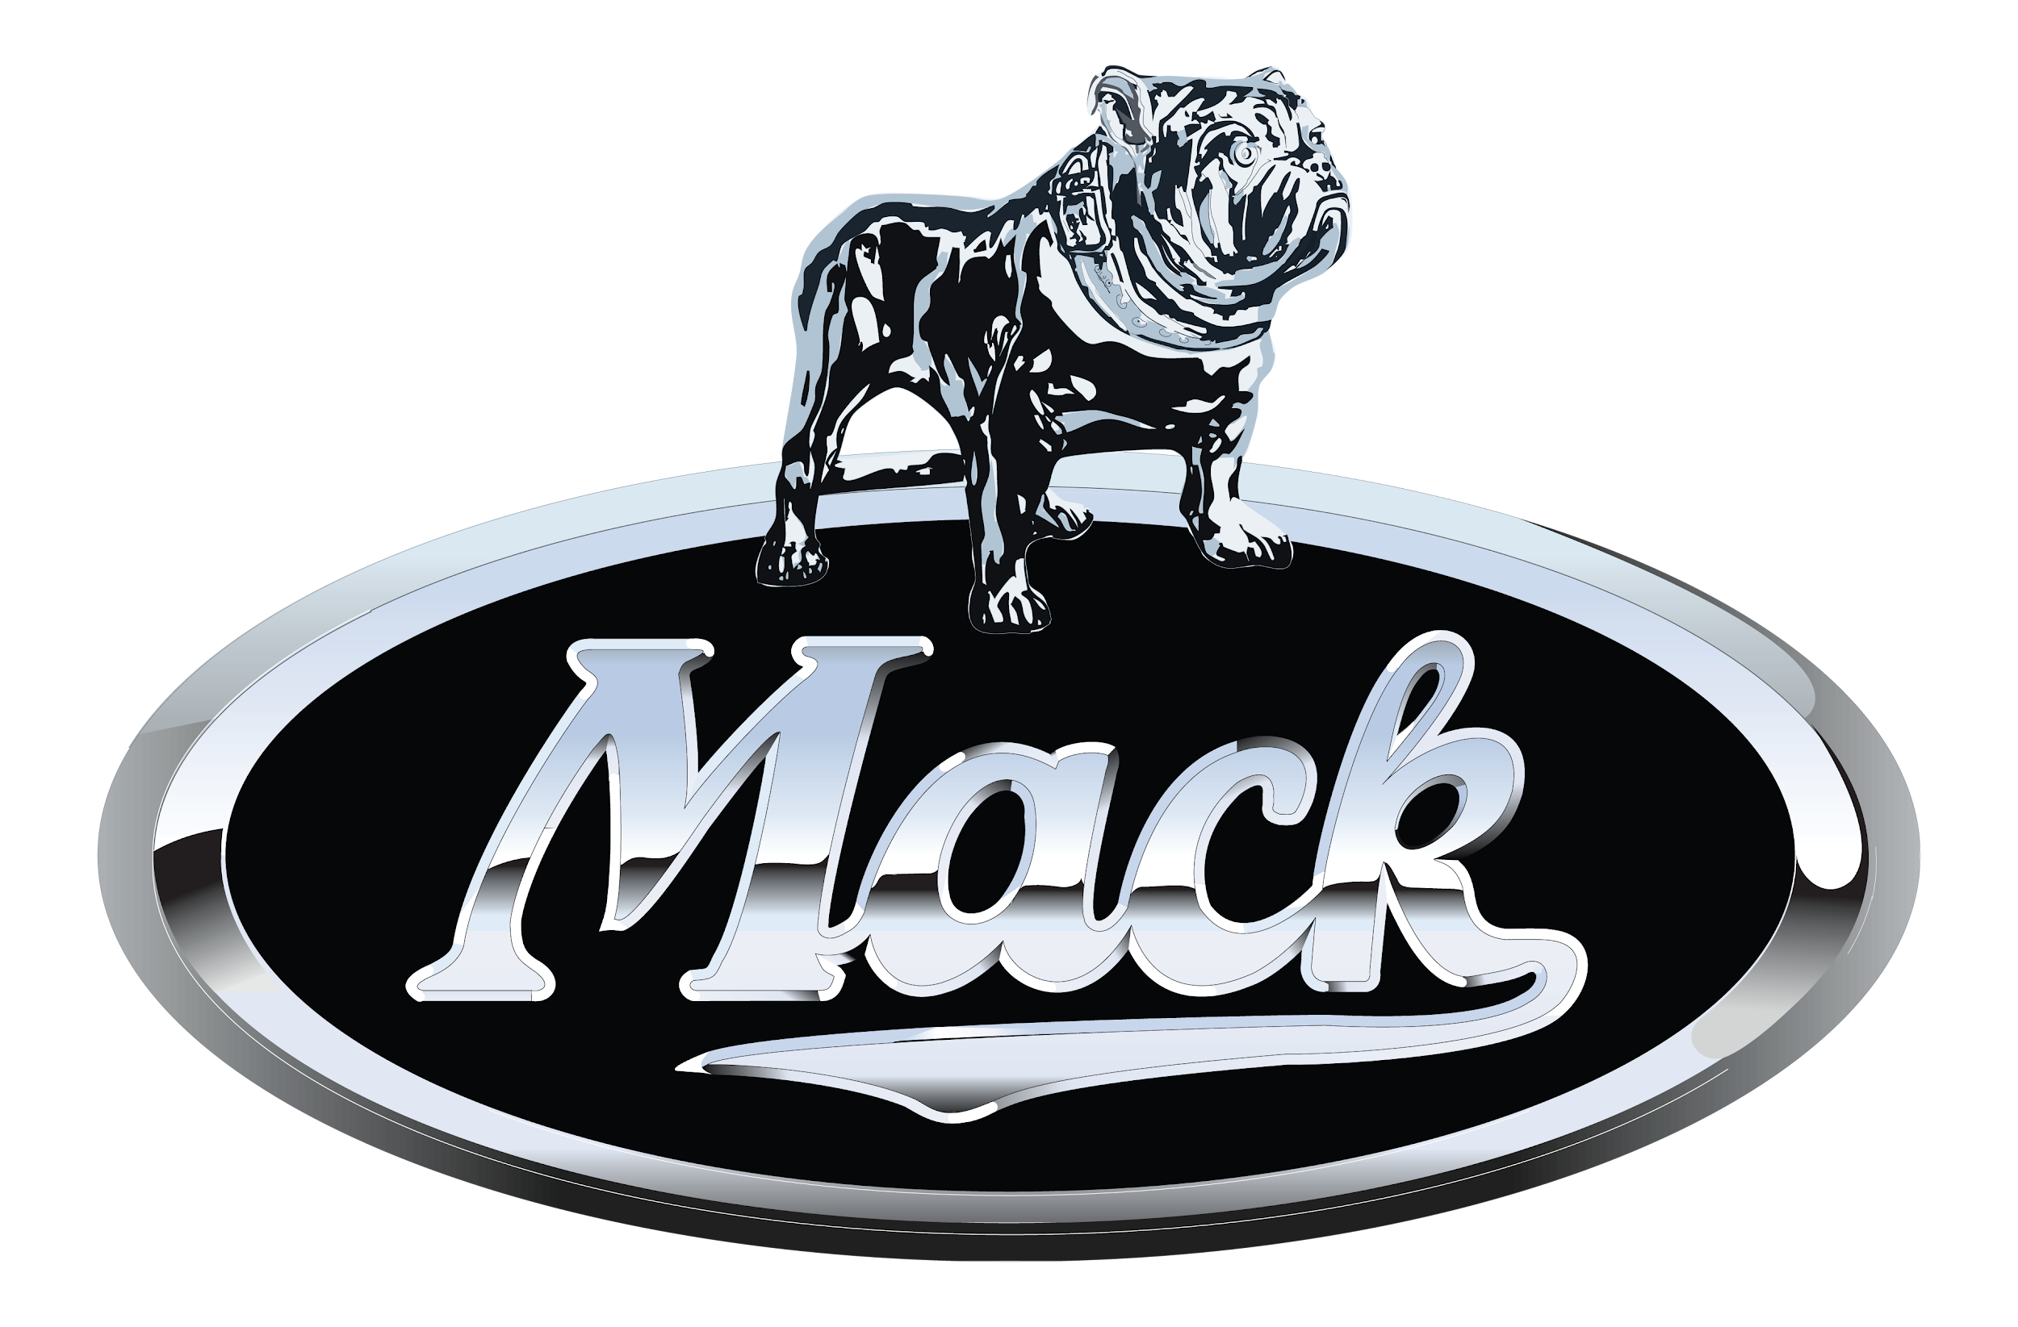

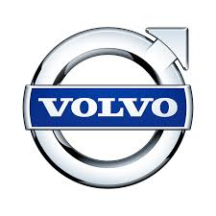
Engine manufacturers and their associated truck
MP-8 Mack
MX-13 Kenworth; Peterbilt
D13 Volvo

Slide 4
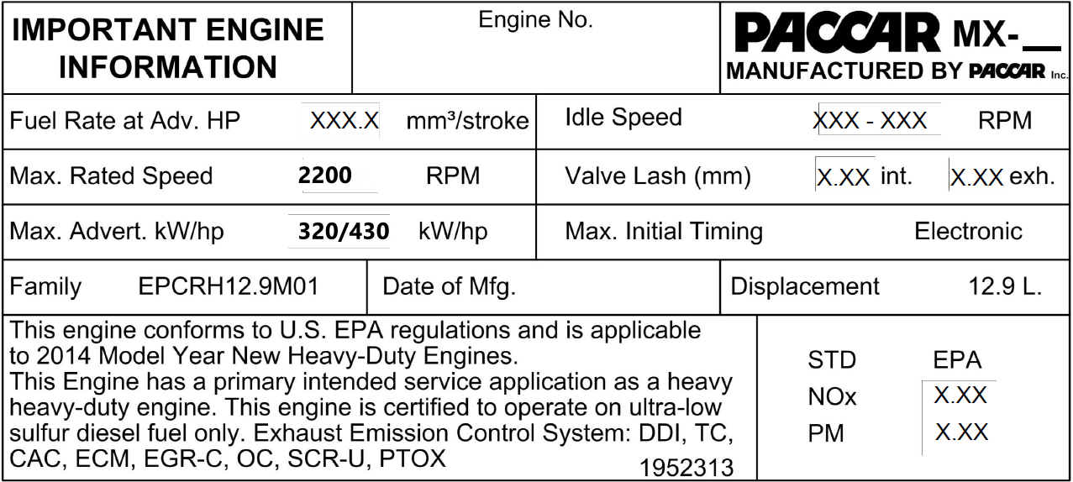
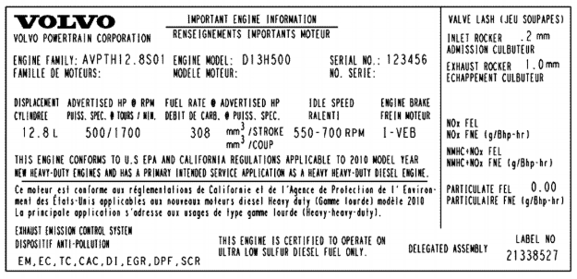
MANUFACTURER DATA SHEET
Maximum power in HP
Notes:
Several data sheets do not show the maximum torque, we can still deduct that the higher th HP, higher the torque will be too

Slide 5
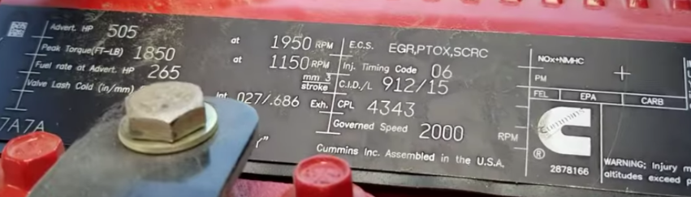
MANUFACTURER DATA SHEET
HP
TORQUE

Slide 6
Some useful links
https://www.cummins.com/fr/engines/heavy-duty-truck
https://demanddetroit.com/engines/
https://ca.internationaltrucks.com/engines
https://www.volvotrucks.ca/en-ca/
https://www.macktrucks.com/powertrain-and-suspensions/
https://paccarpowertrain.com/#section-integrated-powertrain

Slide 7
Thank you
for your participation

