Slide 1

Competency 2 Lesson 2.1.1
Special features of the truck
Notes:
🍐 This is a Pear Deck Text Slide
🍐 To edit the type of question, go back to the "Ask Students a Question" in the Pear Deck sidebar.

Slide 2
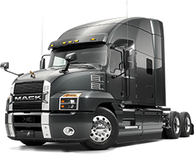
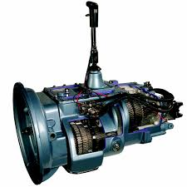
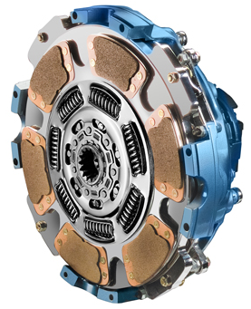
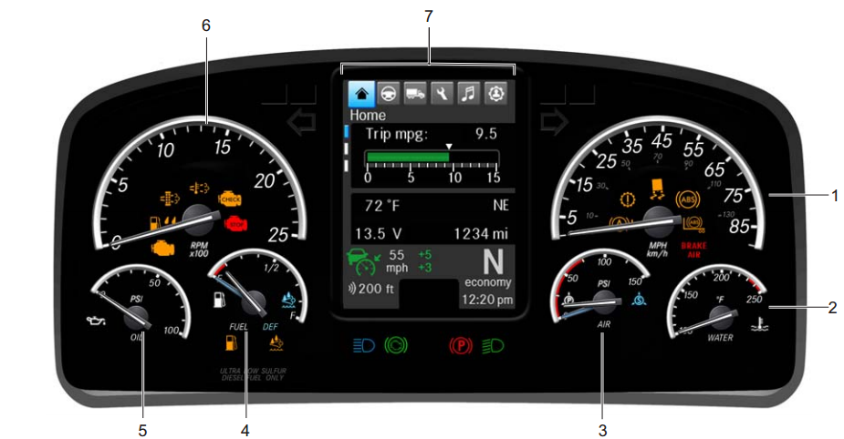

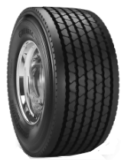
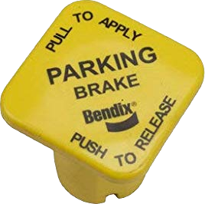
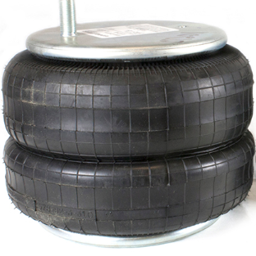
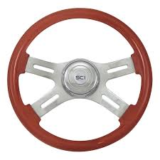

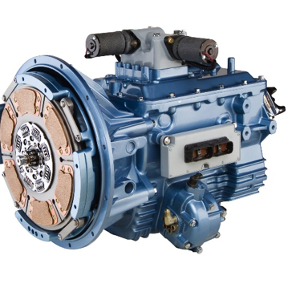
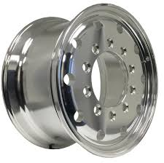



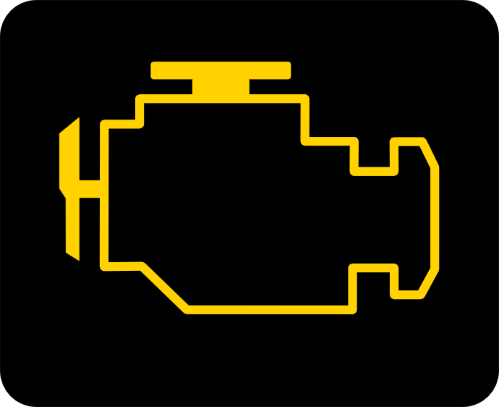


Special features of the truck
Lesson objectives:
Understanding the elements of the competency.
Recognizing different brands of truck
Associating different types of vehicles with different types of goods transported.
Statement of the competency : To identify the possible systems that characterize semi trailers
Introduction of all the elements of competency 2
Identify the features of a truck.
Learn about the capacities of the engine unit.
Select techniques for using the power transmission system.
Select techniques for optimizing the performance of the air brake system.
Learn about the capacities and limits of the suspension and steering systems and the wheels.
Notes:
🍐 This is a Pear Deck Multiple Choice Slide. Your current options are:
🍐 To edit the type of question or choices, go back to the "Ask Students a Question" in the Pear Deck sidebar.

Slide 3
Description :
This theoretical module, examines whether or not you are able to identify the main characteristics of the vehicle you are driving for the first time and take them in account to optimize system performance, as well as to resolve any problems.
Evaluation :
The exam is formulated in the form of a questionnaire.
While using technical data sheets from truck systems, you will have to recognize the capacities and the limits of the different systems according to their specifications.
Based on scenarios,, you will need to indicate the optimal mode of use of the systems and determine the potential problems and the measures to be taken.
The duration of the exam is two hours. Notes are strictly prohibited
It is essential that you make connections between the concepts seen in class and those dealt with in practice.
You are responsable for your learning. You must notify your teacher of your progress.
The success of your learning curve depends on the time, interest and commitment you put in.

Slide 4
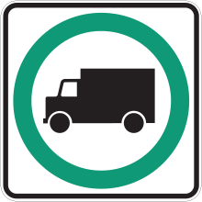
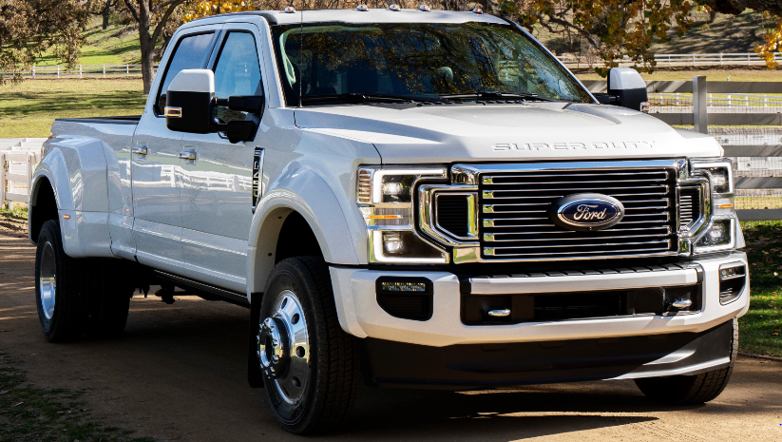
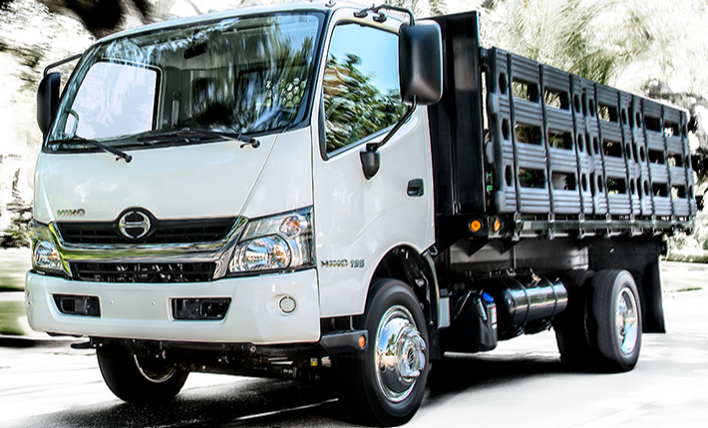
Truck Terminology:
Heavy vehicle : Vehicles having a Gross Vehicle Weight Rating (GVWR) of
4 500 kg or more.
The GVWR is defined as the net mass of a vehicle to which is added the maximum load that it can carry, according to the manufacture..
Classes of trucks: Trucks are classified according to their (GVWR)
Classe 3 4 536 kg to 5 349 kg
Classe 4 6 300 kg to 7 256 kg
Classe 5 7 257 kg to 8 834 kg
Classe 6 8 844 kg to 11 791 kg
Classe 7 11 792 kg to 14 966 kg
Classe 8 14 967 kg and more
Notes:
Remember that driving a heavy vehicle requires a class 3.license. A class 1 license is necessary for driving a heavy articulated vehicle with a trailer wiho has a net mass of more than 2000 kg.

Slide 5
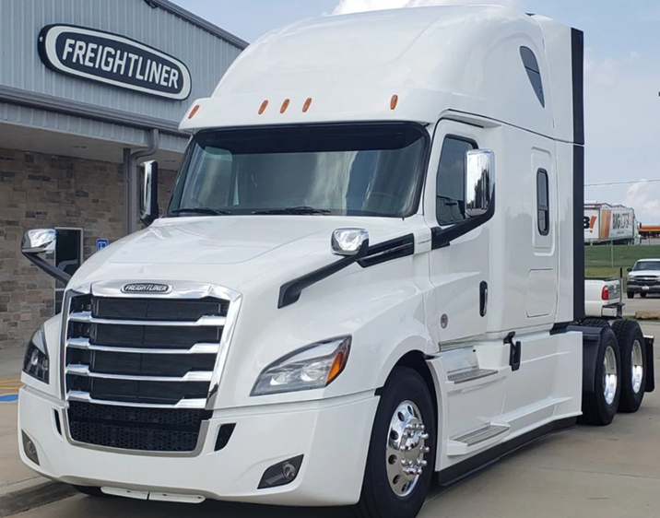

Truck Brands: There are seven manufacturers of class seven and eight trucks in North America
Freightliner is a branche of Daimler

Slide 6
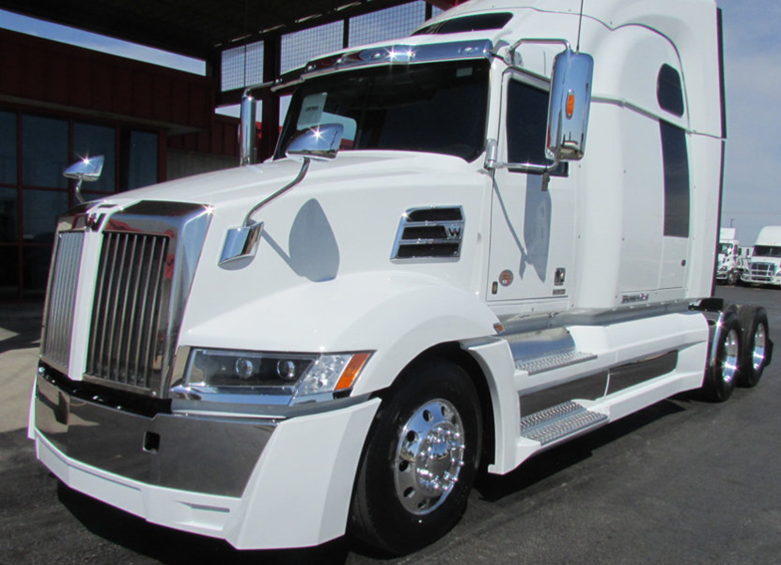

Western Star is a branch of Daimler

Slide 7
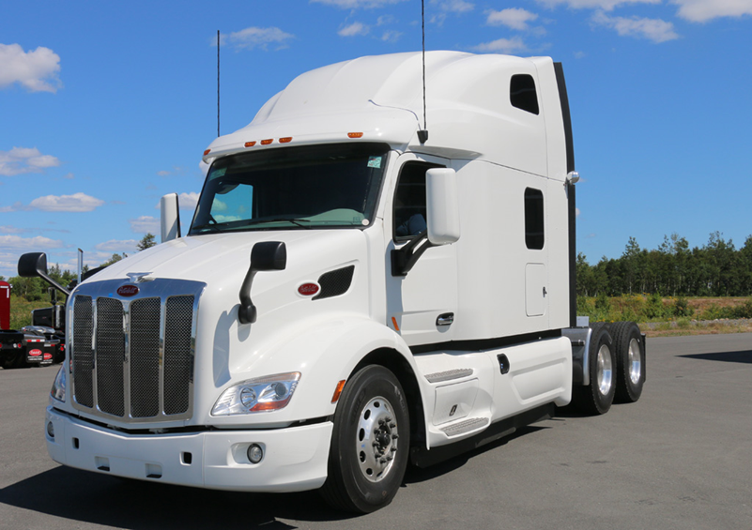

Peterbilt is a division of Paccar

Slide 8
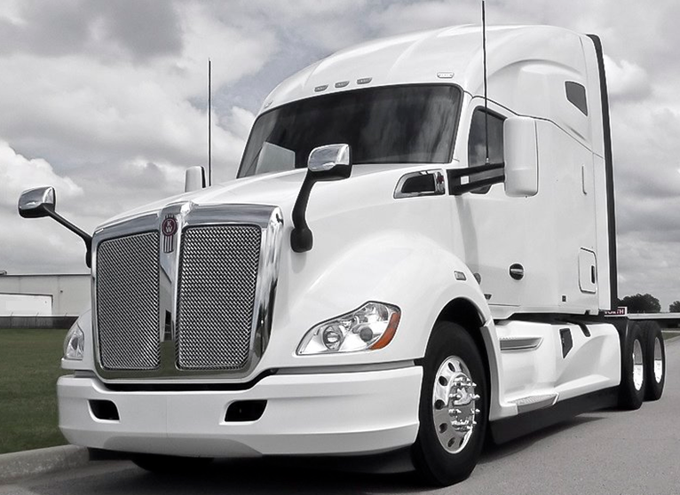

Kenworth is a division of Paccar

Slide 9
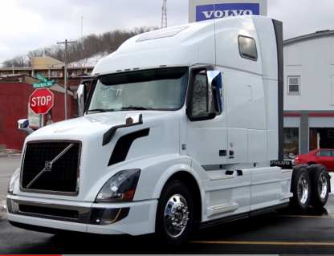

Volvo is a group company of AB Volvo

Slide 10
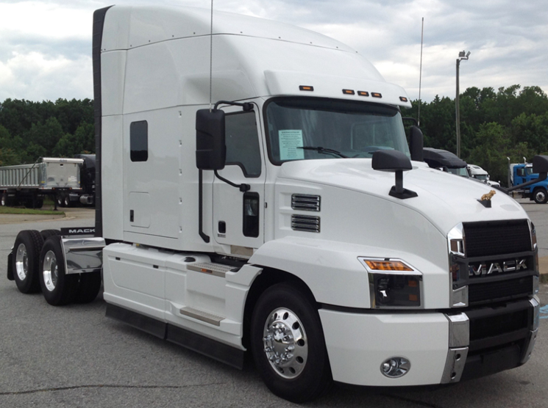

Mack is a group company of AB Volvo

Slide 11
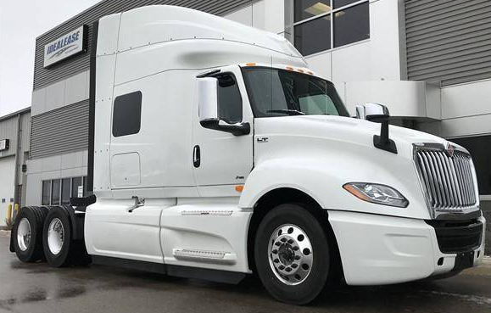

Navistar is the manufacture of International Trucks

Slide 12
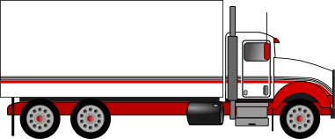
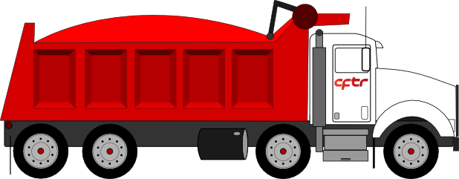
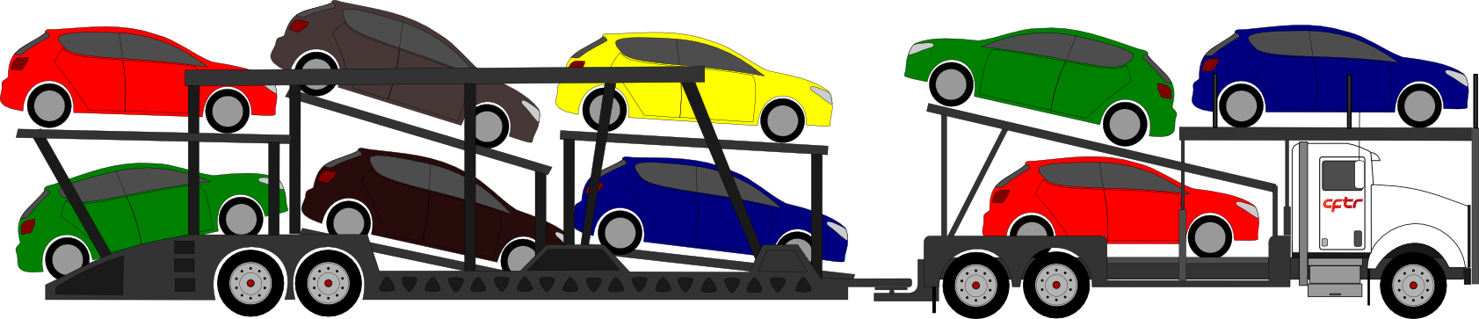
Types of trucks
Straight truck
Dry box for transporting general goods and/or controlled temperature “Refer”
Dump truck for carrying bulk
Tractors, semi-trailers
Semi-Trailer or specialized trailer: Transport of automobiles

Slide 13
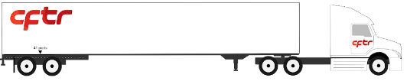
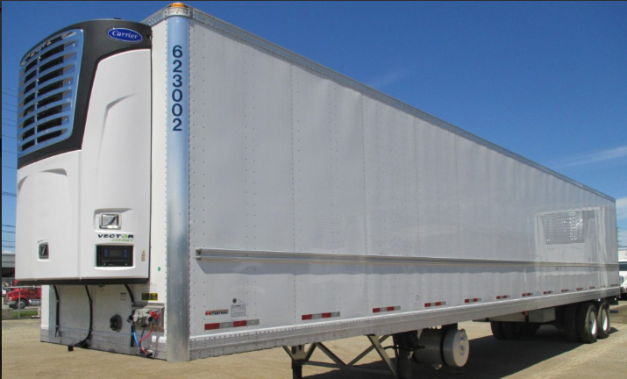
Semi-trailer “dry box” For transporting general goods and/or temperature controlled “Refer”

Slide 14
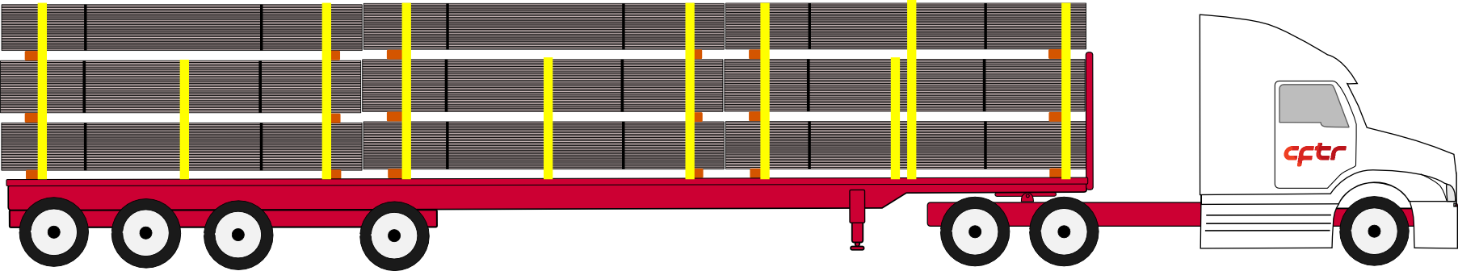
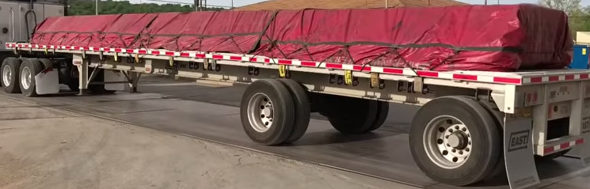
Semi-trailer “Flatbed”: Transport wood, logs, steal,aluminium, etc.
With conventional tarps

Slide 15
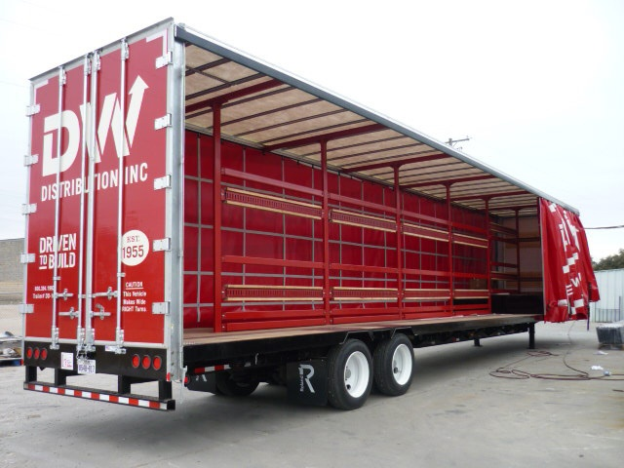
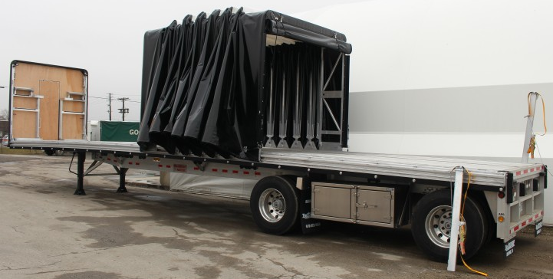
Type of tarp: Accordion style “Rolling tarp”
Type of tarp: Curtain style “Curtain Side” with back doors and frame around trailer

Slide 16
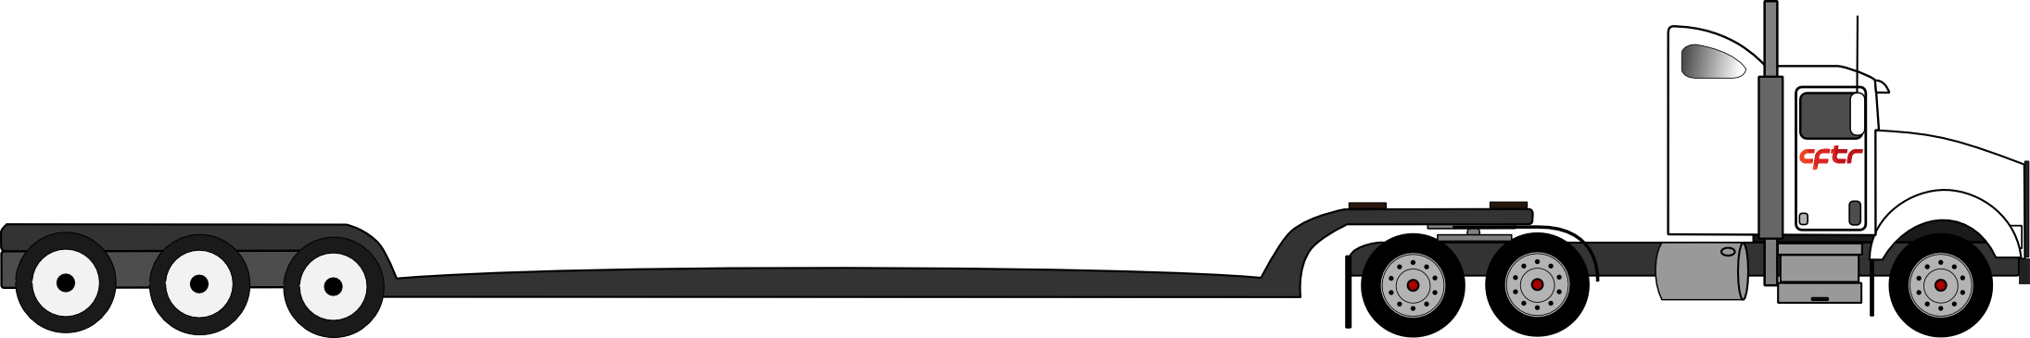
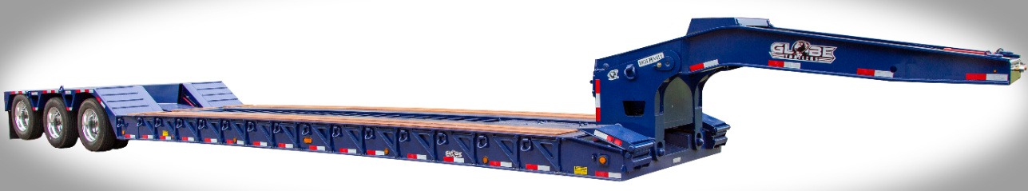
Semi-trailer low bed: Transport of heavy machinery or wide dimensions (wide load)

Slide 17
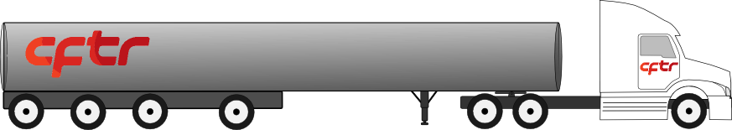
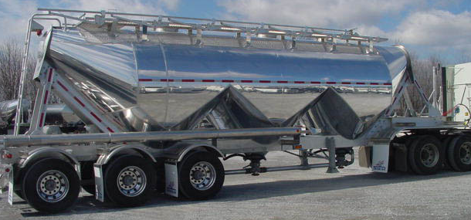
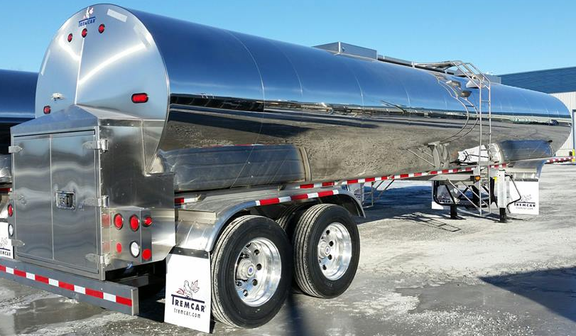
Semi-trailer “Tanker”: Transport of liquid, of gas or dry goods in bulk.

Slide 18
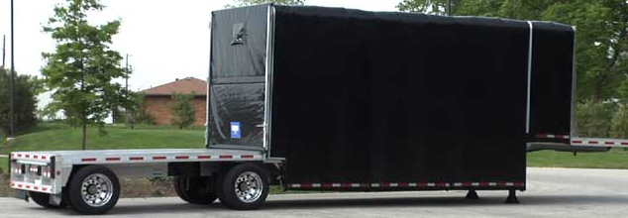
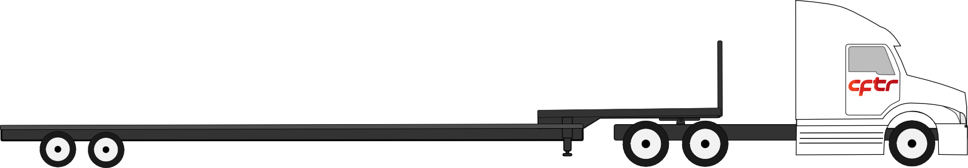
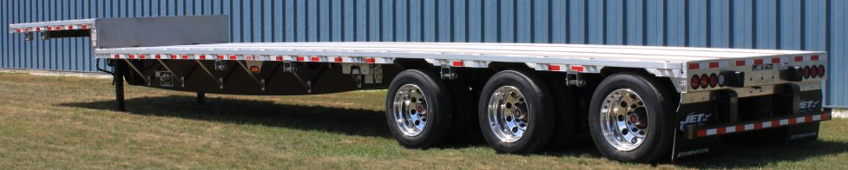
Semi-trailer “Drop deck” and “Double drop deck”: Transport of high loads

Slide 19
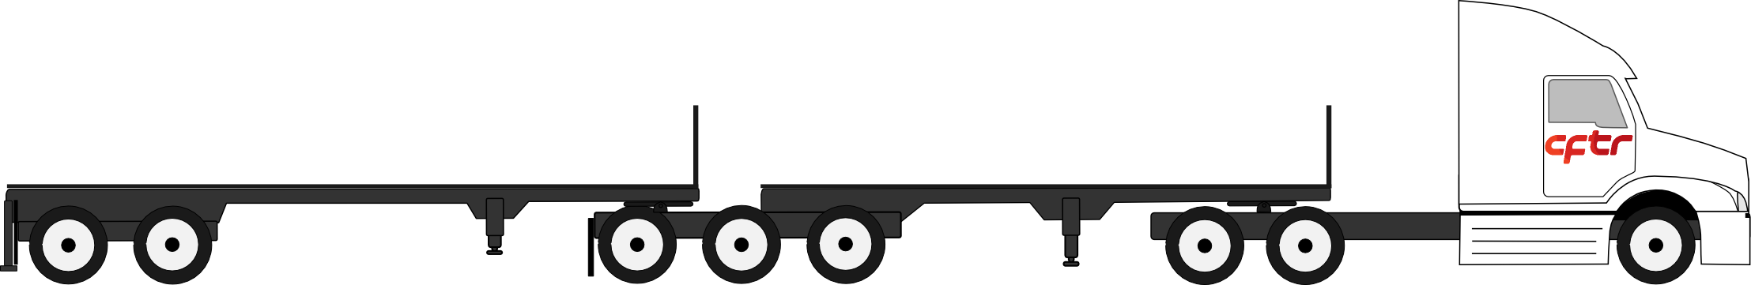
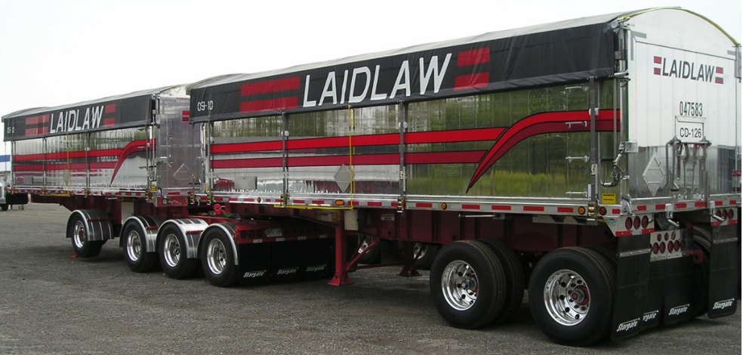
“B-train” maximum length 25 meters

Slide 20
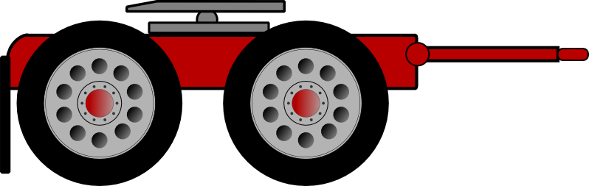
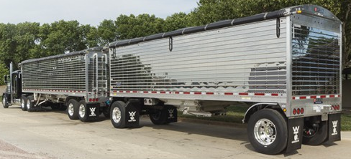
“A-train”; (uses a dolly) maximum length 25 meters

Slide 21
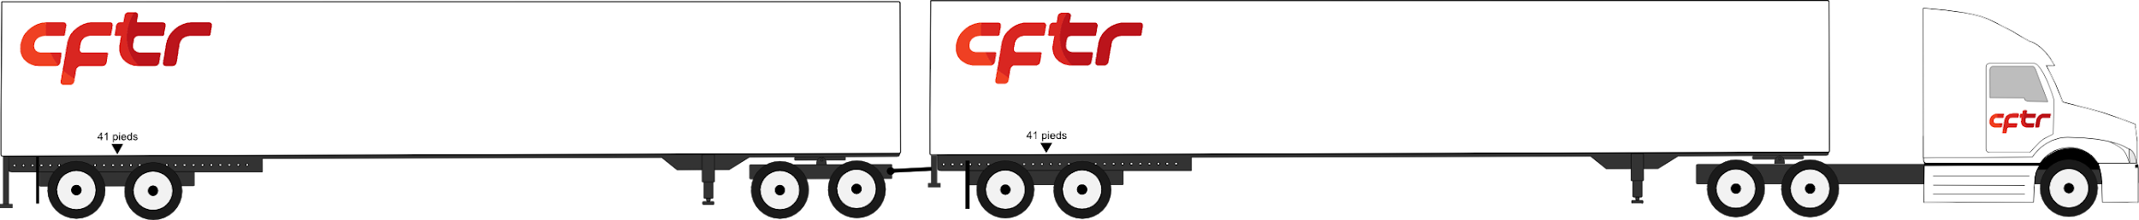

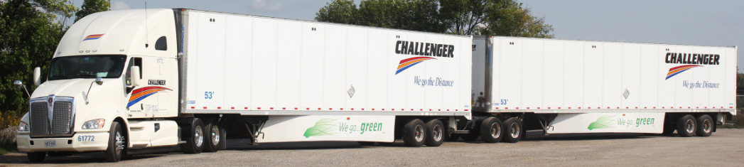
Oversized
Type A
Road trains have fewer accidents per number of kilometers travelled than personal cars or any other mode of transport. They also reduce fuel costs by 32 %. These advantages can be achieved by complying with the following requirements :
Maximum speed of 90 km/h;
Vehicle with a maximum gross weight of 63 500 kg or 139 700 lbs;
Ban on transporting livestock or any dangerous goods;
Travel restrictions on long weekends;
Weather restrictions; cloud cover, snow, ice,visibility, etc. ( Source; Challenger )

Slide 22
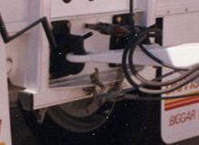
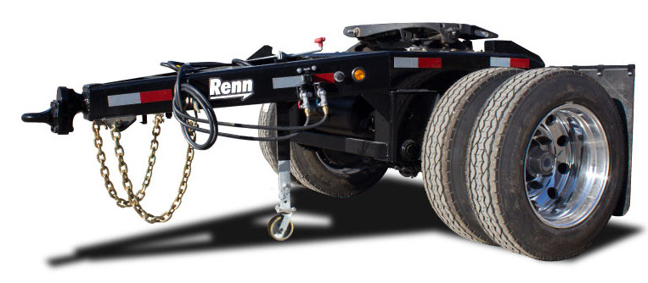
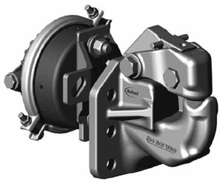
Drawbar hitch and dolly for type A
Diabolo

Slide 23
THANK YOU
FOR YOUR
PARTICIPATION

