Slide 1
Transportation of dangerous goods

Slide 2
Lesson objective:
Resolve problems stemming form the application of regulations.
Competency 3
Transportation of dangerous goods
Notes:
Le transport des marchandises dangereuses relève de la Loi de 1992 sur le transport des marchandises dangereuses. Il s’agit d’une loi fédérale qui nous mène au RÈGLEMENT SUR LE TRANSPORT DES MARCHANDISES DANGEREUSES.
La SAAQ met à la disposition des conducteurs de véhicule lourd un document qui les guide dans les actions et la prise de décisions relatives au transport des matières dangereuses.
Voici une série d’exercices et de mises en situation qui vous familiarisera avec l’utilisation du guide.

Slide 3
WARNING
Provide information on the Transportation of Dangerous goods regulation of the Ministère des Transports du Québec.
page 5 du guide

Slide 4
INTRODUCTION
What is the main objective of the Transportation of Dangerous Goods Regulations?
Comply with safety rules related to road transportation of dangerous goods.
page 5 du guide
Notes:
–Augmenter la sécurité du public pendant le transport.

Slide 5
CLASSIFICATION
How many classes of dangerous goods are there ?
9 classes that are subdivided according to the characteristics of the given product.
page 6 du guide

Slide 6
CLASSIFICATION
Who is responsible for determining the classification of a dangerous goods before allowing a carrier to take possession of it?
The shipper.
page 6 du guide

Slide 7
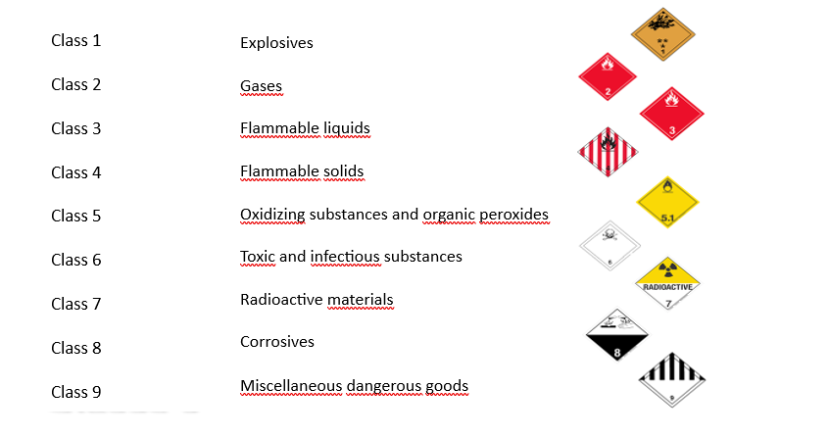
9 classes
Guide, page 6 at 10

Slide 8
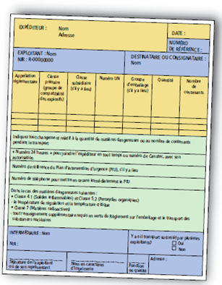
DOCUMENTATION
•The shipper must prepare and provide (to the carrier) a shipping document;
•At the time of transport, the carrier must have in their possession a paper document.
page 11 guide

Slide 9
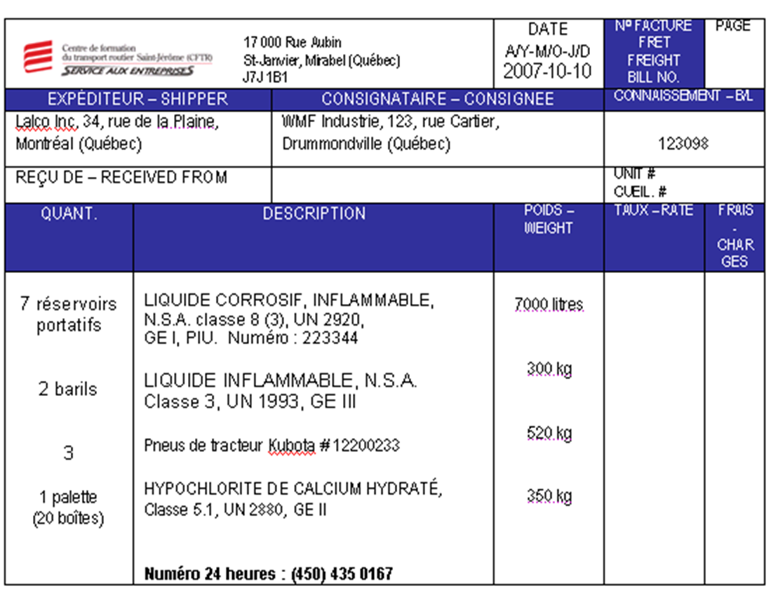
EXAMPLE OF DOCUMENT
The paper document may be handwritten or printed
page 12 guide

Slide 10

STORAGE AND LOCATION
•The document must be stored in a pouch to the driver’s door;
•Or remain within reach, either on the seat or in view on the driver’s side.
page 13 guide

Slide 11
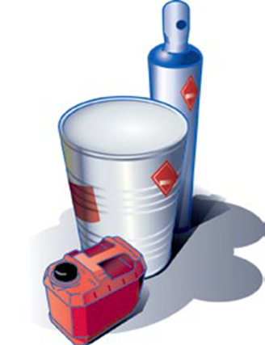
CONTAINERS
Small container (capacity of 450 liters and less)
Cylinders
Jerricans
Pails
Drums
Barrels
Bottles
page 14 guide

Slide 12
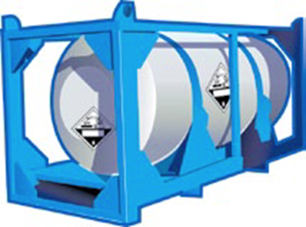
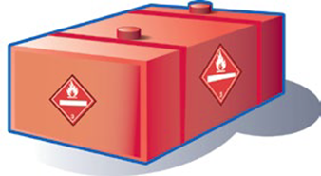
CONTAINERS
Big container (capacity greater than 450 liters)
Road tanks
Intermediate bulk containers
Portable tanks
page 14 guide

Slide 13
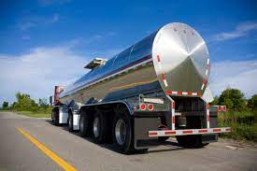
TANK TRUCK
Any tank truck containing dangerous
goods must be equipped with :
(vehicle after August 14th 2006)
A safety marking ;
A device for monitoring driver behavior, or;
An electronic vehicle stability control system.
page 15 guide

Slide 14
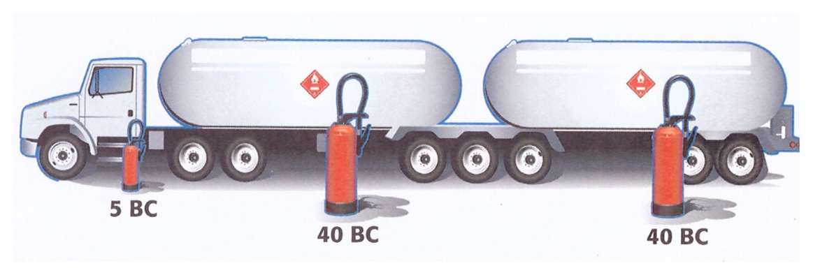
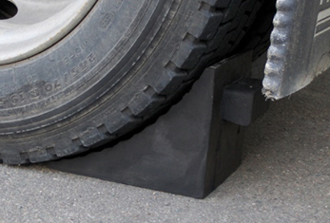
TANK TRUCK
Règle concernant le camion-citerne
Capacité des compartiments d’une citerne ne doit pas excéder 17000 litres;
Doit être muni de 2 cales de roues;
D’un ou deux extincteurs chimiques de
plus de 40 BC.
page 17 guide

Slide 15
Rules concerning tank truck drivers
The driver must:
Use the parking brake during the unloading
of liquefied gases;
Place both wheels chocks for unloading;
Ensure that all tank truck valves connected to the container are closed.
page 18 guide

Slide 16

HAZARD INDICATIONS
Hazard indications must be affixed to the containers.
Labels;
Placards;
Markings and signs.
page 22 guide

Slide 17

HAZARD INDICATION
Smalls containers
The shipper is responsible for affixing or having affixed the primary and subsidiary class labels;
The carrier must ensure that the labels remain in place during transit.
page 22 guide

Slide 18
HAZARD INDICATION
The label must be affixed:
On a side of the container other than the one on which it rests;
For a gas cylinder, the label must be on the shoulder or close to it.
page 22 guide

Slide 19
HAZARDOUS INDICATION
Proper shipping name:
Label(s);
Number UN.
page 23 guide

Slide 20
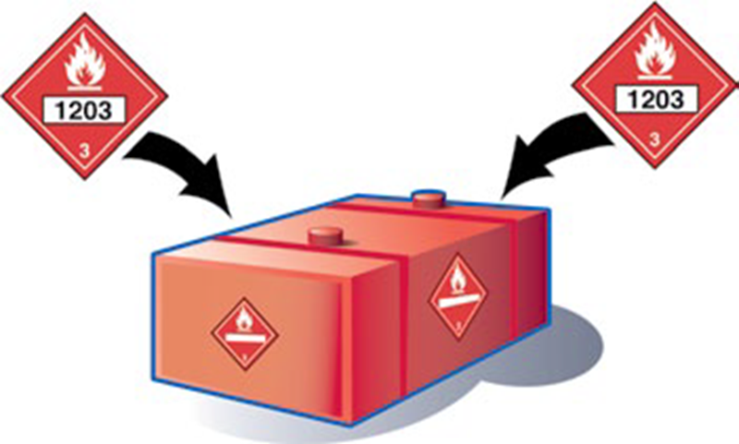
HAZARDOUS INDICATION
Bigs containers
4 placards;
Number UN.
page 23 guide

Slide 21
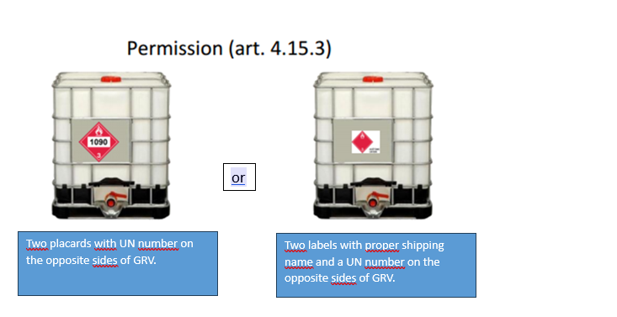
HAZARDOUS INDICATION
Bigs containers
Greater than 450
liters but less
than 3000
liters.
page 24 guide

Slide 22
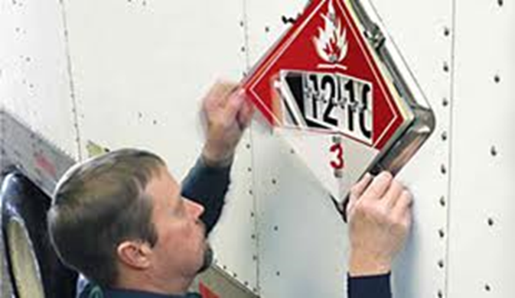
PLACARDING
The carrier must:
Apply or remove placards when quantities or types of materials change during transit;
Remove them when they are no longer required.
page 24 guide

Slide 23
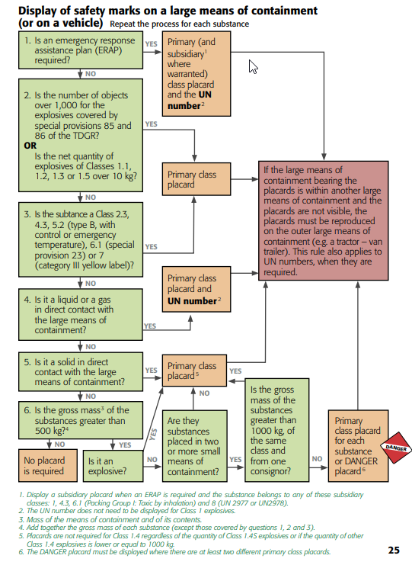
page 25 guide

Slide 24

TRAINING
Requirements:
Have received appropriate training ;
Hold a training certificate.
page 27 guide

Slide 25

TRAINING
Certificate:
The certificate expires 36 months after the date of issue.
page 28 guide

Slide 26

ACCIDENTAL RELEASE
Local police;
Your employer;
Shipper of goods;
The owner, lessee or charterer of the vehicle, infectious substances: CANUTEC at 613-996-6666;
Catastrophic: CANUTEC
Environmental emergency: 1-866-694-5454
page 30 guide

Slide 27
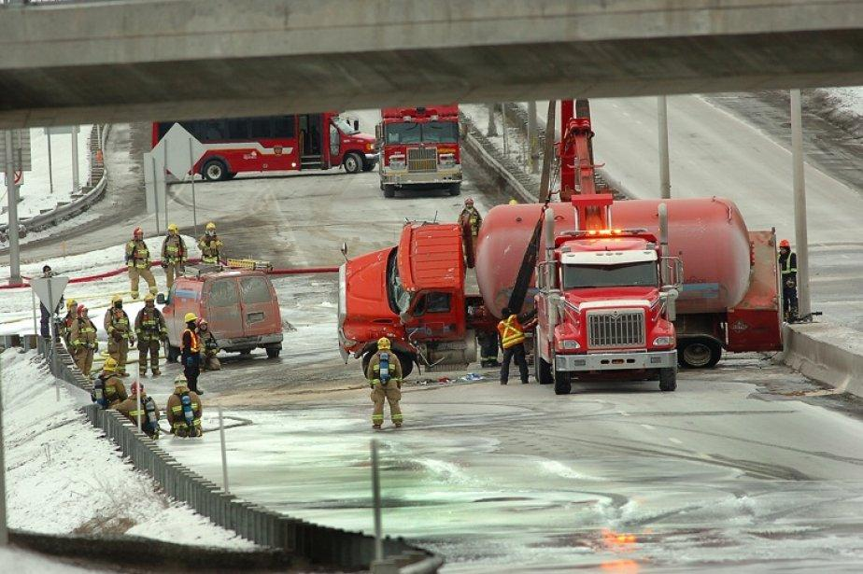
ERAP – Emergency repsonse assistance plan
The emergency response
assistance plan - ERAP
page 30 guide

Slide 28

TUNNELS
Tunnel traffic regulations:
Prohibition of passage through the tunnel
Pont-tunnel Louis-Hippolyte-La-Fontaine;
Ville-Marie;
Viger;
Joseph-Samson;
Melocheville
page 31 guide

Slide 29
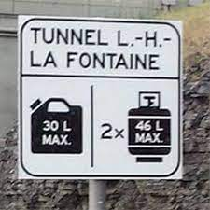
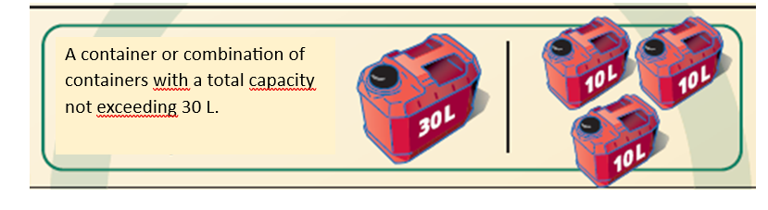
TUNNELS
What is permitted
page 31 guide
Notes:
Transports Québec
43. Il est interdit de circuler dans le tunnel Louis-Hippolyte-Lafontaine, dans les tunnels Ville-Marie et Viger à Montréal, dans le tunnel Joseph-Samson à Québec ou dans la partie de la voie d'accès au tunnel de Melocheville qui est parallèle à la voie réservée aux véhicules transportant des matières dangereuses:

Slide 30

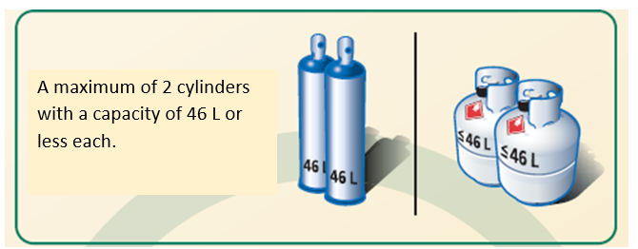
TUNNELS
What is permitted
page 31 guide

Slide 31
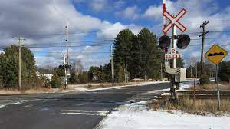
RAIL CROSSING
The driver carrying placarded dangerous goods must stop the vehicle 5 meters from the rail crossing.
page 33 guide

Slide 32
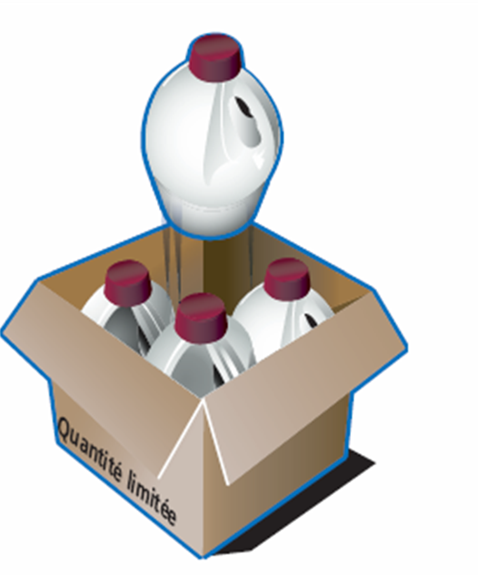
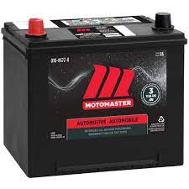

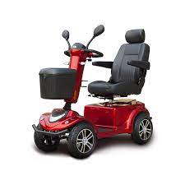

EXEMPTIONS
Particularity page 34 at 47 .
page 34 guide

Slide 33
SAFETY STANDARDS AND REGULATIONS
No dangerous goods shall be installed:
On or in front of th evehicle’s front bumper;
On the outer front end, nor in the bucket or on any part of a utility vehicle.
page 48 guide

Slide 34
CROSS BORDER TRANSPORT
Transportation to the United States:
Have a copy of the FMCSA;
Hold a FAST card;
The shipment must comply with TDG regulations;
The carrier must prove that the staff have received appropriate training.
page 50 guide

Slide 35
SAFETY AND SECURITY MEASURES
Before the beginning:
TDG certificate;
Shipping document;
Dangers indicators properly in place;
Knowledge of emergency procedures;
8 hours of rest;
Perform the circle check inspection and check the load securement;
Compliance with load and dimension standards
page 53 guide

Slide 36
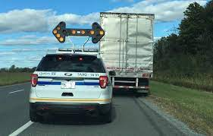
SAFETY AND SECURITY MEASURES
During the transport:
Refrain from smoking;
Safe driving and road conditions;
Compliance with speed limits;
Braking distance;
Check load securement and tire condition;
Compliance with driving and rest hours;
Avoid consuming alcohol and drugs
page 53 guide

Slide 37
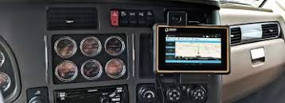
SAFETY AND SECURITY MEASURES
MEANS OF COMMUNICATION:
Reliable communication system;
Transmission of security documents;
Promote tracking systems;
Distress alert button;
Maintenance of a communication exchange network.
page 55 guide

Slide 38
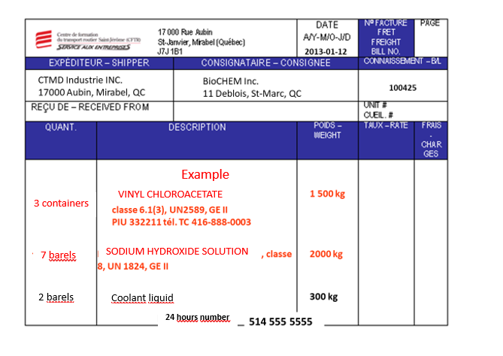
Retour sur la théorie EXERCICE

Slide 39
Thank you for your attention

