Slide 1
Competency 3 Lesson 3.11
Bill Of Lading

Slide 2
What is a Bill Of Lading
A contract for the transport of goods.
An agreement between a Shipper, Carrier and Consignee.
Legal document
A transport agreement for remuneration.
Transportation Act/ Bill of Lading Requirements Regulation

Slide 3
Bill Of Lading
French Term“Le Connaissement”
Abbreviation B/L

Slide 4
Obligations
Must be in your possession when travelling on the road with goods from a shipper.
Before leaving, fill in the missing fields relating to the carrier.
The operator must keep the Bills of Lading for 2 years.

Slide 5
Exemptions from having a Bill of Lading
Examples:
Vehicle used exclusively for the use of a shipper.
Used household goods.
Courier and parcels under 45 kg
Empty containers and trailers.
Bulk materials.
Milk.

Slide 6
Exemptions from having a Bill of Lading
Examples:
Petroleum products with a counter (meter) and a maximum capacity of 18 200 liters.
Automobile carcasses.
Waste and recycling.
Vehicles towed by a tow truck.
Fertilizing substances.
etc.

Slide 7
Some definitions
Consignor
Carrier
Consignee
Notes:
Consignor: The company that ships the goods. The point of origin.
Carrier: The operator of a heavy vehicle who agrees to take possession of the goods in order to transport them by the road network to a company who will receive them.
Consignee: The company that receives the goods. The commodity is dedicated to this address and to which must be delivered. The driver will use this address to do his route planning.

Slide 8
Carrier’s liability
By affixing his signature, the Carrier becomes responsible for loss or damage to the goods on board the vehicle.

Slide 9
What a Bill of Lading should contain
On the front of the Bill Of Lading is found all the information relevant to the transport, that is to be carried out:
Shipper
Consignee
Custom Broker (if applicable)
Date
Numeric Code (required)
Information on the Carrier (Name, NIR “Numéro d’inscription au registre”, Vehicle number, etc.)
Description of the goods (value, quantity, nature, weight, dangerous goods, etc.)
Special instructions
The signatures of the Shipper, Carrier and Consignee.

Slide 10
Some abbreviations and expressions
COD ou PSL
Cash on delivery / Payable sur livraison
COLL
Collect / Frais à percevoir
(transport and/or merchandise)

Slide 11
Some abbreviations and expressions
LTL
Less than truckload / Charge partielle
TL
Truckload / Charge complète

Slide 12
Some abbreviations and expressions
SLC
Shipper load & count / Chargé et compté par l’expéditeur
ASAP
As soon as possible / Urgent

Slide 13
Pro Bill
Legal and official document such as the Bill of Lading.
Merchandise having passed through the Carrier’s terminal.
Provisional freight bill.
Bill of Lading numeric code.
Short version of the Bill of Lading
A copy signed by the Consignee and the Carrier.

Slide 14
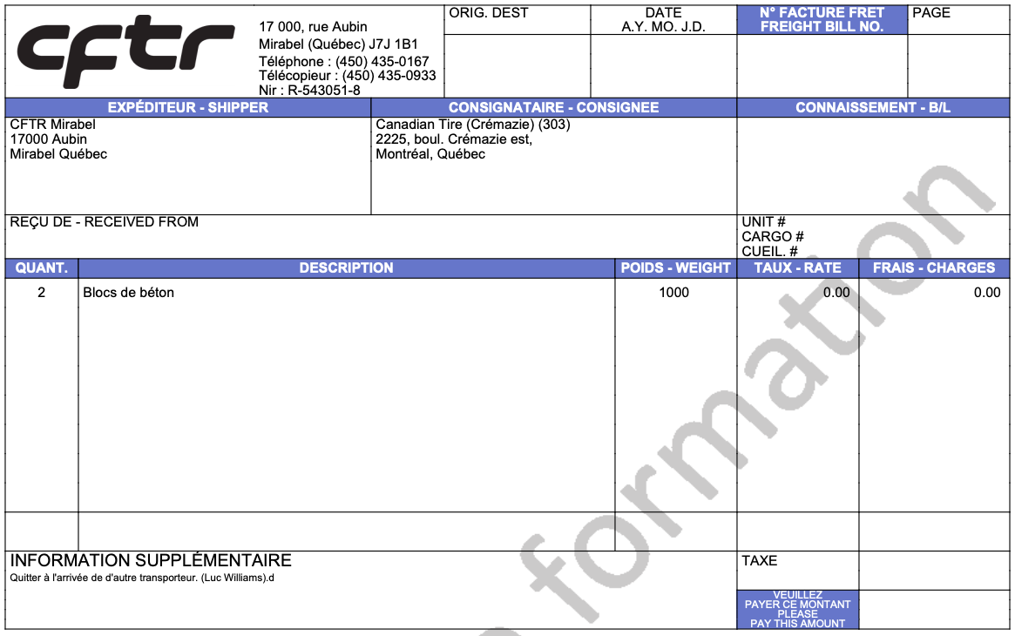
Pro Bill

Slide 15
Thank You
For Your
Participation

