Slide 1
Competency 3
Lesson 3.6
Insurance and Accidents

Slide 2
4 types of accidents can occur to you:
Collision with property damage to an unoccupied vehicle, a pole, a traffic sign and/or a structure such as a bridge.
Collision with property damage to one or more vehicles without bodily harm.
Collision with bodily harm with or without property damage.
Collision with an unowned domestic animal, a wild animal over 25 kilograms that is on the list of notifiable animals.

Slide 3

What to do in one of these situations:
All companies must have an accident policy that the driver must follow. Basically the procedures are the same knowing that insurance companies all ask for the same information. They also, must comply and respect the Highway Safety Code. The difference between Quebec, is that it covers bodily injuries versus other provinces or states that don’t. This opens the door to lawyers in other districts to try to claim in upwards of 2, 3 or even $ 5 ooo ooo. This is why it is extremely important to call the Emergency Number of your company in order to be properly guided.

Slide 4
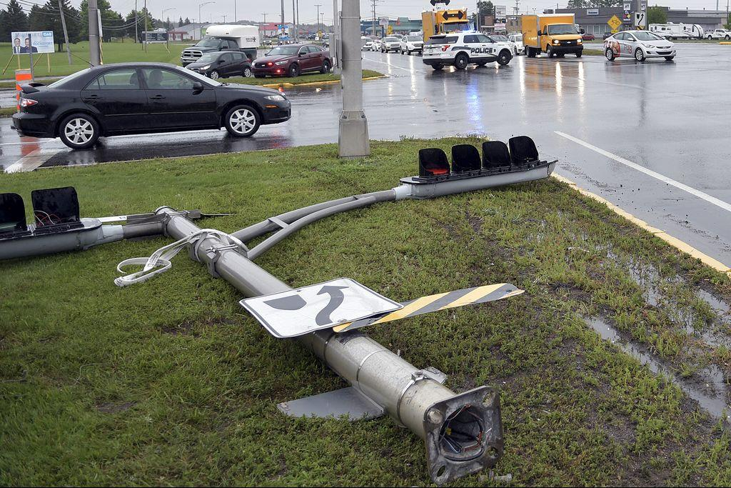
Collision with property damage of an unoccupied vehicle, a pole, a traffic sign and/or a structure such as a bridge:
You should:
Stop your vehicle.
Verify if anyone is hurt.
Call the Emergency Number of your company.
Call 911 to reach the nearest police station, which will come and fill out a Police Report.
Take photos of the damage and of the area in which it occurred.
Complete the accident form (CFTR)* (annex 3)

Slide 5
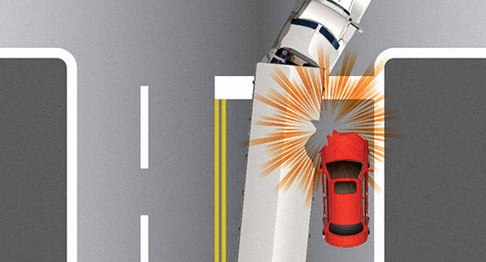
Collision with property damage to one or more vehicles without bodily harm:
You should:
Stop your vehicle.
Verify if anyone is hurt..
Call the Emergency Number of your company.
Fill out an Accident Report (Amicable Report)*
Take photos of the damage and of the area in which it occurred.
Complete the accident form (CFTR)* (annex 3)

Slide 6
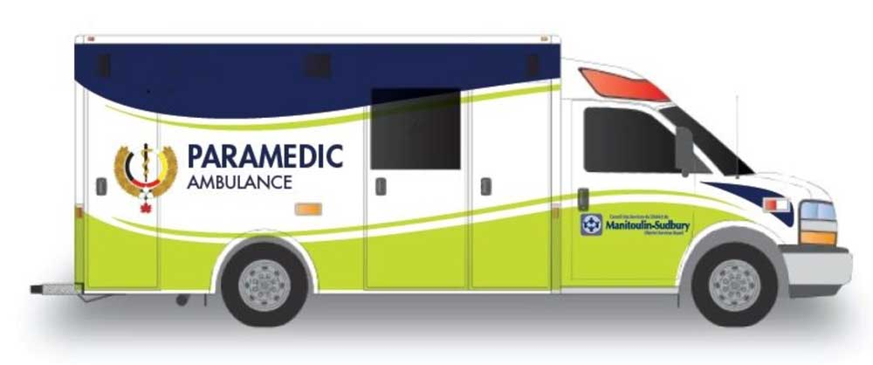
Collision with bodily harm with or without property damage:
You should:
Stop your vehicle.
Assist the injured, even if it’s minor, by calling 911.
Call the Emergency Number of your company.
The police will fill out an Accident Report.
Take photos of the damage and of the area in which it occurred.
Complete the accident form (CFTR)* (annex 3)

Slide 7
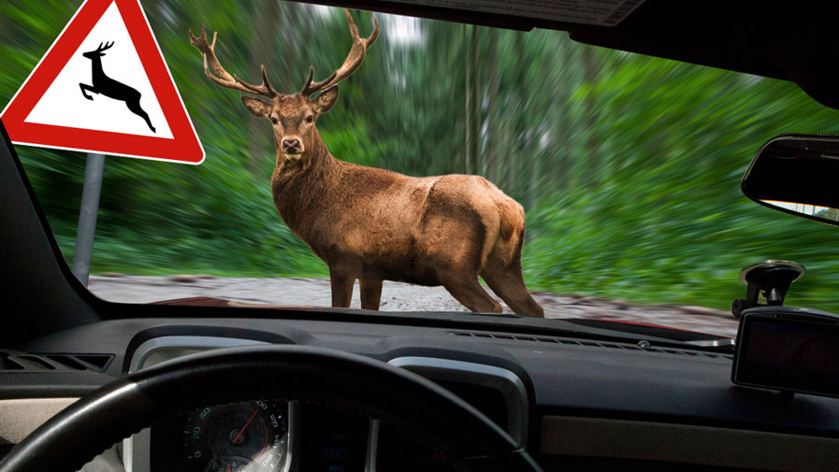
Collision with an unowned domestic animal, a wild animal over 25 kilograms that is on the list of notifiable animals:
You should:
Stop the vehicle.
Assist the owner of the animal if he is injured.
Call the Emergency Number of your company.
Contact a wildlife officer if the animal weighs more than 25 kilograms or if the animal is on the Mandatory Declaration List*.
Take photos of the damage and of the area in which it occurred.
Complete the accident form (CFTR)* (annex 3)

Slide 8
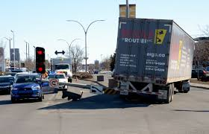
Scenario
You come to an intersection and your supposed to turn left, but unfortunately here’s what happened. You barely touched the light post and it falls down.
You should:
Using the document found in annex 3, please complete it as if it were your accident.

Slide 9
Be Vigilant
Ride Cautiously

