Slide 1

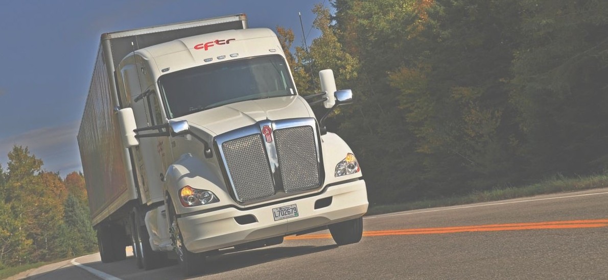
Learner’s licence Class I
Commission scolaire de la Rivière-du-Nord
CHAPTER 12
Circle check of vehicle
Pages 433 à 436 and 450 à 458 of Driving a heavy vehicle

Slide 2
The circle check aims to ensure
The good condition of the main components of the vehicle;
That the owner and operator of the vehicle are informed of the repairs to be carried out;
That a vehicle with major defects is not driven on the road.
Driving a heavy vehicle 346

Slide 3
The three main objectives of this chapter are
To inform the driver of a vehicle subject to a safety round of his obligations regarding the inspection of the vehicle he is driving;
To prepare the driver to carry out a complete and effective safety round;
To make the driver aware of the preventive role he plays in road safety when he carries out constant and rigorous checks of the vehicle he is driving. .
Driving a heavy cehicle 346

Slide 4
What’s means the circle check?
The circle check is a visual and auditory inspection of certain accessible elements of a vehicle. It allows:
defects to be detected as early as possible;
the operator and owner to be informed quickly, who will take appropriate measures to ensure the repair of the anomalies detected;
a vehicle to be prevented from being operated when its condition is likely to cause an accident or breakdown.
A rigorous and effective circle check promotes better safety for the driver, passengers and other road users.
IS IT MANDATORY
The circle check is mandatory on all vehicles covered. Thus, a driver cannot drive and an operator cannot allow a vehicle to be driven if the safety round has not been carried out within the prescribed time frame. Note that it is mandatory to complete a round report for each safety round carried out.
Driving a heavy vehicle 347

Slide 5
Vehicle affected
The following vehicles must be subject to the circle check :
a road vehicle with a gross vehicle weight rating (GVWR) of 4,500 kg or more (e.g., tractor unit, straight truck, cement mixer, tanker truck, trailer, semi-trailer, van, pick-up truck, drill, concrete pump, truck-mounted crane, ambulance, fire department vehicle, etc.);
a combination of road vehicles with a GVWR of at least one of the vehicles of 4,500 kg or more (e.g. pick-up truck and trailer, tractor and semi-trailer, tractor and trailer);;
a bus, a minibus and a tow truck, regardless of the gross vehicle weight rating (GVWR) of the vehicle (for example, coach, minibus, paratransit minibus, school bus, city bus, tow truck;
a road vehicle with a GVWR of less than 4,500 kg transporting dangerous materials which require the application of danger indication plates.
Driving a heavy vehicle 348

Slide 6
Exempt vehicles
The following vehicles do not require a circle check:
a tool vehicle (e.g., grader, wheel loader, backhoe);
a heavy vehicle used when required by an emergency service or in the event of a disaster;
a farm tractor or agricultural machinery (e.g., combine harvester);
a farm trailer (e.g., hay trailer owned by a farmer and used for agricultural purposes);
a heavy vehicle used by a natural person (an individual) for personal purposes, that is, other than commercial or professional (e.g., truck used to move one’s own belongings, motor home);
A two- or three-axle straight truck used in one of the following circumstances:
when transporting primary products from a farm, forest or body of water, if the driver or operator of the truck is the producer;
on the return trip after this transport;
if the truck is empty or is transporting products used in the main operation of a farm, forest or body of water.
Driving a heavy vehicle 349

Slide 7
Who sould do the circle check ?
The driver must carry out a safety inspection of the vehicle he is driving. A person designated by the operator may also carry out this inspection. In this latter situation, the operator becomes responsible for this check.
If the circle check is carried out by a person designated by the operator, the driver can accept or refuse it:
If he accepts: The driver ensures that the circle check is valid (it was done within the last 24 hours) and countersigns the check report to certify that he has read it. The driver is then not held responsible for the check, but he is responsible for keeping the report up to date and reporting any defects he notices along the way.
If he refuses : The driver must repeat the circle check and produce a new report. The driver at the wheel of the vehicle must keep the circle check report up to date and report any defects found during the journey.
Driving a heavy vehicle 350

Slide 8
Who should report defects in road?
The driver :
is the best person to detect symptoms of unusual vehicle behavior;
is always responsible for reporting defects found while driving, even if the circle check was carried out by the person designated by the operator. He must therefore be very vigilant;
must, at all times, be able to check his vehicle and recognize defects normally detected during a circle check.
Conduire un véhicule lourd 353

Slide 9
WHEN TO DO THE ROUND ?
In general, the driver must ensure that a check has been carried out within the last 24 hours before driving the vehicle, otherwise he must do a new safety check. In addition, if the circle check has not been carried out by a person designated by the operator, the driver must do one again, even if less than 24 hours have passed.
In general, the driver must ensure that a check has been carried out within the last 24 hours before driving the vehicle, otherwise he must do a new safety check. In addition, if the safety check has not been carried out by a person designated by the operator, the driver must do one again, even if less than 24 hours have passed.
The driver must also plan his activities so that he can do a new circle check before 24 hours have passed, except for certain vehicles which benefit from different deadlines.
Driving a heavy vehicle 353

Slide 10
Mechanical defects
All persons concerned have a duty to intervene when the mechanical condition of a vehicle presents anomalies. Those which represent an immediate or short-term risk to road safety are designated as major or minor defects.
Driving a heavy vehicle 357

Slide 11


Minor defects
A minor defect does not pose an immediate risk to the safety of the driver and other road users, but could deteriorate rapidly in certain cases. A vehicle with a minor defect cannot be driven if the repairs are not carried out within 48 hours.
Major defects
A major defect presents an immediate risk to safety. Therefore, it is prohibited to drive or allow a vehicle to circulate if it has a major defect.
Driving a heavy vehicle 357

Slide 12
LIST OF DEFECTS
There are three different fault lists, each tailored to the specifics of the vehicle type being checked:
List 1 – Heavy vehicle
For heavy vehicles, excluding those covered by lists 2 and 3.
List 2 – Buses
For buses (except coaches), minibuses and trailers pulled by a bus, minibus or coach.
List 3 – Coach
The content of the defect list is prescribed and its presence in the vehicle is mandatory.
Driving a heavy vehicle 358

Slide 13
CIRCLE CHECK REPORT
The circle check report differs from the defect list. It is a document that must be completed during each circle check. It allows the driver or the person designated by the operator to carry out the circle check to inform the operator and the owner of the vehicle of the result of the inspection and, if applicable, of the defects noted. This report also provides evidence of when the circle check was carried out and its validity.
Driving a heavy vehicle 361

Slide 14
Is it mandatory ?
The person who carried out the safety round must fill out the report, taking care to note the defects that he or she detected. The driver will also add those detected during the trip.
The safety round report also allows you to report certain observations or anomalies that are not on the list of defects. This is why it must be kept up to date with rigor.
It is also mandatory to keep the circle check report (completed and valid) and the list of defects in the vehicle. If it is not on board, the driver must obtain it or repeat the round. In addition, for the same safety round, only one report must be completed. It is suggested to keep it with the list of defects.
Driving a heavy vehicle 361

Slide 15
What is its content ?
The regulations do not require a specific safety round report. However, it must contain the following elements:
The license plate number of the vehicle or unit number registered on the certificate.
The name of the operator
The date and time the circle check was carried out;
The municipality or location on the road where the circle check was carried out;
Defects noted during the safety round or on route;
If no defect has been detected, this must also be indicated;
The name of the person who carried out the security round (in block letters and legible);
A statement, signed by the driver or the designated person who carried out the inspection, certifying that the vehicle has been inspected in accordance with the applicable requirements;
If the driver has not carried out the circle check himself
His signature certifying that he has read and accepted it;
The mileage indicated by the odometer if the vehicle is equipped with one.
Driving a heavy vehicle 362

Slide 16
When to report a defect ?
Minor defects
A minor defect must be recorded in the circle check report and reported to the operator according to the first of the following two possibilities:
before the next circle check ;
within 24 hours of writing the report.
It is recommended to report the problem as soon as possible to avoid repair delays. The operator, if not the owner of the vehicle, must notify the latter to ensure follow-up. Rapid intervention could allow the defect to be repaired before the vehicle even hits the road and thus ensure safe traffic.
Driving a heavy vehicle 364

Slide 17
When to report a defect ?
Major defect
A major defect must be recorded immediately in the safety round report and reported without delay to the operator.
A major defect constitutes a driving ban, i.e. it is prohibited to drive or allow a vehicle to be driven if it has a major defect.
Conduire un véhicule lourd 364

Slide 18
When to transmit a circle check report ?
The driver must send the original of the circle check report to the operator within 20 days of its preparation. This obligation applies even if a copy has been sent to the operator beforehand (to report a defect, for example).
Conduire un véhicule lourd 365

