Slide 1
Competency 3
Lesson 3.3
Research Methods

Slide 2
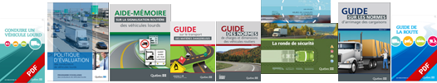


Demonstrate a research method applicable to traditional paper guides and digital documents.

Slide 3
Steps to follow to conduct a search with a document.
Define your goals.
Prepare your research.
Choose the types of documents.
Locate the documents.
Evaluate the documentation collected and all useful information.

Slide 4
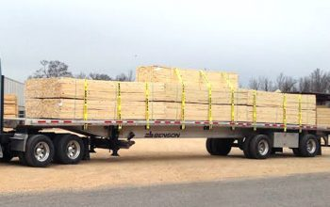
Senario
You have completed loading and securing your cargo of manufactured lumber at the shipper. Before hitting the road, to make your delivery, you ask yourself. When should you perform your next regulatory inspection of the cargo.
What will be your answer and what is the reference in order to comply with cargo securement standards?

Slide 5

Determine the type of work to be done and the research to be carried out.
When to inspect the cargo.
Identify the subject
Cargo securement.
Answers, references.
"KEYWORD"
Inspection of cargo
Define your objectives:

Slide 6


Prepare your research:

Slide 7
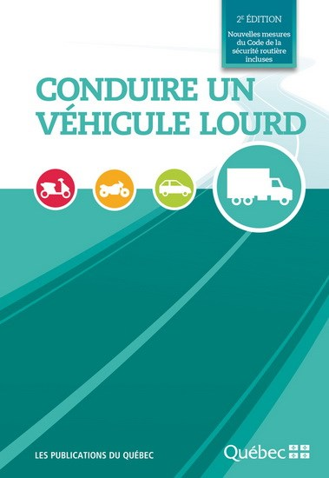
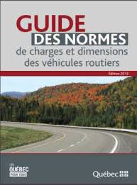


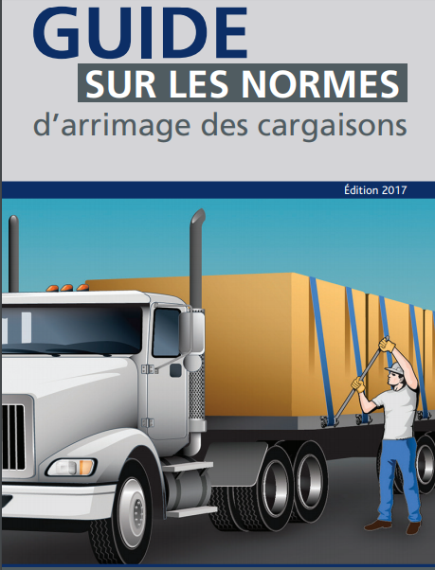

Choose the types of documents:

Slide 8
Locate the documents:
(Paper or digital versions)

Slide 9

Remember the question
When should you perform your next regulatory inspection of the cargo?
Evaluate the documentation collected and all useful information.

Slide 10
Example 1
Choice of document:

Slide 11
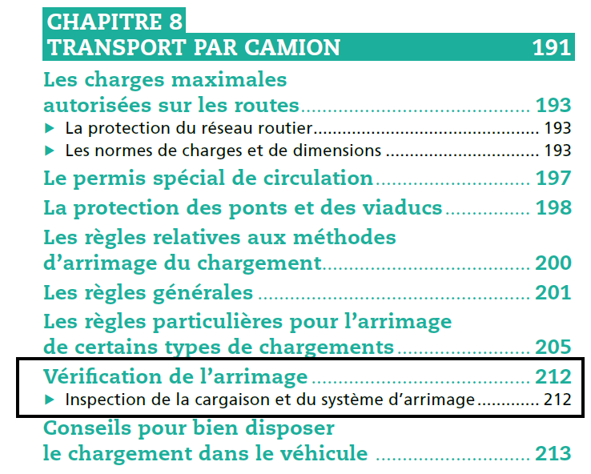
Example 1 (cont’d)
Research the information:

Slide 12
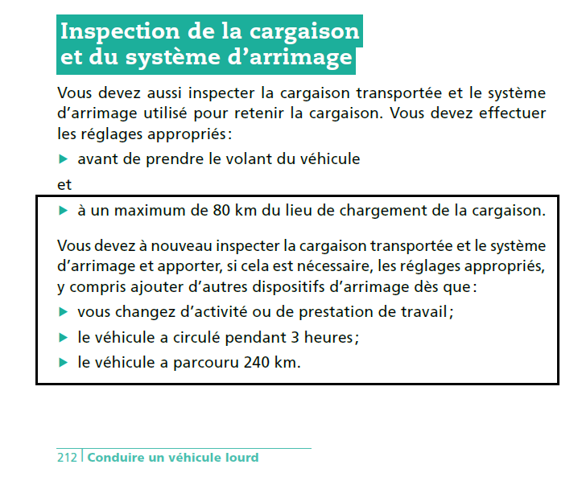

Example 1 (cont’d)
The solution:

Slide 13
Example 2
Choice of document:

Slide 14
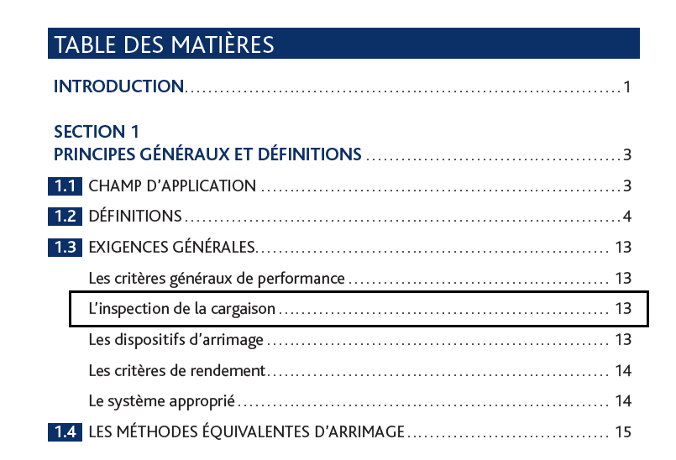
Example 2 (cont’d)
Research the information:

Slide 15
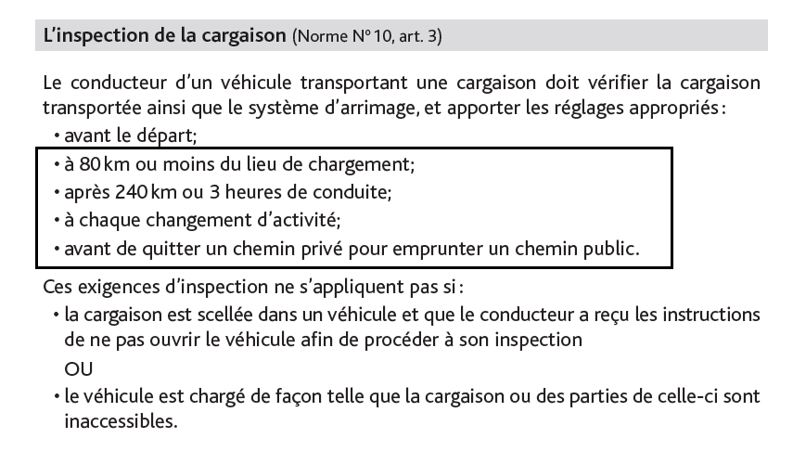
Example 2 (cont’d)
The solution:

Slide 16
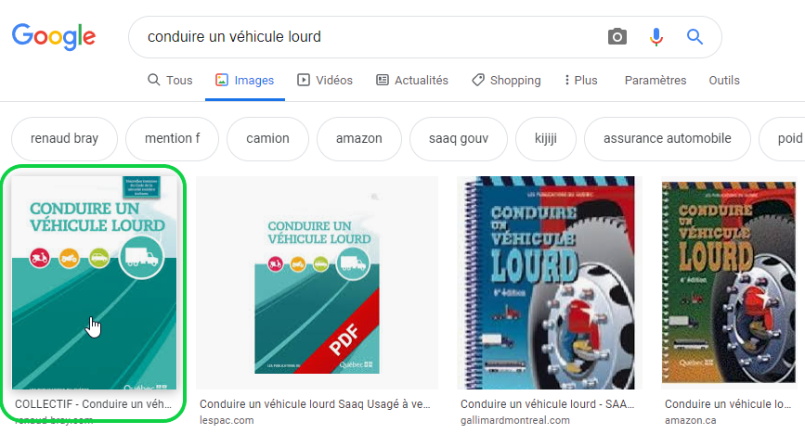
Search method from a digital document.
Example 1
Choice of document:

Slide 17
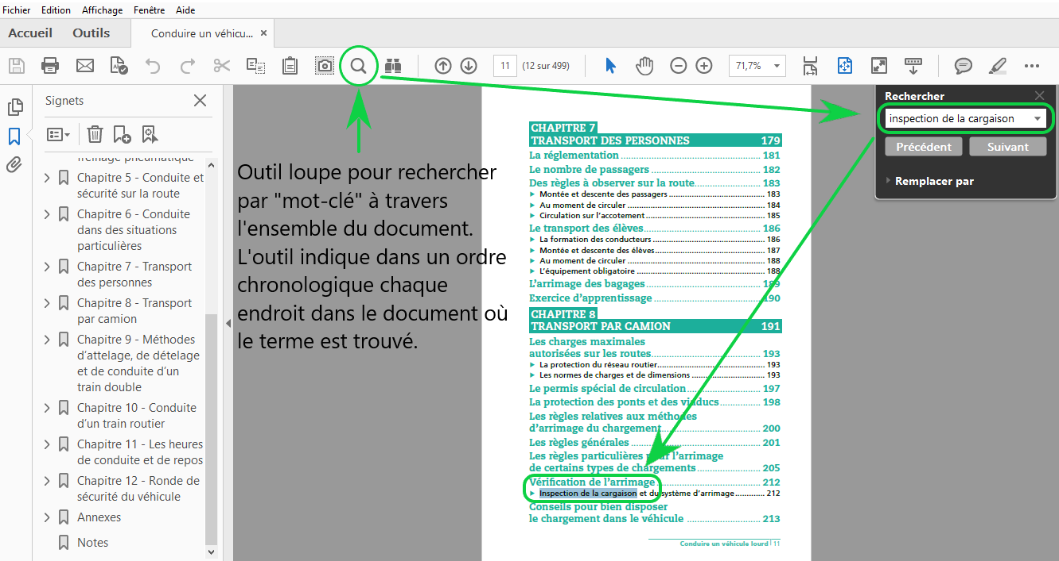
Example 1 (cont’d)
Research information:

Slide 18
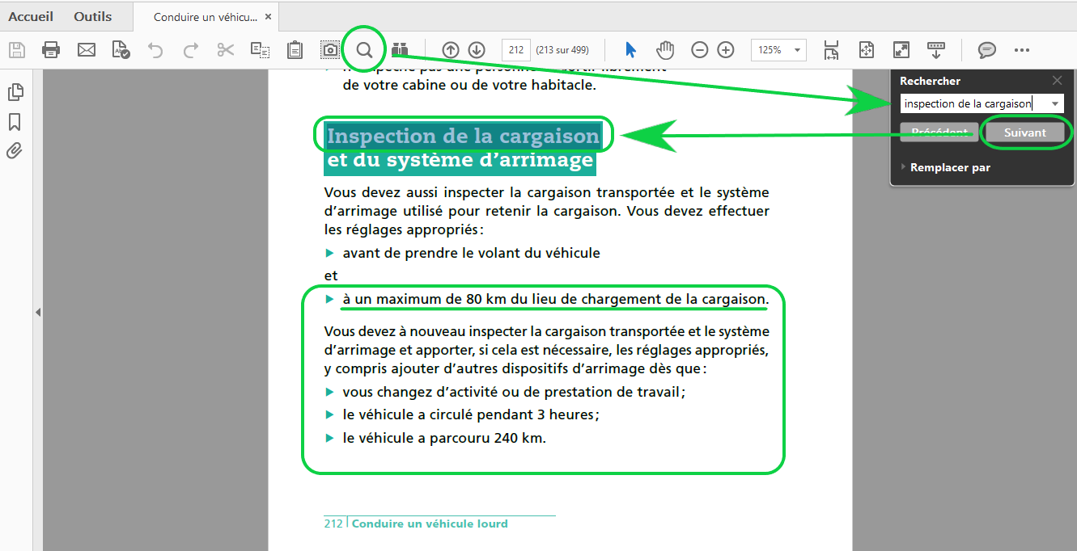
Example 1 (Conclusion)
Solution:

Slide 19
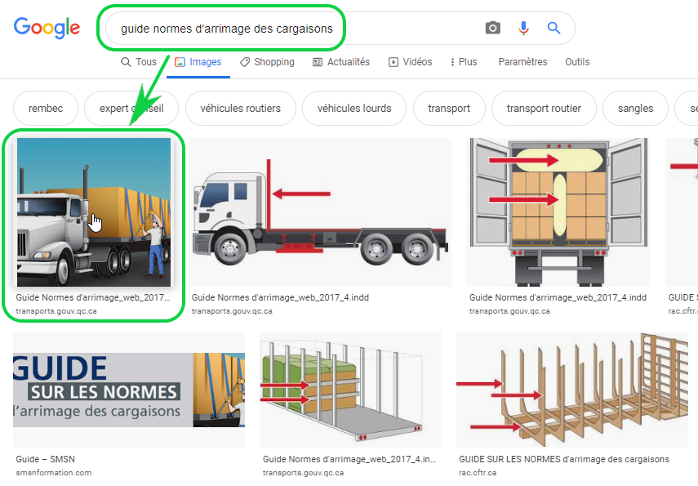
Example 2
Choice of document:

Slide 20
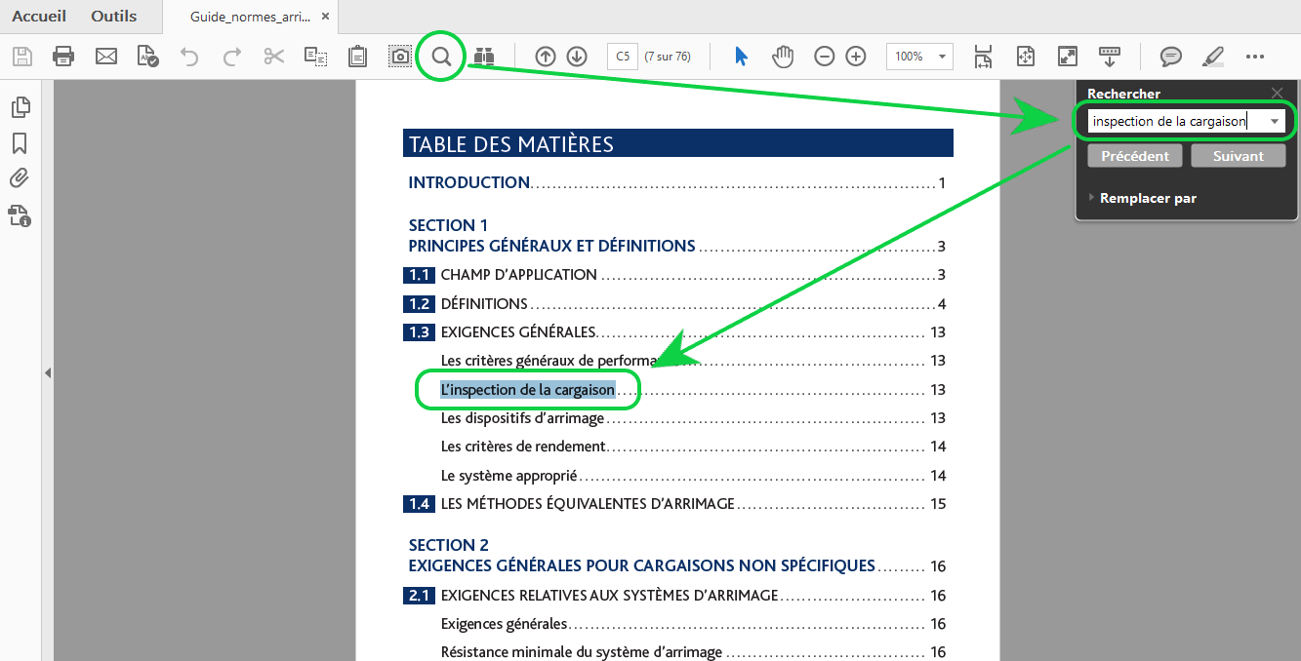
Example 2 (cont’d)
Research information:

Slide 21
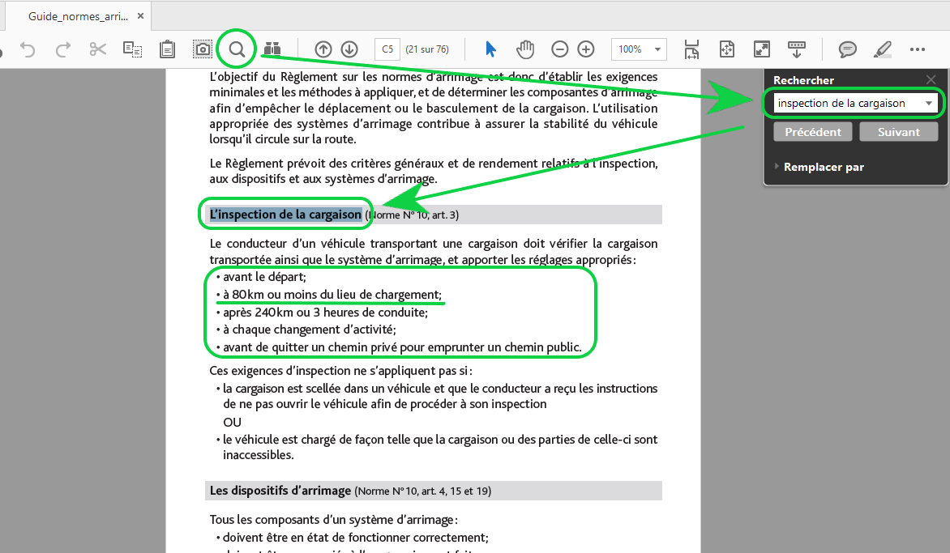
Example 2 (Conclusion)
Solution:

Slide 22


fghh

Slide 23
Search Wiseley

