Slide 1

Competency 3 Lesson 3.2
Sources Of
Information

Slide 2
You don’t have any turn signals at the rear of your vehicle combination?

Slide 3

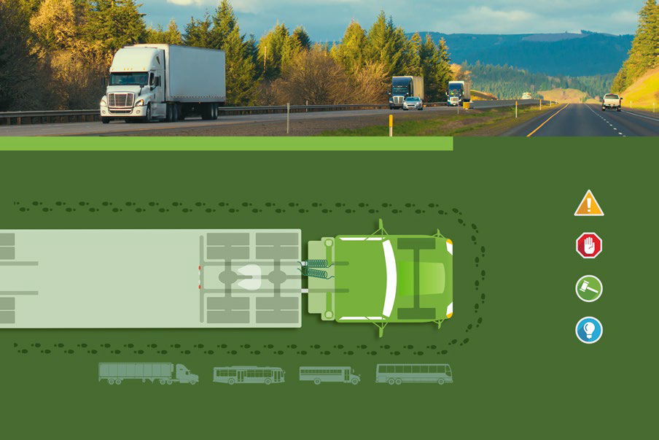
You don’t have any turn signals at the rear of your vehicle combination?

Slide 4
You are facing a traffic sign and want to know its meaning?

Slide 5


You are facing a traffic sign and want to know its meaning?

Slide 6
You are transporting dressed lumber and you want to know how to secure the cargo properly?

Slide 7

You are transporting dressed lumber and you want to know how to secure the cargo properly?

Slide 8
You have committed an offense related to the Hours Of Service Regulation and want to know if you will lose points on your driver’s license or in the section “Information relating to driving a heavy vehicle”

Slide 9

You have committed an offense related to the Hours Of Service Regulation and want to know if you will lose points on your driver’s license or in the section “Information relating to driving a heavy vehicle”

Slide 10
The shipper asks to load cargo and it seems to be too heavy?

Slide 11

The shipper asks to load cargo and it seems to be too heavy?

Slide 12
You have to transport dangerous goods and you want to know if your driver training certificate “Transportation of Dangerous Goods”is still valid?

Slide 13

You have to transport dangerous goods and you want to know if your driver training certificate “Transportation of Dangerous Goods”is still valid?

Slide 14
Your dispatcher asks you to make a special and urgent delivery but you don’t know if you will have enough hours available to get to the customer?

Slide 15

Your dispatcher asks you to make a special and urgent delivery but you don’t know if you will have enough hours available to get to the customer?

Slide 16
You want to know what are the requirements for obtaining your “Mention T” for large road trains on your driver’s license?

Slide 17
You want to know what are the requirements for obtaining your “Mention T” for large road trains on your driver’s license?

Slide 18
Thank You
For Your
Participation

