Slide 1
Planning trips C-9

Slide 2
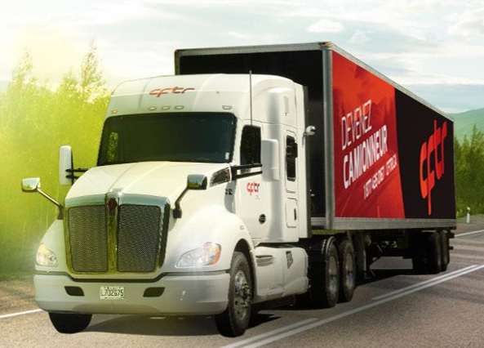
Lesson objectives:
Submit the reports
Gather information about the trip to be completed
Data collection
Determine the route

Slide 3
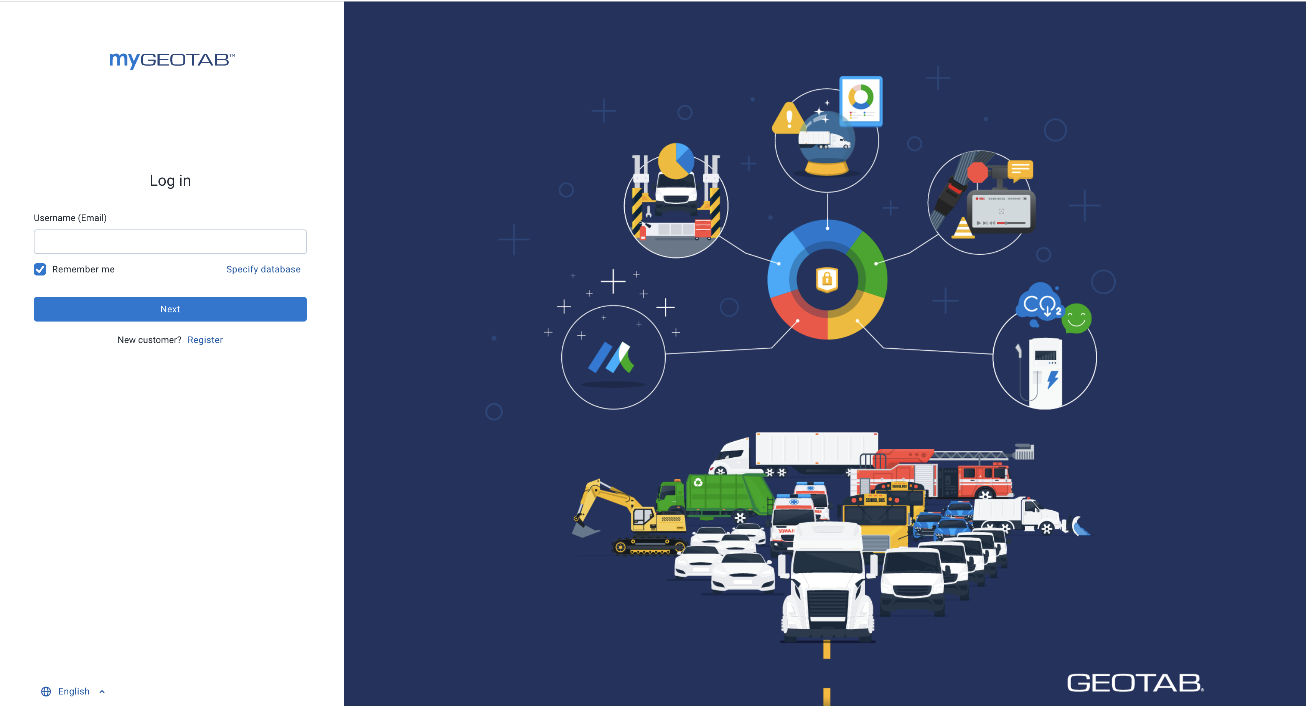
After a day of practical training, you will now need to submit your pre-trip inspection reports and hours of service logs.
To do so, you must be familiar with the procedure in Geotab.
Inséré une image de géotab

Slide 4
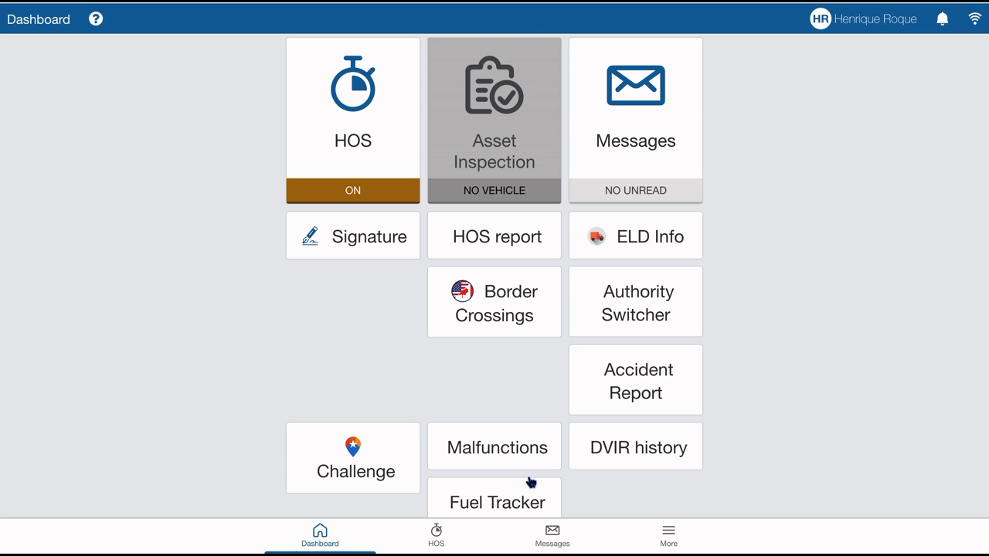

Slide 5
Let’s try it together (on your mobile device)
Click on HOS Report
I want to obtain my activity reports for personal use
French or English
Enter the email address provided by the teacher
Generate

Slide 6
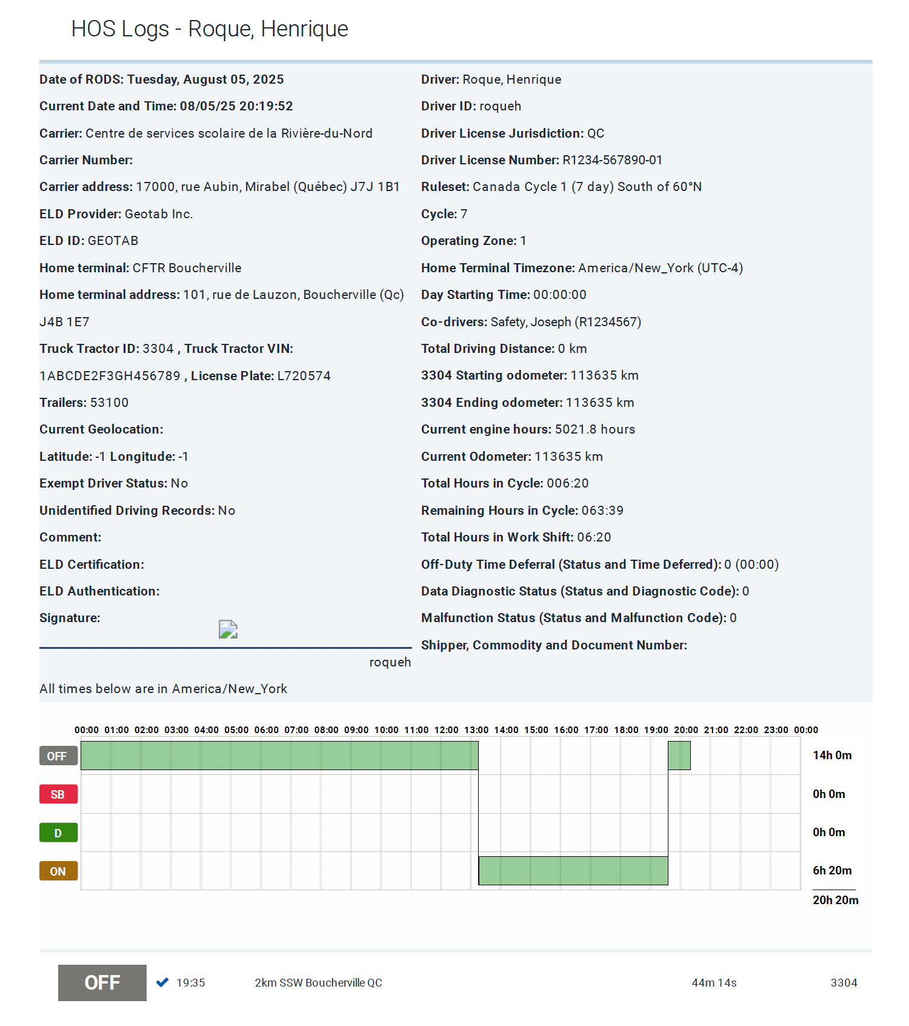
Image exemple rapport HDS

Slide 7
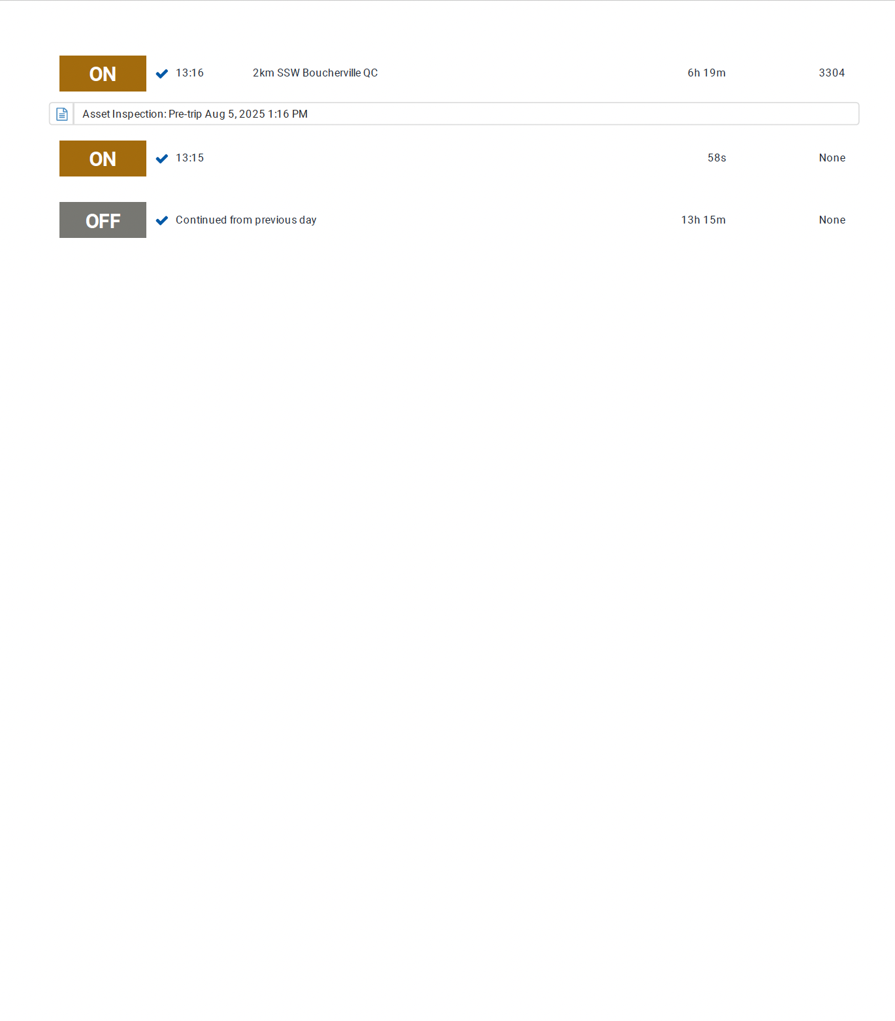
Image exemple rapport HDS

Slide 8
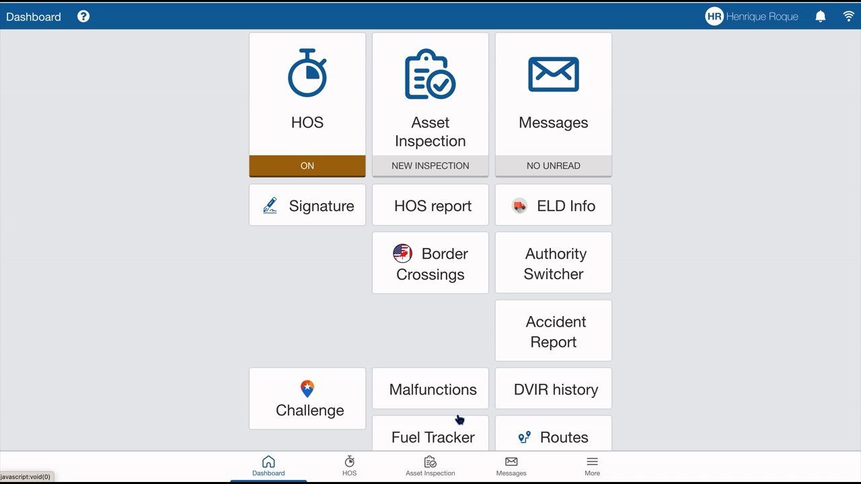

Slide 9
Let’s try it together on your mobile device.
In the dashboard, click on DVIR History
(RDS : Rapport de Défectuosité et Sécurité → DVIR : Driver Vehicle Inspection Report)
French or English
Send
Enter the email address provided by the teacher
Send the reports for the truck and the trailer — once for each piece of equipment.

Slide 10
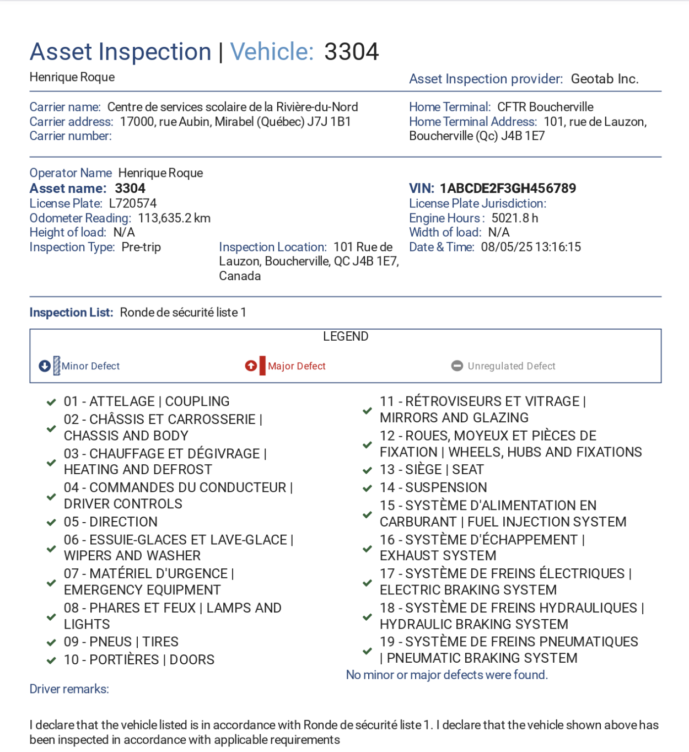

Slide 11
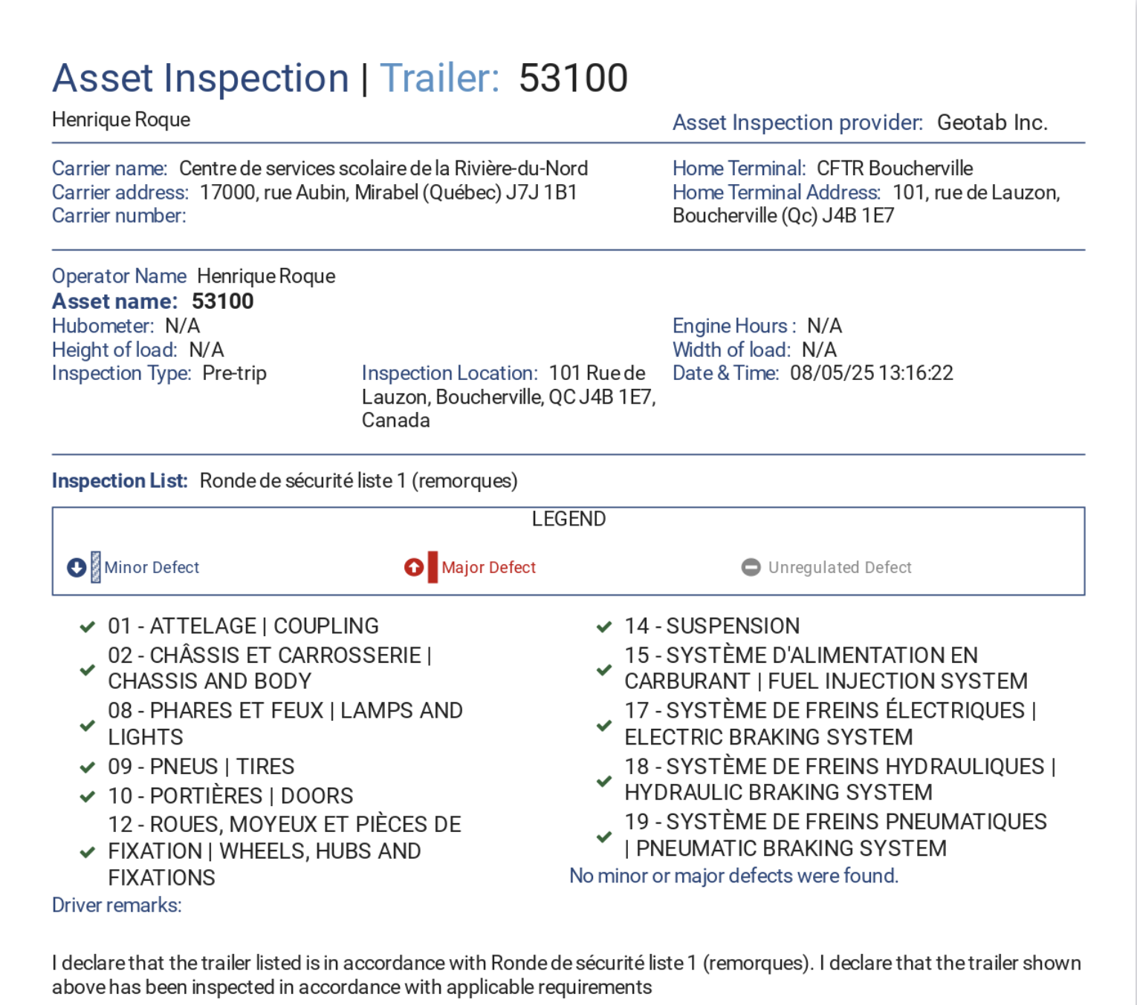

Slide 12
Trip Planning – Competency 9
In Competency 9, you will now be required to plan a route to complete one or more deliveries to a business. You may use the tool of your choice to do so.
You must reach the destination and perform a backing maneuver.
It is strongly recommended that you verify your route using the commercial trucking network map (Carte réseau camionnage).
Writing down a simplified version of your route helps with memorization and reduces surprises on the road when using a GPS.

Slide 13
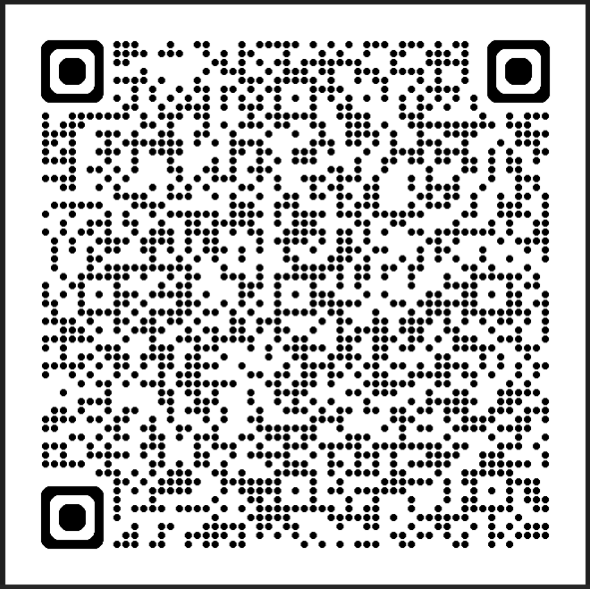
The trucking network (Add it to your favorites list)

Slide 14
Thank you and have a safe delivery !

