Slide 1
Competency 2
Lesson 2.3.3
Transmission In Motion
(Automatic And Automated) Transmissions
Notes:
The purpose of this presentation is to explain the general operation of automatic and automated transmissions available on the job market.

Slide 2
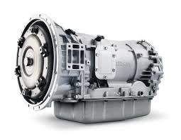
Automatic Transmission
An automatic transmission is a type of transmission that can automatically change gears when the vehicle is in motion.
Notes:
This transmission is like most automatic transmissions used in cars and vans.

Slide 3
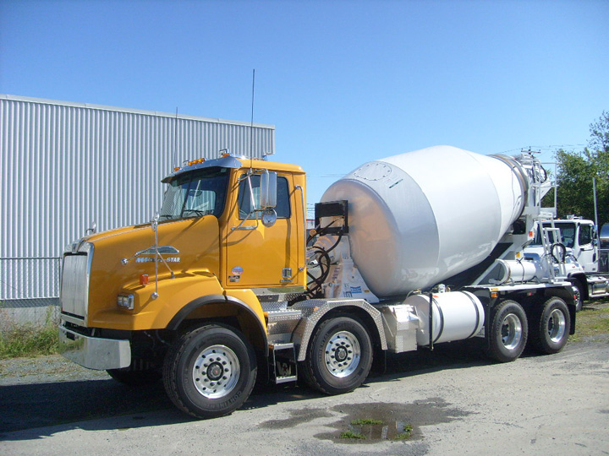
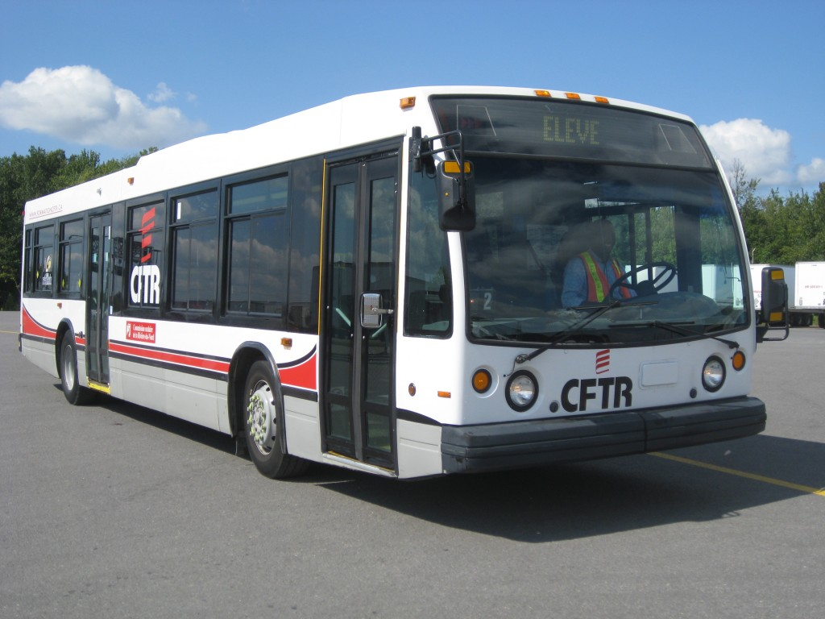
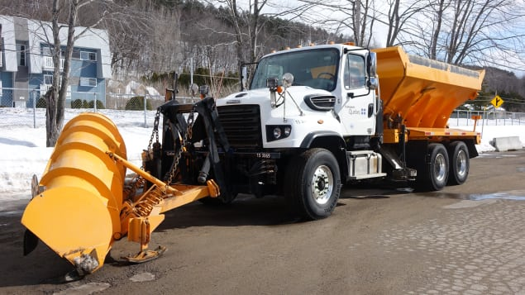
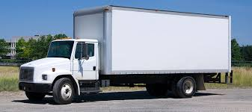
Automatic Transmission
Main uses:
School and city buses
Trucks for municipalities
Trucks for construction
Straight truck
Notes:
They are mainly used for urban applications (Multiple deliveries, municipal vehicles, construction, buses, etc).
They are also present on trucks with a high load capacity. (Mining Trucks)

Slide 4
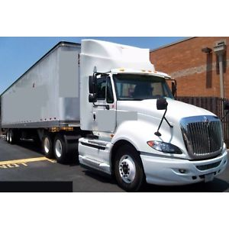
Automatic Transmission
This type of transmission is also used for applications on tractor units.
Notes:
Automatic transmissions are not very present on this type of vehicle due to the higher price than an automated transmission.

Slide 5
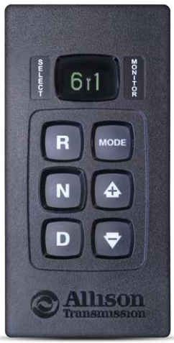
Automatic Transmission
The main manufacturer is Allison
Usually used control selector:
Between 5 and 10 Forward gears
2 Reverse gears
Notes:
See the website for more information:
https://www.allisontransmission.com/fr-fr/why-allison

Slide 6
Automatic Transmission
Main functions:
Gear selected
Automatic gear selection
Manual gear selection
Notes:
Gear selector:
The number on the left indicates the gear selected.
The number to the right indicates the gear not to exceed when the driver wants to maintain some control over the use of engine compression. This is chosen by using the arrows.
Selected keys for moving:
R for Reverse
N for Neutral
D for Drive
Mode selection and gear changing:
Mode for automatic or manual
Arrows to move up or down in manual mode

Slide 7
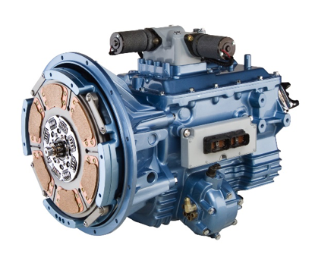
Automated Transmission
This kind of gearbox combines a traditional manual gearbox with a gear change actuator and a computer-controlled clutch.
Notes:
More on more present in class 8 (Tractor and semi-trailer).
These transmissions are now installed on the majority of new vehicles (over 90 %)
Attention: Be careful with the use of these transmissions, as some have restricted specifications and can only be used with a total mass of 50000 kg. To be confirmed with the carrier.

Slide 8
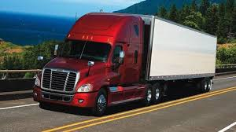
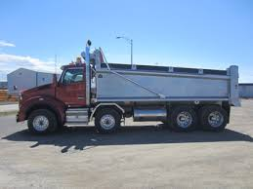
Automated Transmission
Main uses:
Class 8 Tractors
Construction Truck
Notes:
These transmissions usually require a minimum of understanding, of a manual transmission.
They can also be used in manual mode, if the option is available during operation. Some carriers may limit the use of this mode in certain situations.

Slide 9
Automated Transmission
The main manufacturers are:
Détroit (DT12)
Eaton (Ultra-shift, Ultrashift plus)
Eaton/Cummins (Endurent, Paccar)
Volvo (I-Shift)
Mack (M-Drive)
Notes:
Eaton Fuller transmissions are available with Paccar engines as well as Cummins engines.

Slide 10
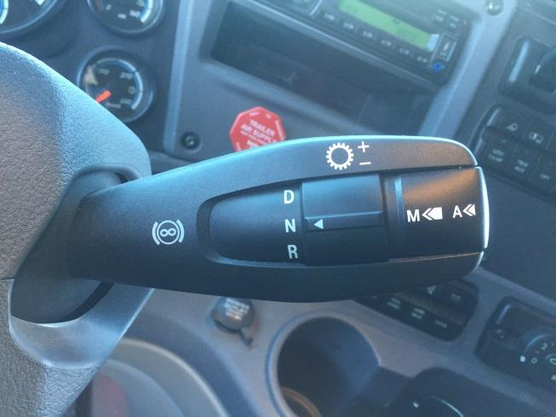
Automated Transmission
12 Forward gears
2 Reverse gears
Notes:
See website for more information:
https://demanddetroit.com/dt12transmission/

Slide 11
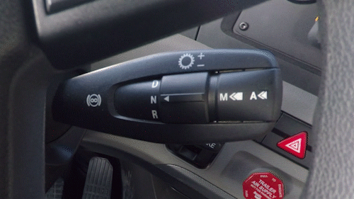
Automated Transmission
To activate manual mode, press and hold the selector for about 1 second at the end of the lever.
Notes:
An indicator in the on-board computer indicates the mode used by the driver.

Slide 12
Automated Transmission
To change gears: Lift lever for a upshift and push down the lever for a downshift.
Upshift
Downshift
Notes:
There are video links of different possibilities...

Slide 13
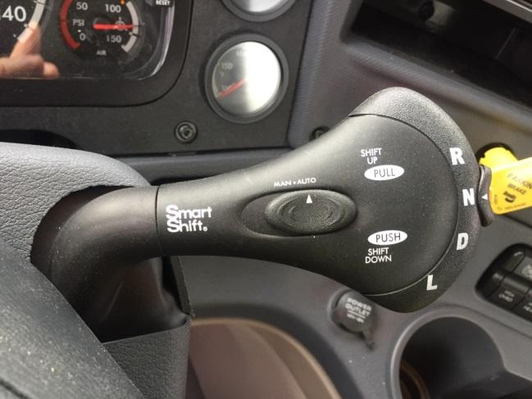
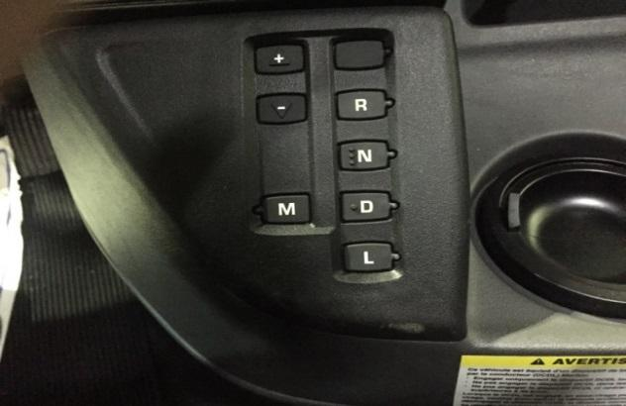
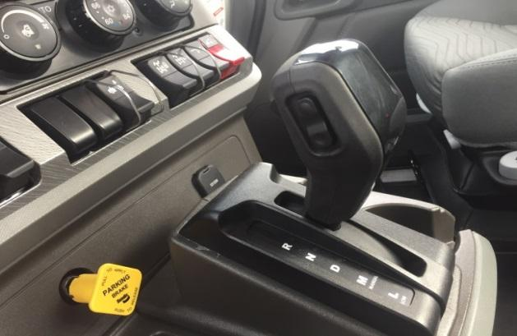
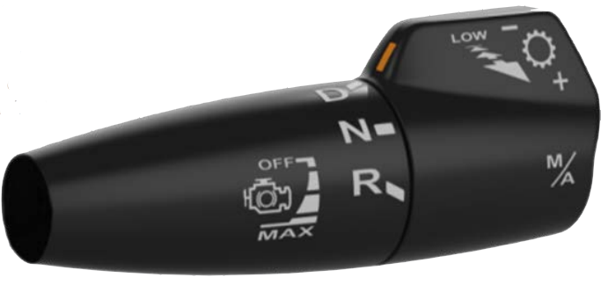
Automated Transmission
Ultra-Shift
Ultrashift Plus
Endurant
10,11,13,16 or 18 Forward gears
Up to 4 Reverse gears
Notes:
See website for more information:
http://www.eaton.com/Eaton/ProductsServices/Vehicle/Transmissions/heavy-duty-automated/index.htm

Slide 14
Automated Transmission
To activate manual mode press M
Notes:
An indicator on the on-board computer indicates the mode used by the driver.

Slide 15
Automated Transmission
To change gears manually, press + to upshift and - to downshift.
Notes:
Access is more difficult than using a lever.

Slide 16
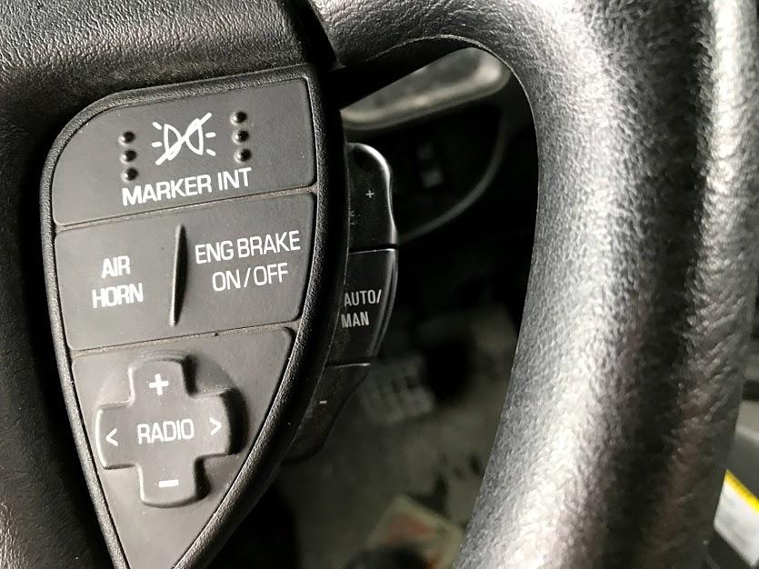
Automated Transmission
In addition, some vehicles even have controls on the steering wheel
Sign + for Upshift
Switch from: Manual or Automatic
Sign - for Downshifts

Slide 17
Automated Transmission
To activate manual mode, slide the button to the side of the desired mode.
Notes:
An indicator on the on-board computer indicates the mode used by the driver.

Slide 18
Automated Transmission
To manually change gears, you have to lift the lever for a upshift and push the lever for a downshift.
LOW mode can be used to lock a gear if necessary.

Slide 19
Automated Transmission
To activate manual mode, place the lever to the M position

Slide 20
Automated Transmission
To change gears in manual mode, use the button on the side of the lever.
Upshift gears
Downshift gears

Slide 21
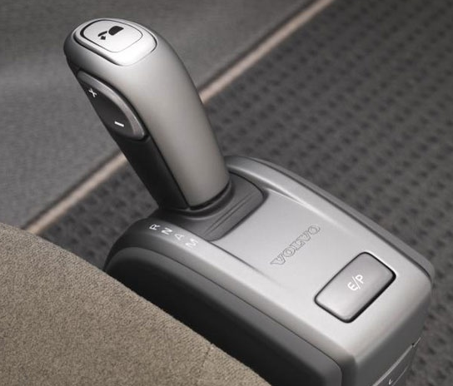
Automated Transmission
(Volvo Trucks)
12 to 14 Forward gears
2 Reverse gears
Notes:
See website for more information:
https://www.volvotrucks.ca/fr-ca/powertrain/i-shift-transmission/

Slide 22
Automated Transmission
To operate the manual mode, place the lever or press the button to the M position.

Slide 23
Automated Transmission
To change gears in manual mode, use the button on the side of the lever or the buttons on the dashboard.
Upshift gears
Downshift gears
Mode Eco/Performance

Slide 24
Automated Transmission
Mack
(Mack Trucks)
12 to 14 Forward gears
2 Reverse gears
Notes:
See website for more information:
https://www.macktrucks.com/powertrain-and-suspensions/transmissions/mdrive/

Slide 25
Automated Transmission
To activate manual mode, press the M button.

Slide 26
Automated Transmission
To change gears in manual mode, press + to upshift gears and - to downshift gears

Slide 27
Automated Transmission
It is suggested by manufacturers to operate automated transmissions in the automatic mode for optimal use. The programming offered by the manufacturers is related to the use of the engine specifications.

Slide 28
Automated Transmission
Some examples when manual mode may be used:
To set in motion on a slippery surface to prevent the wheels from spinning. (Selecting a higher gear will reduce torque and will help get the truck to move easier)
To make sure enough torque is used when going up a slope on a slippery surface.
Driving in wintry (snowy and icy) conditions.
For optimum engine speed management on long steep slopes.
Notes:
See the following video for more explanation.
https://www.youtube.com/watch?v=Pf4iSpSC4hs&t=2s

Slide 29
Automated Transmission
Automated transmissions usually have a performance mode option. These modes can be used when additional power is needed. Several companies override this mode for the sake of fuel economy.

Slide 30
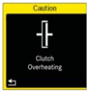
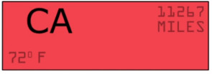
Automated Transmission
Attention: Be aware of indications when the clutch is overworked. Clutch Abuse or Clutch Overheating
Notes:
See video for more explanation.
https://www.youtube.com/watch?v=bJ1i5Bvujbg&list=PL_t8JD78rP4HItbWn8Rft2IFGLLkAbQTp&t=19s&index=5

Slide 31
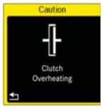
Automated Transmission
When these indicators come on in the instrument panel (display), it means that the clutch is overheating and the clutch may stop working. A protection system can than momentarily disengage the clutch, to allow it to cool. It will therefore be impossible, under these conditions, to move the truck.
Notes:
See the following video for more explanation:
https://www.youtube.com/watch?v=bJ1i5Bvujbg&list=PL_t8JD78rP4HItbWn8Rft2IFGLLkAbQTp&t=19s&index=5

Slide 32
Use: Recommended operating methods of an automated transmission to prevent overuse and overheating.
When driving at a very low speed, especially loaded, avoid constantly pressing and releasing the accelerator. Use the programmed low speed control mode instead or choose a low gear.
During prolonged stops, reduce staying in gear. Instead use neutral.
When waiting to set the truck in motion on a slope, do not use the accelerator to prevent the vehicle from moving. Always apply the service brake pedal.
When the vehicle is in reverse and you need to go forward, first use the service brake pedal to stop the vehicle and than return to the accelerator.
Always respect the GCW (Gross Cargo Weight) established by the manufacturer. Some transmission versions like the DT-12 Direct Drive, has a maximum GCW of only 36 300 kg or 80000 lb

Slide 33
Automated Transmission
Automated transmissions also allow the use of new technologies such as:
Adaptive cruise control
Predictive cruise control
Engine brake control while using the cruise control
E-Coast
Multiple programmations
Lots of development possibilities to make vehicles more and more autonomous
Notes:
Important : All these technologies should be used when road conditions permit.

Slide 34
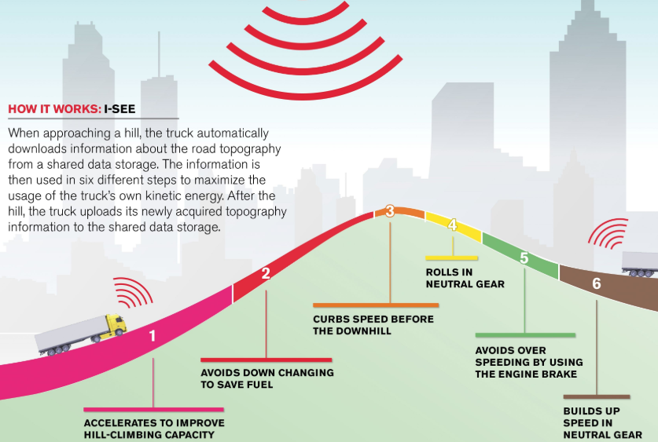
VOLVO I-SEE
Smart Cruise

Slide 35
Automated Transmission
Explanatory videos for enrichment.
Click on the link on our home page in the Ça roule platform.

Slide 36
Have Fun Practicing

